Slide 1
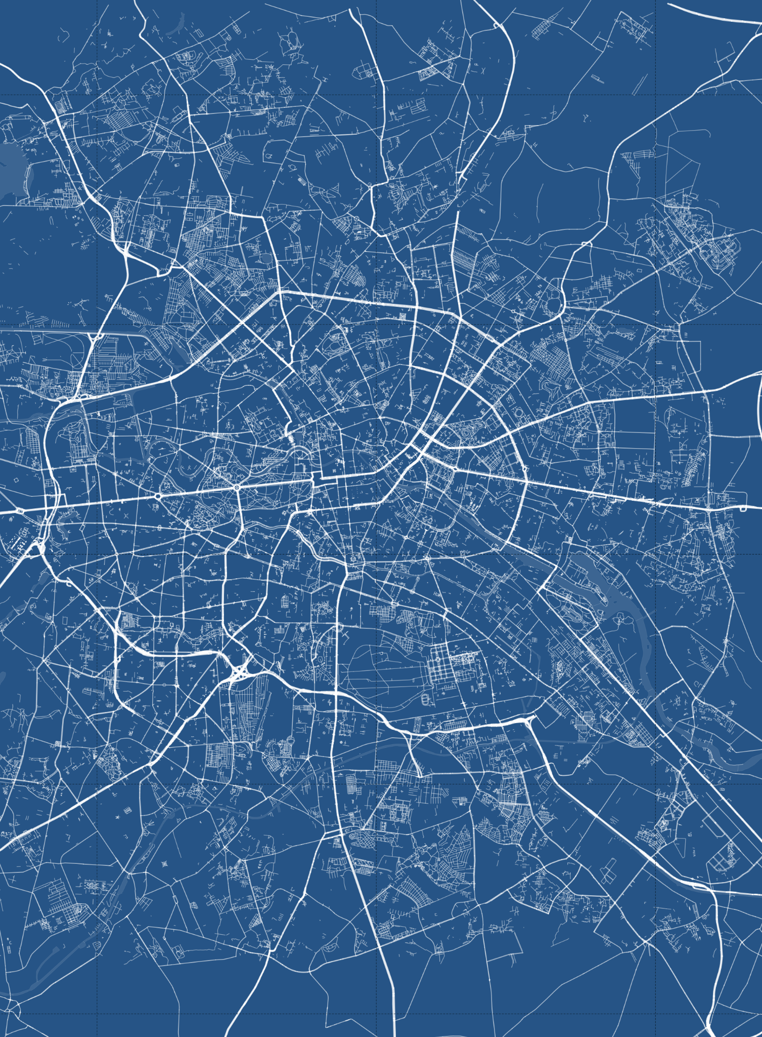
BERLIN
ALEMANIA
52°30'23.5"N / 13°08'40.4"E

