Slide 1










Socios Clave
Actividades Clave
Propuesta de Valor
Relación con Clientes
Segmento de Clientes
Recursos Clave
Canales
Estructura de Costes
Fuentes de Ingresos

Slide 3
Premast Business Model Canvas
Designed for:
Designed by:
Who are our Key Partners?
Empresas y escuelas desde preparatoria hasta universidad
Who are our key suppliers?
No contamos con proovedores
Which Key Resources are we acquiring from partners?
La experiencia y los usuarios para dar las clases
Which Key Activities do partners perform?
Implementar asesorias y dar cursos para los becarios o recien egresados
motivations for partnerships:
Reduction of risk and uncertainty
Acquisition of particular resources and activities
What Key Activities do our Value Propositions require?
Sesiones online para mejorar su programacion
Our Distribution Channels?
Clases online wifi
Customer Relationships?
Si se escucharan sus propuestas para mejoras
Revenue streams?
Comision por clase realizada del 5%
What value do we deliver to the customer?
El proporcionar clases para mejorar en programar
Which one of our customer’s problems are we helping to solve?
Programar de major manera y mas facil
What bundles of products and services are we offering to each Customer Segment?
Ciberseguridad, paginas web
Which customer needs are we satisfying?
Clases desde casa y proyectos a future en los capacitados para empresas
What type of relationship does each of our Customer Segments expect us to establish and maintain with them?
Clientes frecuentes y nuevos
Which ones have we established?
Nuevos
How are they integrated with the rest of our business model?
Canal de distribucion, fuentes de ingreso y valor del cliente
How costly are they?
No pasaran de 100 pesos al mes por persona
For whom are we creating value?
Empresas y escuelas que quieran proporcionar herramientas a sus estudiantes
Who are our most important customers?
Niche Market
Diversified
Multi-sided Platform
What Key Resources do our Value Propositions require?
Sesiones online
Our Distribution Channels?
Clases online mediante wifi
Customer Relationships?
Se escucharan sus propuestas para mejorar
Revenue Streams?
comision por clase realizada del 5%
Through which Channels do our Customer Segments want to be reached?
Sitio web y app
How are we reaching them now?
Redes sociales
How are our Channels integrated?
Recopilacion de datos y campañas multicanal
Which ones work best?
Recopilacion de datos
Which ones are most cost-efficient?
Campañas multicanal
What are the most important costs inherent in our business model?
Mantenimiento, publicidad, promocion, horarios de instructor, formas de pago
Which Key Resources are most expensive?
Los asesores o impartidores de clases
Which Key Activities are most expensive?
Clases
For what value are our customers really willing to pay?
El aprender a programar y poder entender los fundamentos
For what do they currently pay?
Para poder pagar a los instructores
How are they currently paying?
Tarjeta de credito o debito
How would they prefer to pay?
Tarjeta o por sucursales (oxxo)

Slide 4
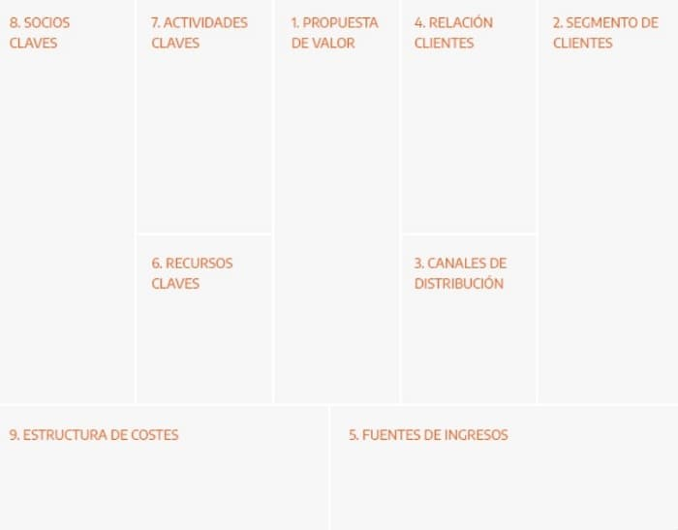
EJEMPLO 1

Slide 5
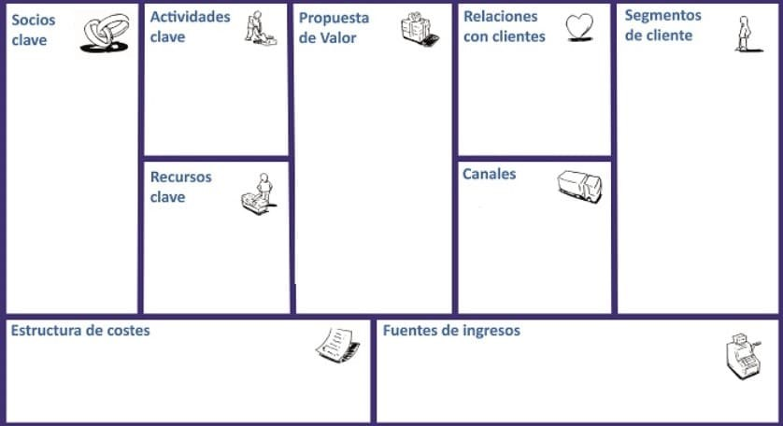
EJEMPLO 2

Slide 6

ICONOS

Slide 7









































Slide 8





