Slide 1
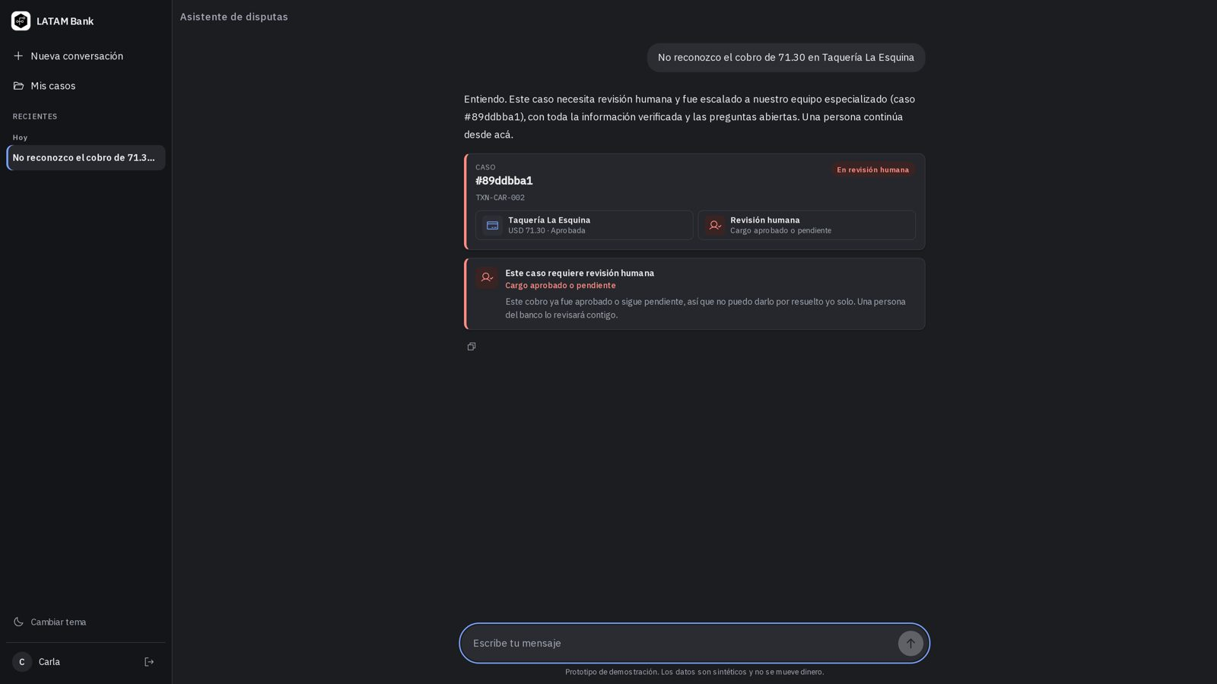
LATAM Bank dispute assistant
bitcoders
Factored AI & Data Hackathon 2026
handoff.app
Fast where it is safe, human where it matters.
Spanish · Portuguese
Synthetic data
Built on a synthetic LATAM Bank dataset
Notes:
Open with the customer, not the product: a charge at eleven at night that they do not recognize. The tagline is the single idea of the whole talk.

Slide 2
Most disputes are simple. A few are fraud. The hard part is knowing which is which.
LATAM Bank dispute assistant
02 / 06
THE PROBLEM
volume.csv
calls.csv
fraud.csv
4.4M
686k
0.10%
card transactions in the dataset
call-center interactions
of transactions are fraud, so a machine must not decide them alone
Source: LATAM Bank synthetic dataset (organizer). Contact reason explains resolution (AUC 0.76); fraud is not predictable from the data (AUC 0.49).
Notes:
Use the numbers to make the bank's side real. Keep the fraud rate tiny: it is why the assistant must hand the risky cases to a person.

Slide 3
A customer writes in Spanish or Portuguese. The assistant checks the policy and decides what it may close.
LATAM Bank dispute assistant
03 / 06
WHAT IT DOES
A declined or reversed charge, the only candidate, under USD 500. Closed in seconds, after the bank's record is read again.
RESOLVES ALONE
Zero or several candidates, or a missing detail. One question per turn, two rounds at most. It never guesses.
ASKS FIRST
An approved or pending charge, suspected fraud, USD 500 or more, or an unknown amount. The specialist gets the facts and the rule prepared.
HANDS TO A PERSON
Notes:
Walk through the three outcomes as the customer experiences them. The product's value is the middle card: the assistant chooses not to answer.

Slide 4
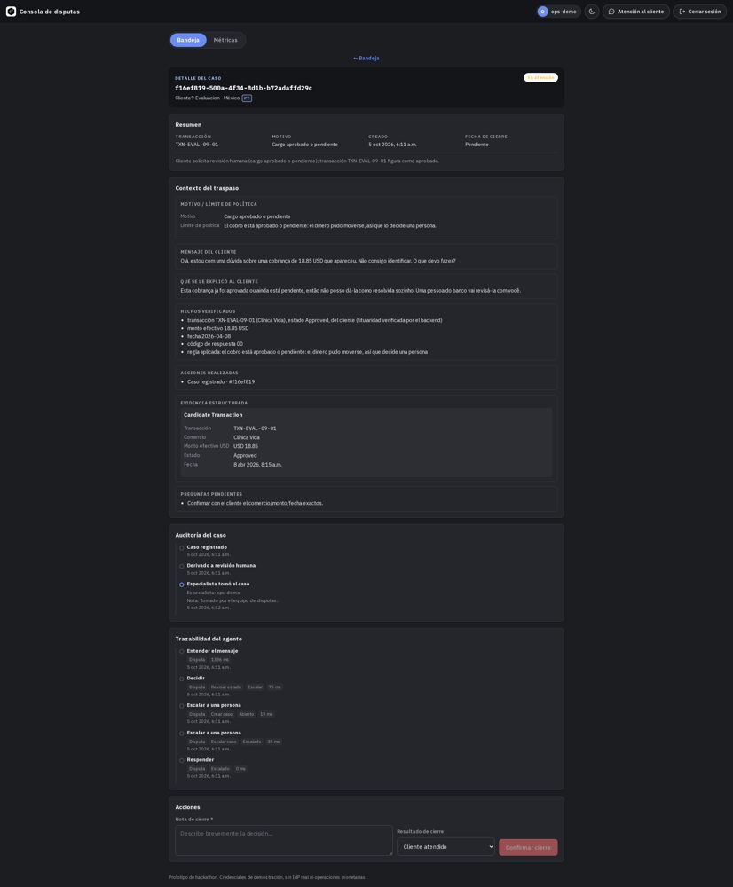
The model helps. The rules decide.
LATAM Bank dispute assistant
04 / 06
ARCHITECTURE DECISIONS
case.app
1
The policy is code, outside the model. The model classifies intent and drafts the reply; it never approves a resolution.
2
Data is reached only through a private backend that checks who is asking. The agent never queries the database directly.
3
It rereads the bank's record before it reports anything as done. Fraud labels are never an input.
LangGraph
FastAPI
dbt + PostgreSQL
Terraform on Google Cloud
Notes:
Three decisions: policy outside the model, data access behind a permission check, and verification after each action. Keep it to 20 seconds; the jury reads the repository for depth.

Slide 5
372 of 372
LATAM Bank dispute assistant
05 / 06
WHAT WE MEASURED
measures.csv
Measure (549 cases) | Without model | With model
Policy followed, disputes | 90.6% | 99.7%
Intent, blind set (228) | 49.1% | 100%
Latency p50 / p95 | — | 0.32 s / 0.42 s
Cost per case | 0 | 0.00093 USD
Test cases where it must not resolve alone, and it never did. A small sample never proves zero risk: the upper bound is about 1%.
Offline, on cases the team generated from synthetic data. Portuguese without the model: 82.8%, the weakest spot. Not a production measurement.
Notes:
Be explicit about the limit: 372 cases prove the pattern, not zero risk. Then say what would be needed to measure it on real traffic.

Slide 6
A prototype on synthetic data. The idea is ready to scale.
LATAM Bank dispute assistant
06 / 06
HONEST NEXT STEPS
Validate on real, de-identified traffic and real Portuguese messages
Add monitoring, access controls and retention before any live use
Keep a human on every approved charge and every suspected fraud
Fast where it is safe. Human where it matters.
Team bitcoders · Factored AI & Data Hackathon 2026
Notes:
Close on the tagline and the team name. Mention the repository and the live demo only if the submission page links them.

