Slide 1
Introducción a VTK

Slide 2
http://goo.gl/QLTehO

Slide 3
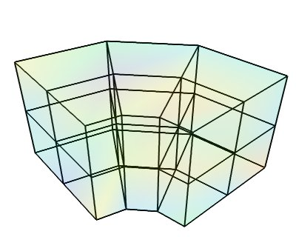
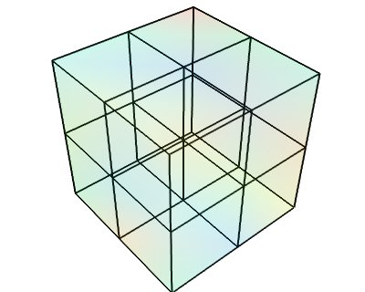
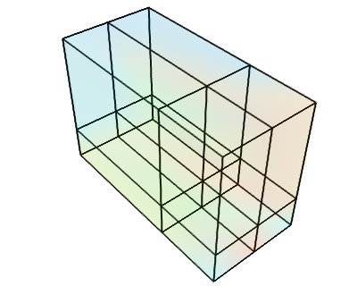
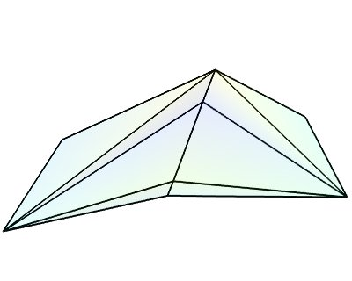
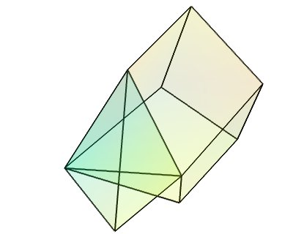
Estructuras
Image Data
Rectilinear Grid
Structured Grid
PolyData
Unstructured Grid
http://docs.enthought.com/mayavi/mayavi/data.html

Slide 4




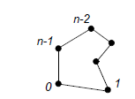

Polydata
(λ_{0, λ1, λ2,)}
λ
(x,y,z)
Point Data
Points
Array
(i_{0, i1, i2, i3,i4, … ,in)}
Cells
Cell Data
…

Slide 5
Filtros
Input Data
Output port
Data
Input Connetion

Slide 6
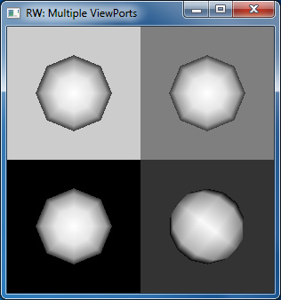
Sistema
RenderWindow
Renderer
Actor
RenderWindowInteractor
http://www.vtk.org/Wiki/VTK/Examples/Cxx/Visualization/SideBySideViewports

Slide 7
Actores
Filtro u objeto
Mapper
Propiedades
Gráficas

Slide 8
Completo
Render Window
Renderer

