Slide 1
Introducción a VTK

Slide 2
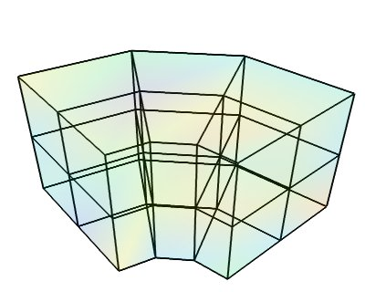
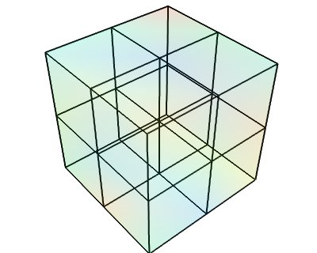
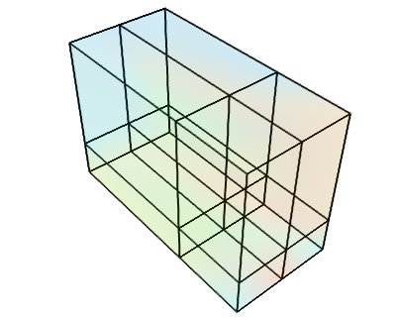
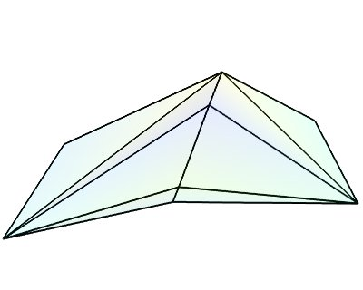
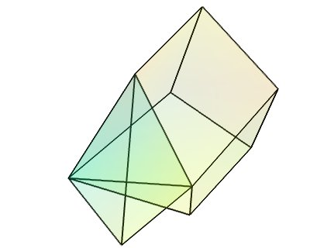
Estructuras
Image Data
Rectilinear Grid
Structured Grid
PolyData
Unstructured Grid
http://docs.enthought.com/mayavi/mayavi/data.html

Slide 3




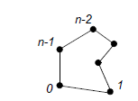

Polydata
(λ₀, λ₁, λ₂,)
λ
(x,y,z)
Point Data
Points
Array
(i₀, i₁, i₂, i₃,i₄, … ,i_{n})
Cells
Cell Data
…

Slide 4
Filtros
Input Data
Output port
Data
Input Connetion

Slide 5
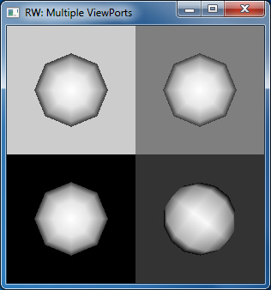
Sistema
RenderWindow
Renderer
Actor
RenderWindowInteractor
http://www.vtk.org/Wiki/VTK/Examples/Cxx/Visualization/SideBySideViewports

Slide 6
Actores
Filtro u objeto
Mapper
Propiedades
Gráficas

Slide 7
Completo
Render Window
Renderer

