Slide 1

THREADS.NET
https://www.threads.net/

Slide 2
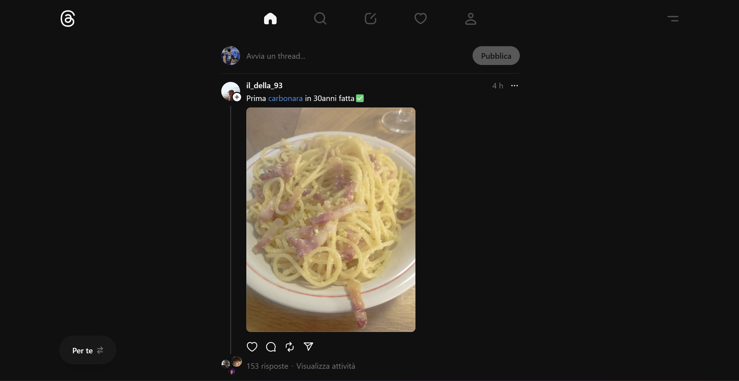
UI THREADS.NET FULL-SIZE

Slide 3
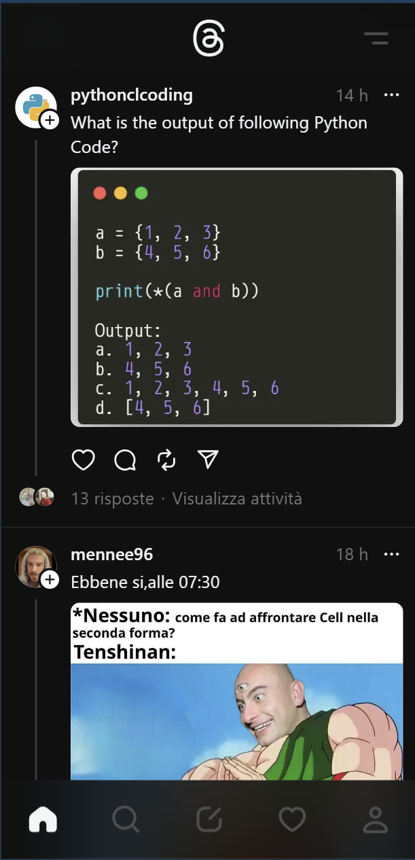
UI THREADS.NET MOBILE-SIZE

Slide 4

UI REPLICA FULL-SIZE

Slide 5

UI REPLICA MOBILE-SIZE

