Slide 1

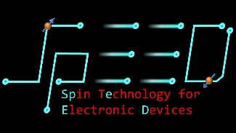
Project:
Skyrmion Machine Learning
Summary:
Implementing machine learning for characterization of magnetic properties
Name: Nicholas Tey
Date: 15 Aug 2019

Slide 2


Motivation
To develop a method to characterise a material’s magnetic properties (A, D etc) for quick identification and selection of materials with suitable properties
AIM:
Current Techniques
Limitations
Experimental approach:
Brillouin light scattering
Equipment prohibitively expensive
Analytical approach:
Discrete Fourier Transform
Speed and accuracy in characterising samples

Slide 3
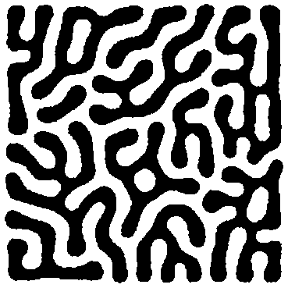
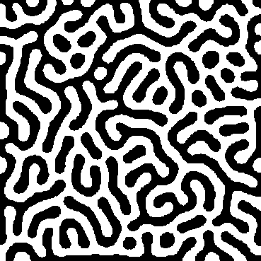
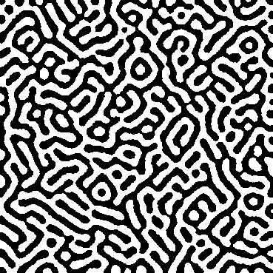
Objective
Training Data
Test Data
Proposal: Predict magnetic properties from…
Principal Component Analysis
Support Vector Regression
D = 1.75
D = 1.9
D = ?

Slide 4
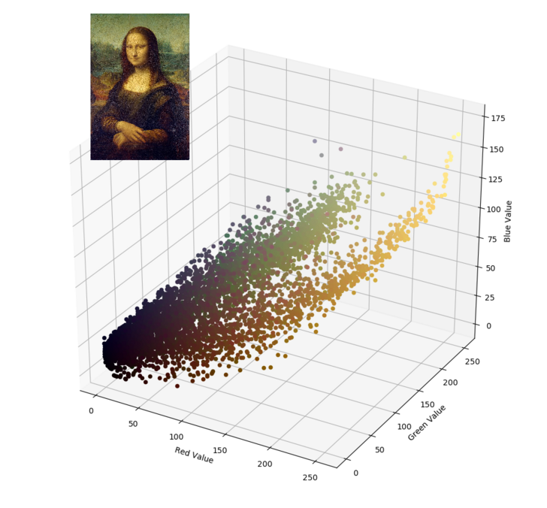
Principal Component Analysis (PCA)
Summary of PCA:
Captures multi dimensional information in fewer dimensions
Minimises information lost by discarding dimensions with lower variances

Slide 5
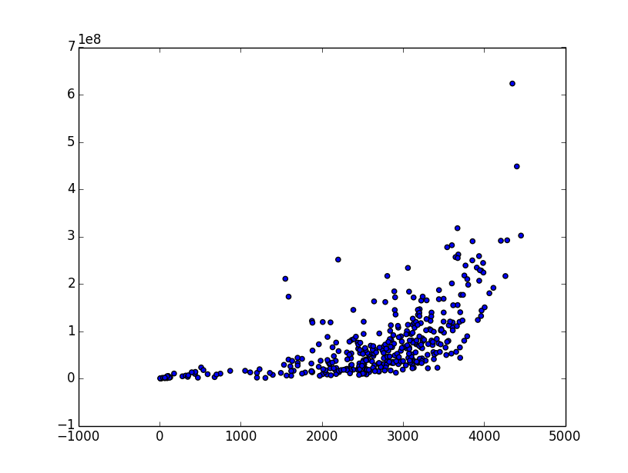
Support Vector Regression (SVR)
Summary of SVR:
Transforms data into a higher dimension, such that data can be mapped in a linear, continuous way
If converted back to lower dimensions, equivalent to a curved fit
Relatively high R^2 value

Slide 6
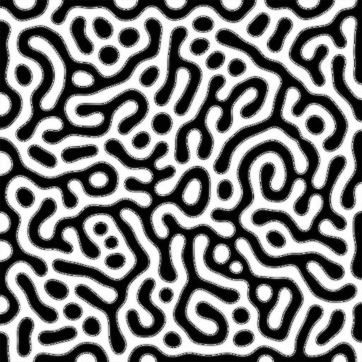
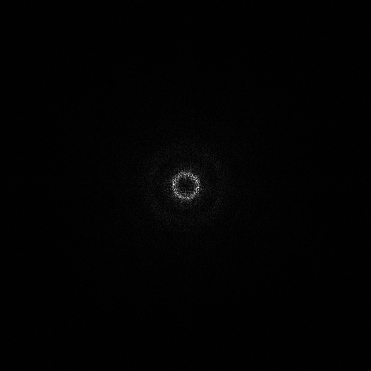
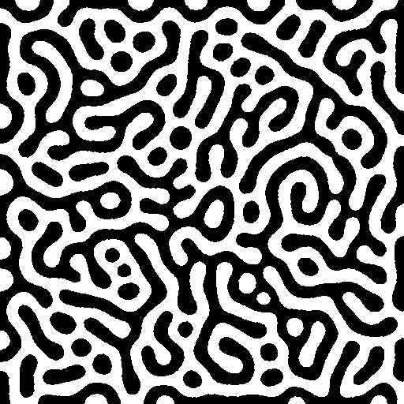
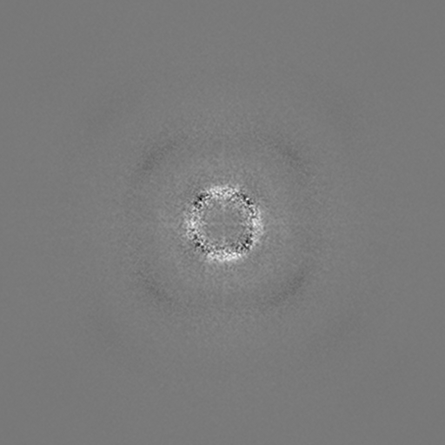
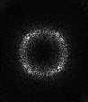

Overview: Data processing for SVR
Image generation
Image Processing
Fourier Transformation (FT)
Rough Scaling – max avg pixel value for given radius
Refined Scaling –pixel by pixel multi. w/ reference
High mean intensity
Low mean intensity
High Value
Low value
Example of an Eigenface
Find eigenface of magnitude of FT (Uses PCA)
Fourier Transformed Image
Raw Input Image
Binarised and Median Filtered Image

Slide 7
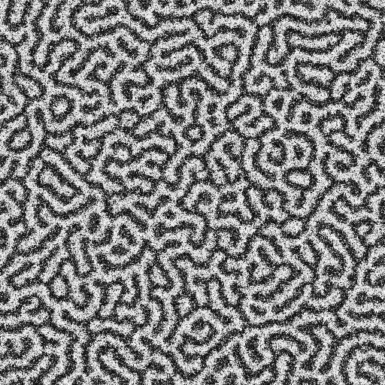
Step 1: Data Generation
Script: 01-GenerateMumaxSims-Modified.py, and others
Readme: README_0.txt
Key notes:
Generates images from non discrete values of A and D
Check for discrepancies in generated images. Reject those data points
Indication that relaxed image is correctly generated (refer to ReadMe)

Slide 8
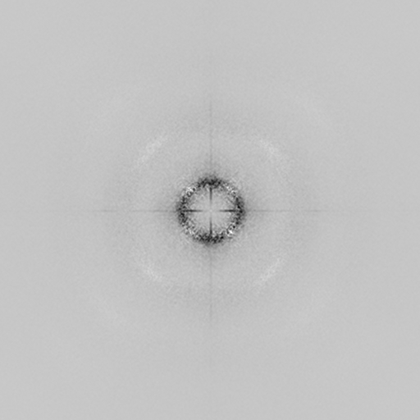
Steps 2-6: Data processing
Script: a0-Compiler.py and dependencies
Readme: README_1.txt
Key notes:
Performs 2 levels of scaling and generates eigenfaces
Check 3-Fitting Curves and 4-FS Scaled\Intensity Curves folders for failed fittings
Example of eigenface generated

Slide 9
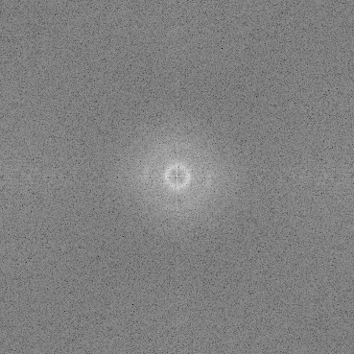
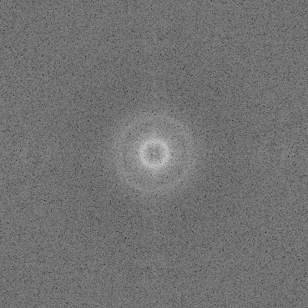
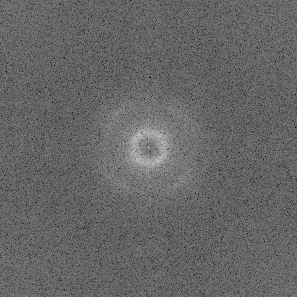
Relationship between scale in Fourier and real spcae
Inner White Ring
Small
Medium
Large
Fourier Transformed Images of (L), (M) and (H) simulation images
Size of inner white ring inversely related to periodicity

Slide 10
Step 4: Rough Scaling
Find centre pixel, and set a small distance from centre
Do a radial sweep and find average pixel values
Repeat step 2 iteratively with slightly larger dist. from centre
Method
Distance from centre
Radial Sweep
Low mean intensity
High mean intensity
Low mean intensity

Slide 11
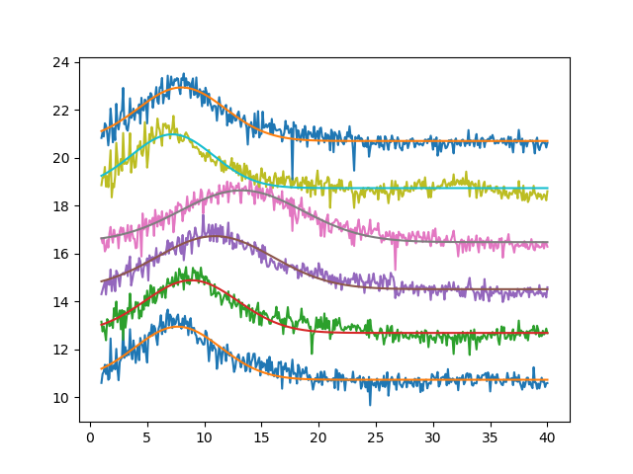
Step 4: Rough Scaling
Method
Plot average pixel value as distance from centre increases
Find distance of peak from centre and scale UP accordingly
Note: Minimal scaling is used and scale down is not done to reduce information lost.
Mean Intensity (with offset)
Gaussian Fits applied
Radial sweep distance from centre (pixels)

Slide 12
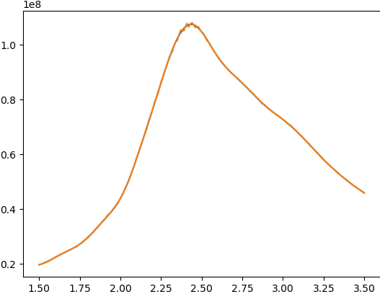
Step 5: Refined Scaling
Defined square area around centre of img is matrix multiplied with same area in reference image (Large white circle)
Step 1 is repeated as the image is scaled up iteratively
Peak value obtained is compared and images are scaled UP
Method
Matrix multiplication value
Scale to reach fit with reference white circle compared and then normalised
Scale to reach optimum fit with reference white circle

Slide 13
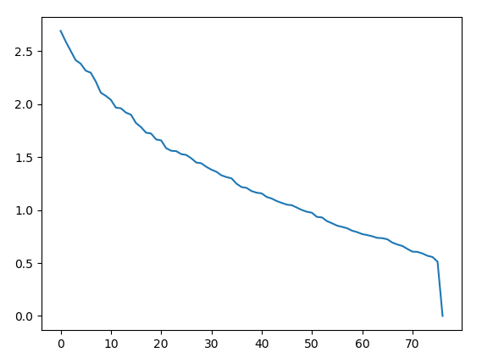
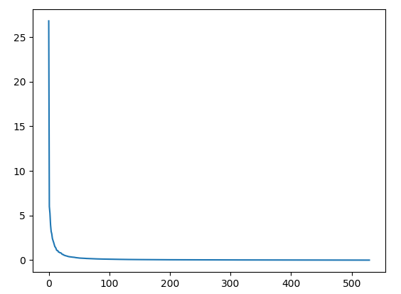
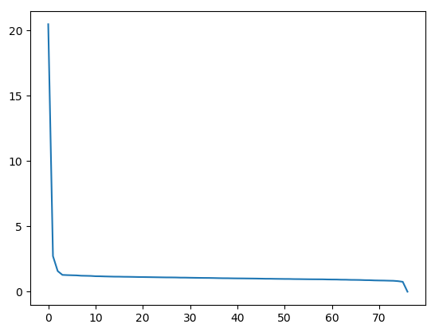
Note: PCA and variance ratio
Script: a7-PCA_Final.py
explained_variance_ratio_ from sklearn.decomposition.pca
Variance ratio (%)
Variance ratio (%)
Real Space
Fourier Space
Fourier space
(Scaled)
Eigenface Number
Eigenface Number
PCA must not be performed in real space because poor clustering results in the first 10 eigenfaces capturing very little data

Slide 14
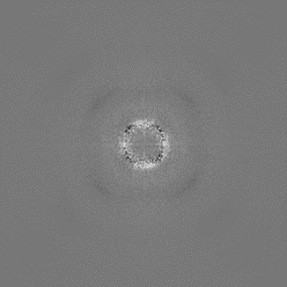


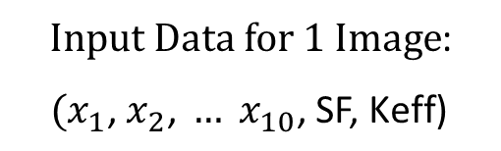
Overview: Implementation of SVR
Read images as pixels and their respective labels (K, A, D etc.)
Find the matrix projections (dot product) of an image on a fixed number of eigenfaces
$\left(\begin{matrix}i_{11} & i_{12} \\ i_{21} & ⋱\end{matrix}\right)∙$ $\left(\begin{matrix}a_{11} & a_{12} \\ a_{21} & ⋱\end{matrix}\right)=x_{1}$
Construct input data and (Optional) append scaling factor and value of Keff
$\left(\begin{matrix}i_{11} & i_{12} \\ i_{21} & ⋱\end{matrix}\right)∙$ $\left(\begin{matrix}b_{11} & b_{12} \\ b_{21} & ⋱\end{matrix}\right)=x_{2}$
$$⋮$$
$\left(\begin{matrix}i_{11} & i_{12} \\ i_{21} & ⋱\end{matrix}\right)∙$ $\left(\begin{matrix}k_{11} & k_{12} \\ k_{21} & ⋱\end{matrix}\right)=x_{10}$
$Input Data for 1 Image$:
$$(x_{1}\text{,} x_{2}\text{,} … x_{10}\text{,} \text{SF}\text{, }\text{Keff}\text{)}$$
Randomly allocate images to either training or testing. Fit input data to labels and predict labels for test images
Scaled with refinement,
Fourier Transformed Image
Repeat step 4 (1000 times). Analyse results

Slide 15
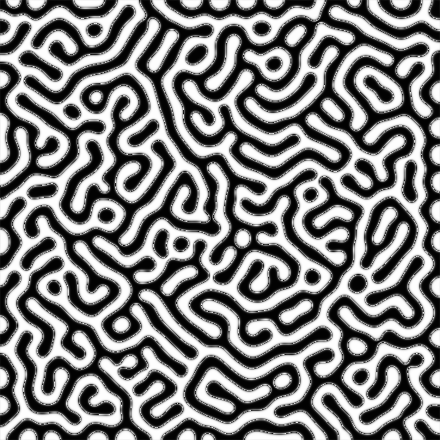
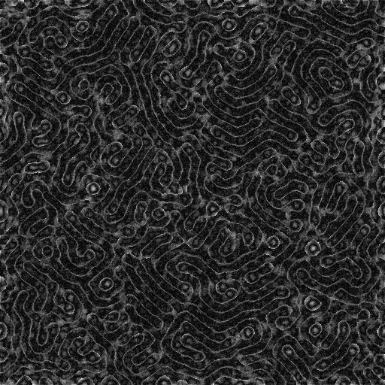

Method: Visual Interpretation of the input data
$Input Data for 1 Image$:
$$(x_{1}\text{,} x_{2}\text{,} … x_{10}\text{)}$$
Reconstruction of FT image, where E is a matrix:
$$\sum_{i=0}^{n}{x_{i}E_{i}}$$
Combines magnitude info from step 1 with phase info. Perform Inverse Fourier transform.
Reconstruction of Input Data (x₁, x₂, … x₁₀)
Original image generated by NSCC
Script: Recon_EF_Proj.py

Slide 16
Further insight into the values: x1 to x10
There exists some slight relationship between eigenface projection and final scale factor
Eigenface projection magnitude decays with eigenface number rapidly
Only first 10 eigenfaces used because after that magnitude is almost negligible
File: Eigen_projection_graph.xlsx

Slide 17
Steps 1-5: Support Vector Regression
Script: SVR.py
Readme: README_2.txt
Key notes:
Appending Keff and scaling factor useless unless their magnitude is increased
Hyperparameters (gamma, epsilon and C) are slightly different for each dataset
Example of eigenface generated
Different labels have a large impact on result accuracy

Slide 18
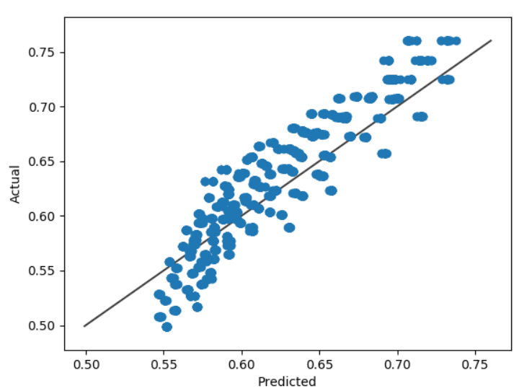
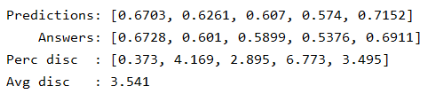

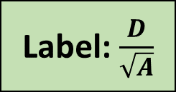
Results & Discussion
Input Data:
125 33J Images
Label: $\frac{D}{\sqrt{A}}$
Result of 1 iteration
Overall Result

Slide 19
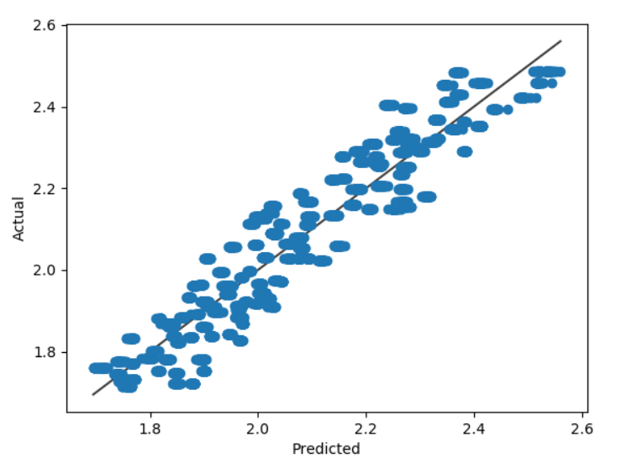

Results & Discussion
Input Data:
125 33D
Label: $D$
Quick Statistics
Average discrepancy: 2.9%
Worst discrepancy: 9.4%
Discrepancies > 5%: 895/5000

Slide 20
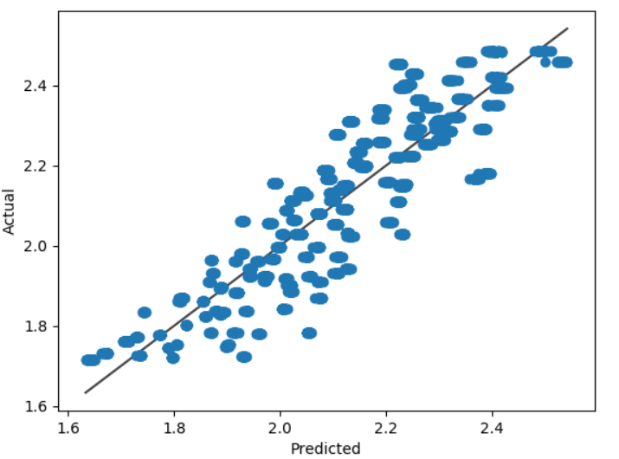


Significance of PCA in SVR
Average discrepancy: 3.8%
Average discrepancy: 2.9%
Discrepancies > 5%: 1266/5000
Discrepancies > 5%: 895/5000
Worst discrepancy: 15.7%
Worst discrepancy: 9.4%
Using refined scale factor only (i.e. without PCA)
Using 10 eigenface projections (i.e. with PCA)
Input Data:
125 33D
Label: $D$
Input Data:
125 33D
Label: $D$

Slide 21
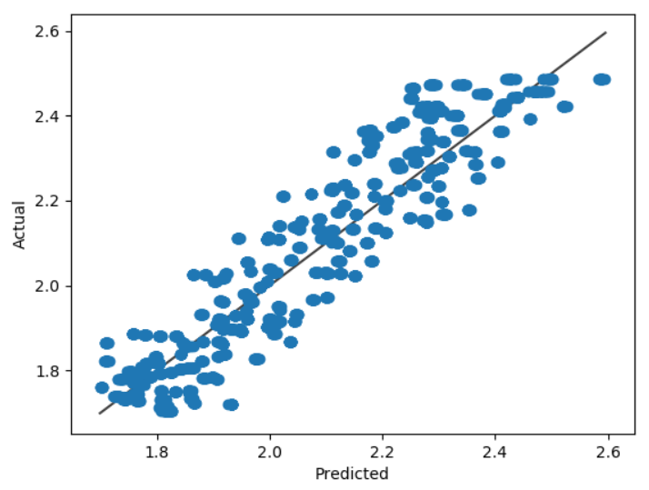
Introducing samples with different Keff
Input Data:
100 33M, 100 33D
Label: $D$
Quick Statistics
Average discrepancy: 3.5%
Worst discrepancy: 12.4%
Discrepancies > 5%: 1561/5000

Slide 22
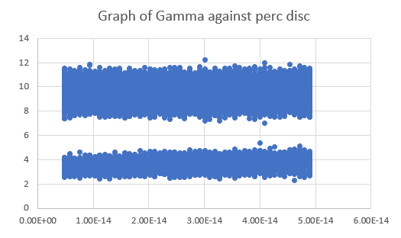
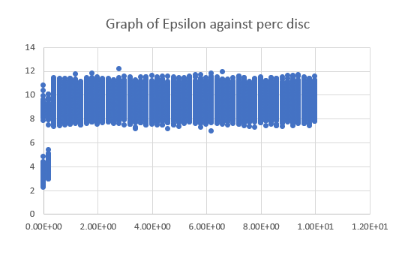
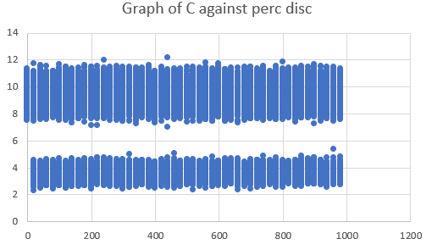
Grid graph scanning: Broad hyperparameters sweep
Percentage Discrepancy (%)
Percentage Discrepancy (%)
Percentage Discrepancy (%)
C
Gamma
Epsilon
Scripts: OptimiseSVR.py,
NSCC Test.py
Key notes:
Parameters:
20 Manifold
125 33D
12500000 Tests
(Using NSCC)
Epsilon should be small
There exists many combinations of hyperparameters that give good results

Slide 23
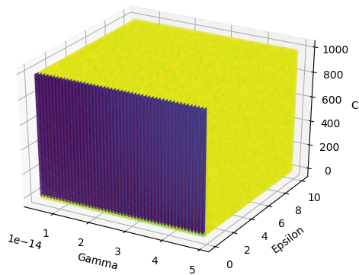
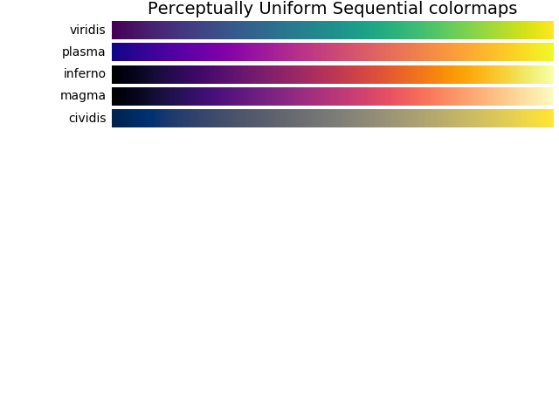
Grid graph scanning: Broad hyperparameters sweep
Scripts: Plot_4D_Graph
Low Perc Disc (2.5-3%)
High Perc Disc (9-10%)

Slide 24
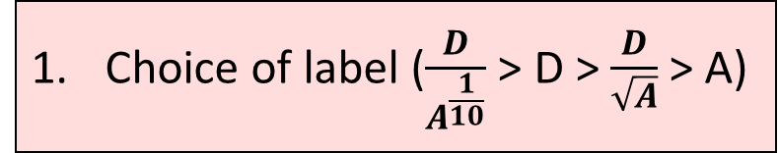
Factors affecting percentage discrepancy:
Choice of label ($\frac{D}{A^{\frac{1}{10}}}$ > D > $\frac{D}{\sqrt{A}}$ > A)
Appended Keff and scaling factor, if multiplied by a sufficiently large constant
Number of training samples – For a given range of A and D
Hyperparameters - Many combinations can yield roughly the same results
Note: Point 5 is not well understood, because hyperparameters need to be retuned substantially to gauge accuracy accurately (Retuning has not been tested extensively)
If SVR not trained with a specific type of sample like 33f, testing 33f samples will have lower acc

Slide 25
Testing experimentally determined images
Script: Standardise_Res.py
Note: Interpolation is sub par compared to paint!
Experimentally obtained images may have different resolutions compared to simulated data
(nm per pixel for simulated data = 4)
Successful approach:
Scale real space image to match resolution
Crop to 512x512 pixel
Use multiple images if scaled real space img is larger than 512x512 pixel
Take the average of the predicted values
Failed approach:
1) Perform Fourier Transform on img
2) Add zero padding
3) Interpolate zero padded, FT image
Probable cause of failure: Ring not so well defined in experimental image, surrounding specs of grey spots non-trivial and cannot be replaced with zero padding.

Slide 26
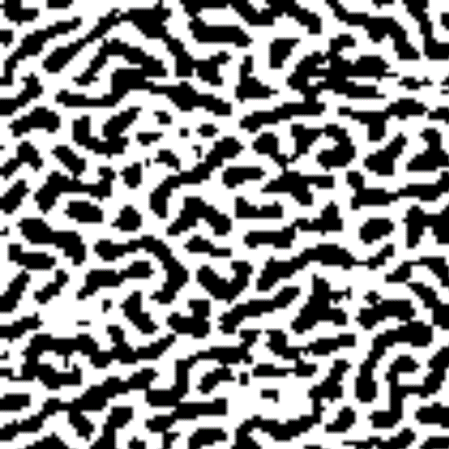
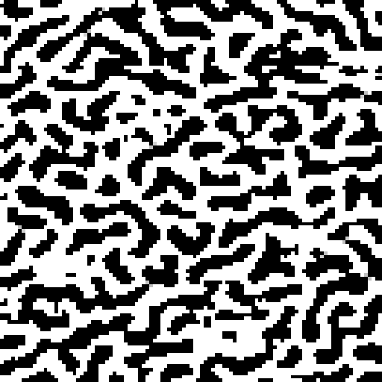
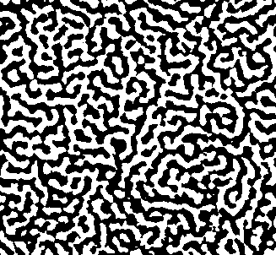
A note on interpolation
Magnification Scale: 2.85 times
Applicable to:
Testing on experimentally determined images
2) When performing rough scaling, refined scaling
Need to Improve on current interpolation technique to reduce information lost
Cubic/linear/lanczos interpolation using cv2 library
Interpolation with paint

Slide 27
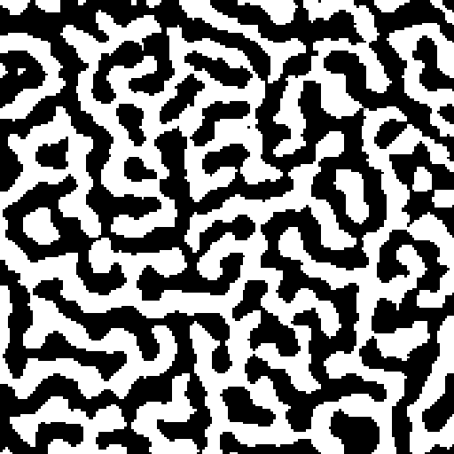
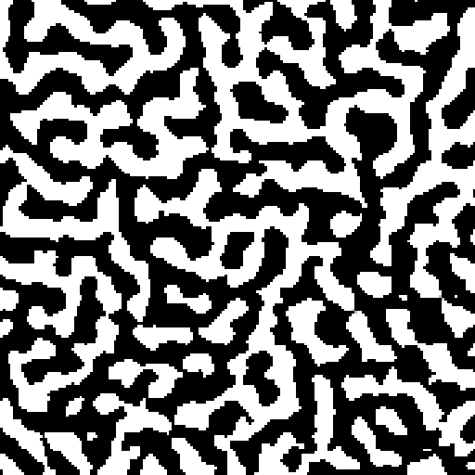
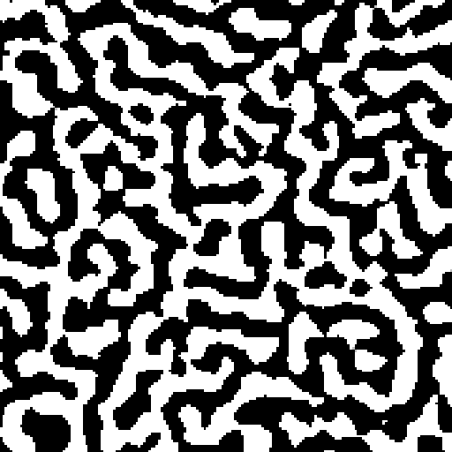
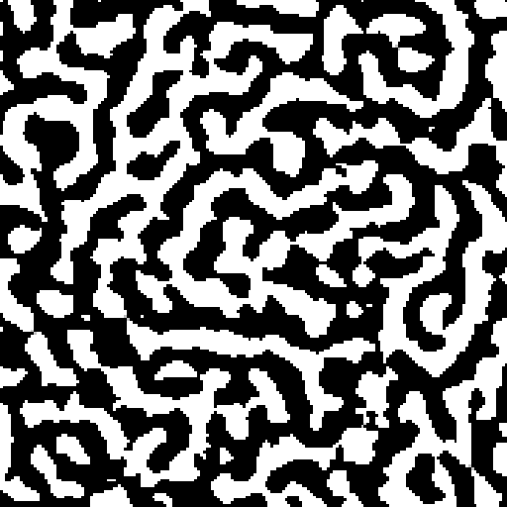
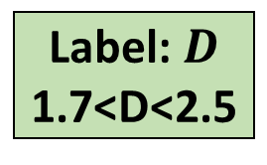
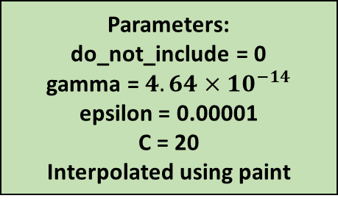
Experimental data prediction (26 and 33 series)
Test Data:
MTXM: 26j, 26m,
MFM: 33d, 33f, 33j, 33m
Parameters:
do_not_include = 0
gamma = $4.64×{10}^{−14}$ epsilon = 0.00001
C = 20
Interpolated using paint
Training Data (Simulations):
100 33M, 100 33D 93 33J
Label: $D$
1.7<D<2.5
33D
1.87
2.01
1.89
1.89
Average D = 1.92
33F
2.41
2.38
2.40
2.44
Average D = 2.41
33J
1.24
1.16
1.25
1.26
Average D = 1.22
33M
1.90
1.86
1.80
1.70
Average D = 1.82
Note: SVR had to extrapolate to obtain these values
26J
1.70
1.68
1.78
1.69
Average D = 1.71
26M
2.73
2.65
2.64
2.67
Average D = 2.67

Slide 28
A note on experimental predictions
Complications:
Predicted values “jitter” within a small range depending on hyperparameters.
Suggestion:
Find optimal hyperparameters for a range of known experimental data for accurate future prediction
Other observations:
It was found that a larger gamma (less overfitting) generally favourable if test data type is out of range of training data and extrapolation required

