Slide 1

Customer Support Challenge
Assessing the health of forests in Bhutan
through the use of satellite images
CSE: Diego Alarcón

Slide 2
Customer needs
How to valuate the health of forests?
Results in Cloud Optimized GeoTIFF (COG) format

Slide 3
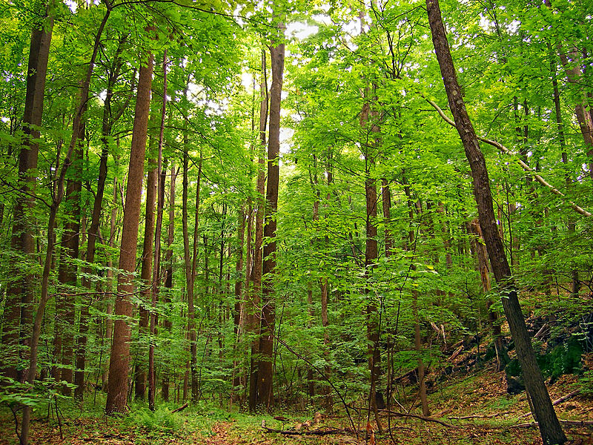
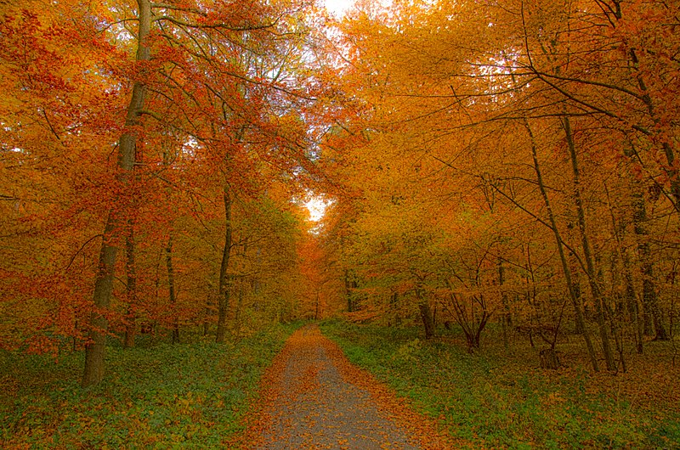
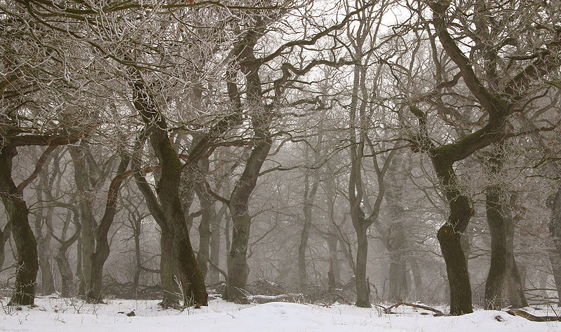
Forestry in Bhutan
Deciduous & Evergreen Species
Weather condition
Topography
Three deciduous forests shown summer, autumn and winter.

Slide 4
Possible solutions
NVDI, EVI & other Index
Time-Series (longer timeframe)
Mosaic from scenes
Modis
Sentinel-2 L2A
Spot & Pleiades (Specific places)

Slide 5
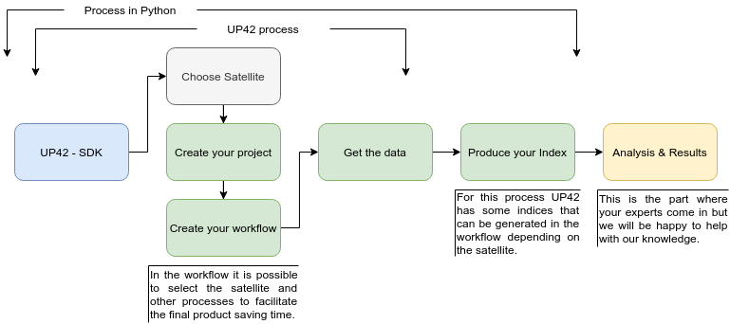
UP42 Service

Slide 6
Illustrative examples
GitHub - Challenge_up42
Python process with Sentinel-2 data
Sample on the web

