Slide 1



Slide 2
VIVA Project Dissertation Presentation Title Traffic Data Analysis Between Kent and London and the Implementation of Potential Solutions to Decrease the Amount of Traffic and Pollution on this Route by Diego Alves Id: 3036748 September - 2019

Slide 3
Agenda:
Project Miles Stone
Introduction
Research Aim
Research Objectives
Research Methodology
Demo
Future Works
Conclusion

Slide 4
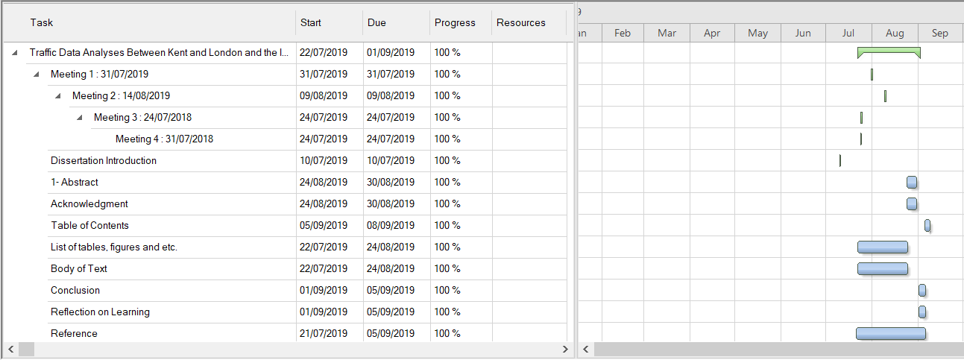
Project Milestone:

Slide 5
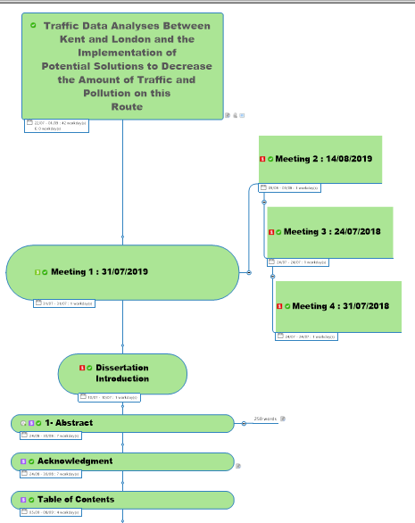
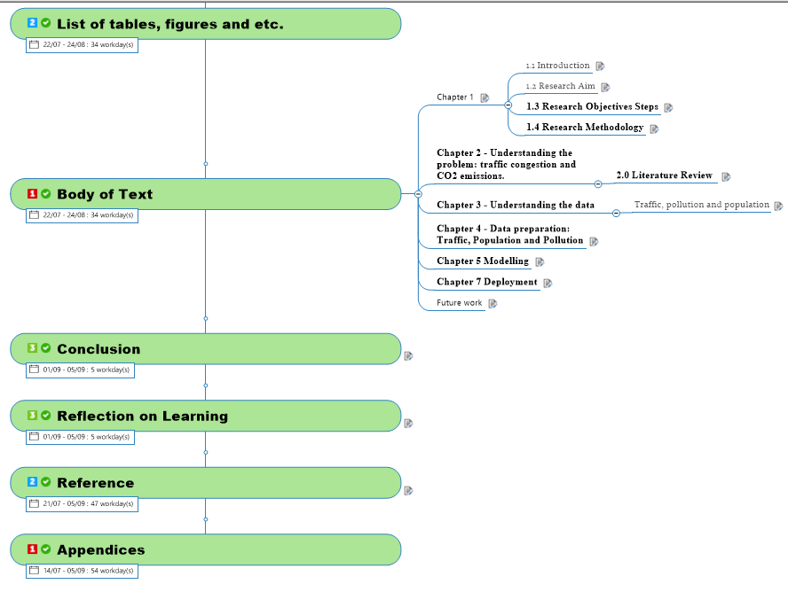
Milestone 2:

Slide 6
Introduction
Presentation of a project based on traffic data analysis, using Data Science methods to prove a conception that the traffic congestion and pollution can be improved.
How the approach solution to the research problem was conduct and how the software tools ware used to prove the project aim.

Slide 7
Research Aim
This thesis aims to demonstrate that it is possible to minimize CO₂ emissions and reduce the occurrence of traffic jams in between Kent and London by running computer simulations based on data science research.

Slide 8
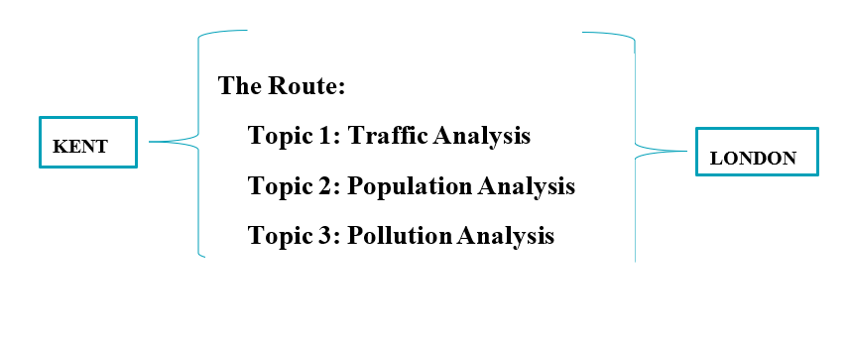
Research Objectives Select Datasets based on these topics:

Slide 9
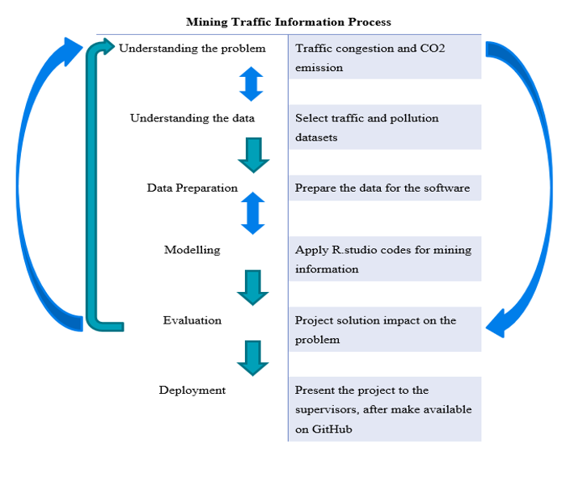
Research Objectives 2

Slide 10
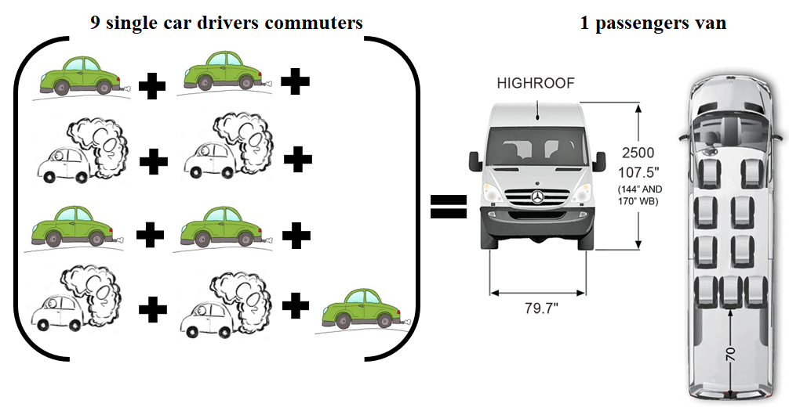
Research Objectives 2.1

Slide 11
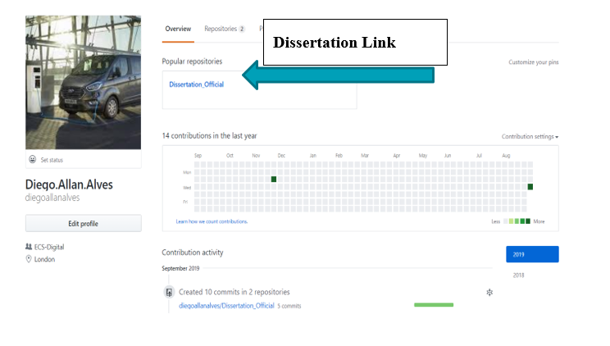
Research Objectives 3 Place the project on GitHub:

Slide 12



Research Methodology

Slide 13
Demo

Slide 14
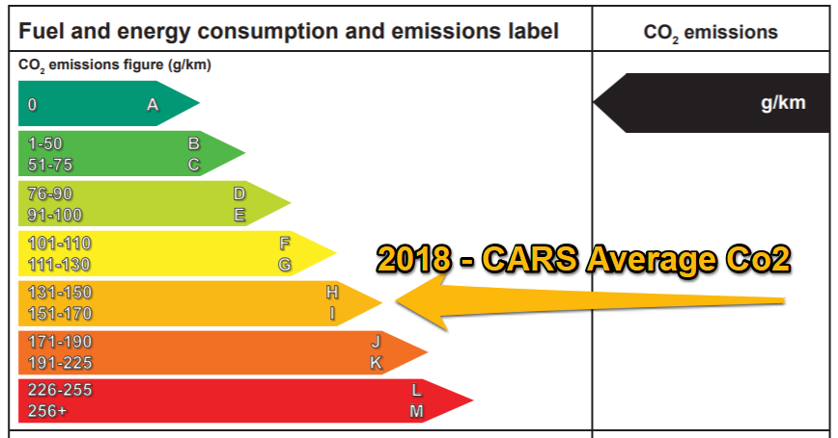

Slide 15
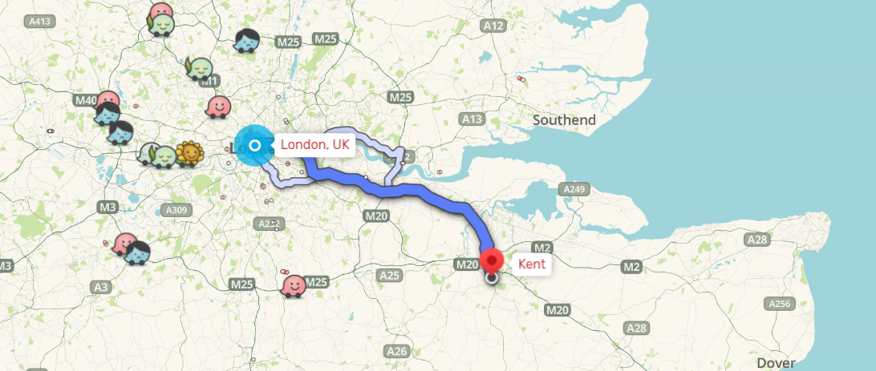
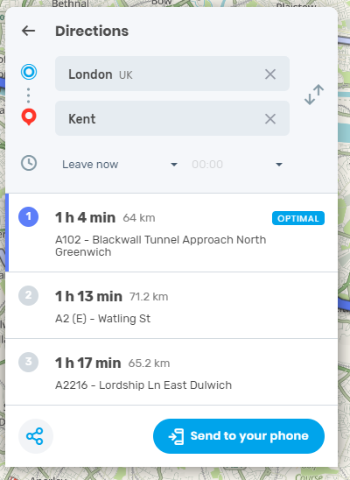
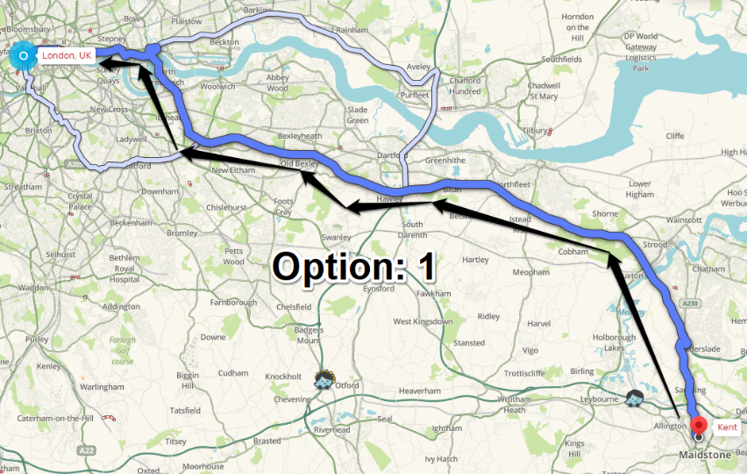

Slide 16
Future work
The next Census will be available in 2021. Then update the information.
Expand the analysis to more regions.
Improve the codes.
Present the project to the public, such as GitHub and other resources.
Present the idea to developers, such as transport organizations.

Slide 17
Conclusion
Data Science is changing the way information can be processed. The tools and techniques provided by the discipline have many advantages, such as mining information. The traffic example used in this project is one them. A simple analysis can make a significant change. Take for instance the passenger vans as an example. We have the data and the software tools to prove the concept that traffic and pollution could be decreased.
I really enjoyed this project because it was based on a real-life issue. Also I could present the data science tools that could convince business investors to see the traffic problem and realise that data analysis can support ideas to real-life issues that some people are not able to see.
Thank you
Diego Alves

