Slide 1
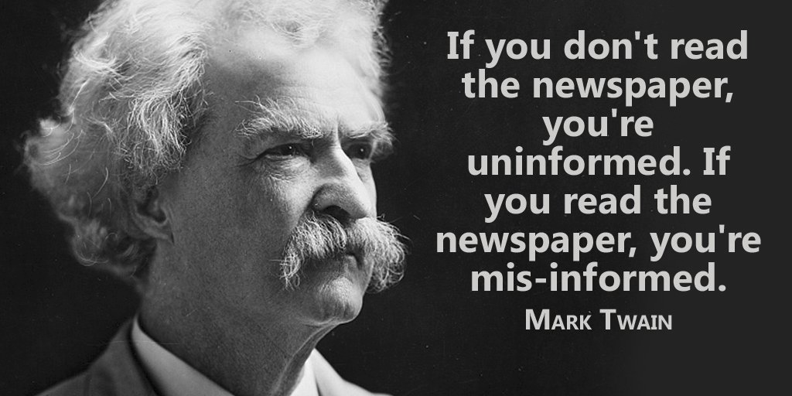
Fighting disinformation in tech news

Slide 2



Should we stay uninformed ?
Should we believe an “authoritative” source ?
Should we believe our feeds ?

Slide 3






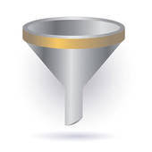

We can do all of this, but what about….
…. get information from several sources ?

Slide 4












For instance in tech ….
TECHCONTROVERSY.COM

Slide 5
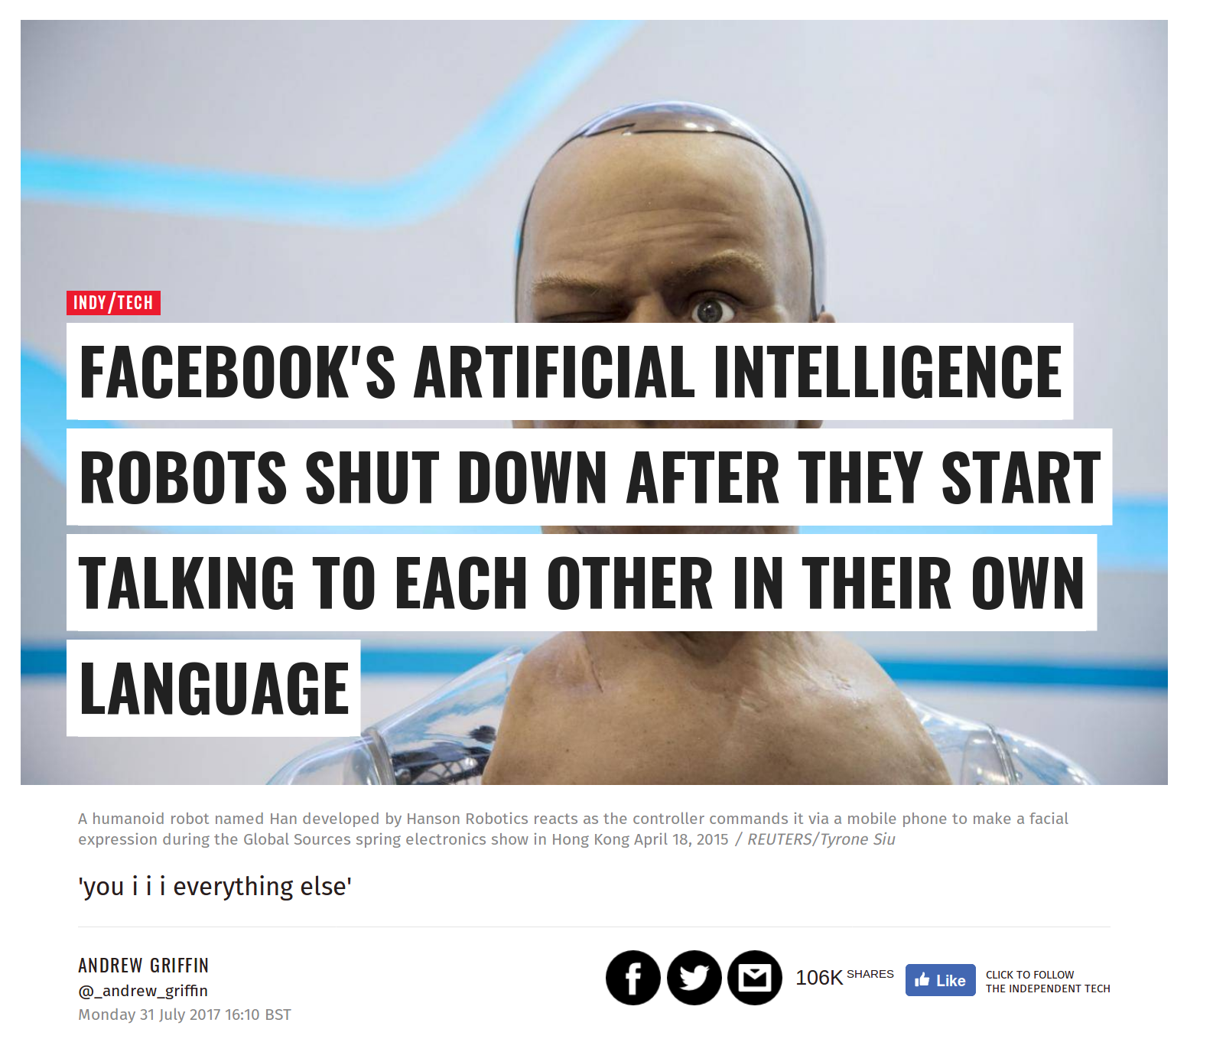
DISINFORMATION IN TECH NEWS?
Update: This article has been amended to stress that the experiment was abandoned because
the programs were not doing the work required, not because they were afraid of the results, as has been reported elsewhere.
Source : http://www.independent.co.uk/life-style/gadgets-and-tech/news/facebook-artificial-intelligence-ai-chatbot-new-language-research-openai-google-a7869706.html
SNOPE : https://www.snopes.com/facebook-ai-developed-own-language/

Slide 6
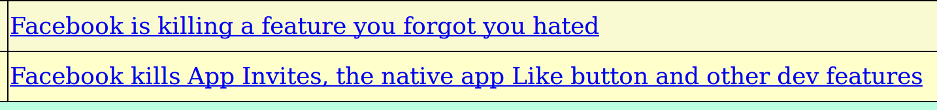
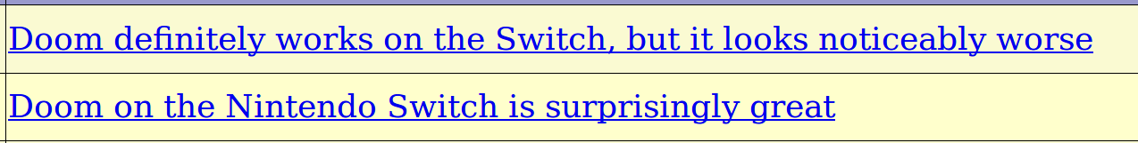
Controversy in Tech news

Slide 7
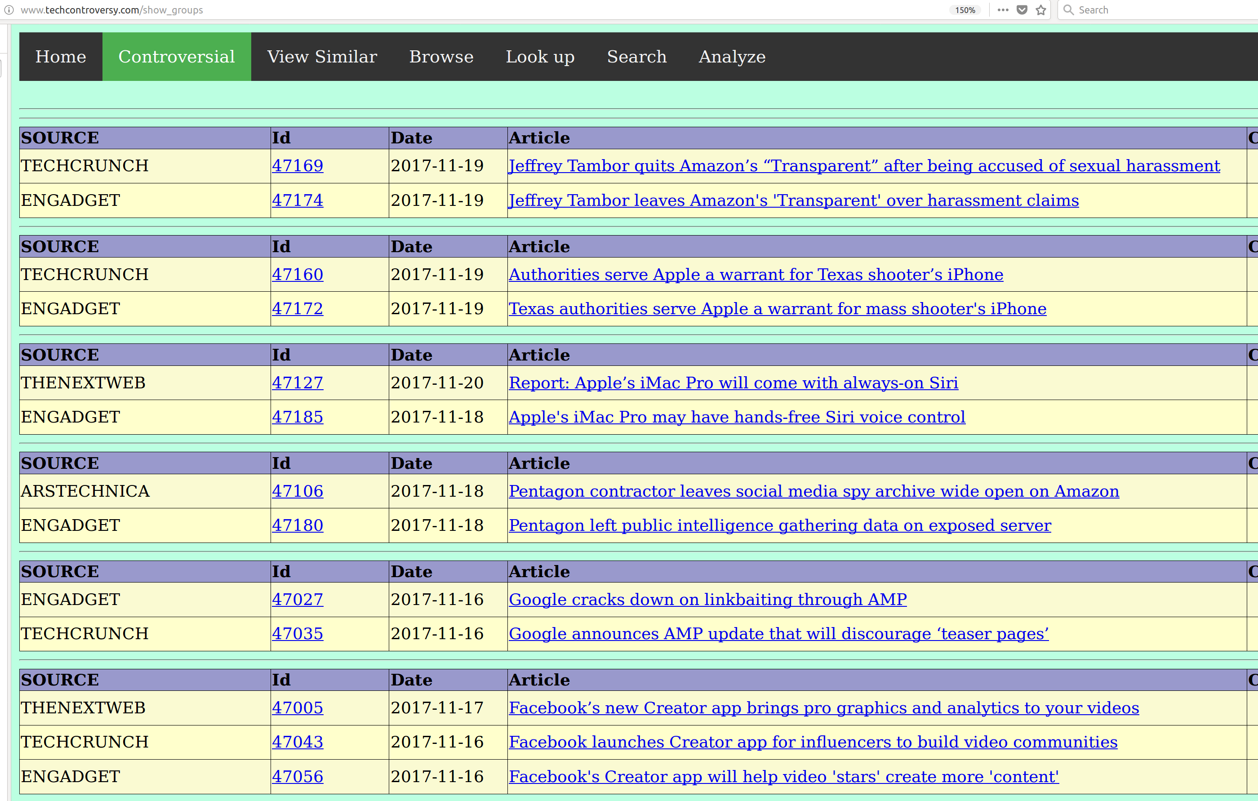
Let’s find controversy in tech...
http://www.techcontroversy.com/show_groups
http://www.techcontroversy.com/show_groups

Slide 8
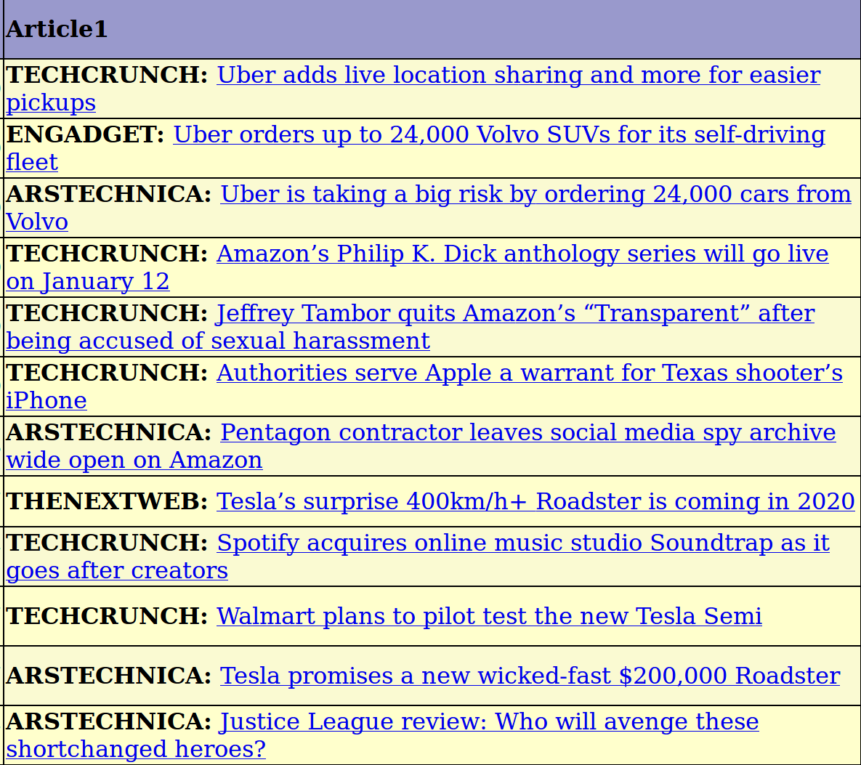
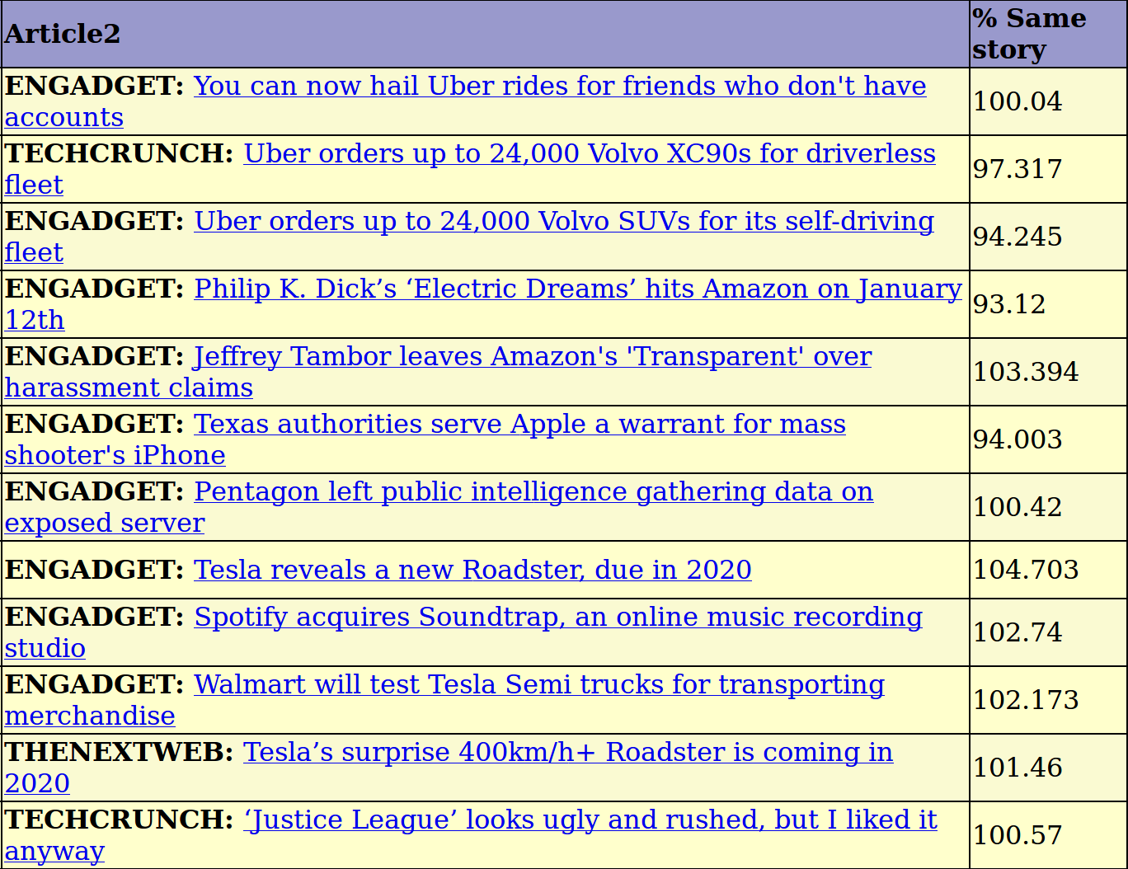
Probability “same story”
http://www.techcontroversy.com/duplicates
We look for articles close in time and calculate the probability that they relate the same story.

Slide 9

1. Retrieving the articles
Admin panel
Tech portals
Database
scraping
Around 50.000 articles all from the year 2017, mainly from following portals

Slide 10
Complexity
- The complexity of comparing each article with each other article is quadratic
- (2-combination over a set of 50k) → around 1.25 billions
- Therefore it is necessary to reduce the problem
- identification of candidate article pair in a range of five days,
- calculation of final similarity score of candidate article pairs

Slide 11
2. Identification of candidate article pairs
Each new article is compared with the other articles in the database in a range of five days.
Article 1
Preprocessing
Gensim
(TFIDF, Doc2Vec)
Accept as
candidate
Yes
Removal of token sentences,
Regexp substitution,
Tokenization,
Lemmatization,
N-gram creation
Compare
articles
Similarity score
> threshold ?
No
Reject as
candidate
Article 2
Preprocessing

Slide 12
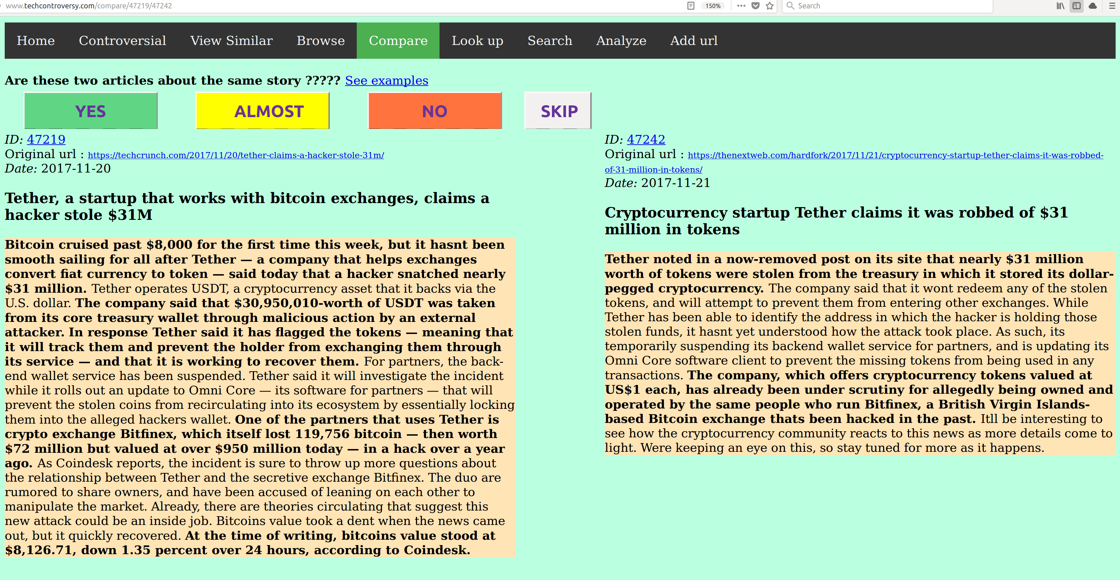
3. Creation of validation set
I created in this way a dataset of around 3,5k article referring to the same story (YES – 1.0),
being strongly related (ALMOST – 0.5) or relating two different stories (NO – 0.0)
This view is also used to compare stories

Slide 13
Phase 4: Final estimation
For each candidate “article pair”, calculate features and feed them into a classifier, using
the training set created in the previous step.
Gensim
TRAINING SET
TFIDF-BOW
Article 1
Preprocessing
Features
Generation
XGBOOST
PROB
DOC2VEC
Article 2
Preprocessing
Common
“Rare” n-grams

Slide 14
Prediction scores
XGBRegressor
For probability
Training set : 3476 data points
Mean Square Error: -0.03717525 (+/- 0.01147319)
XGBClassifier
For categorization
Training set : 3476 data points
F1: 0.92160535 (+/- 0.04361092)
Precision: 0.91337931 (+/- 0.11427947)
Recall: 0.93454545 (+/- 0.07633477)
Accuracy: 0.92375879 (+/- 0.05016181)
Score not high enough to fully automate aggregation.

Slide 15
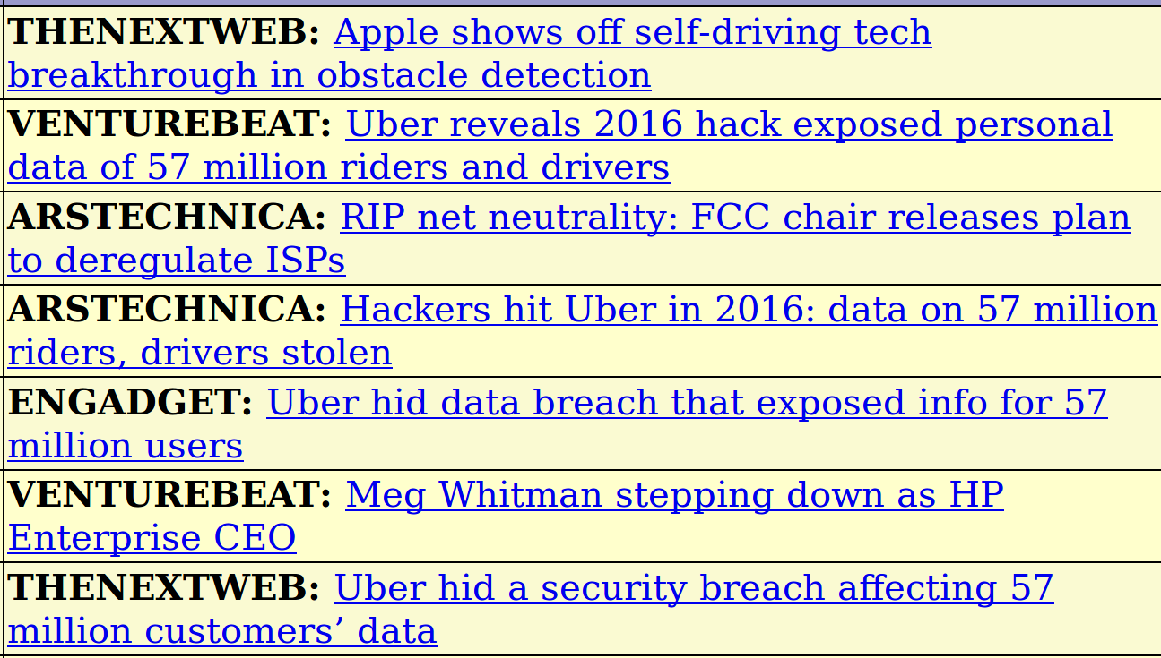
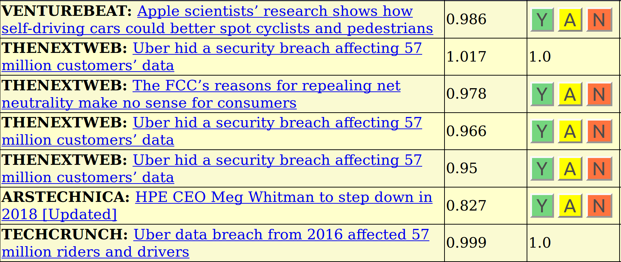
Phase 2
-

Slide 16


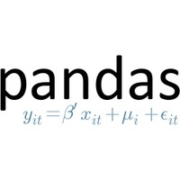










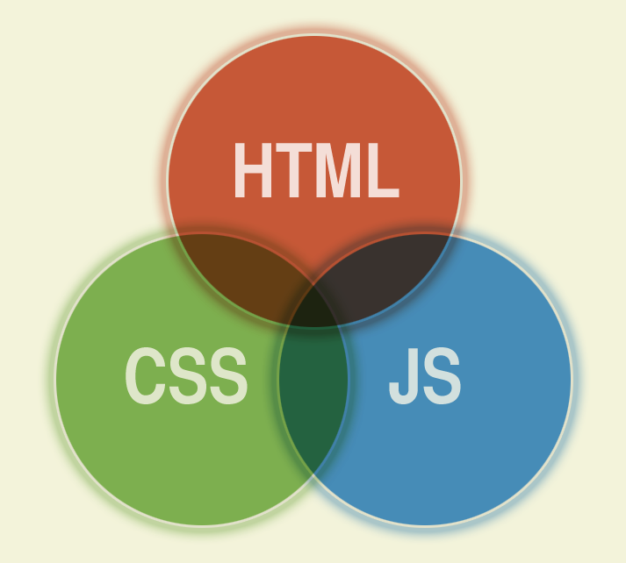






Technologies used

Slide 17
FUTURE DEVELOPMENTS
Improving look and feel of the web page
Score improvement
Automatic pruning of “uinteresting” articles
Improving search functionality
Improving summaries
Entity recognition
Categorization

Slide 18
CONTACT INFORMATION
Visit my site : http://www.amicabile.com
App available at http://www.techcontroversy.com
Email : diego.amicabile@amicabile.com

