Slide 1
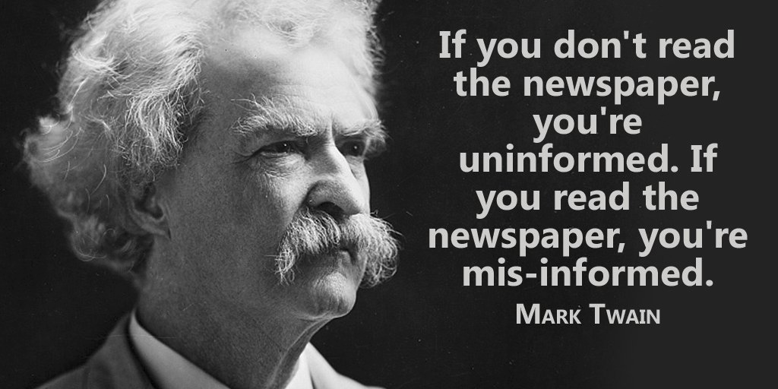
Fighting disinformation in tech news

Slide 2



Should we stay uninformed ?
Should we believe in an ideology ?
Should we believe our feeds ?

Slide 3






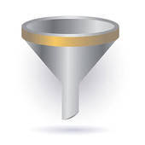

We can do all of this, but what about….
…. get information from more sources ?

Slide 4












For instance in tech ….
TECHCONTROVERSY.COM

Slide 5
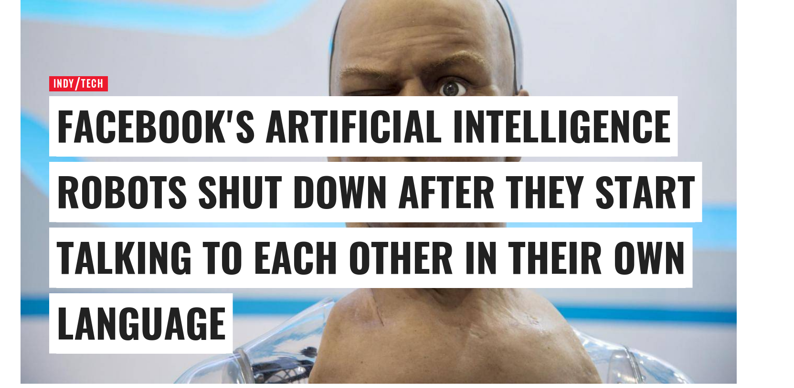
Source :
http://www.independent.co.uk/life-style/gadgets-and-tech/news/facebook-artificial-intelligence-ai-chatbot-new-language-research-openai-google-a7869706.html
Update:
This article has been amended to stress that the experiment was abandoned because the programs were not doing the work required, not because they were afraid
of the results, as has been reported elsewhere.

Slide 6
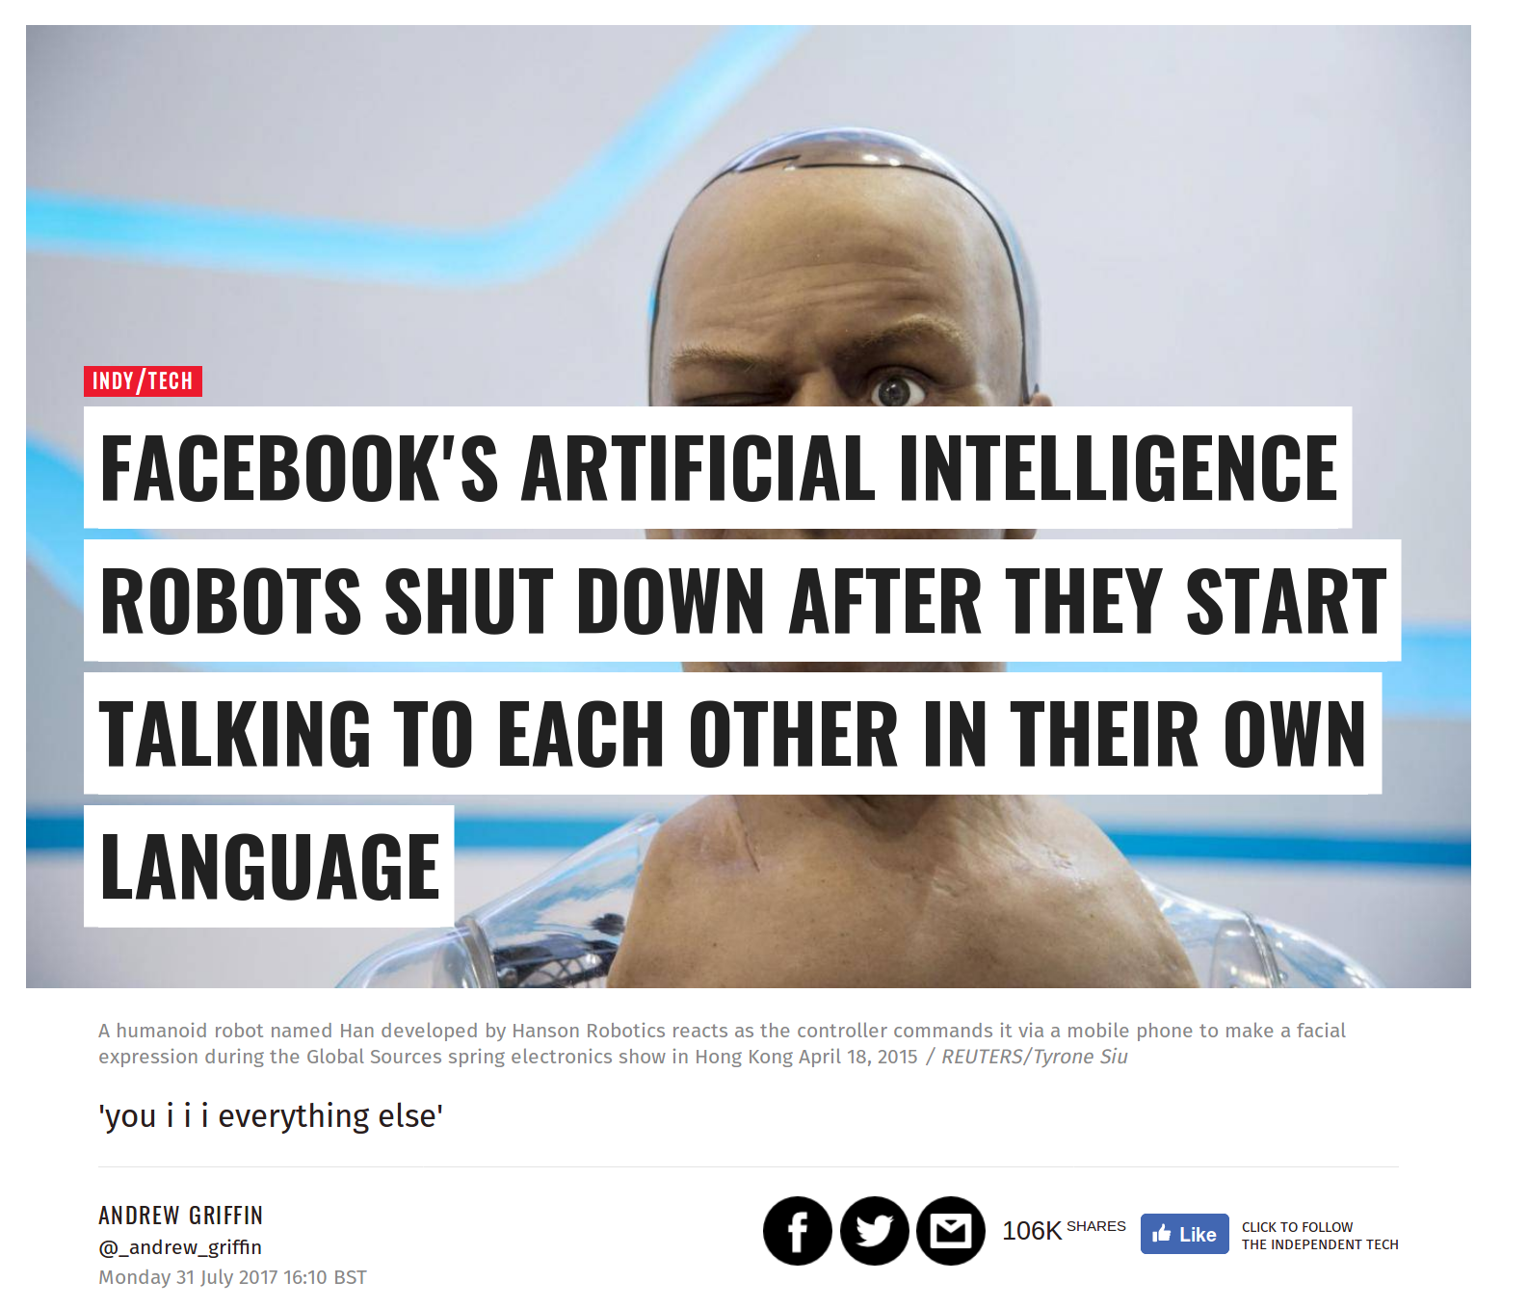
DISINFORMATION IN TECH NEWS?
Did Facebook Shut Down an AI Experiment because Chatbots
Developed Their Own Language?
Update: This article has been amended to stress that the experiment was abandoned because
the programs were not doing the work required, not because they were afraid of the results, as has been reported elsewhere.
Source : fhttp://www.independent.co.uk/life-style/gadgets-and-tech/news/facebook-artificial-intelligence-ai-chatbot-new-language-research-openai-google-a7869706.html
https://www.snopes.com/facebook-ai-developed-own-language/

Slide 7
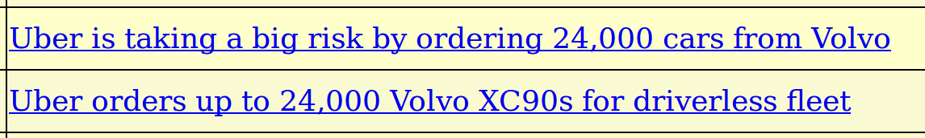
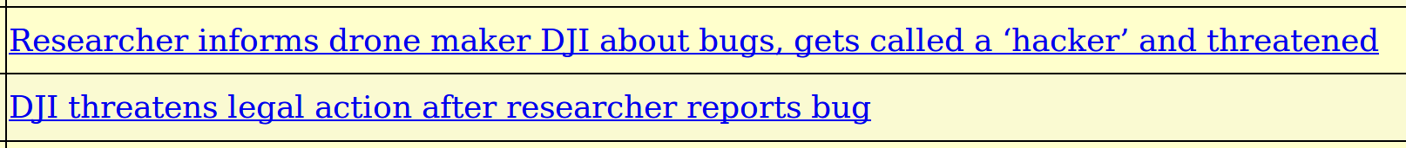
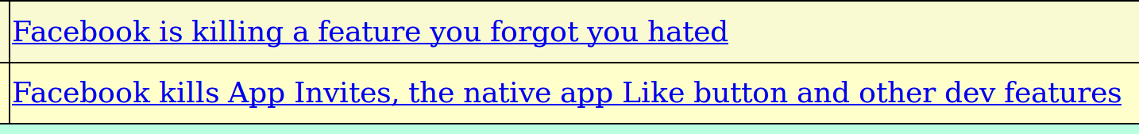
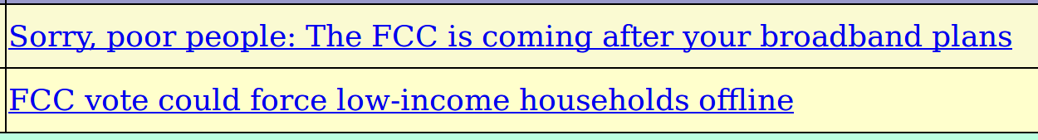
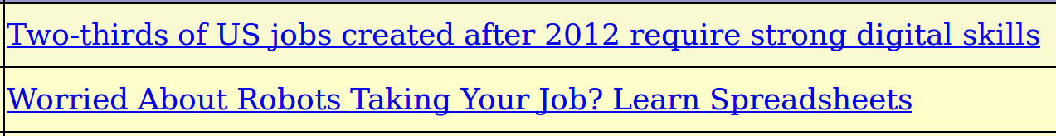
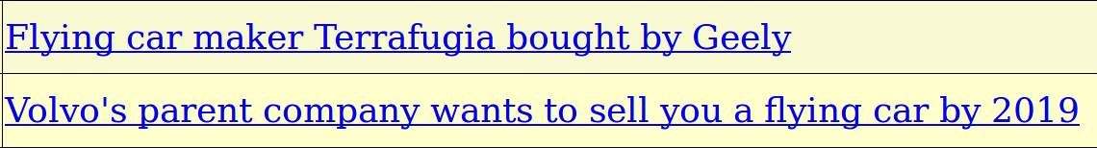
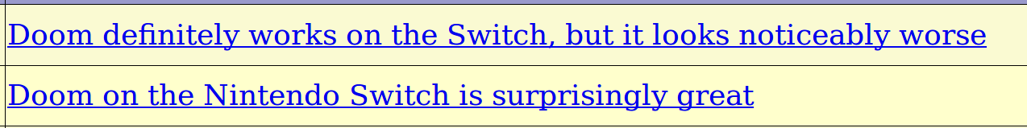
Controversy in Tech news

Slide 8
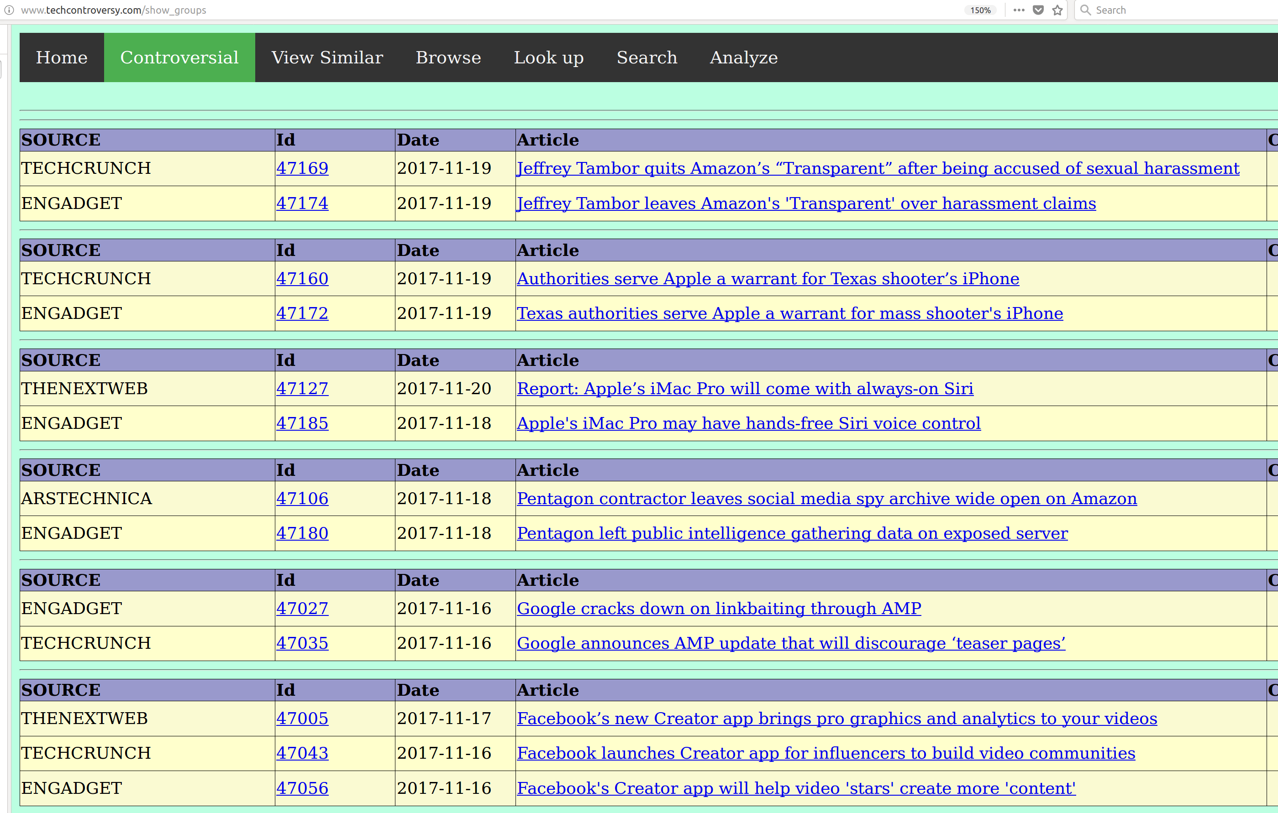
Let’s find controversy in tech...
http://www.techcontroversy.com/show_groups
http://www.techcontroversy.com/show_groups

Slide 9
Controversy in tech news ?
Main goal: scrape main tech news portals every day and detect articles relating to the same story
Articles about the same story are shown together under “Controversial” and users can compare them to get a different slant

Slide 10
For instance in tech ….
Admin panel
Tech portals
Database
scraping
Around 50.000 articles all from the year 2017, mainly from following portals

Slide 11
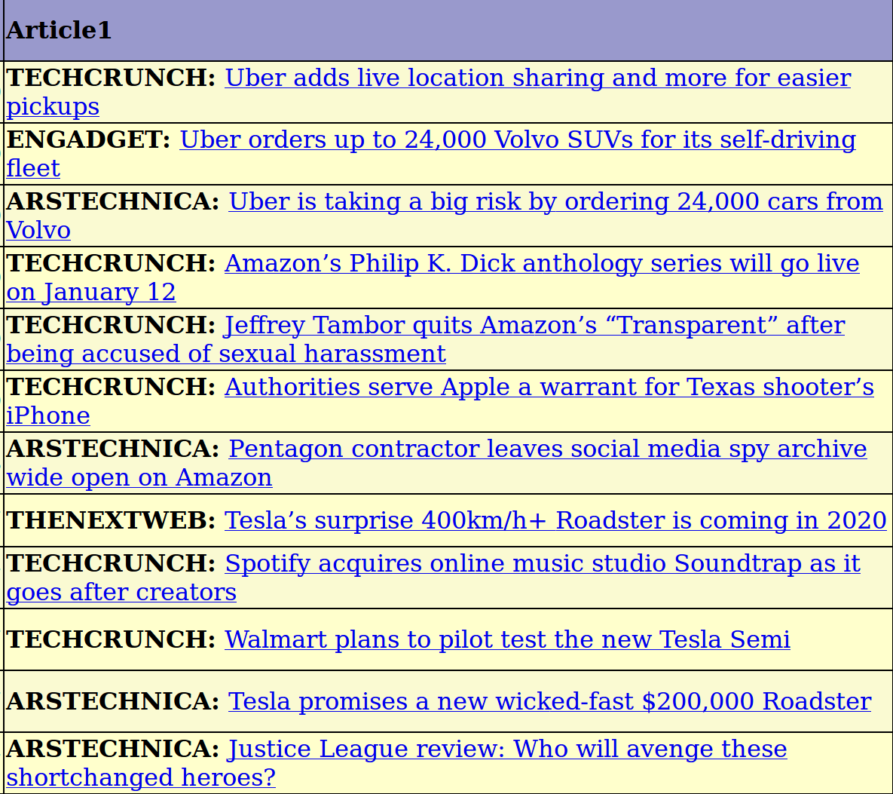
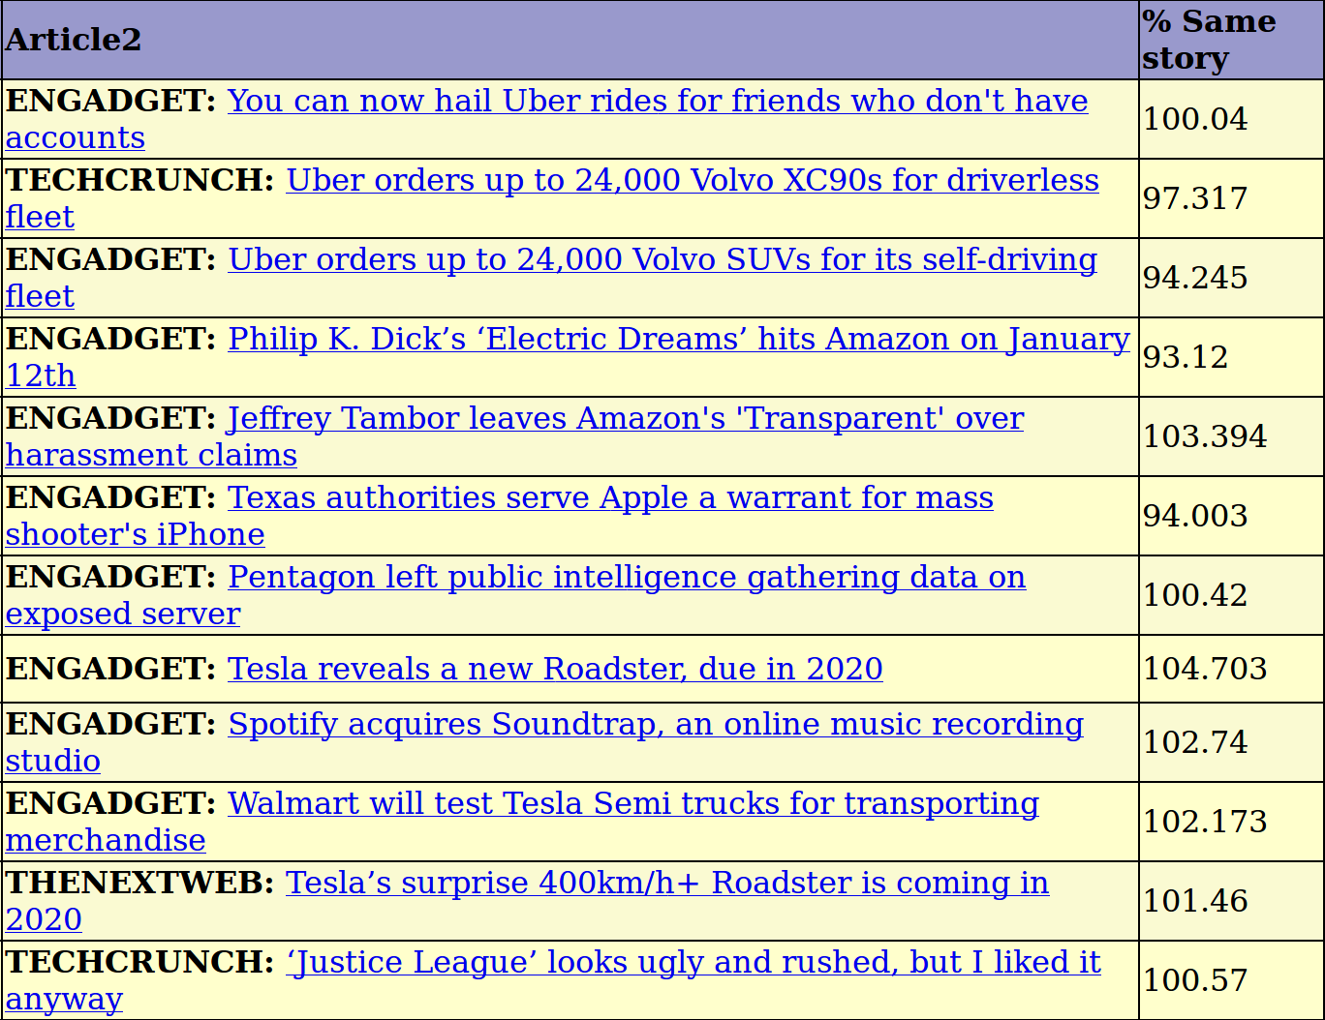
Probability “same story”
http://www.techcontroversy.com/duplicates
We look for articles close in time and calculate the probability that they relate the same story.

Slide 12
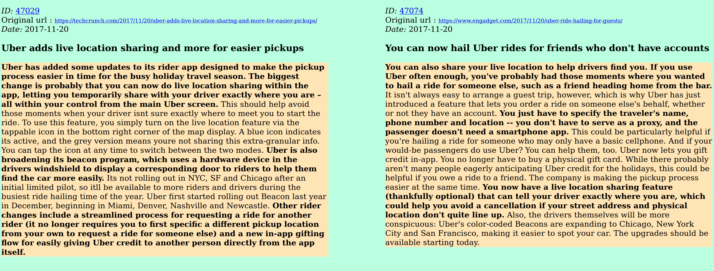
Compare two stories
Follow the “compare” icon and you can see the stories side by side.
The program will try to highlight the most important sentences

Slide 13


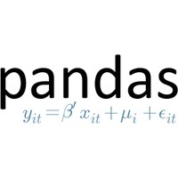

















Technologies used

Slide 14
Complexity
- The complexity of comparing each article with each other article is quadratic
- (2-combination over a set of 50k) → around 2.5 billions
- Therefore it is necessary to reduce the problem
- identification of candidate article pair in a range of five days,
- calculation of final similarity score of candidate article pairs

Slide 15
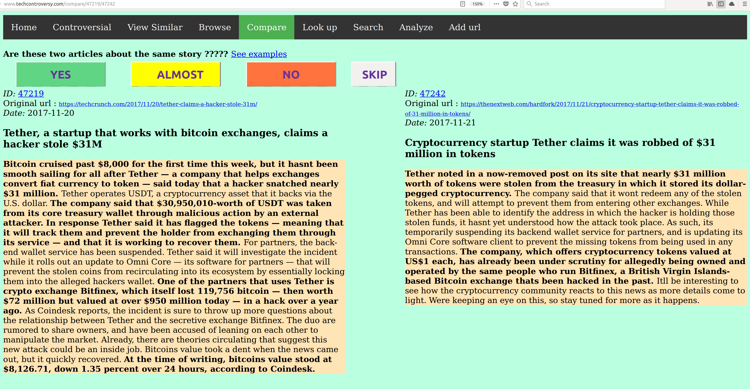
Creation of validation set
I created in this way a dataset of around 3,5k article referring to the same story (YES – 1.0),
being strongly related (ALMOST – 0.5) or relating two different stories (NO – 0.0)

Slide 16
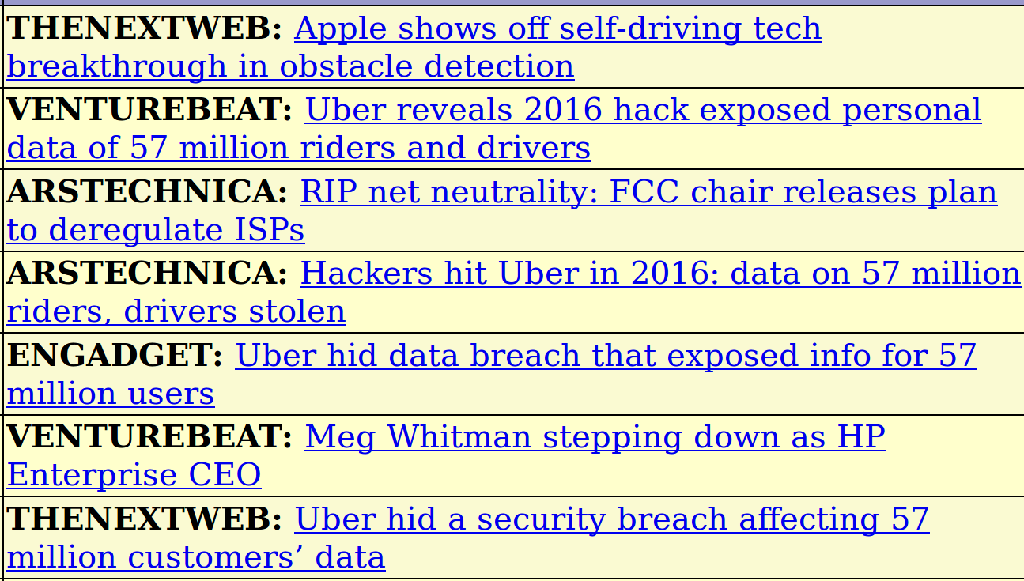
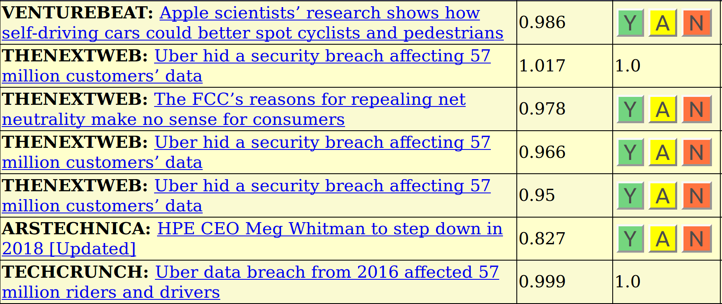
Phase 2
- Generation of final similarity score features for candidate article pairs
- Spacy, Gensim (Tfidf, Doc2vec, Phraser)
- Fitting and prediction using XGBoost over training set
- Prediction of final probability for candidate article pairs ( probability that they relate
to the same story)
- Probability is shown on the “Similar articles” tab and the administrator can choose
whether to confirm that the articles actually refer to the same stories.

Slide 17
Phase 2: Identification of candidate article pairs
Each new article is compared with the other articles in the database in a range of five days.
Article 1
Preprocessing
Gensim
(TFIDF, Doc2Vec)
Accept as
candidate
Yes
Removal of token sentences,
Regexp substitution,
Tokenization,
Lemmatization,
N-gram creation
Compare
articles
Similarity score
> threshold ?
No
Reject as
candidate
Article 2
Preprocessing

Slide 18
Phase 3: Final estimation whether articles relate to the same story
For each candidate “article pair”, calculate features and feed them into a classifier
Gensim
TRAINING SET
TFIDF-BOW
Article 1
Preprocessing
Features
Generation
XGBOOST
PROB
DOC2VEC
Article 2
Preprocessing
Common
“Rare” n-grams

Slide 19
Probability prediction of score
Base : A set of manually generated scores for article pairs similarity
Generation of features for article pair similarity using Gensim
Fitting and prediction using a XGBoost classifier
5-Fold cross-validation over training-set gives a 0.038 Mean Square Error
(neg_mean_squared_error)
Training set : 3391 data points
[-0.03949988 -0.04280428 -0.04591686 -0.02720717 -0.03400522]
Error: -0.03788668 (+/- 0.01327815)

Slide 20
FUTURE DEVELOPMENTS
Score can still be improved
Search functionality improvement
Summaries
Detecting differences and sentiments
Entity recognition
Identification of “interesting articles”
Categorization of articles
Try other technologies
Improving look and feel of the web page

Slide 21
CONTACT INFORMATION
Visit my site : http://www.amicabile.com
App available at http://www.techcontroversy.com
Email : diego.amicabile@amicabile.com

