Slide 1
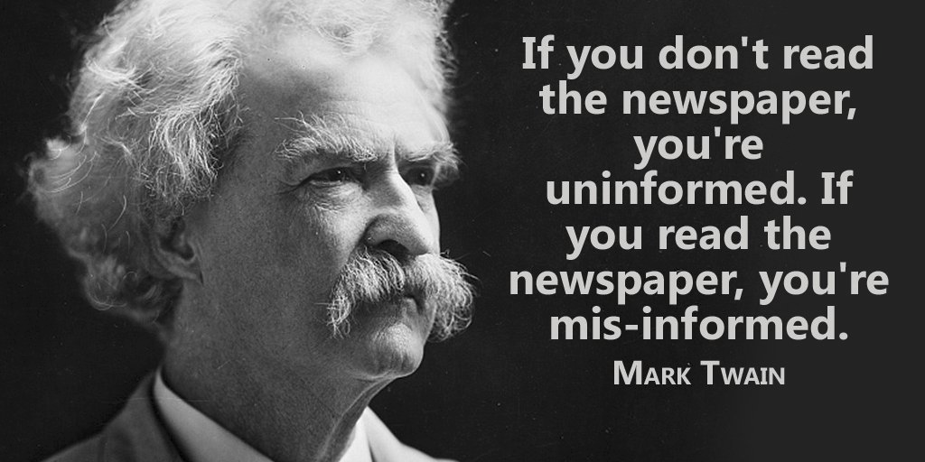
Fighting disinformation in tech news

Slide 2



Should we stay uninformed ?
Should we believe in an “authoritative” source ?
Should we get news from social networks ?

Slide 3



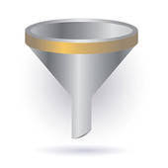

Here is my proposal:
Don’t trust social media for news
Get information from several authoritative sources

Slide 4












For instance in tech ….
TECHCONTROVERSY.COM

Slide 5
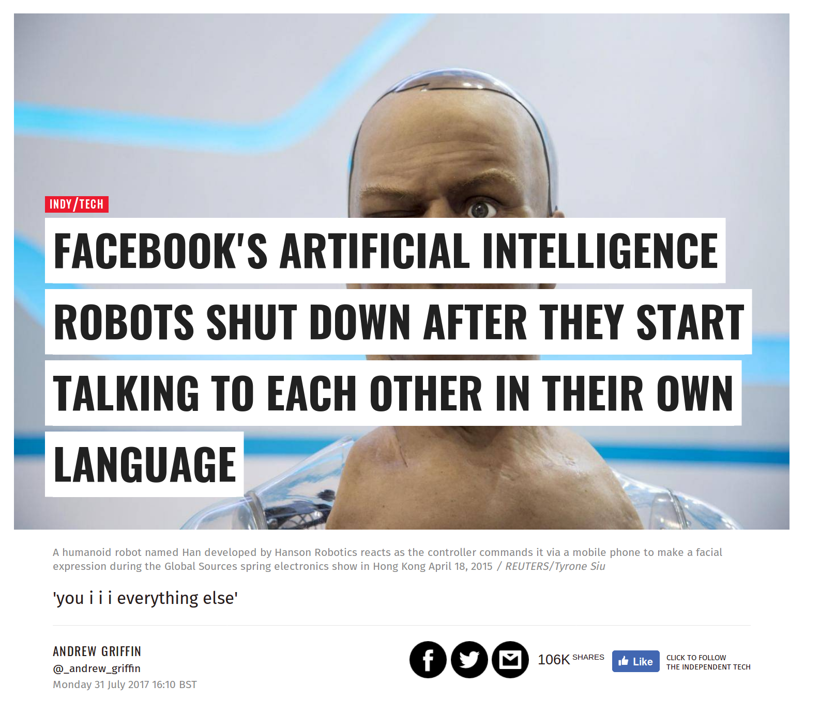

Disinformation in tech news?
The experiment was abandoned because the programs were not doing the work required, not because they were afraid of the results.
SNOPE : https://www.snopes.com/facebook-ai-developed-own-language/

Slide 6
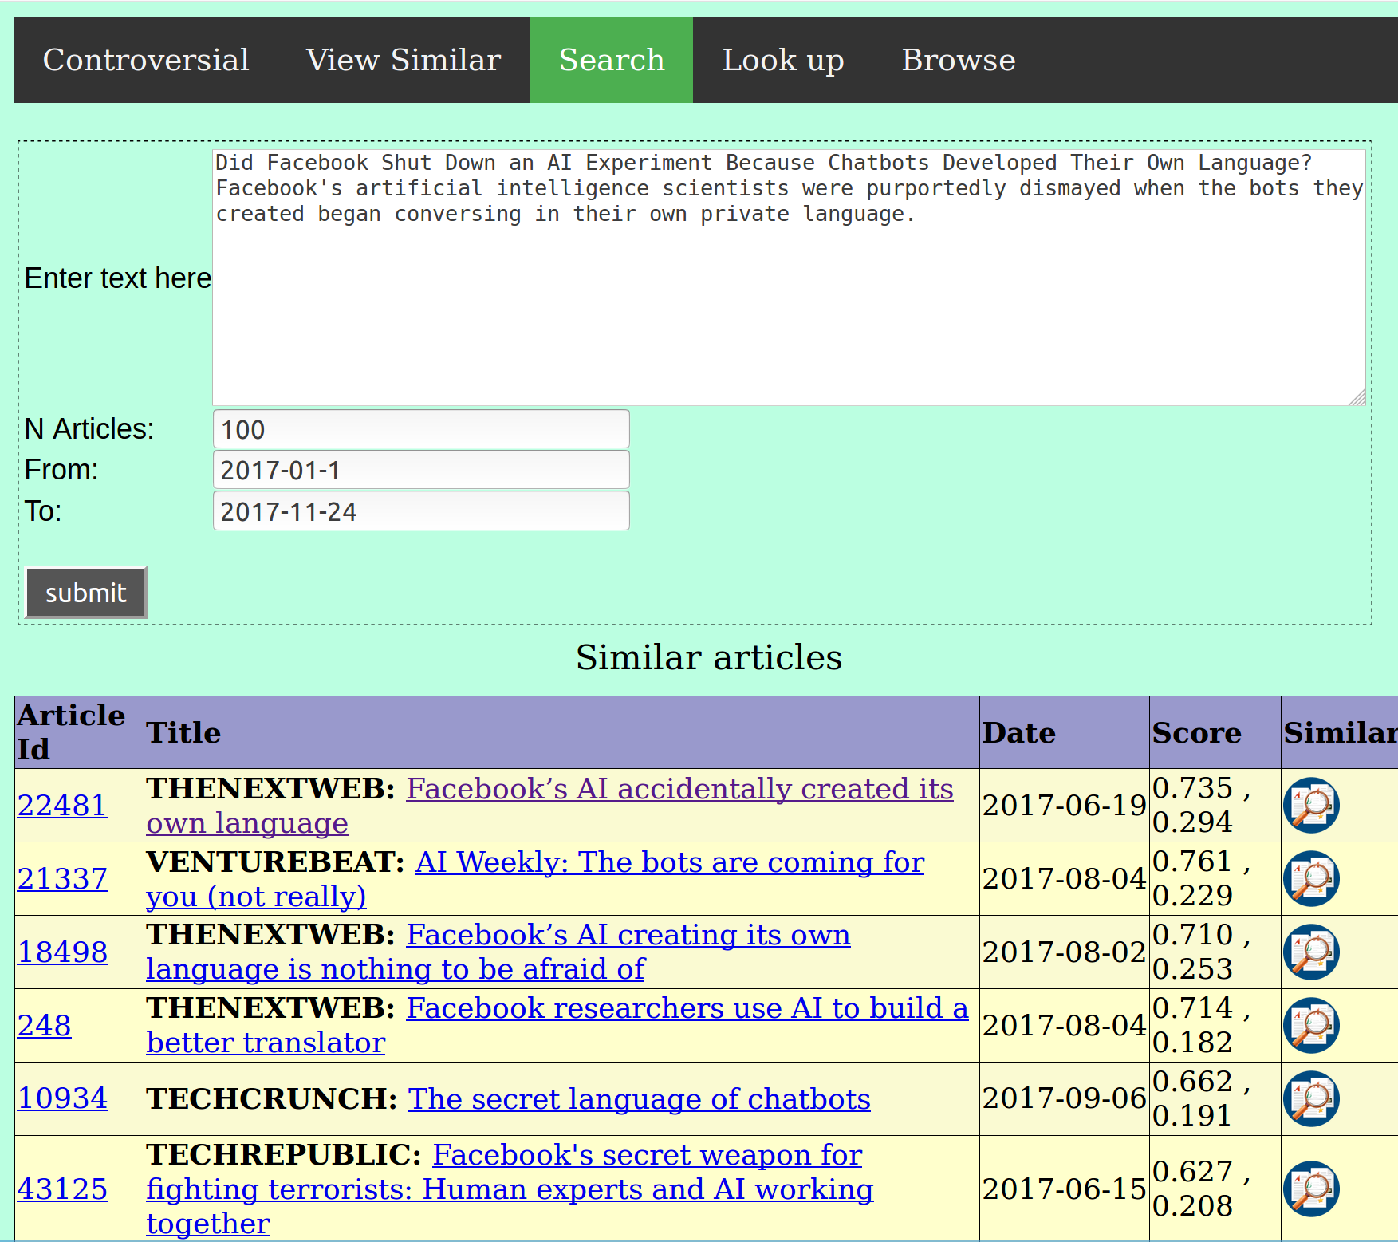
Let’s check on techcontroversy...
Notes:
Did Facebook Shut Down an AI Experiment Because Chatbots Developed Their Own Language? Facebook's artificial intelligence scientists were purportedly dismayed when the bots they created began conversing in their own private language.

Slide 7

Let’s find controversy in tech...

Slide 8
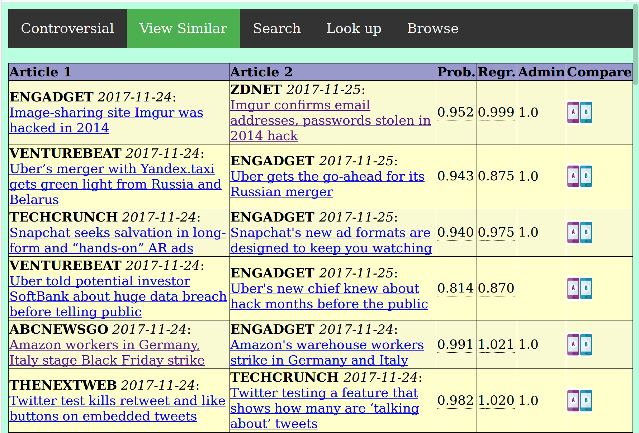
Probability “same story”
We look for articles close in time and calculate the probability that they relate the same story.

Slide 9

1. Retrieving the articles
Admin panel
Tech portals
Database
scraping
Around 50.000 articles all from the year 2017, mainly from following portals:

Slide 10
Complexity
- The complexity of comparing each article with each other article is quadratic
- 2-combinations over a set of 50k
~ 1.25 billions
Therefore to reduce the problem
- identification of candidate article pairs in a range of five days
- calculation of final similarity score of candidate article pairs

Slide 11
2. Identification of candidate article pairs
Each new article is compared with the other articles in the database in a range of five days.
Article 1
Preprocessing
Gensim
(TFIDF, Doc2Vec)
Accept as
candidate
Yes
Removal of token sentences,
Regexp substitution,
Tokenization,
Lemmatization,
N-gram creation
Compare
articles
Similarity score
> threshold ?
No
Reject as
candidate
Article 2
Preprocessing

Slide 12
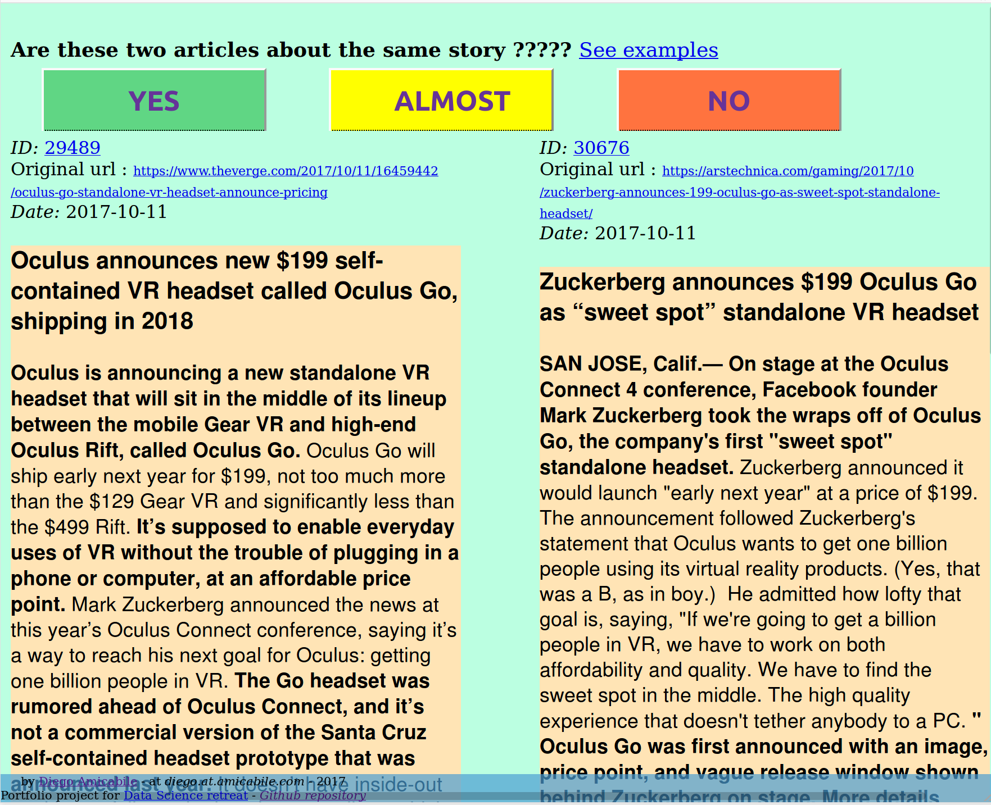
3. Creation of a training set
A training dataset of around 4k article pairs, with the information whether they refer to the same
story (YES, 1.0) or are strongly related (0.5) .

Slide 13
Phase 4: Final estimation
For each candidate “article pair”, calculate features and feed them into a classifier, using
the training set created in the previous step, and generate the probability that they relate
to the same story.
Gensim
TRAINING SET
TFIDF-BOW
Article 1
Preprocessing
Features
Generation
XGBOOST
PROB
DOC2VEC
Article 2
Preprocessing
Common
“Rare” n-grams

Slide 14
Classification or Regression ?
I use a regressor to calculate a similarity score and a classifier to calculate the probability
that two articles relate the same story.
XGBRegressor
Neg Mean Squared Error: -0.03584226 (+/- 0.00706475)
XGBClassifier
F1: 0.91886022 (+/- 0.05837126)
Precision: 0.90741178 (+/- 0.14900768)
Recall: 0.93727530 (+/- 0.06995592)
Accuracy: 0.91823336 (+/- 0.07290250)
Neg Log Loss: -0.21029180 (+/- 0.16332790)

Slide 15
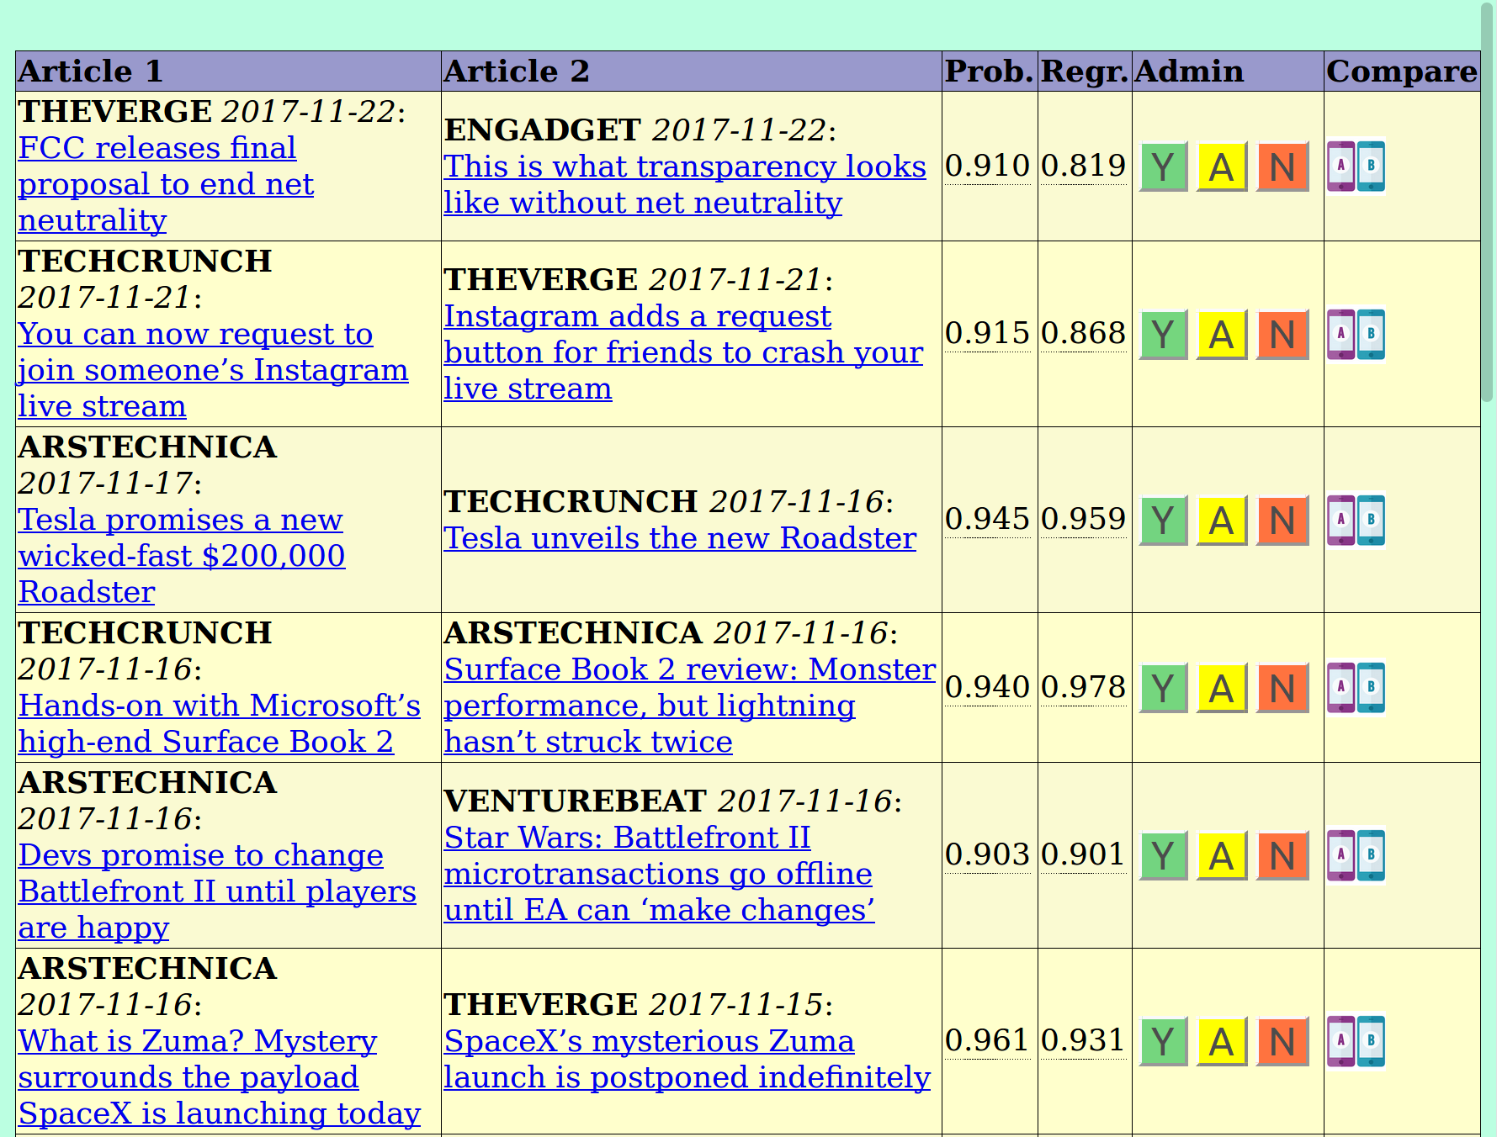
A manual confirmation is required
-

Slide 16


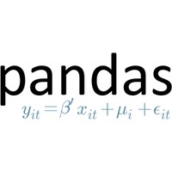










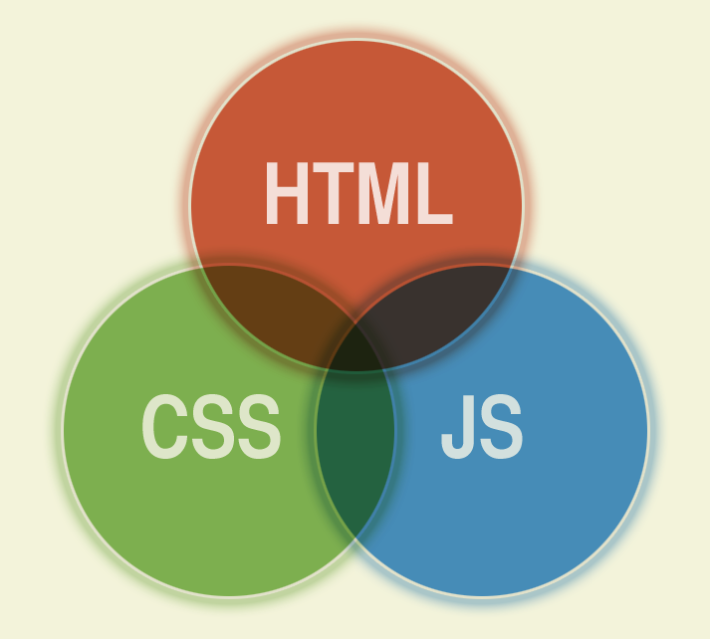







Technologies used

Slide 17
CONTACT INFORMATION
Visit my site : http://www.amicabile.com
Application available at http://www.techcontroversy.com
Email : diego.amicabile@amicabile.com

