Slide 1
TECH CONTROVERSY
Are two articles about the same story ?

Slide 2
WHY IS IT IMPORTANT?
If You Don’t Read the Newspaper You Are Uninformed, If You Do Read the Newspaper You Are Misinformed (Mark Twain)
Then why not read several newspapers, to get unbiased information?

Slide 3
TECH CONTROVERSY
Main goal: scrape main tech news portals every day and detect articles relating to the same story
Articles about the same story are shown together under “Controversial” and users can compare them to get a different slant

Slide 4
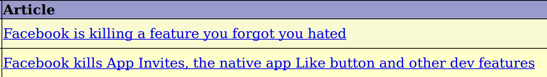
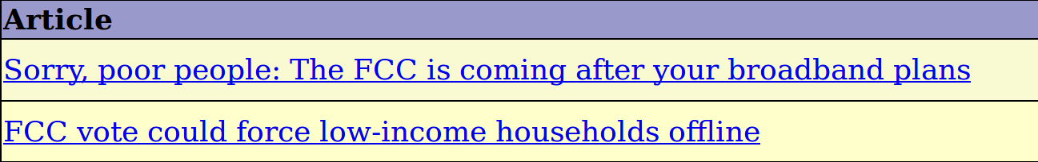
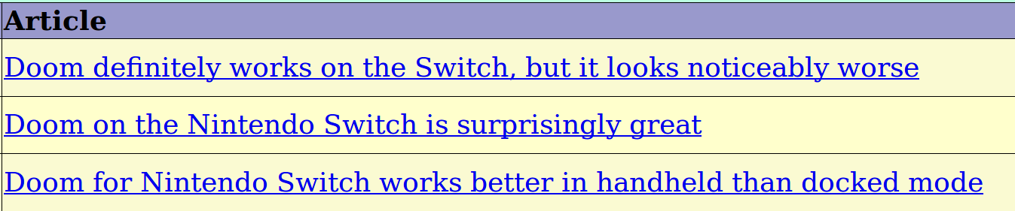
Controversy in Tech news

Slide 5
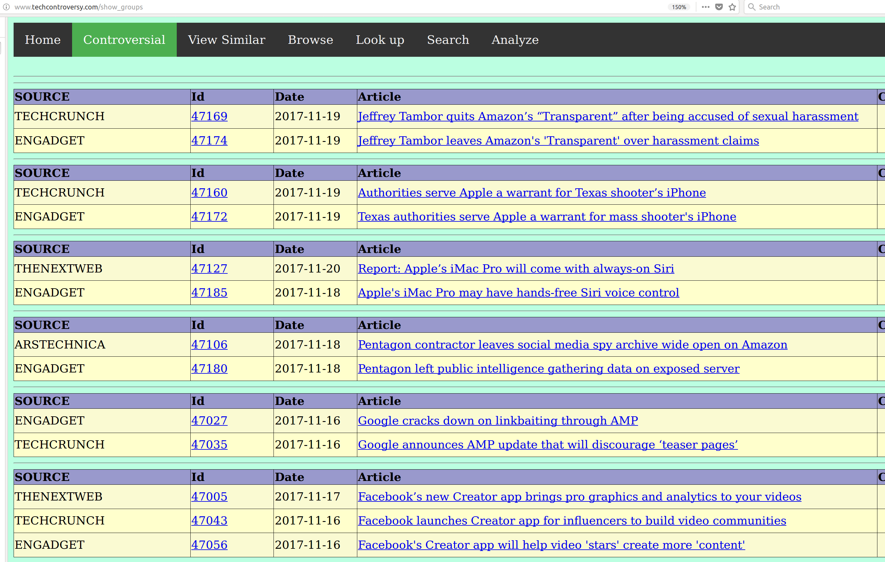
Aggregation of articles
http://www.techcontroversy.com/show_groups
http://www.techcontroversy.com/show_groups

Slide 6
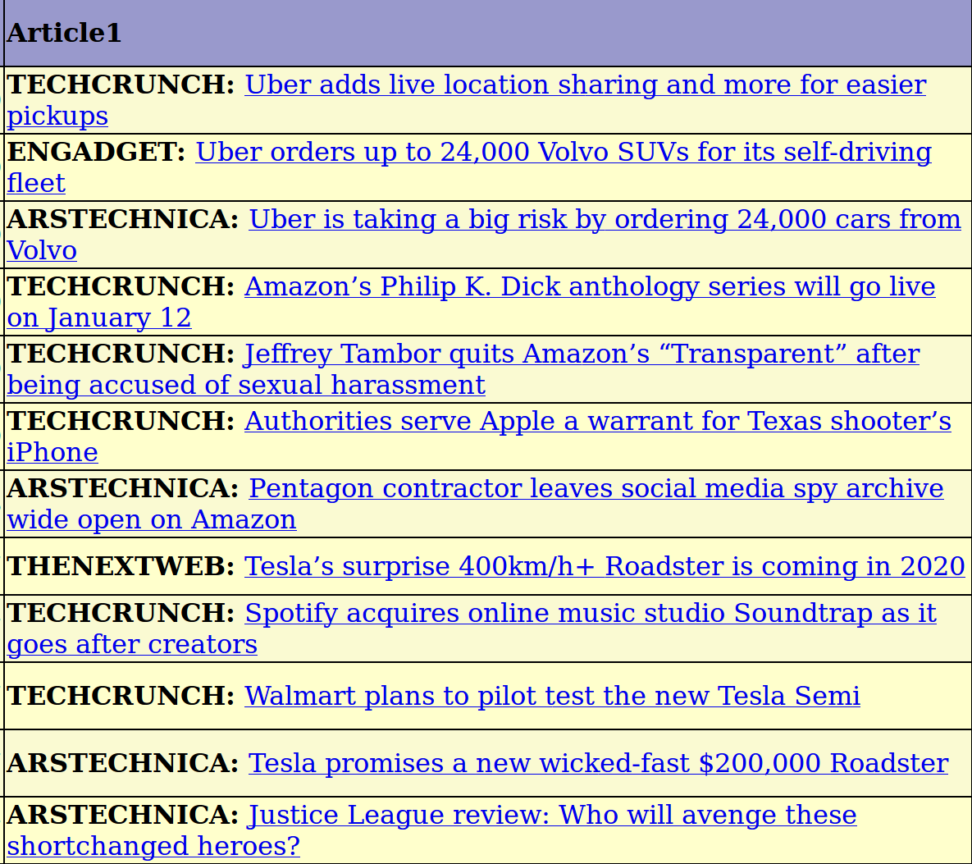
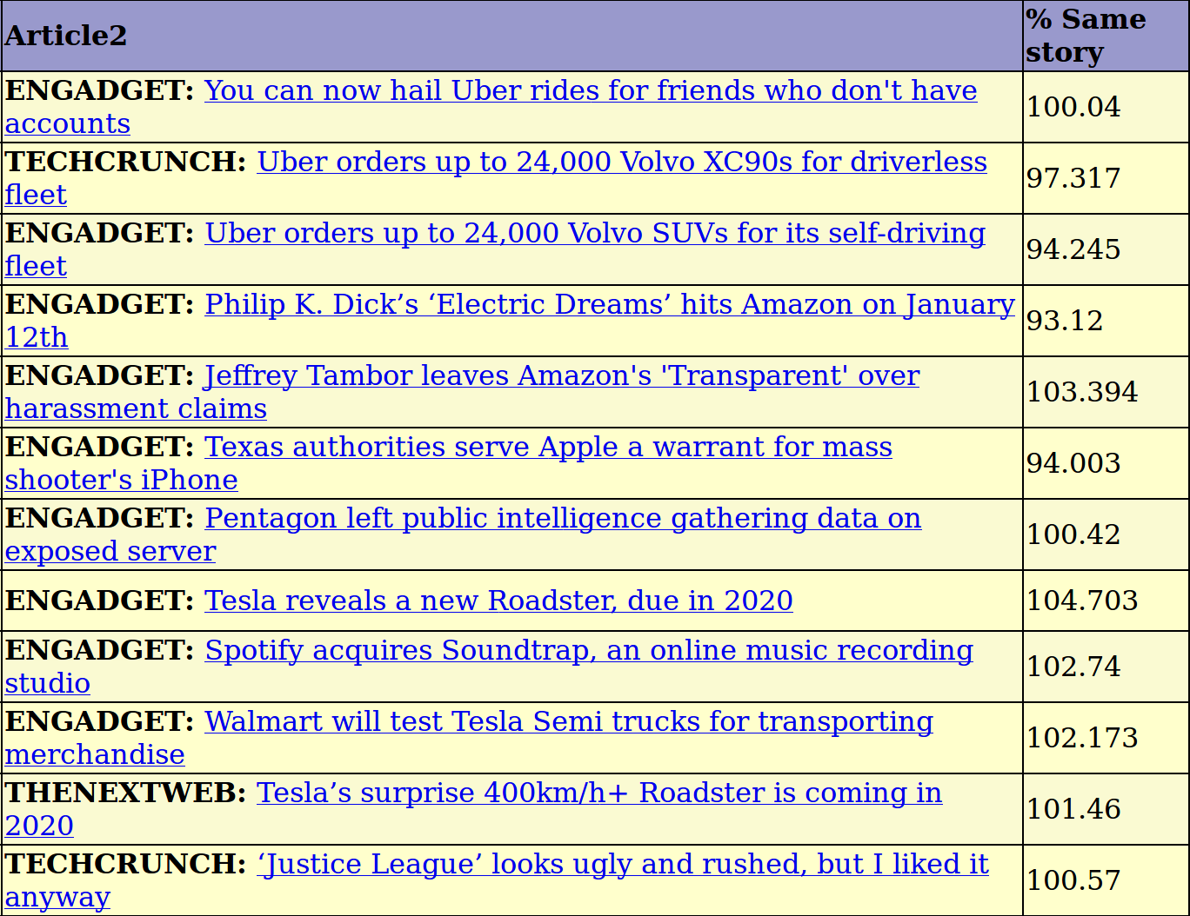
Probability “same story”
http://www.techcontroversy.com/duplicates
We look for articles close in time and calculate the probability that they relate the same story.

Slide 7
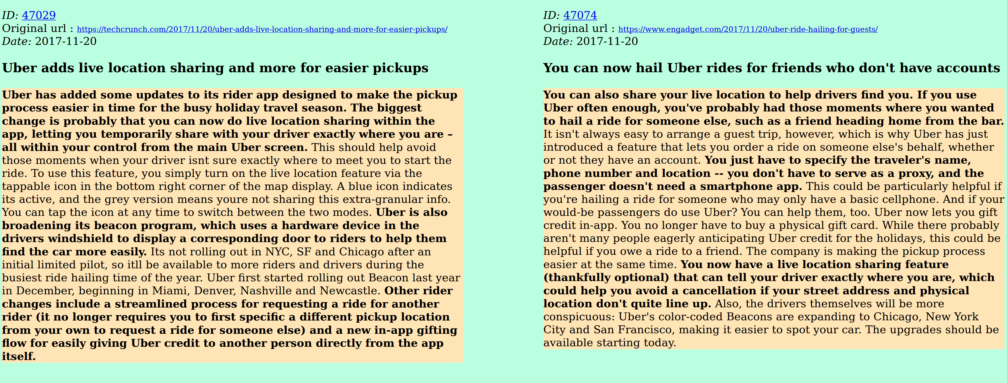
Compare two stories
Follow the “compare” icon and you can see the stories side by side.
The program will try to highlight the most important sentences

Slide 8
Phase 1
Technology : Python together with numpy, pandas, gensim, scikit, spacy, mysql, flask, scrapy
In the first phase I set up following components:
- A database for maintaing the articles (MySql)
- Scripts to retrieve articles from selected portals (Xpath, Scrapy)
- Around 50.000 articles all from the year 2017, from seven tech portals
- A method to estimate the similarity between articles (Gensim)
Training on documents using Tfidf-Bow and Doc2Vec
- A method to identify candidate pairs of articles (having a high similarity score
and close in date)
- A web application allowing to browse the articles and to build a training test

Slide 9
Complexity
- The complexity of comparing each article with each other article is quadratic
- (2-combination over a set of 50k) → around 2.5 billions
- Therefore it is necessary to reduce the problem
- identification of candidate article pair in a range of five days,
- calculation of final similarity score of candidate article pairs

Slide 10
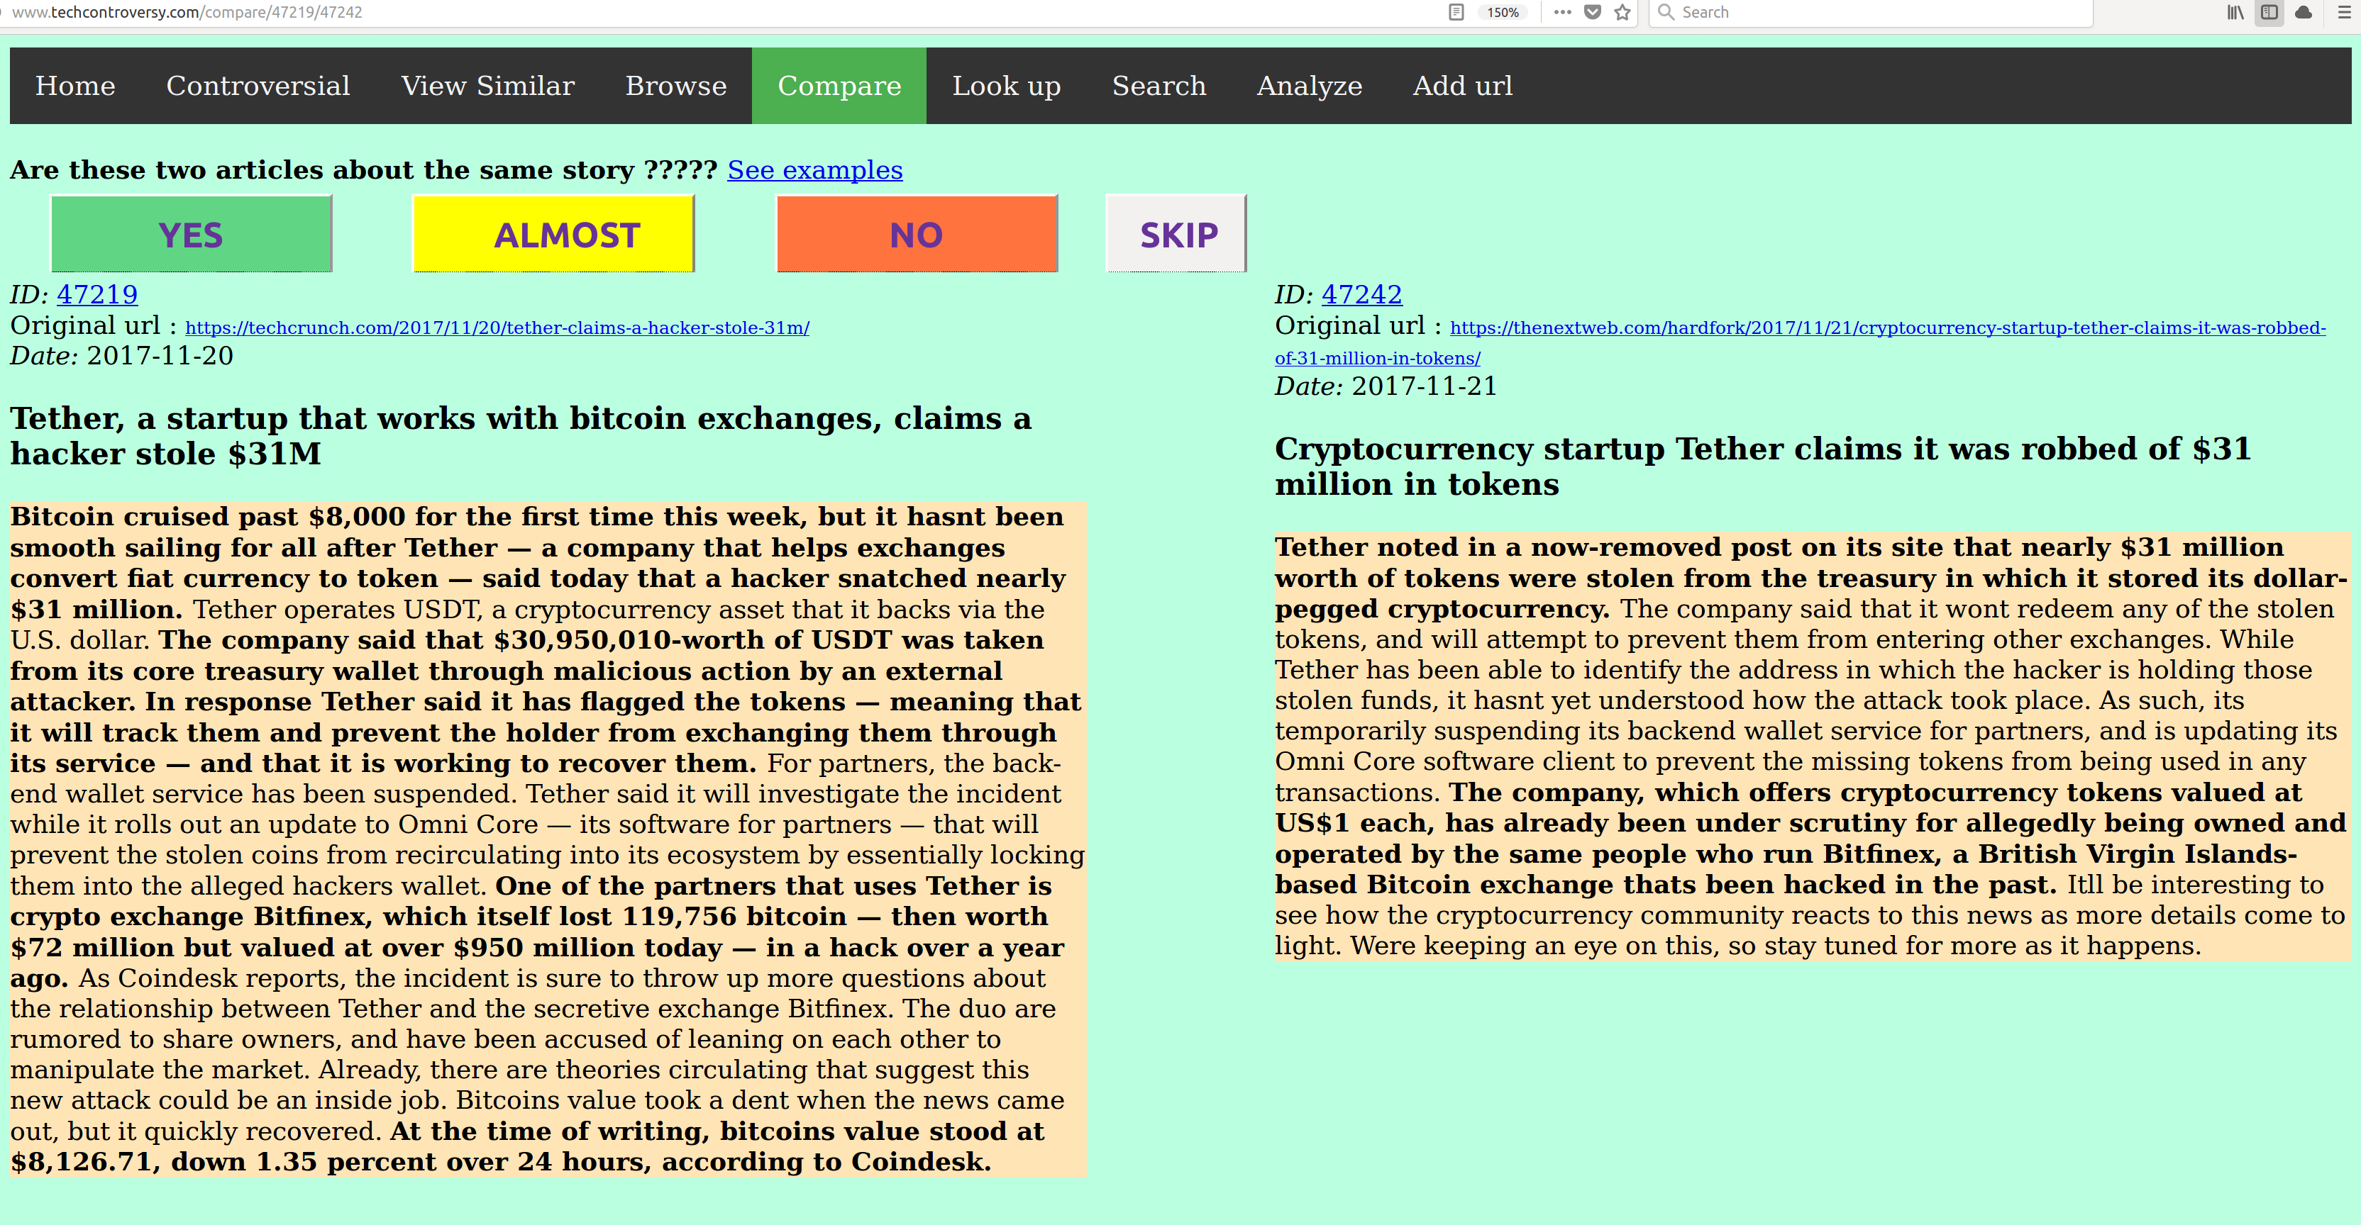
Creation of validation set
I created in this way a dataset of around 3,5k article referring to the same story (YES – 1.0),
being strongly related (ALMOST – 0.5) or relating two different stories (NO – 0.0)

Slide 11
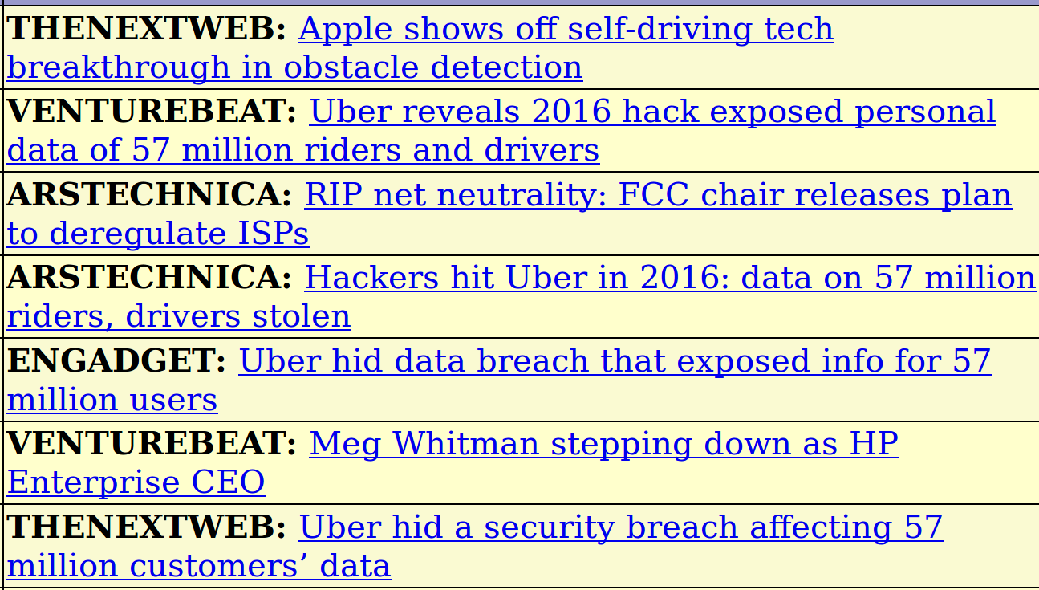
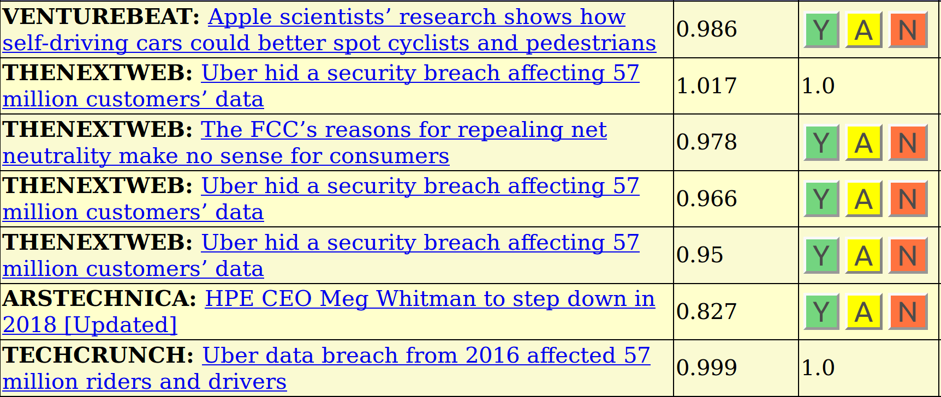
Phase 2
- Generation of final similarity score features for candidate article pairs
- Spacy, Gensim (Tfidf, Doc2vec, Phraser)
- Fitting and prediction using XGBoost over training set
- Prediction of final probability for candidate article pairs ( probability that they relate
to the same story)
- Probability is shown on the “Similar articles” tab and the administrator can choose
whether to confirm that the articles actually refer to the same stories.

Slide 12
Identification of candidate article pairs
Each new article is compared with the other articles in the database in a range of five days.
Article 1
Preprocessing
Gensim
(TFIDF, Doc2Vec)
Accept as
candidate
Yes
Removal of token sentences,
Regexp substitution,
Tokenization,
Lemmatization,
N-gram creation
Compare
articles
Similarity score
> threshold ?
No
Reject as
candidate
Article 2
Preprocessing

Slide 13
Calculation of features
For each candidate “article pair”, calculate features and feed into classifier
Gensim
TFIDF-BOW
T_TITLE
T_TEXT
T_SUMMARY
T_SUMMARY_2
Article 1
Preprocessing
Features
Generation
DOC2VEC
D_TITLE
D_TEXT
D_SUMMARY
D_SUMMARY_2
XGBOOST
PROB
Article 2
Preprocessing
Common
“Rare” n-grams
CW_TITLE
CW_TEXT
CW_SUMMARY
CW_SUMMARY_2
DIFF_DAYS

Slide 14
Probability prediction of score
Base : A set of manually generated scores for article pairs similarity
Generation of features for article pair similarity using Gensim
Fitting and prediction using a XGBoost classifier
5-Fold cross-validation over training-set gives a 0.038 Mean Square Error
(neg_mean_squared_error)
Training set : 3391 data points
[-0.03949988 -0.04280428 -0.04591686 -0.02720717 -0.03400522]
Error: -0.03788668 (+/- 0.01327815)

Slide 15
FUTURE DEVELOPMENTS
Score can still be improved
Search functionality improvement
Summaries
Detecting differences and sentiments
Entity recognition
Identification of “interesting articles”
Categorization of articles
Try other technologies
Improving look and feel of the web page

Slide 16
CONTACT INFORMATION
Visit my site : http://www.amicabile.com
App available at http://www.techcontroversy.com
Email : diego.amicabile@amicabile.com

