Slide 1

CHAPTER 2
PMP Study Group
www.pmigdl.org
Creating the Project Charter
Bibliography:
Kim Heldman - PMP Study Guide 5th Edition .
PMI - PMBok 4th Edition.
Author(s):
Lorena Valentan Alarcon, PMP®

Slide 2
CHAPTER 2 – Content :
Project Management Knowledge Areas
Conduct project selection methods
Project charter
Identify Stakeholders
Process Group
Knowledge area(s):
Integration
Communication
Initiating

Slide 3
Project management knowledge areas
Each process group is made up of a collection of processes used throughout the project life cycle The PM BOKGuide groups these processes into 9 categories that it calls The Project Management Knowledge Areas. These groupings, or Knowledge Areas, bring together processes that have characteristics in common
Note
Knowledge Areas bring together processes by commonalities, whereas project management process groups are more or less the order in which you perform the project management processes. Projects are executed in process group order, but the Knowledge Areas allow a project manager to think about groups of processes that require specific skills.

Slide 4
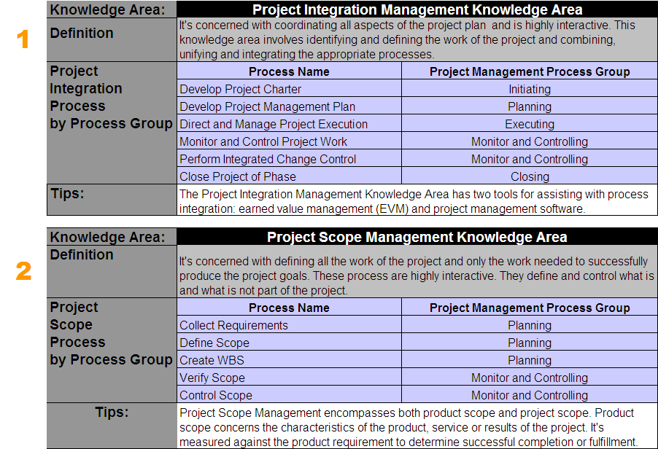
Project management knowledge areas

Slide 5
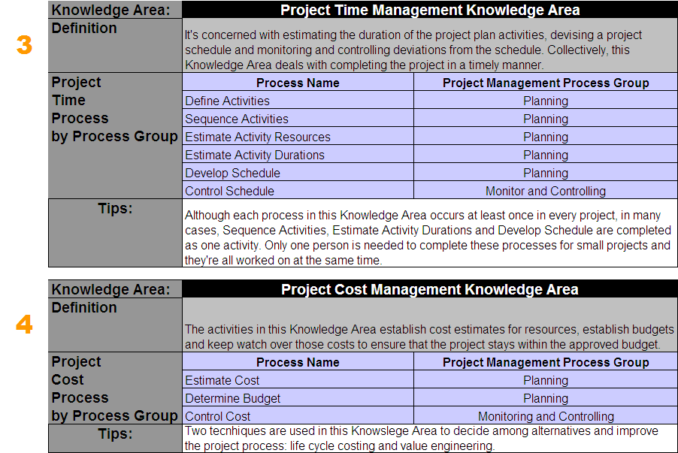
Project management knowledge areas

Slide 6
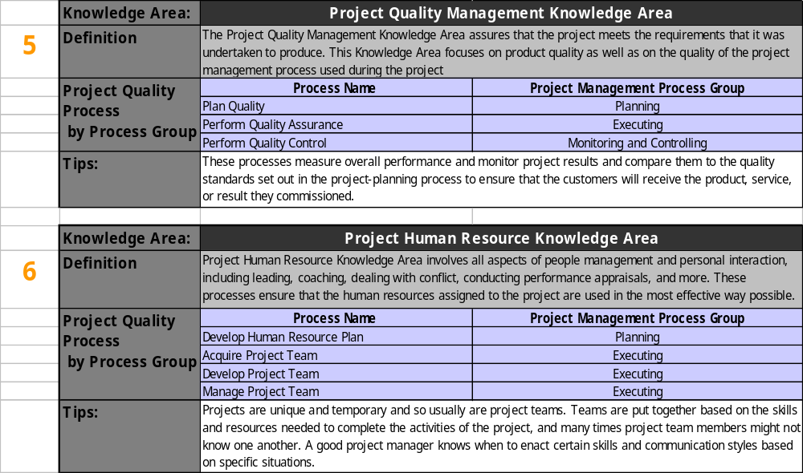
Project management knowledge areas

Slide 7
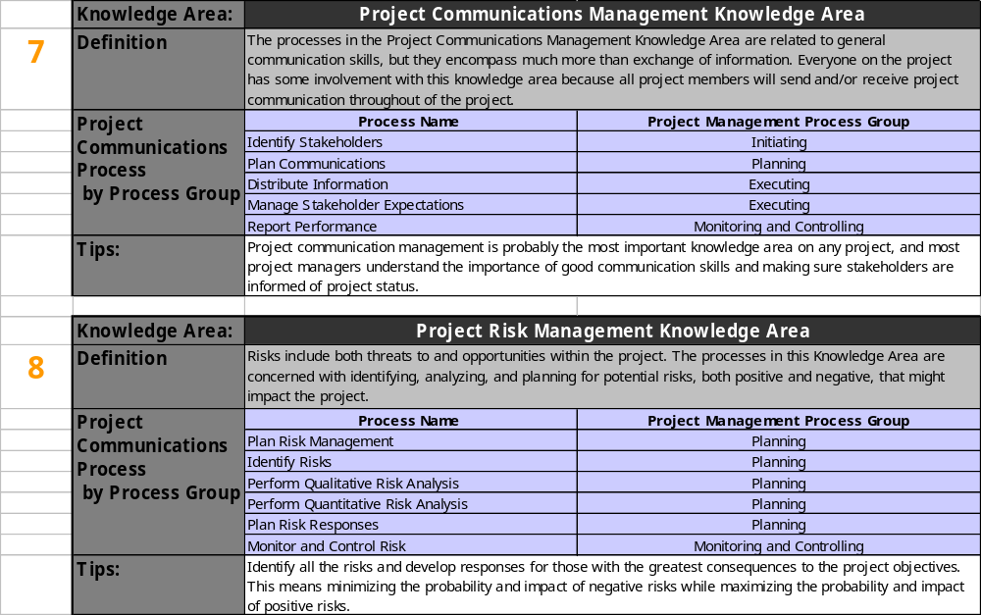
Project management knowledge areas

Slide 8
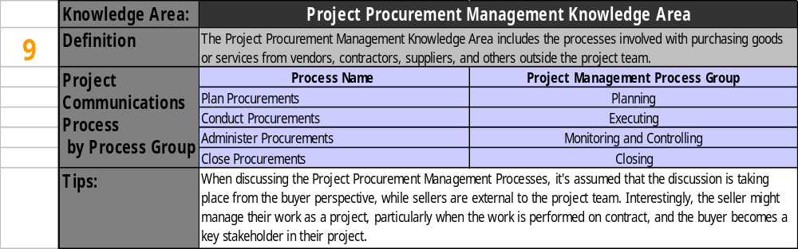
Project management knowledge areas

Slide 9
Conduct Project Selection Methods
Needs and demands:
Feasibility Studies:
Most projects will fit into one of the seven needs and demands:
Market demand
Strategy opportunity / business need
Customer request.
Technological advance.
Legal requirements.
Ecological impacts.
Social need.
They are undertaken mainly to:
1. Determine whether the project is a viable project.
2. Determine the probability of the project succeeding.
3. Examine the viability of the product, service, or result of the project.
Feasibility studies might be conducted as separate projects, as subprojects, or as the first phase of a project.

Slide 10
Conduct Project Selection Methods
Selecting and Prioritizing Projects:
Project selection methods are concerned with the advantages or merits of the product of the project. In other words, selection methods measure the value of what the product, service, or result of the project will produce and how it will benefit the organization.
Selection Methods
Mathematical Model (calculation methods)
Benefit measurement Methods (decision models)

Slide 11
Conduct Project Selection Methods
Selection
Methods
Types
Mathematical Models: Mathematical models use linear, dynamic, integer, nonlinear, and/or multi-objective
programming in the form of algorithms or in other words, a specific set of steps to solve a particular problem.
Mathematical models are also known as constrained optimization methods.
2. Benefit Measurement Methods:
Benefit measurement methods employ various forms of analysis and comparative approaches to make project decisions. These methods include comparative approaches such as cost-benefit analysis, scoring models, and benefit contribution methods that include various cash flow techniques and economic models.
Cost-Benefit Analysis
Scoring Models
Cash Flow Analysis Techniques
The name of this method implies what it does—it compares the cost to produce the product, service, or result of the project to the benefit (usually financial in the form of savings or revenue generation) that the organization will receive as a result of executing the project.
Also knows as weighted scoring model. Each project is rated on a scale with the higher number being the more desirable outcome to the company and the lower number having the opposite effect. This rating is then multiplied by the weight of the criteria factor and added to other weighted criteria scores for a total weighted score.
Payback Period
Discounted Cash flows
Net Present value
Internal rate of return

Slide 12
Conduct Project Selection Methods
Cash Flow Analysis Techniques
The payback period is the length of time it takes the company to recoup the initial costs of producing the product, service, or result of the project. This method compares the initial investment to the cash inflows expected over the life of the product, service, or result.
Payback Period
Money received in the future is worth less than money received today. Future value calculations FV = PV(1 + i)n. The discounted cash flow technique compares the value of the future cash flows of the project to today’s money.
Discounted Cash flows
Net present value (NPV )allows to calculate an accurate value for the project in today’s money. Net present value works like discounted cash flows in that you bring the value of future monies received into today’s money. With NPV, you evaluate the cash inflows using the discounted cash flow technique applied to each period the inflows are expected instead of in one sum. The total present value of the cash flows is then deducted from your initial invest-ment to determine NPV. NPV assumes that cash inflows are reinvested at the cost of capital
Rule: If the NPV > 0, accept the project // If the NPV < 0, reject the project
Net Present value
IRR is the discount rate when the present value of the cash inflows equals the original investment. When choosing between projects or when choosing alternative methods of doing the project.
Rule: Projects with higher IRR values are generally considered better than projects with low IRR values.
Internal rate of return

Slide 13




Develop Project Charter
It is the written acknowledgment that the project exists. The project charter documents the name oft he project manager and gives that person the authority to assign organizational resources to the project.
The project is officially authorized when the project charter is signed .
Inputs
T&T
Outputs
Project statement of work
Business case
Contract
Enterprise environmental factors
Organizational Process Assets
Expert Judgement
Project
Charter
Knowledge area(s):
Integration
PMIS
Initiating

Slide 14
Identifying Stakeholders
The Identify Stakeholders process involves identifying and documenting
all the stakeholders on the project, including their interests and potential positive or negative impacts on the project. Stakeholder identification should occur as early as possible in the project and continue throughout its life.
Inputs
T&T
Outputs
Project charter
Procurement documents
Enterprise environmental factors
Organizational Process Assets
Expert Judgement
Stakeholder analysis
Stakeholder Register
Stakeholder management strategy
Knowledge area(s):
Communication
Initiating

Slide 15
Exam tips:
Understand the needs and demands that bring about a project for the exam.
Project selection methods are also used to evaluate and choose between alternative ways of performing the project.
The project charter (which is an output of the Develop Project Charter process) is the written acknowledgement that the project exists. The project charter documents the name of the project manager and gives that person the authority to assign organizational resources to the project. The project is officially authorized when the project charter is signed.
Remember that organizational process assets encompass many elements, including policies, guidelines, standards, historical information, and so on, and they’re divided between two categories: processes and procedures and corporate knowledge base. Make certain you understand what the organizational process assets entail for the exam and that you can differentiate them from the enterprise environmental factors input.
Initiating

Slide 16
Exam tips:
In some organizations the project manager might write the project charter. However, if you (as the project manager) are asked to write the charter, remember that your name should not appear as the author.
Stakeholder identification should appear as early as possible in the project and continue throughout its life. Likewise, the stakeholder analysis and strategy should be reviewed periodically throughout the project and updated as needed.
For the exam, you need to know three facts concerning IRR
IRR is the discount rate when NPV equals zero.
IRR assumes that cash inflows are reinvested at the IRR value.
You should choose projects with the highest IRR value.
Initiating

Slide 17
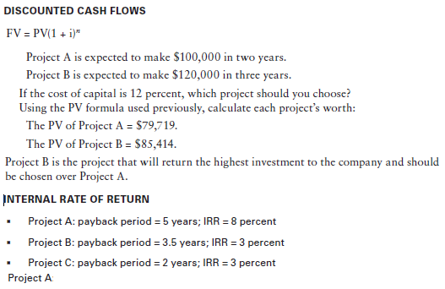
Exercises:
Initiating

Slide 18
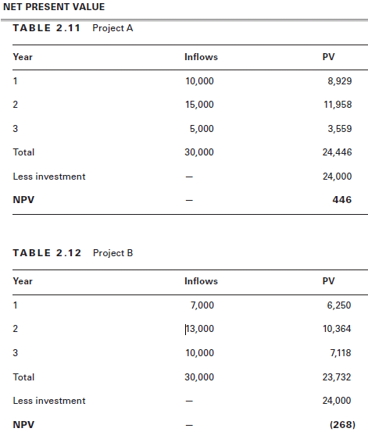
Exercises:
Initiating

Slide 19
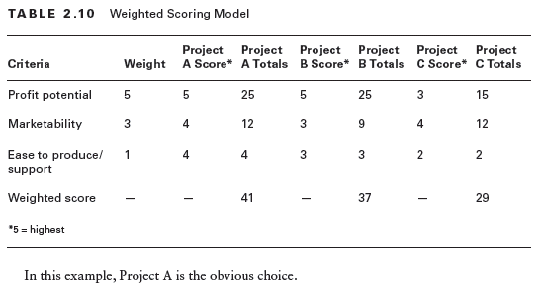
Example:
Initiating

Slide 20
PMP Study Group
www.pmigdl.org
Questions or Comments ?

Slide 21
PMP Study Group
www.pmigdl.org
Thank you
Bibliography:
Kim Heldman - PMP Study Guide 5th Edition .
PMI - PMBok 4th Edition.
Author(s):
Lorena Valentan, PMP®

