Slide 1
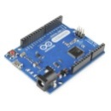
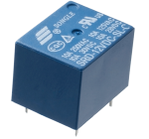


T3
T4
T5
Project Resources:
3 Arduino UNO R3
2 Relays
2 Water level sensor
+ Redundant sensors
D 40m
25m
T2
P2
T1 (Lençol freatico)
P1

