Slide 1

Lab Book 1.0. Waveguides
Student: Diego Alonso Diaz Riega

Slide 2
Instructions
General
SCRIPTS
From GitHub →
  Fork the repo: cccanvas-upv/pic-upv-lab1
  Clone the repo using VSCode
Run the Jupyter Notebook:
  WAVEGUIDES_Student.ipynb
W (width)
W (width)
Core
Core
h_core
h
(height)
Cladding
Cladding
Slab
h_slab
deep waveguide
shallow waveguide

Slide 3
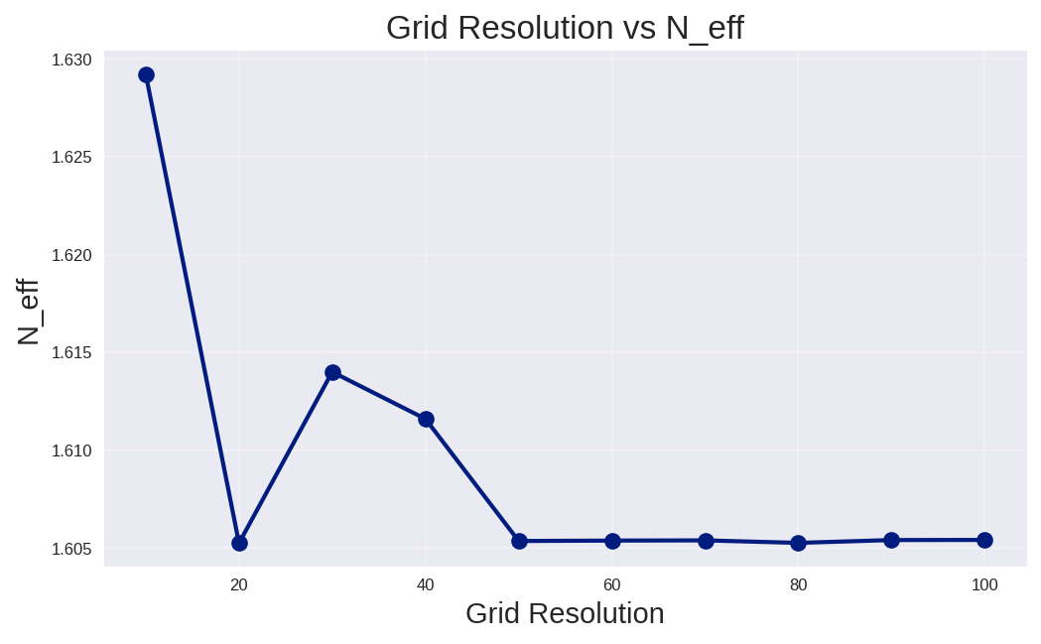
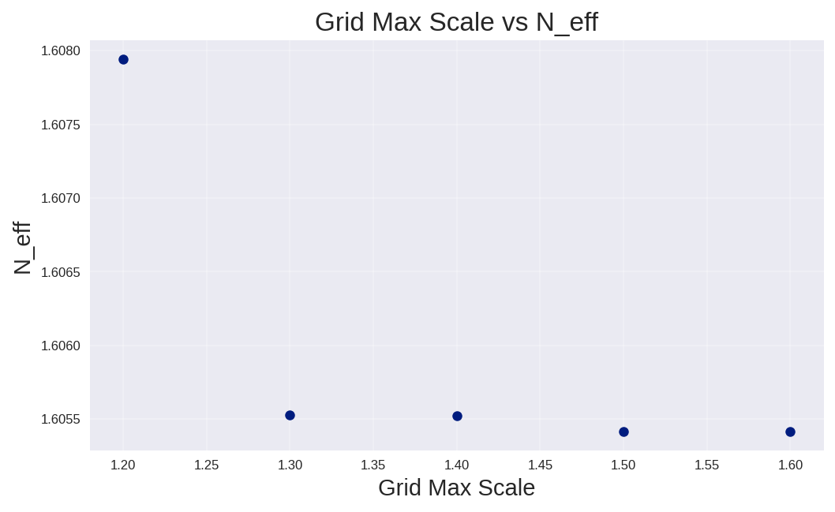
Learning outcome #1 – Convergence tests
DE waveguide, w = 1.2 µm, neff_TE0, wvl 1.55 µm.
deep waveguide
Paste neff_TE0 vs grid_resolution plot here
deep waveguide
Paste neff_TE0 vs max_grid_scaling plot here
These plots show us how the simulation of n_eff converges eventually after a specific value. Grid Resolution and Max Scale controls the discretization of the simulation area by controlling the amount of points in the mesh. As more points in the mesh leads to more processing time, finding the smallest values in which the solutions of the simulation converges is a key step in PIC design. For these results, grid resolution and max scale converges after 20 and 1.3 respectively.

Slide 4
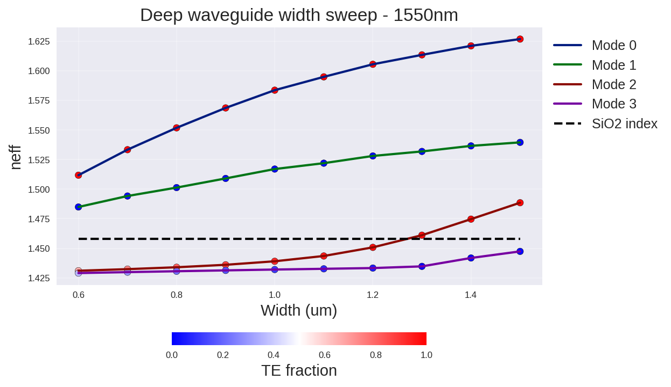
Learning outcome #2 – Width dependence
Width 0.6 - 1.6 µm (step 0.1 µm) – Wavelength 1.55 µm
deep waveguide
Paste plot here
These sweep of simulations tell us that neff increases with width, hence light its better confined in wider waveguides. At around 1.3um, mode 2 could start to lose some energy towards the cladding. Modes obtained are seen to have a stable polarization. Modes 1 and 2 neff’s flattens as width increases. These graph can help us to select a width with good separation of neff between modes to design robust waveguides to avoid phase-mitssmtatch due to fabrication errors.

Slide 5
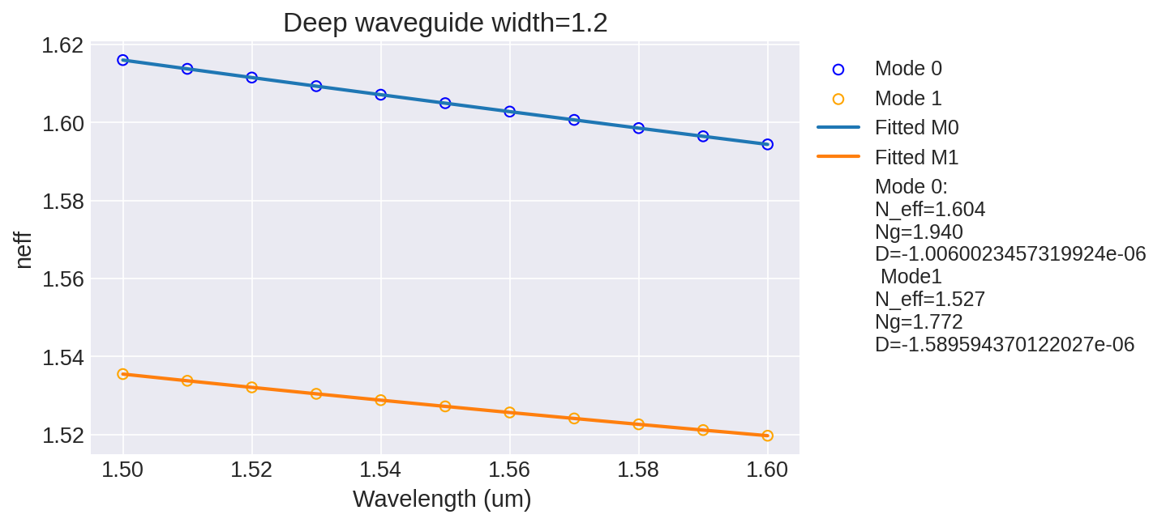
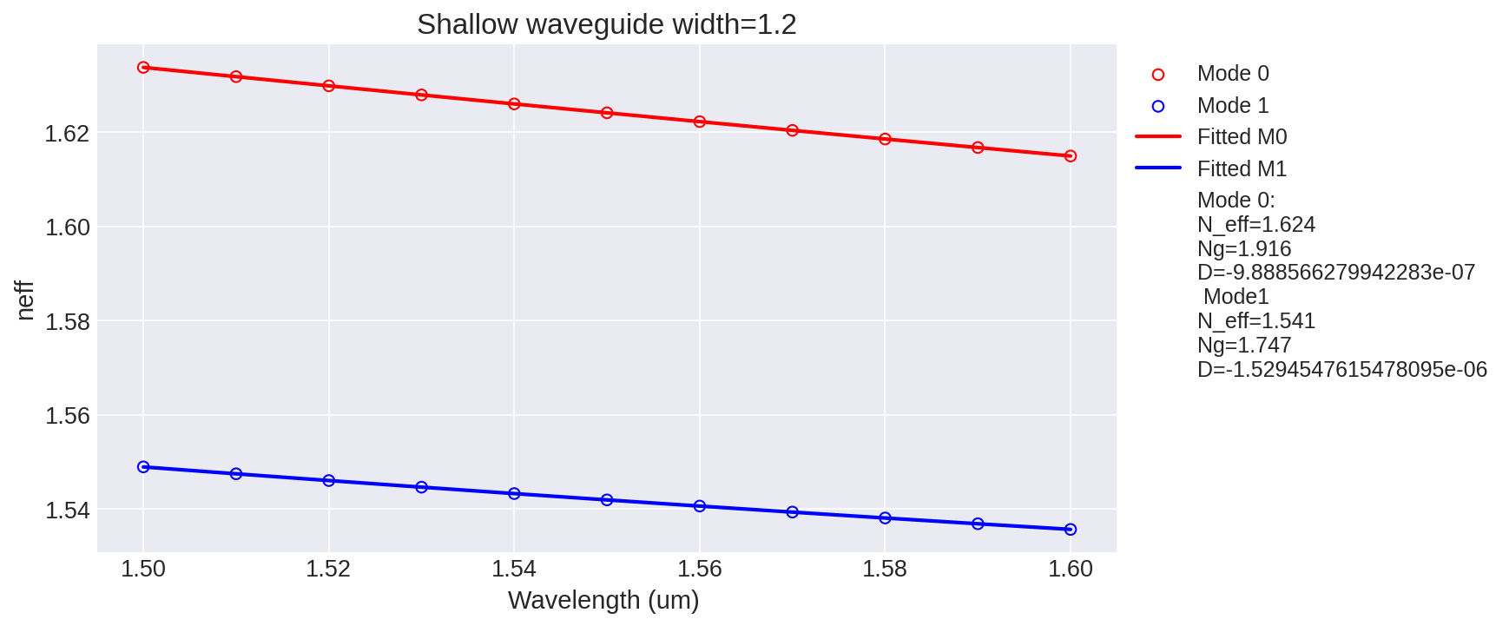
Learning outcome #3 – Waveguide compact model
Let’s model the waveguide using a second order polynomial:
$$n_{eff}\left(λ\right)=n_{1}+n_{2}\left(λ−λ_{0}\right)+n_{3}{\left(λ−λ_{0}\right)}^{2}$$
deep waveguide
neff_TE0 vs $$λ$$ with the second-degree polynomial fit
& neff_TM0 vs $$λ$$ with the second-degree polynomial fit
shallow waveguide
neff_TE0 vs $$λ$$ with the second-degree polynomial fit
& neff_TM0 vs $$λ$$ with the second-degree polynomial fit
slab: 150nm
Find the second-degree polynomial coefficients and relate them with the group index and the dispersion parameter. $$\left\{\begin{aligned}n_{eff}=n_{1} \\ n_{g}=n_{1}−n_{2}λ_{0} \\ D=−\frac{2λ_{0}n_{3}}{c}\left[\frac{s^{2}}{m}\right]\end{aligned}\right.$$
* Units of D in S2/m
Obtaining the compact model allows us to reduce the amount of simulations to obtain parameters to choose a specific wavelength. In these case we can see how shallow waveguides obtained a higher neff at the same wavelength, meaning better confinement. As an example, if we want higher bandwidth for telecommunications we could select the waveguide with less ng (shallow waveguide). Group index is also important for designing structures such as ring resonators, as it is directly related to FSR.

Slide 6
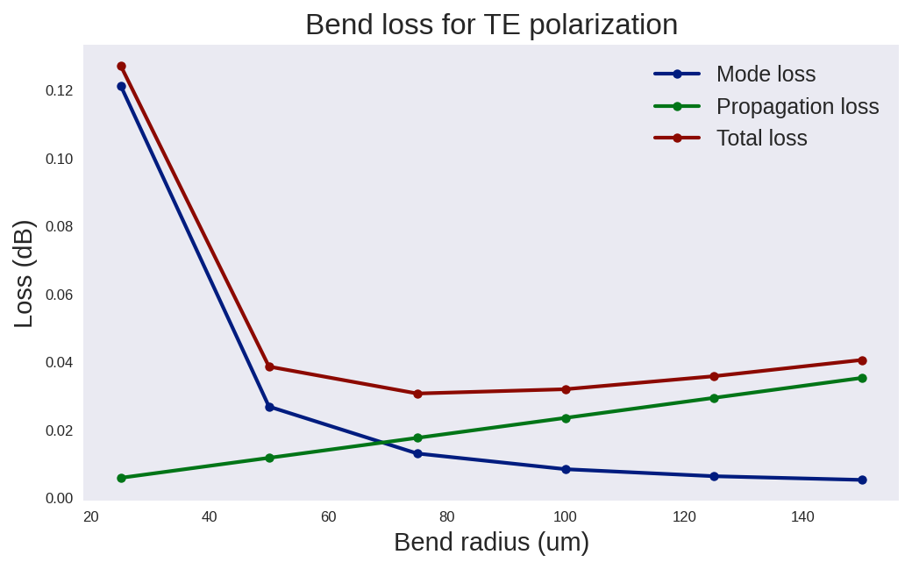
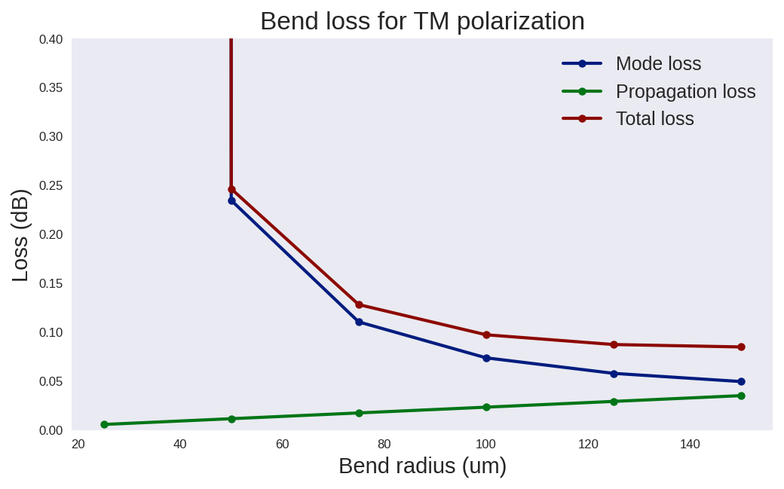
Learning outcome #4 – Bend waveguide radius vs. loss – deep
Find neff_TE0 for wvl 1.55 µm, width 1.0 µm for R=25,50,75,100, 125,150 µm
deep waveguide
Paste dB/90º neff_TE0 & neff_TM0 vs R
$$α\left[\frac{dB}{90°}\right]=$$ $$R\frac{π}{2}α\left[\frac{dB}{µm}\right]$$
This bend loss analysis show us how the overall loss reduces as bend radius gets bigger. We can also notice how a larger radius generates more propagation losses yet the mode loss component reduces. In the case of the TM polarization we see that is much more sensible to smaller radius mainly due mode loss.
Another key detail we can see is that losses initially decrease fast by increasing bend radius, as mode mismatch decays rapidely. After a certain radius, propagation losses become more significant, dominating the total loss.
By considering less than 0.1db as acceptable losses, the minimum radio for TE would be 50um and for TM 100um.

Slide 7
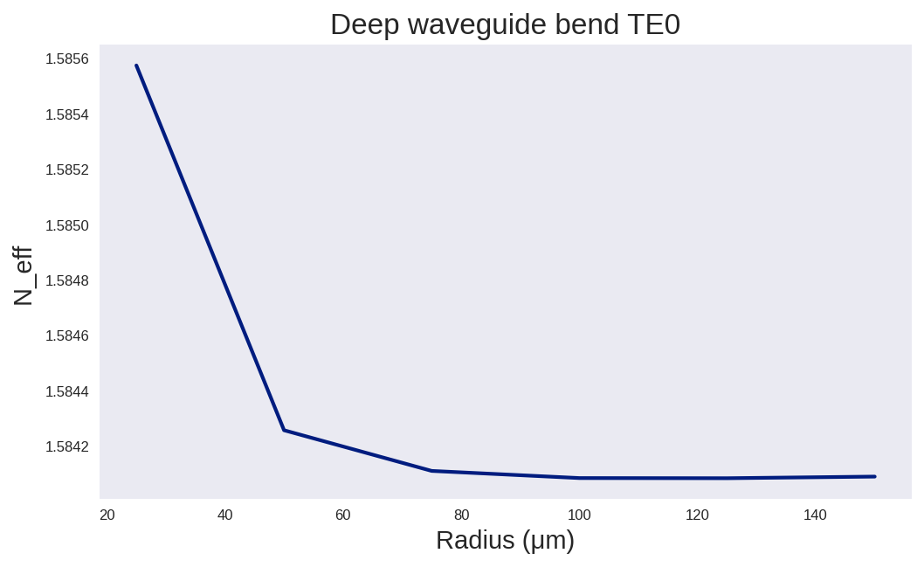
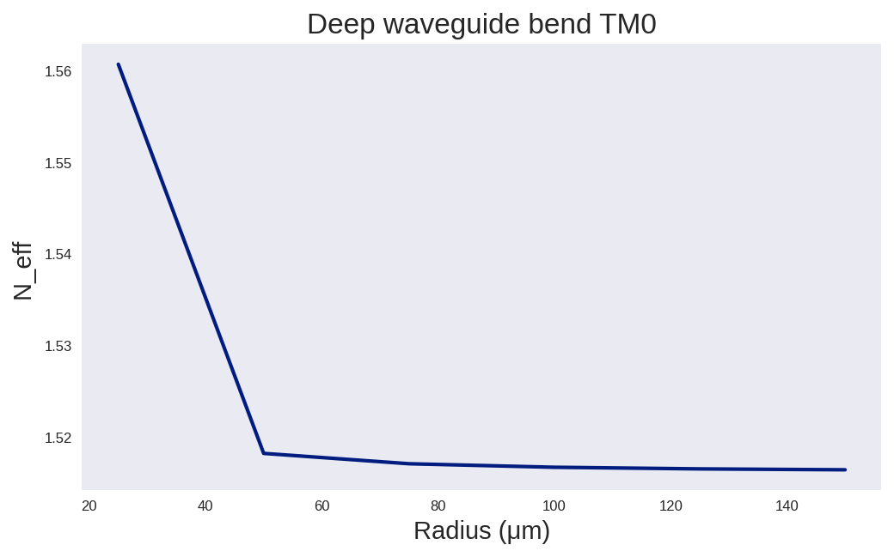
Learning outcome #4 – Bend waveguide radius vs. loss – deep
Find neff_TE0 for wvl 1.55 µm, width 1.0 µm for R=25,50,75,100, 125,150 µm
Regarding the Neff vs wavelength graphs, we can find that in TE0 and TM0, as the bending radius goes higher, the effective index slightly decreases (More in TM than TE). This means that modes become less confined and closer towards the refractive index of the cladding. Nevertheless, variation is small; perhaps even less relevant than the fabrication tolerances.

Slide 8

Thank you

Slide 9
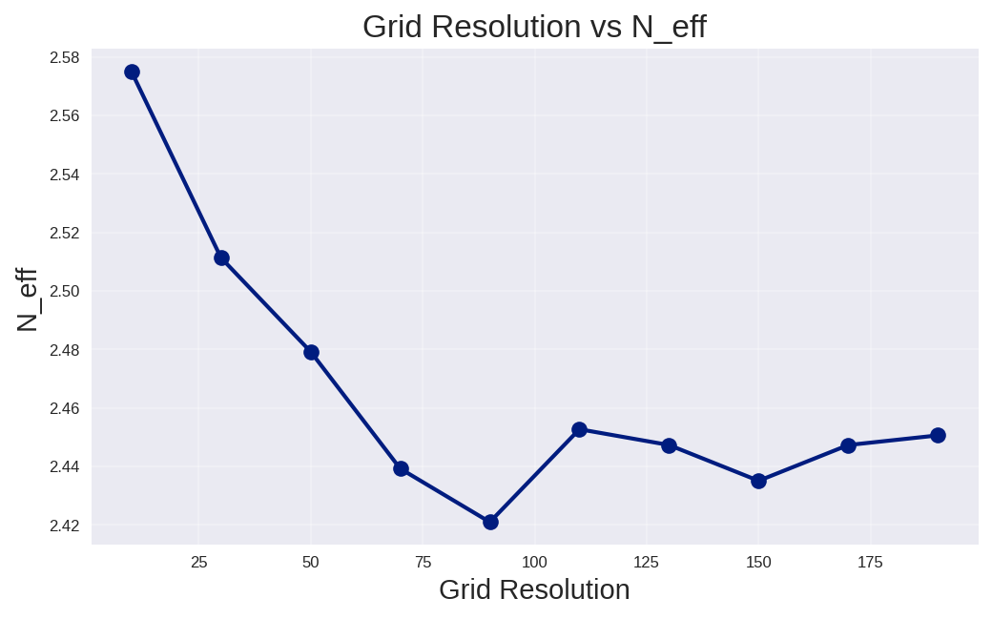
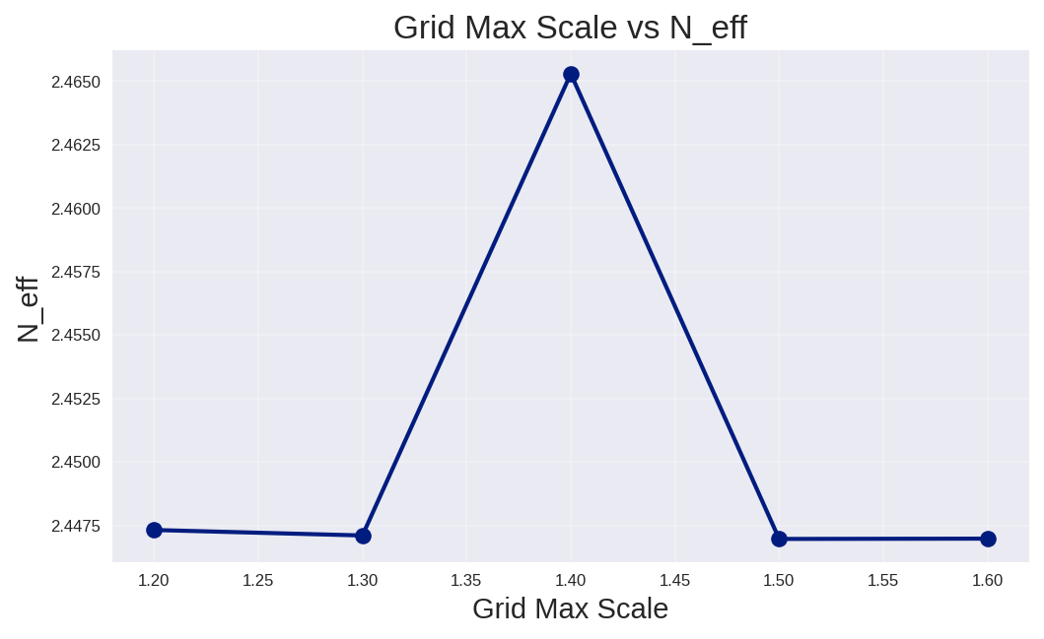
Extra 1 Lo.1 Silicon on insulator
v
$$α\left[\frac{dB}{90°}\right]=$$ $$R\frac{π}{2}α\left[\frac{dB}{µm}\right]$$
- Resolution sweep is more unstable compared to silicon nitrade, it requires more resolution (20vs70)
- Requires smaller max scale (1.2), sweep resultssshows also more unstable compared to silicon nitrade
- Due to resolution been higher, the processing times increases.

Slide 10
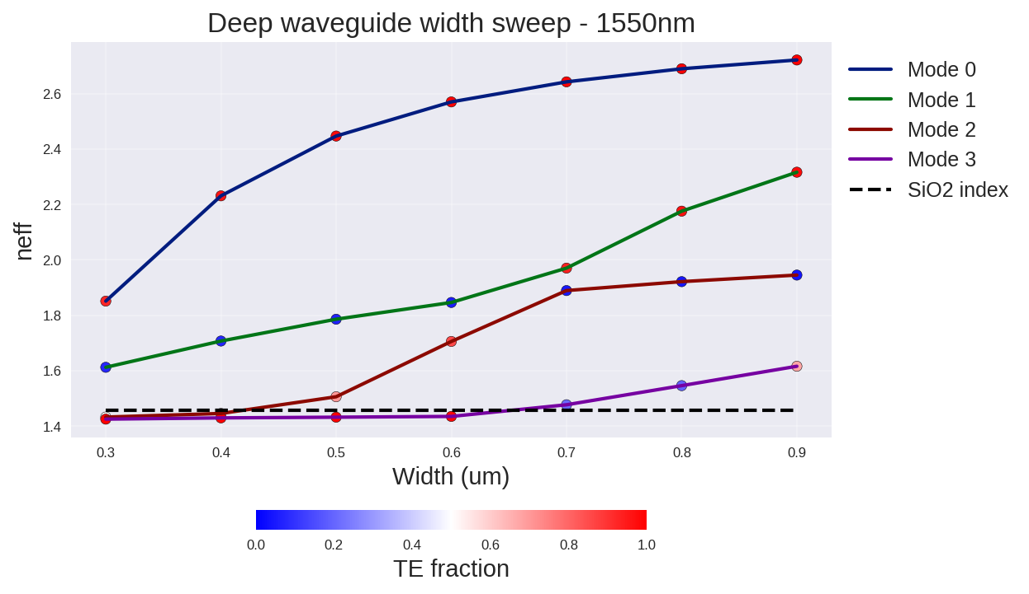
Extra 1 Lo.3 Silicon on insulator
- Smaller geometry.
- Higher neff due to bigger difference between the refractive index of core and cladding.
- Smaller separation between modes.
Modes.
Mode 1 and 2 seem to have experienced a crossing at around 0.7um. Where the polarization was exchanged.

Slide 11
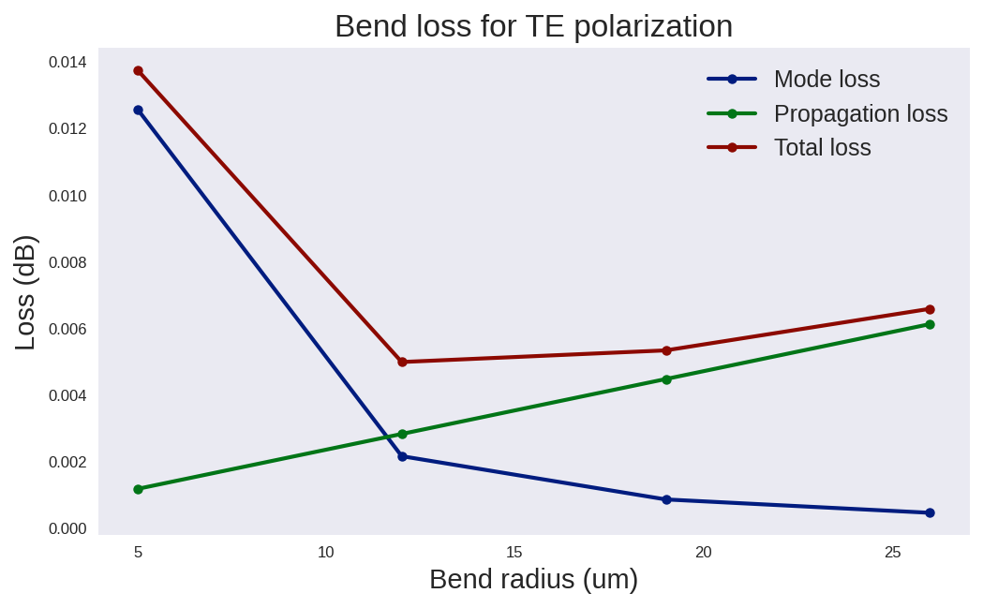
Extra 1 Lo. 4 Silicon on insulator
Compared to silicon nitrade, SOI technology has a better bend radius.
SOI shows to be a better material when the space of a chip is limited.
The Propagation loss grows faster compared to silicon nitrade.
SOI also has a smaller low-loss radius range.
Safe radius around 12-20um

