Slide 2
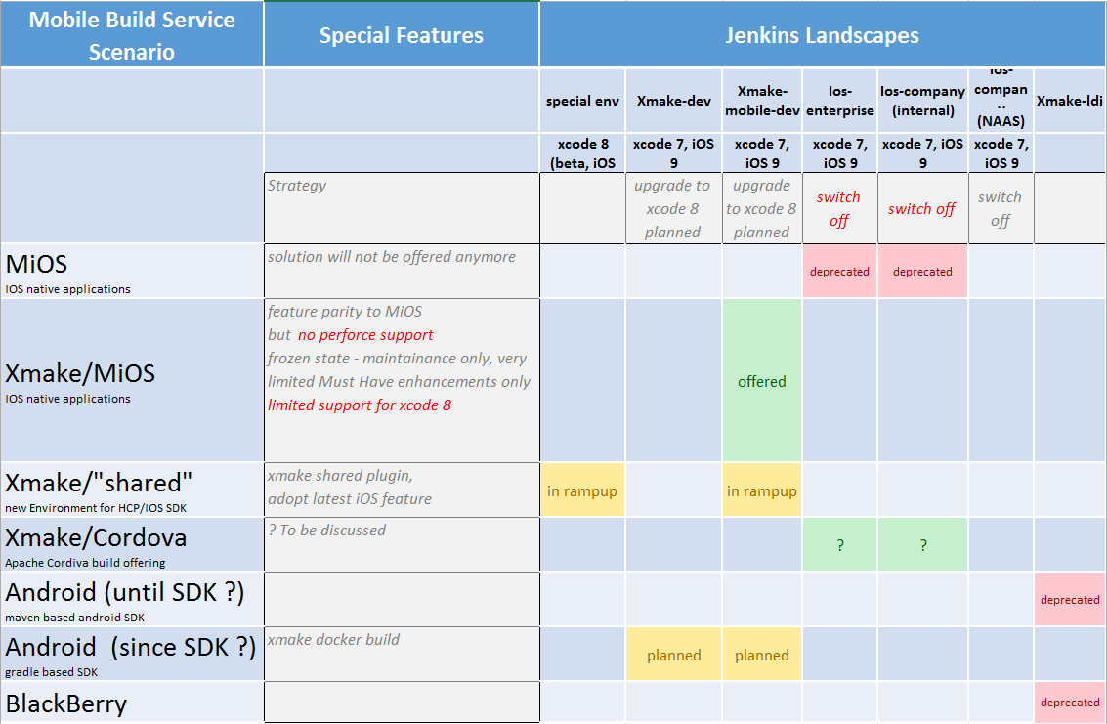
Mobile Landscape Overview
Starts as soon as feature parity with xmake/MiOS
In preparation

Slide 3
Mobile Service Offering
MiOS
Develop xmake/MiOS  DT India
Setup xmake-mobile-dev  DT India
Migration from MiOS to xmake/MiOS (and xmake-mobile-dev) DT India + all using teams
Xmake/MiOS deprecation as soon as xmake/tango appropriate alternative
Must Haves to support iOS9/xcode8 DT India + all using teams
Xmake/ tango
Standardisation of xmake/tango DT India first central environment to build five apps DT India in cooperation with dev teams
Standardization of xmake/tango as get ready for large scale app development support Support required iOS 9/xcode8 features DT India in cooperation with dev teams
Ramp up new xmake/tango based build Service DT India in cooperation with dev teams
Special prototypical build environment for xmake/tango DT India in cooperation with dev teams

Slide 4
Mobile Service Roadmap (iOS)
Wave 16/2
Wave 16/3
Wave 16/4
Pragmatic first offering for Apple/HCP SDK
Same feature scope as before , but running and signing on xcode 8
Deprecated as soon as feature parity in iOS Std
Custom Solutions, if standard offering not sufficient
Improved to ship first 5 Apps
Our Standard Offering for xcode 8 and future
MiOS
MiOS
xcode 7
iOS std
tango
Custom builds
MiOS
tango
Maven
tango
Maven
Common libs
Common lib for siging, OTA, …
Implementation
Maven
xmake
xmake
xmake
Ios-enterprise
Special env
Xmake-mobile-dev
Xmake-mobile-dev
Landscapes
Ios-company
Landscape Consolidation
MiOS to xmake/MiOS Migration

