Slide 1
PROPRIETARY INVESTMENT STRATEGY
Systematic Factor Income Fund
A rules-based equity portfolio with an options income overlay
Strategy overview Confidential, for internal review

Slide 2
CONTENTS
What this overview covers
1
The objective
What the fund is built to do
2
Why this approach
Proven return drivers, plus an income layer
3
The factor strategy
The four traits we select stocks on
4
Building the portfolio
Turning scores into holdings, within strict limits
5
The income overlay
Earning option premium on what we own
6
The data pipeline
Where the numbers come from
7
Execution, risk and results
How we trade, how we control risk, how it tested
8
Operations
Monitoring and infrastructure
9
Status and outlook
Where the build stands today
·
Appendix
Formulas, sources, detailed results, glossary
Systematic Factor Income Fund · confidential
01

Slide 3
01
The objective
A book built to diversify the firm with steady, risk-adjusted returns

Slide 4
1 · THE OBJECTIVE
What the fund is built to do
The mandate is risk-adjusted income and capital preservation, not maximum return
▪ Preserve capital first. Every design choice favours protecting the book over maximising return. Shallow drawdowns matter more than big years.
▪ Produce uncorrelated returns. A return stream that diversifies the firm's core business rather than echoing it.
▪ Stay explainable. A transparent, rules-based strategy with a long research record. Anyone can audit why a position is held.
▪ Earn income steadily. Option premium provides a recurring return that does not depend on the market rising.
Systematic Factor Income Fund · confidential
02

Slide 5
1 · THE OBJECTIVE
What it is, and what it is not
Stating the boundaries up front keeps the strategy disciplined
WHAT IT IS
WHAT IT IS NOT
A systematic factor portfolio
Not a forecasting model
Rules select stocks on proven traits, rebalanced monthly.
No black-box prediction of next month's returns.
An options income layer
Not market timing
Covered calls turn holdings into a recurring income stream.
No attempt to call tops or bottoms. The factors carry the defense.
Broadly diversified
Not concentrated bets
About 20 stocks, with firm limits on any one name or sector.
No large single-stock positions or thematic gambles.
Systematic Factor Income Fund · confidential
03

Slide 6
1 · THE OBJECTIVE
Two engines, one portfolio
A stock portfolio decides what we own. An overlay earns income on it.
FACTOR STOCK PORTFOLIO
earns income on
COVERED-CALL OVERLAY
About 20 stocks chosen on four proven traits, rebalanced monthly
Sell call options on those holdings to collect cash premium
Total return comes from two sources: the stocks we select, and the premium the overlay collects. The overlay also lowers the portfolio's volatility, in exchange for capping gains on any stock that rises sharply.
Systematic Factor Income Fund · confidential
04

Slide 7
02
Why this approach
Built on durable, well-documented sources of return

Slide 8
2 · WHY THIS APPROACH
Why proven factors, not prediction
The strategy relies on effects with a long academic and practical record
▪ Predicting short-term returns is the most crowded game in investing. Thousands of funds chase the same price signals, and any edge erodes quickly.
▪ Factors are paid for bearing risk, not for finding mistakes. That is why they have persisted across decades and across markets, rather than being arbitraged away.
▪ A rules-based portfolio is defensible. It can be explained and audited, and it holds up to scrutiny during a weak stretch. A black-box model cannot.
▪ It fits the mandate. The goal is durable, risk-adjusted income, which is exactly what factor premia and an options overlay are designed to provide.
Systematic Factor Income Fund · confidential
05

Slide 9
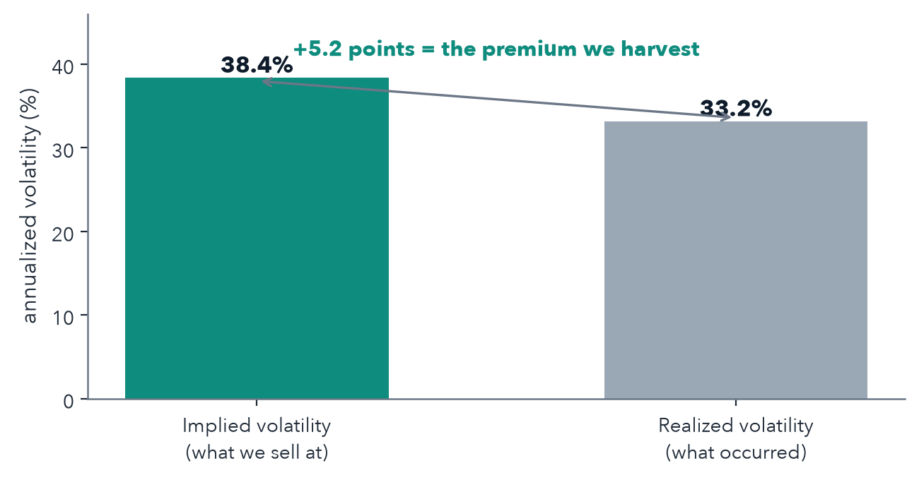
2 · WHY THIS APPROACH
Why an options income overlay
Options consistently trade richer than the price moves that follow
▪ Implied volatility is the price movement the market expects, and it is built into every option's price.
▪ It usually runs higher than the movement that actually occurs. Sellers of options are paid for that gap. It is a persistent, well-studied premium.
▪ We collect it on stock we already own. Selling calls on our holdings turns that premium into income, with no extra capital tied up.
▪ It also smooths the ride. Premium cushions down months and lowers overall volatility, at the cost of capping the occasional very large gain.
Systematic Factor Income Fund · confidential
06

Slide 10
03
The factor strategy
Four traits, measured the same way, combined into one score

Slide 11
3 · THE FACTOR STRATEGY
What we mean by a factor
A factor is a company trait that has historically earned higher long-run returns
We score every stock on four such traits, combine the four scores into one, and hold the highest-ranked names. Each trait below is supported by decades of research.
Quality
profitable, efficient companies
Value
Combined score
Hold the best ~20
inexpensive vs. fundamentals
Momentum
sustained recent strength
Low volatility
steadier price behaviour
Systematic Factor Income Fund · confidential
07

Slide 12
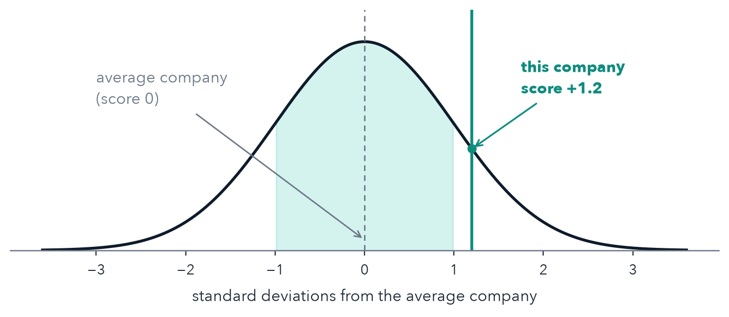
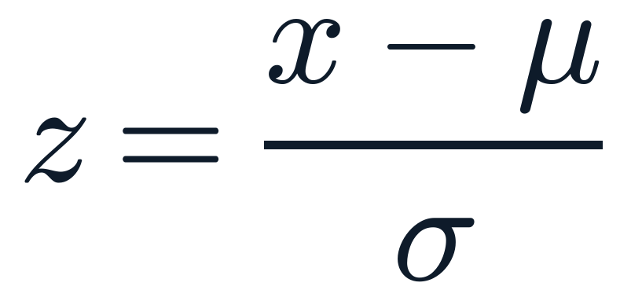
3 · THE FACTOR STRATEGY
Putting every company on the same scale
Each trait becomes a score showing how far a company sits from the average
A score (a z-score) measures how far a company sits above or below the average, counted in standard deviations. A standard deviation is the usual gauge of how spread out a set of numbers is. A score of +1 means one standard deviation better than average. Zero is exactly average.
HOW A SCORE IS CALCULATED
x company value μ the average σ standard deviation
Systematic Factor Income Fund · confidential
08

Slide 13
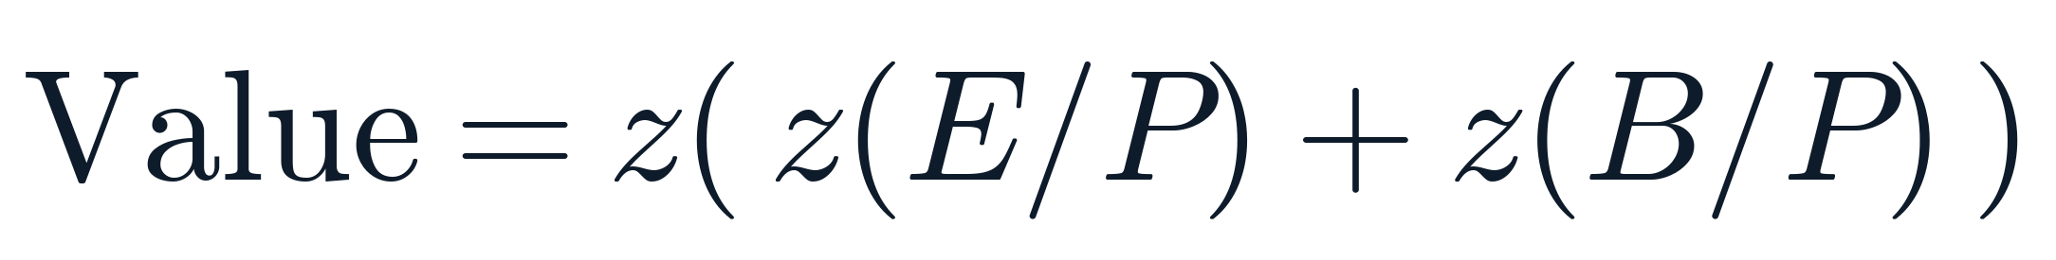
3 · THE FOUR FACTORS
Value: paying less for what you get
Cheaper stocks, judged against company fundamentals, have historically out-returned expensive ones.
▪ Price-to-earnings (P/E): share price divided by yearly earnings per share. It shows how many dollars you pay for one dollar of profit. Lower is cheaper.
▪ Price-to-book (P/B): share price divided by net asset value per share. Lower is cheaper.
▪ We score the inverse (the yield), so a lower price produces a higher Value score.
HOW IT IS MEASURED
E/P earnings yield = 1 ÷ (P/E) B/P book yield = 1 ÷ (P/B) z standardised score
Foundational research: Fama & French (1992, 1993); Basu (1977).
Systematic Factor Income Fund · confidential
09

Slide 14
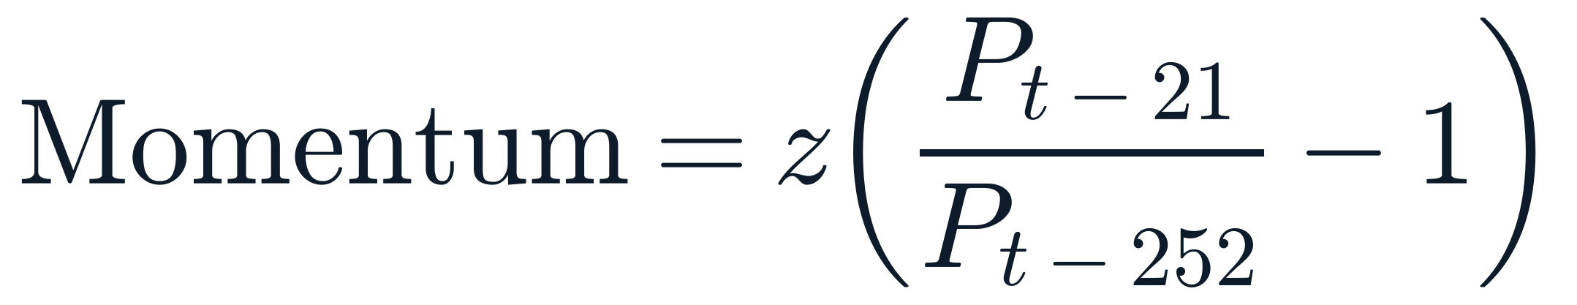
3 · THE FOUR FACTORS
Momentum: recent strength tends to continue
Stocks that have outperformed over the past year have tended to keep outperforming over the next months.
▪ We measure the price change over the past year, skipping the most recent month, which tends to reverse.
▪ P is the share price; the subscripts count trading days back from today (252 days is about one year, 21 is about one month).
▪ The result is then put on the same 0-centred scale as the other factors.
HOW IT IS MEASURED
P share price t−21 ≈ 1 month ago t−252 ≈ 1 year ago z standardised score
Foundational research: Jegadeesh & Titman (1993); Asness, Moskowitz & Pedersen (2013).
Systematic Factor Income Fund · confidential
10

Slide 15
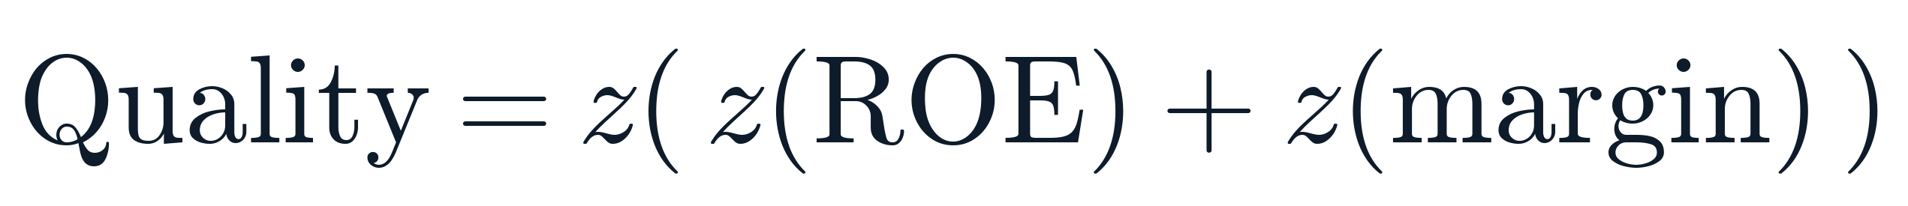
3 · THE FOUR FACTORS
Quality: profitable, well-run businesses
Highly profitable, efficient companies have delivered better risk-adjusted returns over time.
▪ Return on equity (ROE): annual profit as a percentage of shareholders' money. Higher is better.
▪ Margin (gross margin): the share of revenue left after the direct cost of goods. Higher means more pricing power.
▪ Quality companies also tend to hold up better in downturns, which adds a defensive tilt without any market timing.
HOW IT IS MEASURED
ROE return on equity margin gross margin z standardised score
Foundational research: Novy-Marx (2013); Asness, Frazzini & Pedersen (2019); Piotroski (2000).
Systematic Factor Income Fund · confidential
11

Slide 16
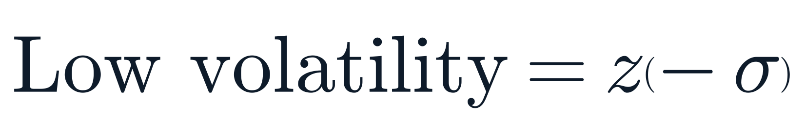
3 · THE FOUR FACTORS
Low volatility: steadier stocks, better risk-adjusted returns
Calmer stocks have historically delivered stronger returns per unit of risk than the most volatile ones.
▪ Volatility (σ): how much a stock's daily price bounces around, measured over the past year. Higher means a wilder ride.
▪ We score the negative of volatility, so a calmer stock receives a higher score.
▪ Together with Quality, this is what makes the portfolio defensive on its own, without a separate risk-off switch.
HOW IT IS MEASURED
σ volatility = the size of daily price swings z standardised score
Foundational research: Ang, Hodrick, Xing & Zhang (2006); Frazzini & Pedersen (2014); Baker, Bradley & Wurgler (2011).
Systematic Factor Income Fund · confidential
12

Slide 17
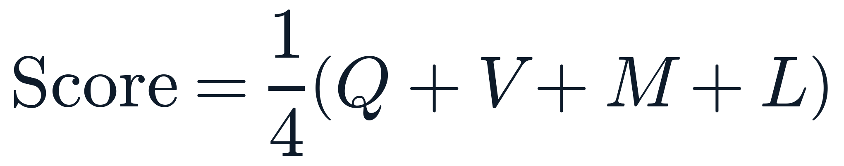
3 · THE FACTOR STRATEGY
Combining the four into one score
Equal weight, with safeguards that keep the comparison fair and honest
▪ Equal weight to start. Each factor counts for one quarter of the score. With no strong reason to favour one, equal weighting is the most defensible starting point.
▪ Extreme values are trimmed before scoring. A handful of outliers cannot distort the scale, so all four factors genuinely count equally.
▪ Only public information is used. A company's financials enter the score only once they have actually been filed, so the historical test never sees the future.
THE COMBINED SCORE
Q, V, M, L the four factor scores
The highest combined scores become the portfolio.
Systematic Factor Income Fund · confidential
13

Slide 18
04
Building the portfolio
Turning scores into holdings, inside strict risk limits

Slide 19
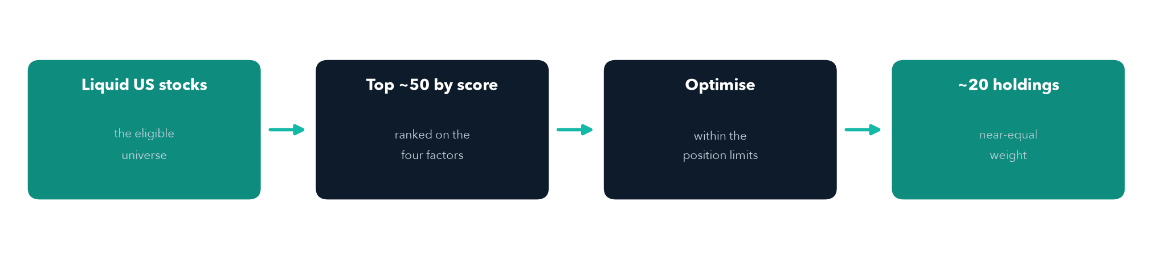
4 · BUILDING THE PORTFOLIO
Turning scores into a portfolio
From the whole market down to about twenty holdings
Each month the four-factor score ranks the eligible universe. An optimiser funds the best-scoring names subject to the limits, then trims anything too small to hold.
Systematic Factor Income Fund · confidential
14

Slide 20
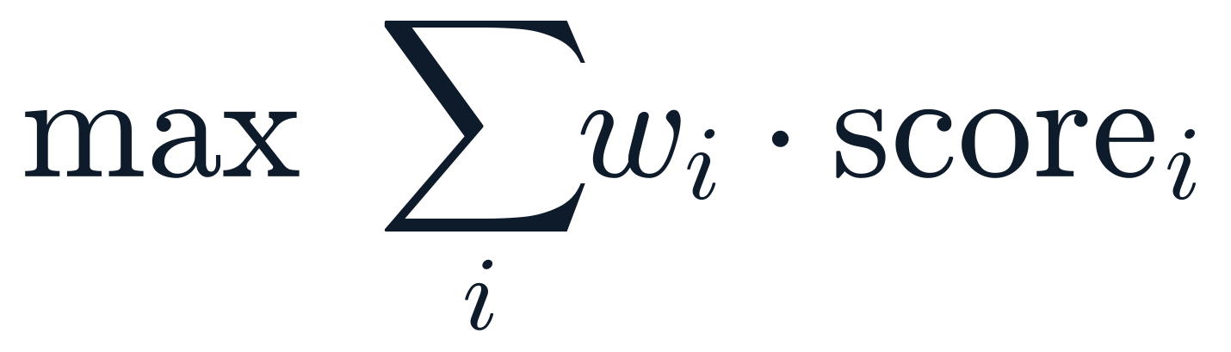
4 · BUILDING THE PORTFOLIO
From scores to holdings
The scores choose the names. Hard limits keep the portfolio diversified.
▪ Rank by combined score. The top-scoring names are the candidates to hold.
▪ Maximise total score, subject to limits. A standard optimiser sets the weights to favour the best-scoring names while respecting every limit below.
▪ The result is roughly equal-weight across about 20 stocks. Equal-weight factor portfolios have travelled well in out-of-sample testing.
WHAT THE OPTIMISER SOLVES
w each stock's weight score its combined factor score
In plain terms: put the most money in the best-scoring names, within the limits.
Systematic Factor Income Fund · confidential
15

Slide 21
4 · BUILDING THE PORTFOLIO
The limits are the risk controls
Diversification is enforced by rule, not left to chance
5% maximum per stock
30% maximum per sector
No single name can dominate. This is what sets the holding count near 20.
No single industry can take over the book.
~20 holdings, near equal weight
95% invested, 5% cash
Broad enough to diversify, focused enough to matter.
A stable allocation at all times, with a small cash buffer.
Systematic Factor Income Fund · confidential
16

Slide 22
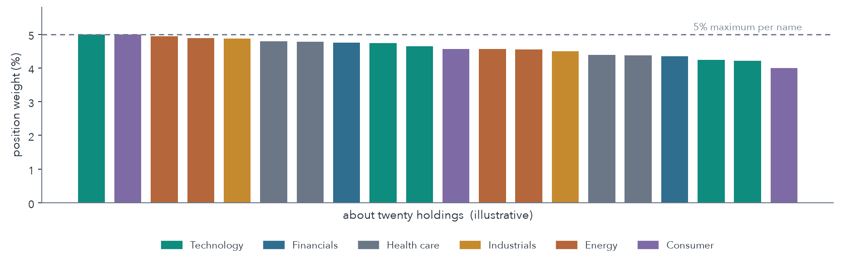
4 · BUILDING THE PORTFOLIO
What the portfolio looks like
About twenty near-equal positions, capped and spread across sectors
Illustrative. No single name exceeds 5%, no sector exceeds 30%, and every position clears a minimum size.
Systematic Factor Income Fund · confidential
17

Slide 23
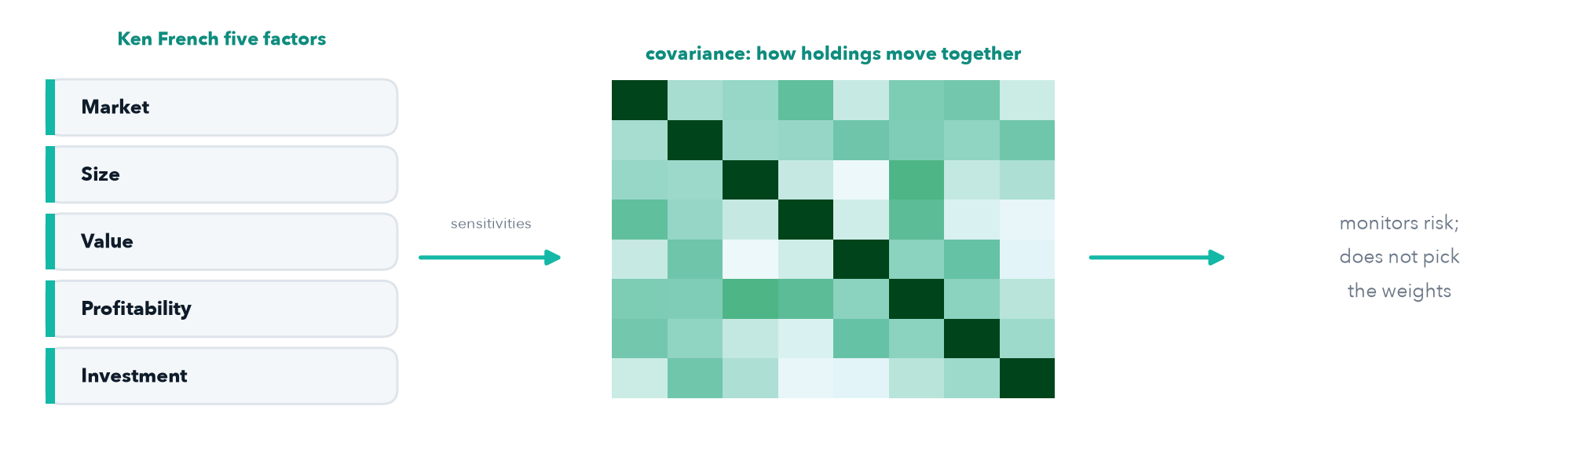
4 · BUILDING THE PORTFOLIO
How we model risk
A factor model estimates how the holdings move together
▪ Built from the Ken French five-factor data. Daily returns of the market, size, value, profitability, and investment factors.
▪ It measures co-movement, not direction. Each stock's sensitivity to those factors gives a covariance matrix: how the holdings tend to move together, and which names have too little history to trust.
▪ Used to monitor, never to choose. The factor scores pick the holdings; this model only reports their risk. It deliberately does not set the weights.
Systematic Factor Income Fund · confidential
18

Slide 24
05
The income overlay
Earning option premium on the stocks we already own

Slide 25
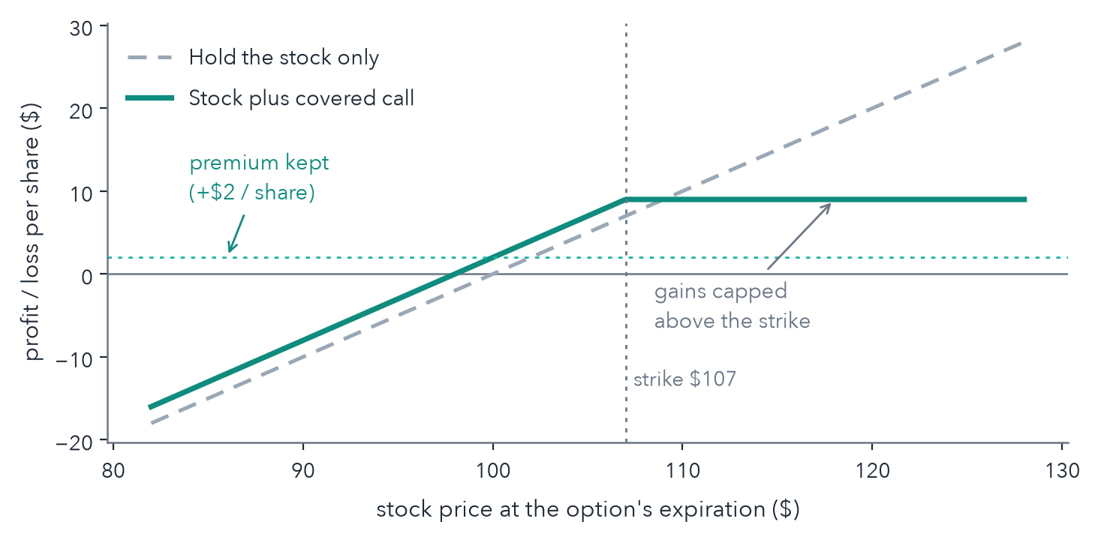
5 · THE INCOME OVERLAY
Selling covered calls
We sell call options on our holdings and keep the cash premium
▪ Call option: a contract that lets its buyer purchase our stock at a fixed “strike” price before a set date. We sell that right.
▪ Premium: the cash the buyer pays us up front. We keep it in every outcome.
▪ If the stock stays below the strike, the option expires worthless and we simply keep the premium and the stock.
▪ If it rises above the strike, the stock is sold at the strike. We keep the premium and the gain up to that point, but give up the gain beyond it.
Systematic Factor Income Fund · confidential
19

Slide 26
5 · THE INCOME OVERLAY
Choosing which call to sell
The rule is consistent across every stock, with no discretion
▪ Delta, about 0.30. Delta estimates the chance the option ends up being exercised. Targeting 0.30 means roughly a 30% chance the stock is sold at the strike. Low enough to keep most of the upside, high enough to collect meaningful premium.
▪ Strikes set by probability, not a fixed percentage. Using delta adapts the strike to each stock automatically. A calm stock and a volatile one get the same ~30% odds.
▪ Expiring in 30 to 45 days. Long enough to collect a worthwhile premium, short enough to refresh monthly with the rest of the portfolio.
▪ Sold at the quoted middle price. We take a fair price from the live option market rather than chasing.
Systematic Factor Income Fund · confidential
20

Slide 27
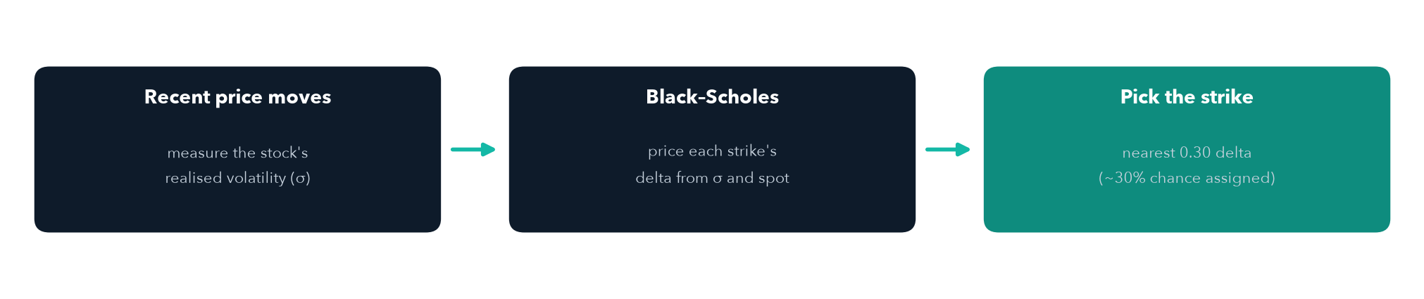
5 · THE INCOME OVERLAY
Estimating the volatility behind the strike
The option feed gives prices but no Greeks, so we work out the delta ourselves
We estimate each stock's volatility from its recent daily price movement, annualised, feed that into the Black–Scholes formula to get a delta for every listed strike, then sell the call nearest 0.30 delta. We do not rely on a market-quoted implied volatility; the estimate from realised volatility is the conservative, always-available basis.
Systematic Factor Income Fund · confidential
21

Slide 28
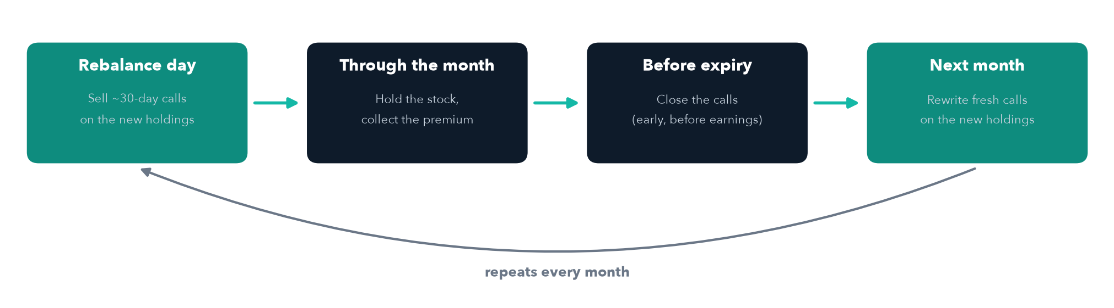
5 · THE INCOME OVERLAY
Managing the options through the month
One simple monthly cycle, repeated against each new set of holdings
▪ Closed early before earnings, then rewritten afterward, because an earnings announcement can cause a large, unpredictable jump.
▪ Re-entered only if still wanted. If a stock is sold through an option, it is bought back only when it still ranks well, never chased above the strike.
Systematic Factor Income Fund · confidential
22

Slide 29
5 · THE INCOME OVERLAY
An honest limit on coverage
The overlay covers most, but not all, of the portfolio
▪ Options trade in blocks of 100 shares. A stock position must be at least 100 shares before we can sell a call against it.
▪ Some positions are too small to cover. On higher-priced stocks, a normal position can fall short of 100 shares, so part of the book earns no premium.
▪ This is a known constraint, not a flaw in the idea. Position sizing and the investable amount determine how much of the book the overlay can reach, and that is managed deliberately.
Systematic Factor Income Fund · confidential
23

Slide 30
06
The data pipeline
Where the numbers come from, and how they stay trustworthy

Slide 31
6 · THE DATA PIPELINE
The same sequence runs every trading day
Fully automated, and checked against the broker before any order is placed
Gather data
Score stocks
Build portfolio
Add overlay
Risk checks
Place orders
prices and financials
the four factors
weights and limits
covered calls
pre-trade review
send to broker
The portfolio is rebalanced once a month. The rest of the time the system monitors positions, manages the options, and keeps its records aligned with the broker.
Systematic Factor Income Fund · confidential
24

Slide 32
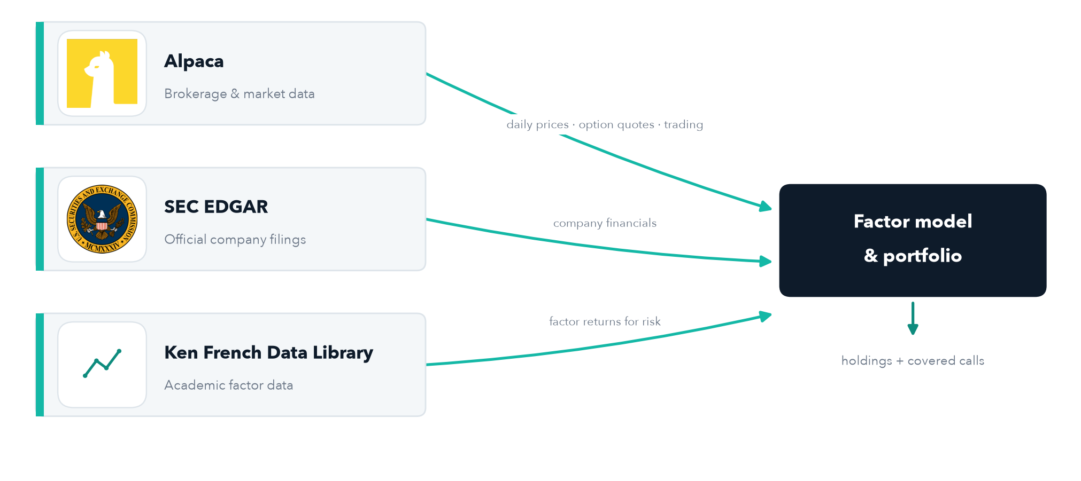
6 · THE DATA PIPELINE
Three data sources, each with a clear job
A small, low-cost, auditable set of inputs feeding the model
Systematic Factor Income Fund · confidential
25

Slide 33
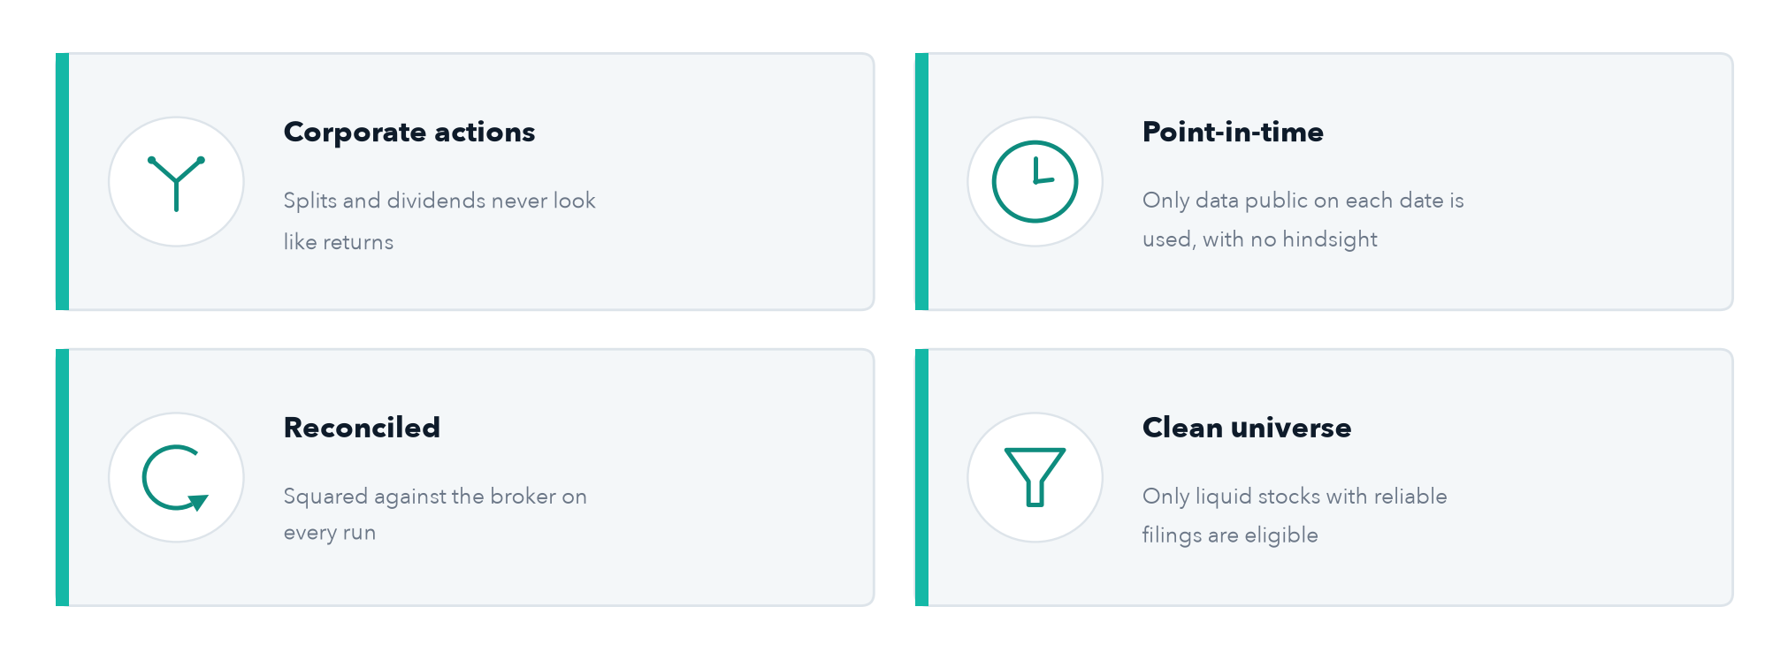
6 · THE DATA PIPELINE
Keeping the data trustworthy
The unglamorous half of the work, and where many strategies quietly fail
Systematic Factor Income Fund · confidential
26

Slide 34
07
Execution, risk and results
How orders are placed, how risk is controlled, and how it tested

Slide 35
7 · EXECUTION AND RISK
How orders reach the market
Order type is chosen to balance certainty of filling against control of price
Situation | Order type | Why
Large, highly liquid stock | Market order | Fills immediately, with negligible price impact
Less liquid stock | Marketable limit | Fills the same session while bounding the price paid
Selling a covered call | Limit at mid-price | Takes a fair premium without chasing the market
Closing a call near expiry | Market order | Prioritises certainty of closing the position
▪ Timing. The monthly rebalance runs mid-session, leaving a liquid window before the close for orders to fill.
▪ Unfilled orders. Cancelled after a short window and completed at the next run. Nothing is left resting overnight.
Systematic Factor Income Fund · confidential
27

Slide 36
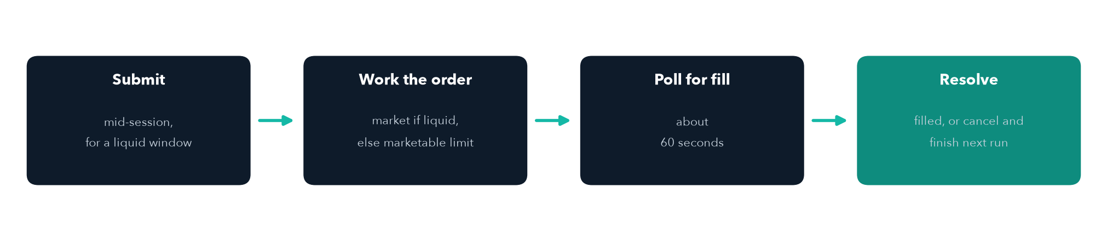
7 · EXECUTION AND RISK
How an order is worked
Fill quickly in-session, and never leave an order resting overnight
▪ Marketable limits. For a less-liquid name the limit is set just across the spread, so the order fills the same session instead of resting unfilled at the mid-price.
▪ Reconciled first. Before any order, the system squares its own records against the broker, and halts if the broker cannot be reached.
Systematic Factor Income Fund · confidential
28

Slide 37
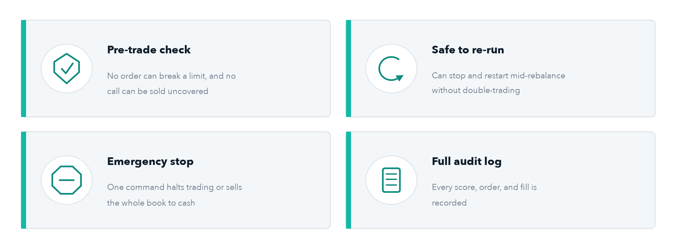
7 · EXECUTION AND RISK
Controlling risk
For a capital-preservation mandate, this is the most important part
Systematic Factor Income Fund · confidential
29

Slide 38
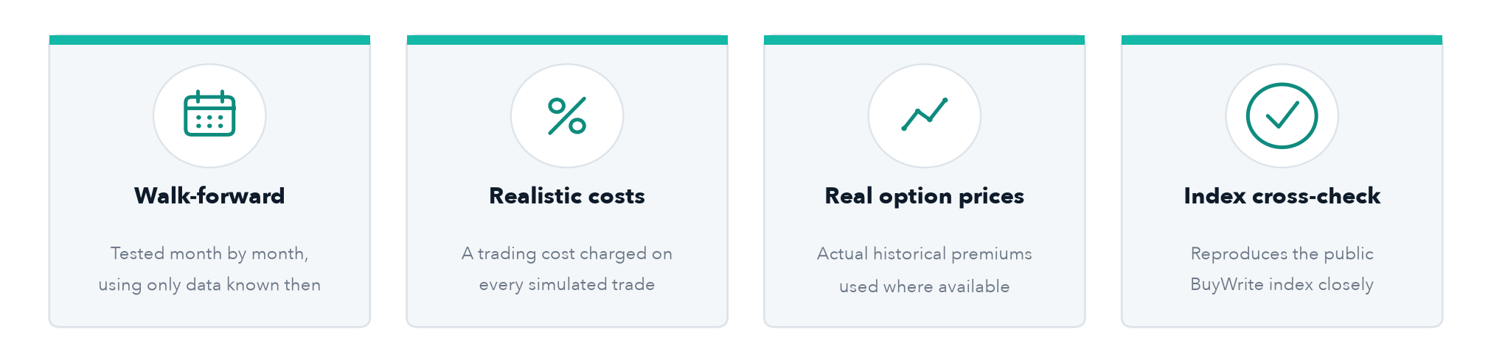
7 · EXECUTION AND RISK
How the strategy was tested
A walk-forward simulation over 2021 to 2026, designed to resist over-fitting
Each month, the strategy runs on only the information available at the time, exactly as it would run live. The results, and their limitations, follow.
Systematic Factor Income Fund · confidential
30

Slide 39
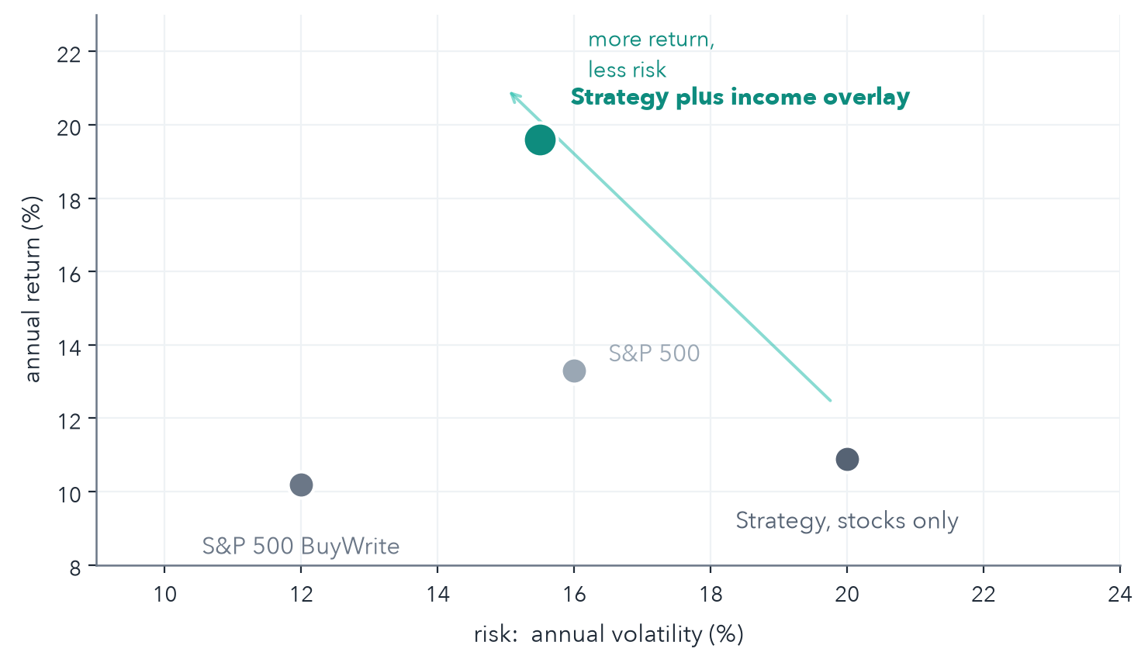
7 · RESULTS
How the strategy performed in testing
The most dependable result is lower risk: smaller swings and shallower losses than the market
−16.7%
Worst loss (drawdown) in the test, vs. −24% for the S&P 500
15.5%
Volatility, the size of the swings, vs. 16% for the S&P 500
1.24
Risk-adjusted return in the test, vs. 0.87 for the S&P 500
Simulated and paper-traded results, not live capital. Sharpe = return per unit of risk; drawdown = worst peak-to-trough loss. Limitations next.
Systematic Factor Income Fund · confidential
31

Slide 40
7 · RESULTS
How to read these results
The results are encouraging, but they carry real limitations
▪ Simulated, not live. A historical simulation and paper trading, not a track record, and not a prediction of future returns.
▪ One favourable period. The 2021 to 2026 window had specific conditions. A sustained bull market would likely show lower relative returns.
▪ Premium is partly modeled. Where real option prices are unavailable, the premium is estimated, so the overlay's contribution is uncertain.
▪ Costs are estimates. Real trading costs, taxes, and slippage may run higher than modeled.
▪ Mild hindsight in the data. Some company financials are restated over time, making the factor results modestly optimistic.
▪ Figures are unlevered. Leverage would scale both returns and losses: larger gains, but larger drawdowns.
The real verdict comes from live paper trading on real prices, not from more simulation.
Systematic Factor Income Fund · confidential
32

Slide 41
08
Operations
A live, monitored system, running on its own

Slide 42
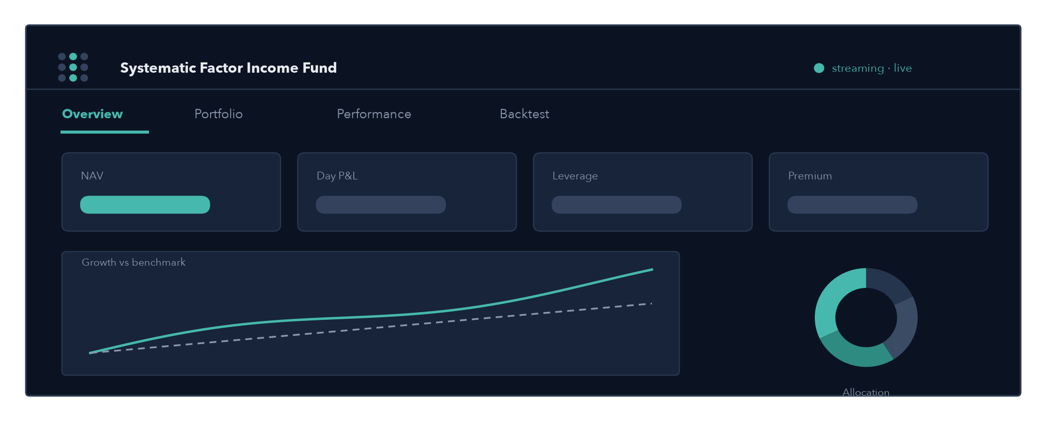
8 · OPERATIONS
Monitoring: a live dashboard
One page, four tabs, updating itself from the live account
Overview · Portfolio · Performance · Backtest account value, holdings vs. target, factor tilt, growth vs. benchmarks, risk, and execution costs. Served read-only behind a password.
Systematic Factor Income Fund · confidential
33

Slide 43
8 · OPERATIONS
Infrastructure and safeguards
Reliable, low-maintenance plumbing
▪ Runs unattended in the cloud. Hosted on a dedicated server that runs the daily process and the dashboard on a fixed schedule.
▪ Restart-safe. Every component restarts automatically, with a watchdog that checks the system is alive.
▪ Backed up nightly. The operational database is copied to cloud storage each night, with a retention policy.
▪ Alerts by email. The system emails on the events that matter, such as a failed run or a risk check that blocks a trade.
▪ Shared securely. The dashboard is viewable read-only behind a password.
Systematic Factor Income Fund · confidential
34

Slide 44
09
Status and outlook
Where the build stands, and what remains before live capital

Slide 45
9 · STATUS AND OUTLOOK
Where the build stands today
Built, tested, and paper-trading, with one verification step ahead
▪ The full strategy is built and tested. Data, factor scoring, portfolio construction, the options overlay, execution, and risk controls are all in place.
▪ It is running on a paper account. The system trades a simulated account with live market data, monitored by the dashboard.
▪ The remaining step is live-paper verification. Confirm the full strategy fills, prices, and behaves correctly on the real account before any discussion of live capital.
Systematic Factor Income Fund · confidential
35

Slide 46
9 · STATUS AND OUTLOOK
Risks and what comes next
Risks we monitor
What comes next
▪ Crowding in factors
· tracked by per-factor performance
▪ Capped upside in strong rallies
· the deliberate cost of the overlay
▪ Data-source reliability
· clean universe, reconciled each run
▪ The gap from test to live
· what paper trading is there to close
▪ Live-paper verification
· the immediate milestone
▪ Refine factor weights
· after more live evidence
▪ Broaden the income overlay
· more coverage, additional option strategies
▪ Define the go-live criteria
· before any real capital is committed
Systematic Factor Income Fund · confidential
36

Slide 47
IN SUMMARY
A disciplined factor portfolio
Four proven traits, computed transparently and weighted equally.
An income overlay that lowers risk
Covered calls harvest a persistent premium and smooth the ride.
Built for capital preservation
Firm diversification limits, a pre-trade risk check, and an emergency stop.
Tested, and honest about its limits
Strong risk-adjusted returns in a rigorous simulation, with the assumptions stated.
Live and monitored
Running on a paper account, one verification step from the go-live discussion.
Systematic Factor Income Fund · confidential
37

Slide 48
10
Appendix
Formulas, sources, detailed results, and a glossary

Slide 49
APPENDIX · A1
Factor formulas
VALUE
MOMENTUM
QUALITY
LOW VOLATILITY
z(·) standardised score E/P, B/P earnings & book yield ROE return on equity margin gross margin σ volatility
Systematic Factor Income Fund · confidential
38

Slide 50
APPENDIX · A2
Selected research
Value
· Fama & French (1992), The Cross-Section of Expected Stock Returns
· Fama & French (1993), Common Risk Factors in Stocks and Bonds
· Basu (1977), Investment Performance in Relation to P/E Ratios
Momentum
· Jegadeesh & Titman (1993), Returns to Buying Winners and Selling Losers
· Carhart (1997), On Persistence in Mutual Fund Performance
· Asness, Moskowitz & Pedersen (2013), Value and Momentum Everywhere
Quality
· Novy-Marx (2013), The Gross Profitability Premium
· Asness, Frazzini & Pedersen (2019), Quality Minus Junk
· Piotroski (2000), Value Investing and the F-Score
Low volatility
· Ang, Hodrick, Xing & Zhang (2006), The Cross-Section of Volatility
· Frazzini & Pedersen (2014), Betting Against Beta
· Baker, Bradley & Wurgler (2011), Benchmarks as Limits to Arbitrage
Options premium
· Whaley (2002), Return and Risk of the CBOE BuyWrite Index
· Carr & Wu (2009), Variance Risk Premiums
· Bakshi & Kapadia (2003), Delta-Hedged Gains and the Volatility Premium
Systematic Factor Income Fund · confidential
39

Slide 51
APPENDIX · A3
Detailed results, 2021 to 2026
Strategy figures from the walk-forward simulation; benchmarks from index history
 | Annual return | Volatility | Sharpe | Max drawdown | Premium / yr
S&P 500 | +13.3% | 16.0% | 0.87 | −23.9% | —
S&P 500 BuyWrite (BXMD) | +10.2% | 12.0% | 0.87 | −21.6% | —
Strategy, stocks only | +10.9% | ~20% | 0.62 | −26% | —
Strategy + covered calls | +19.6% | 15.5% | 1.24 | −16.7% | ~25%
Strategy + put-wheel (optional) | +18.7% | 12.9% | 1.40 | −12.8% | —
Benchmarks (S&P 500 and BXMD) computed from total-return index history over Sep 2021 to Jun 2026, monthly. Strategy figures are from the walk-forward backtest on a 1x (unlevered) basis. All results are simulated or paper-traded, not live capital.
Systematic Factor Income Fund · confidential
40

Slide 52
APPENDIX · A4
The volatility premium, measured
The premium the overlay collects is real and persistent
+5.2 pts
78%
1.16x
22%
Implied volatility sold (38.4%) over realized (33.2%)
of months with implied above realized volatility
average implied-to-realized volatility ratio
of holdings called away (within the 30% target)
Most of the premium compensates the risk of occasional large single-stock moves. The 30-delta strike is chosen to cap exactly that risk, which is why the overlay improves returns even after accounting for it.
Systematic Factor Income Fund · confidential
41

Slide 53
APPENDIX · A5
Key parameters
Every setting lives in one configuration file, not scattered through the code
Setting | Value | Setting | Value
Universe | liquid US stocks | Max per stock | 5%
Holdings | about 20 | Max per sector | 30%
Factor weights | 25% each | Invested / cash | 95% / 5%
Momentum window | 12 months less 1 | Volatility window | 12 months
Call delta target | 0.30 | Call expiry | 30 to 45 days
Rebalance | monthly | Benchmarks | S&P 500, BXMD
Systematic Factor Income Fund · confidential
42

Slide 54
APPENDIX · A6
Glossary
Factor
Premium
A company trait linked to higher long-run returns
The cash received for selling an option
z-score
Strike
How far a value sits from the average, in standard deviations
The fixed price at which an option can be exercised
P/E, P/B
Delta
Price vs. earnings, and price vs. net asset value
An option's rough chance of being exercised
ROE
Implied volatility
Profit as a percentage of shareholders' money
The price movement the market expects, priced into options
Volatility
Assignment
How much a price moves around, a measure of risk
Being required to sell the stock when a call is exercised
Call option
Sharpe ratio
The right to buy a stock at a set price by a set date
Return earned per unit of risk taken
Systematic Factor Income Fund · confidential
43

