Slide 1
COULD A PE FUND
TAKE DOMINO'S
PRIVATE?
Domino's Pizza Group plc (LSE: DOM)
A five-year leveraged buyout & investment committee case
INDEPENDENT | FINANCIAL MODELLING PORTFOLIO | NOVEMBER 2026

Slide 2
DPG / PUBLIC-TO-PRIVATE
02 / EXECUTIVE SUMMARY
Investment conclusion
Under a 30% takeover premium, the model does not clear a 20% gross sponsor IRR hurdle.
Acquisition EV
Sponsor equity
Gross MOIC
Gross sponsor IRR
£1445.9m
£1083.5m
1.44x
7.5%
10.6x LTM EBITDA
3.0x initial senior debt
Five-year hold
Target hurdle: 20%
RECOMMENDATION
Do not proceed at the illustrative 30% premium.
Public information as of 6 Nov 2026 | Independent educational analysis
2

Slide 3
DPG / PUBLIC-TO-PRIVATE
03 / COMPANY
Business profile
Domino's Pizza Group plc is the UK & Ireland master franchise operator, not US-listed DPZ.
Reported revenue FY2025
Underlying EBITDA FY2025
Network at FY2025
£685.4m
£133.9m
1,399
+3.1% versus FY2024
-6.6% year on year
UK & Ireland stores
Economic model
Franchise network, royalties, supply chain and operational support.
Competitive position
Large home-market pizza share, with digital engagement and loyalty rollout.
Public information as of 6 Nov 2026 | Independent educational analysis
3

Slide 4
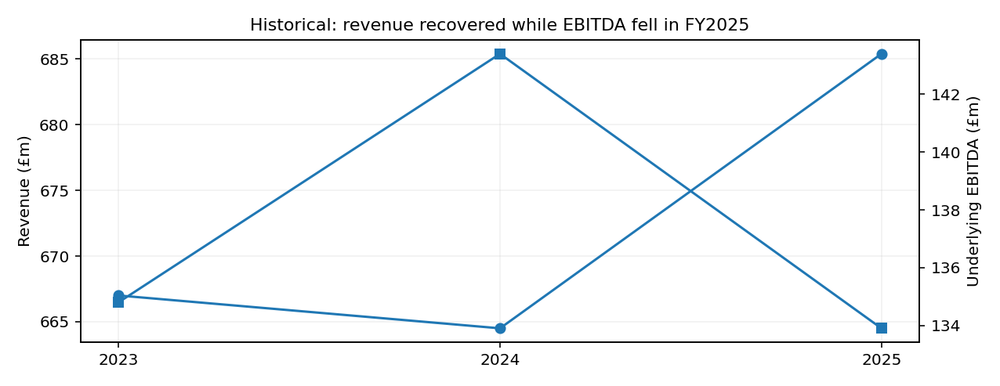
DPG / PUBLIC-TO-PRIVATE
04 / AUDITED DATA
Historic performance
Revenue held up in FY2025, but adjusted EBITDA contracted.
2025 METRICS
19.5%
EBITDA margin
£80.7m
Company-defined FCF
Public information as of 6 Nov 2026 | Independent educational analysis
4

Slide 5
DPG / PUBLIC-TO-PRIVATE
05 / UPDATED FACTS
Interim trading and 2026 bridge
H1 financial results plus Q3 trading commentary inform the acquisition underwriting.
H1 indicator
2025
2026
Change
Revenue
£331.5m
£353.6m
+6.7%
Underlying EBITDA
£63.9m
£66.2m
+3.6%
Company-defined FCF
£25.7m
£47.9m
+86%
Net debt
£306.6m
£290.1m
-£16.5m
LTM EBITDA = FY25 £133.9m + H1 2026 £66.2m - H1 2025 £63.9m = £136.2m
Public information as of 6 Nov 2026 | Independent educational analysis
5

Slide 6
DPG / PUBLIC-TO-PRIVATE
06 / PRICING
Entry valuation
Offer premium is hypothetical; share count and undisturbed price are verified.
Equity-to-enterprise bridge
Base case
6 Nov share price
231p
Shares outstanding
384.869m
Market equity value
£889.0m
Takeover premium
30%
Acquisition equity
£1,155.8m
H1 net debt
£290.1m
Acquisition EV
£1,445.9m
Entry EV / EBITDA
10.6x
Public information as of 6 Nov 2026 | Independent educational analysis
6

Slide 7
DPG / PUBLIC-TO-PRIVATE
07 / TRANSACTION STRUCTURE
Financing Sources & Uses
Cash equity is the financing plug after new debt and target cash.
Uses of funds
GBP m
Sources of funds
GBP m
Purchase shareholder equity
1,155.8
New senior loan (3x EBITDA)
408.6
Refinance debt
299.7
Target cash deployed
9.6
Transaction fees + financing fees
31.3
Sponsor cash equity
1,083.5
Closing minimum cash
15.0
TOTAL
1,501.8
TOTAL
1,501.8
Commercial debt terms are illustrative and uncommitted.
Public information as of 6 Nov 2026 | Independent educational analysis
7

Slide 8
DPG / PUBLIC-TO-PRIVATE
08 / UNDERWRITING
Five-year operating plan
Scenario-based revenue growth, margin recovery and cash conversion drive value.
Assumption
Bear
Base
Bull
Annual revenue growth
1.0%
3.5%
6.0%
FY2031 EBITDA margin
18.0%
21.0%
23.0%
Capex / revenue
3.5%
3.5%
3.5%
Cash interest
7.5%
7.5%
7.5%
Exit EV / EBITDA
9.0x
9.0x
9.0x
Growth levers: loyalty frequency • supply chain throughput • Irish network opportunity • tighter capital allocation
Public information as of 6 Nov 2026 | Independent educational analysis
8

Slide 9
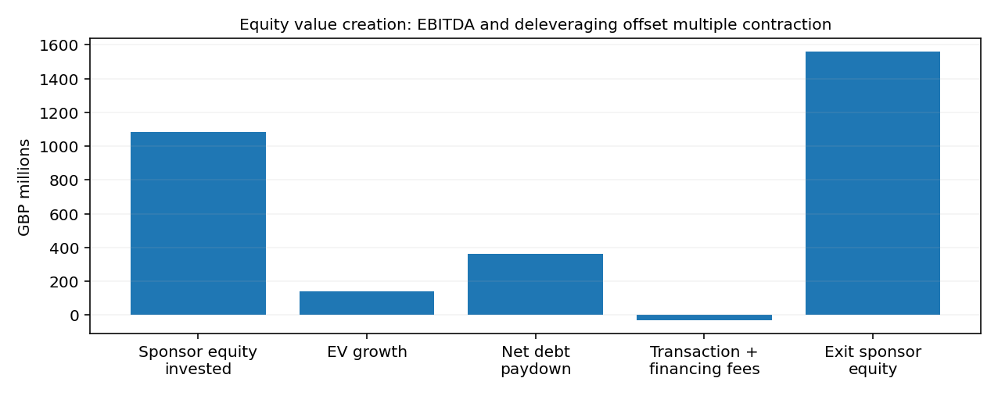
DPG / PUBLIC-TO-PRIVATE
09 / CREDIT
Debt repayment mechanics
A 1% mandatory amortisation plus 80% excess-cash sweep governs debt paydown.
Closing net debt in FY2031: £30.8m | Cash generated is applied to debt reduction or retained.
Public information as of 6 Nov 2026 | Independent educational analysis
9

Slide 10
DPG / PUBLIC-TO-PRIVATE
10 / EQUITY RETURNS
Sponsor return case
Under the selected base assumptions: 1.44x MOIC and 7.5% five-year gross IRR.
FY2031 EBITDA
Exit enterprise value
Exit sponsor proceeds
£176.5m
£1588.1m
£1557.4m
21.0% target margin
9.0x EBITDA exit
Net debt deducted
MOIC = £1,557.4m / £1,083.5m = 1.44x | IRR = 1.44x^(1/5) – 1 = 7.5%
Public information as of 6 Nov 2026 | Independent educational analysis
10

Slide 11
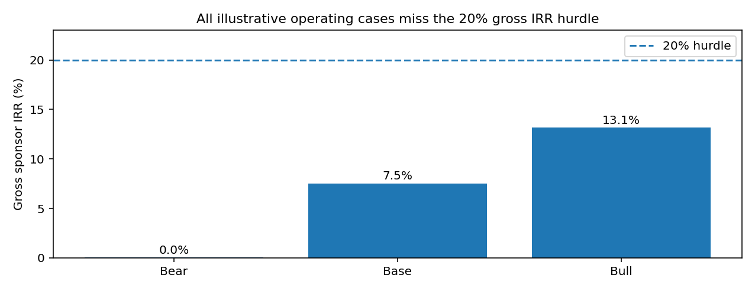
DPG / PUBLIC-TO-PRIVATE
11 / SCENARIO ANALYSIS
Operating downside matters
Independent cash and debt roll-forwards recalculate each operating case.
Public information as of 6 Nov 2026 | Independent educational analysis
11

Slide 12
DPG / PUBLIC-TO-PRIVATE
12 / INVESTMENT HURDLES
Maximum defensible equity bid
Reverse-solve the sponsor equity cheque for required returns.
Target gross IRR
Maximum offer equity value
Value per issued share
15%
£852.6m
£2.22
20%
£707.1m
£1.84
25%
£593.8m
£1.54
20% hurdle price is below the unaffected £2.31 market share price.
Public information as of 6 Nov 2026 | Independent educational analysis
12

Slide 13
DPG / PUBLIC-TO-PRIVATE
13 / RISKS
Diligence and model limitations
These underwriting risks must be resolved before any genuine investment proposal.
Franchise rights
Change-of-control and renewal conditions are not diligenced.
Capital structure
£200m PP note maturities July 2027; lender terms may constrain leverage.
IFRS 16
Gross lease obligations must be matched with corresponding receivables and EBITDA.
Data cut-off
Nov 2026 share price, H1 balance and Q3 qualitative trading data.
Model assumptions
7.5% coupon, 30% premium, 9.0x exit are hypotheses.
Public information as of 6 Nov 2026 | Independent educational analysis
13

Slide 14
DPG / PUBLIC-TO-PRIVATE
14 / INVESTMENT COMMITTEE
Conclusion and supporting files
Independent educational analysis; not a takeover offer or recommendation to trade securities.
DO NOT PROCEED AT THE 30% PREMIUM
Model
13+ worksheets with audited historical figures, cash sweeps, sensitivities and checks.
Deliverables
PDF committee memo, Spanish learning guide, LinkedIn carousel and README.
Sources: UK FY2025 Annual Report | H1 2026 RNS | Q3 2026 RNS | LSE 6 Nov close | LSE Voting Rights
Public information as of 6 Nov 2026 | Independent educational analysis
14

