Slide 1
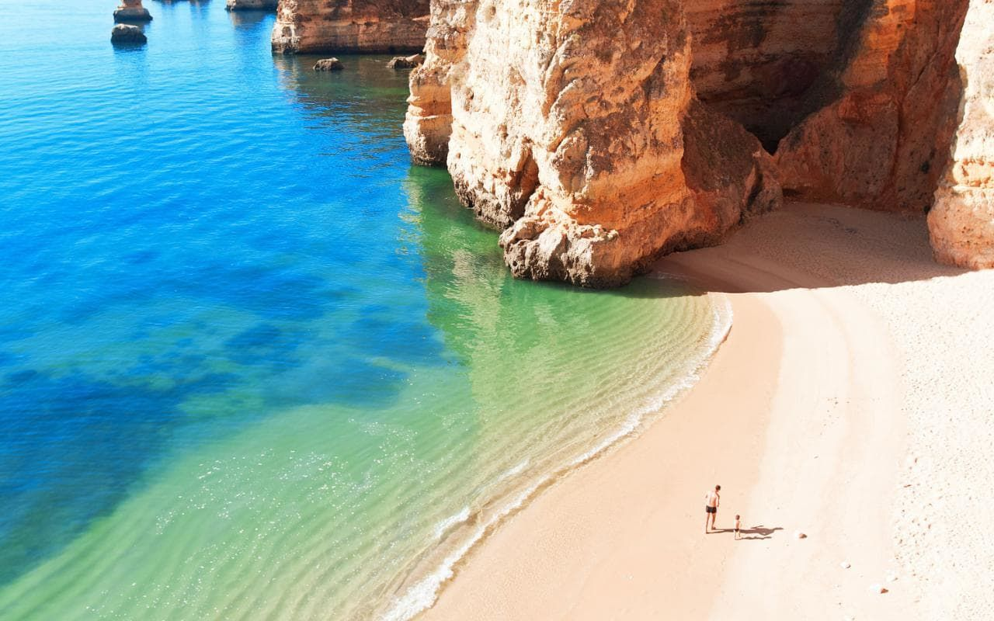
Portugal booking
Group 6

Slide 2
Data Set
It consists of a reservation history of a hotel company that has two types of hotels (city and resort), located in Portugal, from 2015 to 2017.
It contains different details that could be counted on after a hotel reservation is made, in addition to its final stage (check-in / cancellation).
https://www.kaggle.com/jessemostipak/hotel-booking-demand

Slide 3
Cancelations Model
One of the questions we did not ask at the beginning of the project was whether this model could anticipate future cancellations.
This would give us the advantage of being able to oversell rooms and know with more certainty the number of clients expected for a certain date. Allowing a better allocation of resources (personnel, supplies, etc.) according to the expected customers.

Slide 4
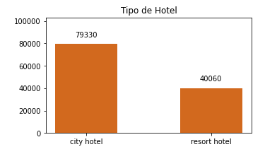
How do we build the model?
The distribution of the data from both hotels is as follows
Hotel Type
To build our model, we use all the reservations of our City Hotel and our Resort from 2015 to 2017.
119,390 total records
30 Variables and only 4 of them with missing values
37% of reservations canceled.

Slide 5
Some of the most important variables
Type of client: Groups, Agencies, etc.
Deposit: if it exists or not and if the sum is greater than the reserve.
Country of residence of the clients.
Meal package chosen for the stay.
Number of adults and children.
Reserved room vs Assigned room.

Slide 6
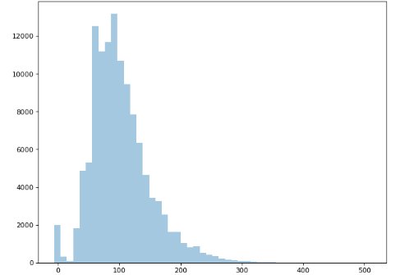
Is all our data correct?
The price distribution per night presents the following distribution
We found that some of our prices per day, both at the hotel and at the resort, were too high or low.
Corroborating the information with the reservation page booking.com we could see that the lowest price per night in all of Portugal was 15 Euros.
Bookings
Prices

Slide 7
Feature engineering + Insights

Slide 8
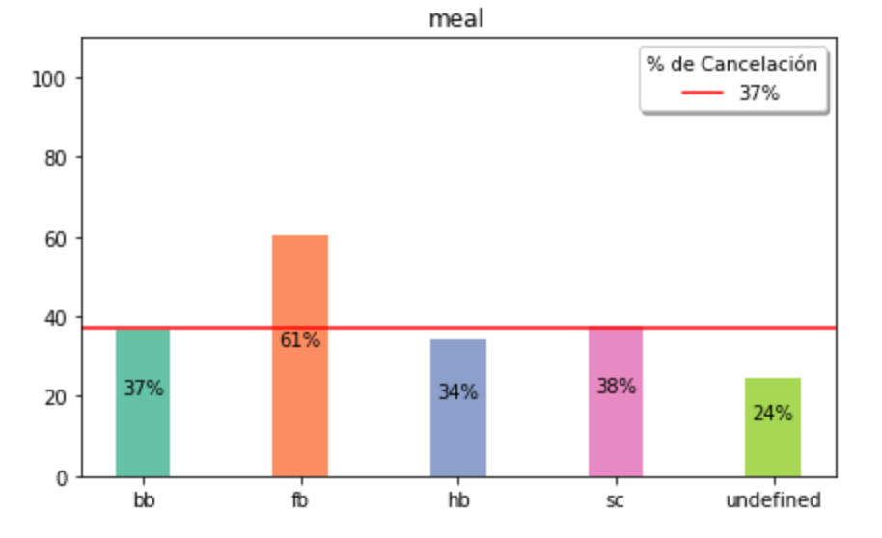
Food category selected in the reservation
When we see the type of food selected, we see that there is a tendency of non-cancellation when selecting “Full Breakfast”

Slide 9
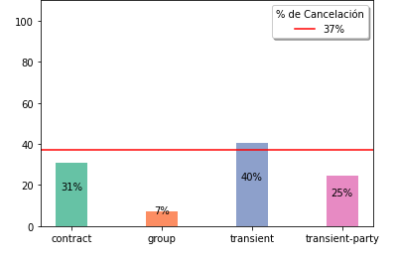
Our clients when they cancel
Transient type clients are the most frequent when canceling reservations. These are autonomous clients, that is, without contracts or groups.
%

Slide 10
The dataset has many features that are groupable or categorizable.
350+
For this we will seek to categorize different features, as well as create new ones that allow us to dispense with the current ones that imply an excess when they are converted to dummies.
+1200%
28
Intials Features
Features dummies without categorizing

Slide 11
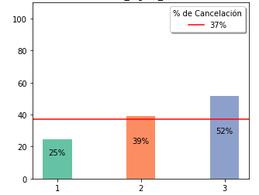
Booking total nights matters
The number of nights was grouped:
1 Night = Group 1
2 to 14 Nights = Group 2
+15 Nights = Group 3
With an average cancellation probability of 37%, these are the results we obtained
%

Slide 12
In addition, the categories of certain features were reduced
To reduce some dimensions, but at the same time not lose information that is key to the problem, some of the features with many classes were transformed into features with 2 classes.
Number of Babies
Number of kids
Kind of room booked
Kind of room asigned
Has babies/kids?
(1 o 0)
You were assigned the same room you booked?
(1 o 0)

Slide 13
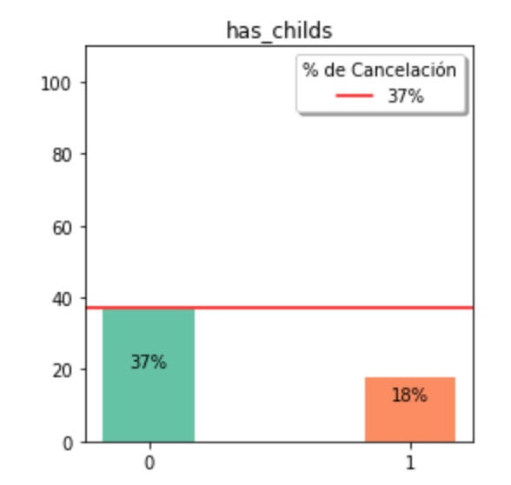
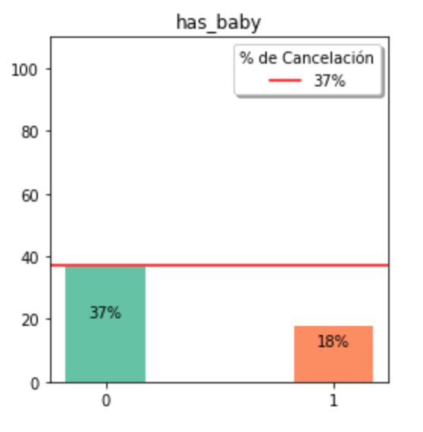
Clients with kids or babies
We were able to group the quantitative variable of children and babies to create a categorical one that helps us

Slide 14
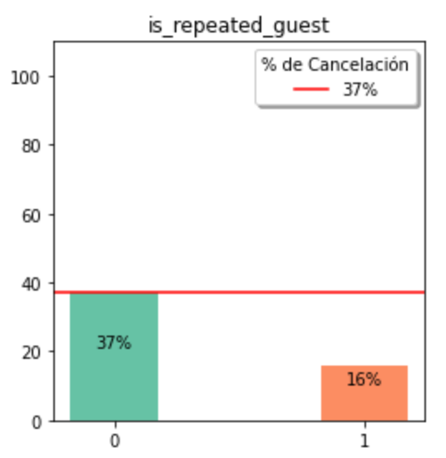
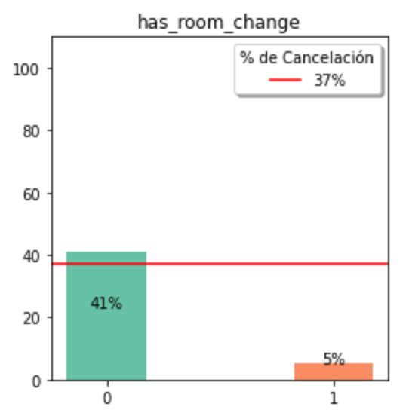
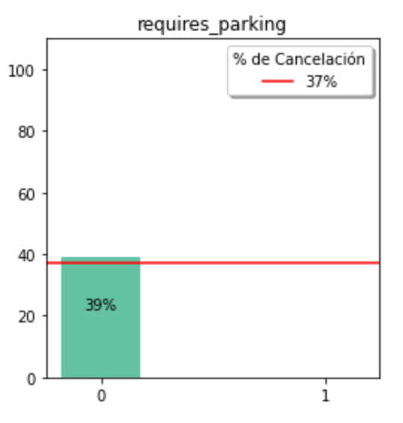
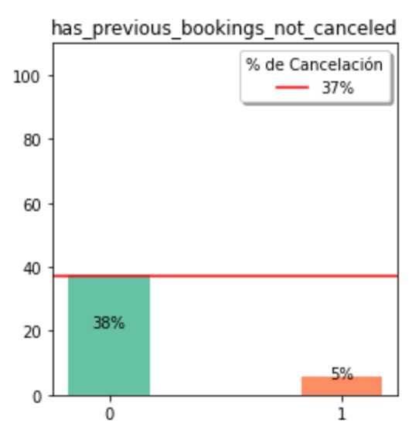
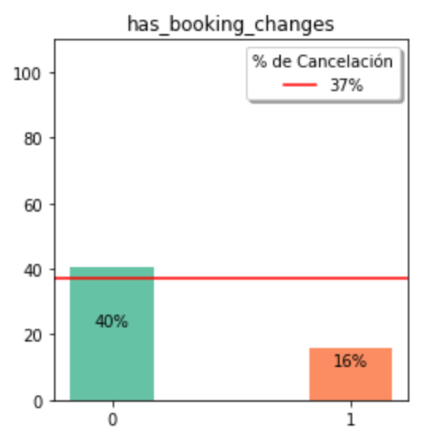
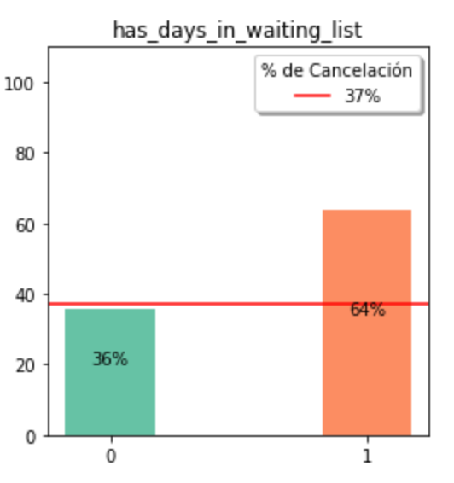
Categorization of various quantitative values
Repeated Guest
Does have change in reverse
Does have room change
Requiere parking
Previous cancelations
Hold on days
We see that the following 6 fields show higher correlation with the field to predict after being categorized.

Slide 15
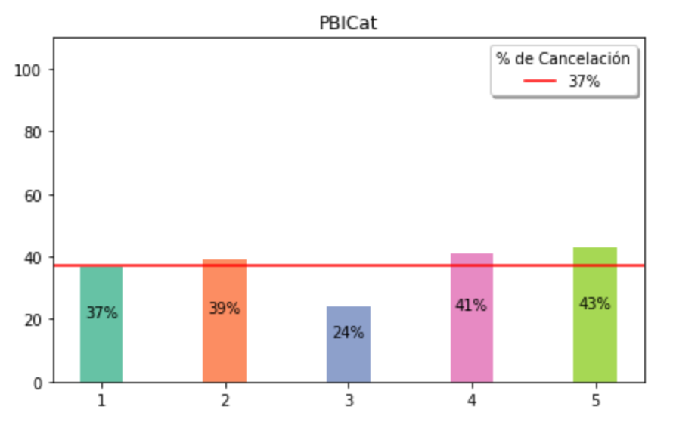
The possibility of adding the per capita GDP of the host's country of origin was analyzed.
At the time of crossing the information we decided to create 5 categories of GDP per capita in order to be able to categorize the information.
As can be seen, there is not really a very big change between the final result and the cancellation, except for a single category.

Slide 16
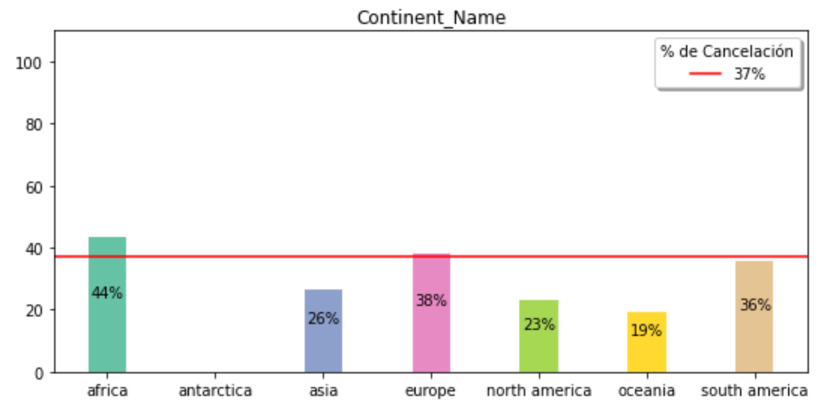
Could we reduce dimensions using exogenous variables?
Cancellations by residents by continent
We found that yes!
It occurred to us to use the continent of the host's country of origin as a feature to discard the categorical column ‘country’
This ended up being relevant with the variable to predict

Slide 17
Most of the variables in the dataset are categorical
350+
Thanks to the entire feature engineering process, the dimensionality of the problem was reduced
-69%
110
28
Initials
Features
Features dummies without
Final
Features

Slide 18
Feature selection y PCA

Slide 19

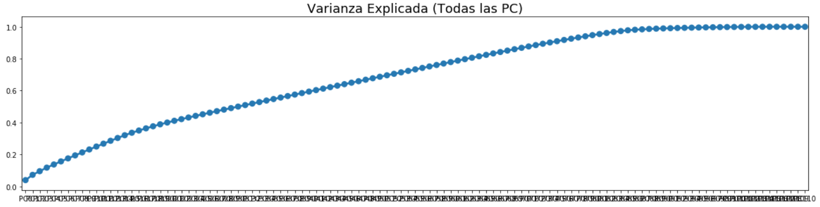
We also use the PCA method to continue reducing dimensionality
PC 84
PC 110
The Variance Explained by each principal component does not present much difference between each component. Therefore, it is chosen not to use a reduced dataset, but instead it is saved as an alternative to evaluate the models.
A feature was created so that PCA can be applied directly to the best performing models.

Slide 20
Filter and Wrapper for the different models
In search of reducing the number of possible features for each model, thus optimizing its performance, we did different tests using the Filter and Wrapper functions.
For the KNN and Naive Bayes models, several versions of the Filter were run, each with a different amount of features (using F score and P value), on the other hand, the Wrapper function is only available for the Random Forest and Logistic Regression models.
For each case, the best possible hyperparameters were previously obtained based on a reduced sample of the dataset.
Features by Dataset by Post Filter model:
KNN: 38 Features
NB: 80 Features
Features by Dataset by Post Filter and Wrapper model:
Log: 82 Features
Log Balanced: 20 Features
Random F: 54 Features
Random F Bal: 80 Features

Slide 21
Our Models at the time of training

Slide 22
Classification models
After having once again obtained the hyperparameters for each model with its new and respective optimized Dataset, different classifiers were modeled.
These were trained with Overfitted and Underfitted Datasets and also, if the model allows it, they were tested with the option of balancing them.
Once we got the results, the best 4 models had PCA applied to further reduce their components and try to improve their performance.
Modelos:
Overfitted (SMOTE) :
Logistic
KNN
NB
Random Forest
Underfitted (RUS) :
Logistica
KNN
NB
Random Forest
Balanced :
Random Forest
Logistica

Slide 23
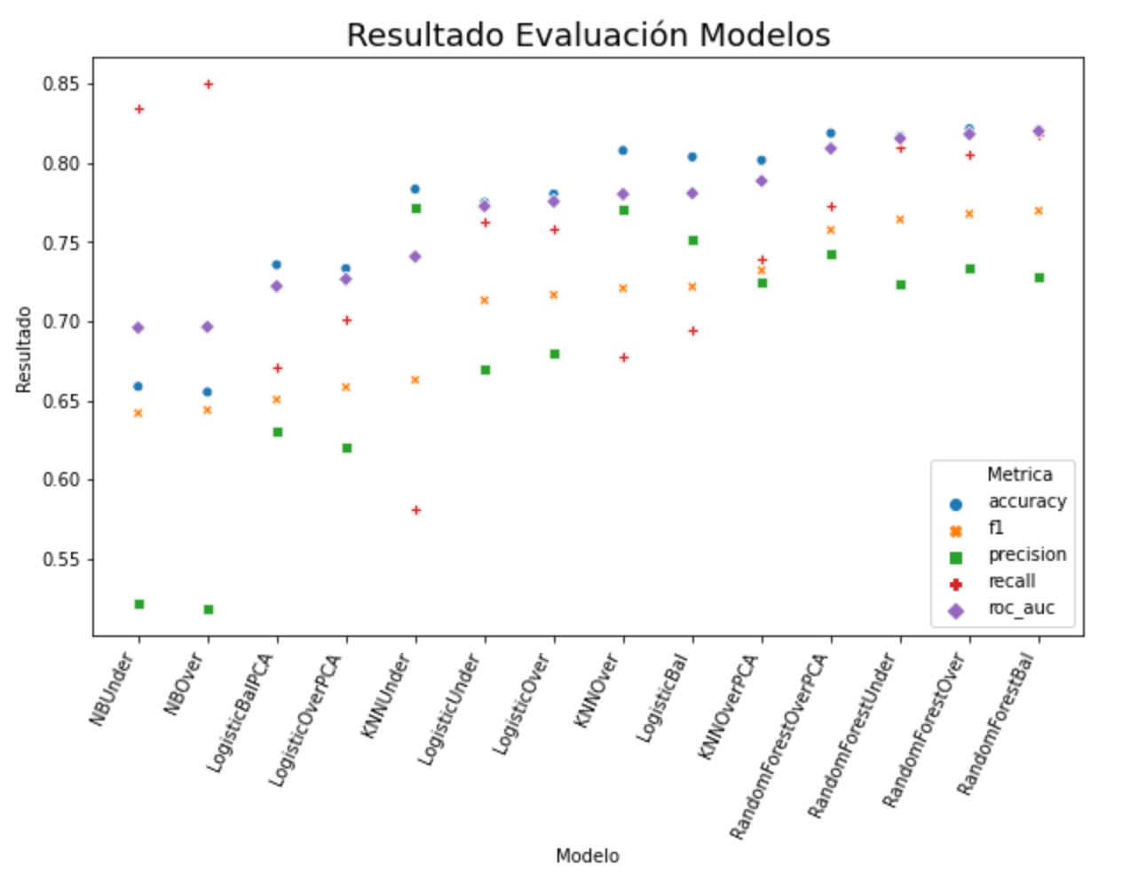
Result Evaluations Model

Slide 24
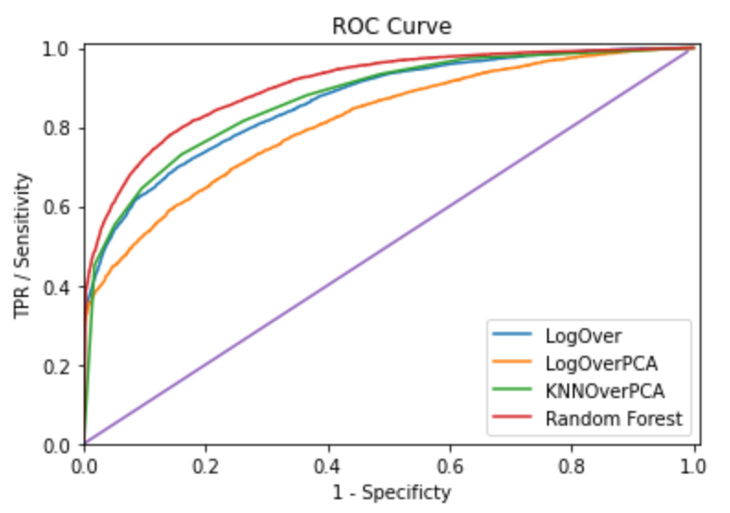
ROC curves for models

Slide 25
Our best model was….

Slide 26
“The Wisdom of Crowds” A large number of relatively uncorrelated models (trees) operating as a committee will outperform any of the individual constituent models. The reason for this wonderful effect is that the trees protect each other from their individual errors. While some trees may be wrong, many other trees will be right, so as a group the trees are able to move in the correct direction. (“Understanding Random Forest” - Tony Yiu - Towards Data Science)

Slide 27
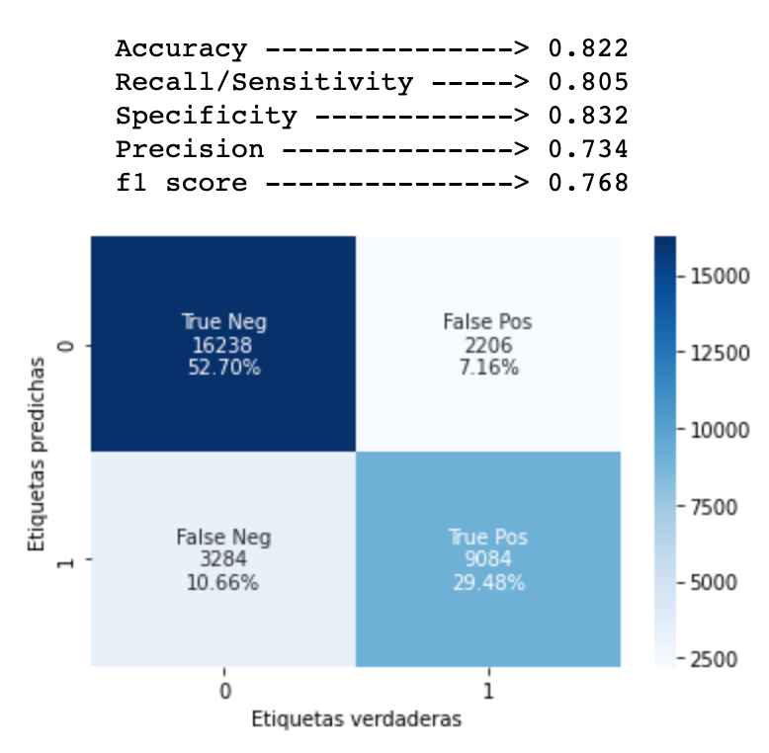
Random Forest Overfitted
After analyzing the models according to the needs of our prediction giving priority to ROC, F1, Precision.
We fit the model with its respective dataset and its hyperparameters.
54 Features, 960 estimators (trees)

Slide 28
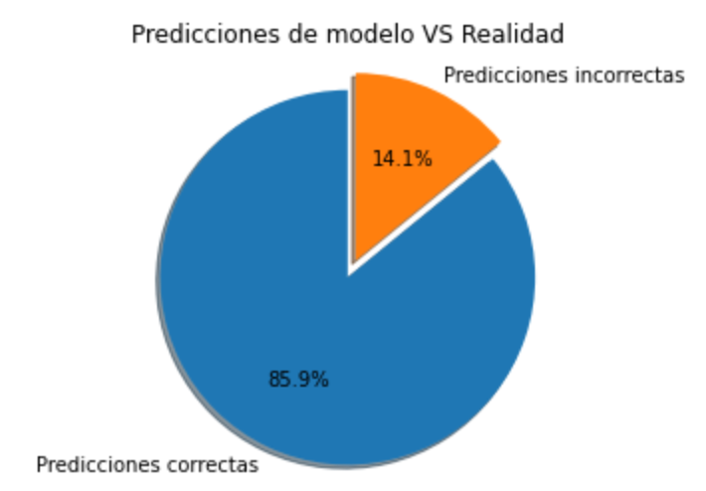



Sampleo y conclusiones
After having our model, chosen, ready and fitted, a sample of 10,000 reserves was chosen on which to analyze the results and draw conclusions.
We obtained quite encouraging results since in almost 86% of the cases we have correct results
Model Predictions

Slide 29
Playing with the classification thresholds
Once the model is fitted, it gives us the possibility of knowing with what percentage of certainty each result is giving us, in our case we choose to “play” a little with these values.
We use the premise that the lower category the room in question is, the higher the occupancy rate the hotel requires to be profitable. In other words, the higher the category of the room, the less pressure we have to obtain correct results.
Taking this into account, we ran a function to see with which thresholds the model runs best by room category.
Threshold by category:
Low end: 57%
Medium: 60%
High end: 64%
Top: 67%

Slide 30
Last conclusions
After applying the knowledge obtained, we were able to modify the dataset, its features and adapt the classification models in such a way that we could obtain a percentage of correct results of 86% using a reduced dataset of 10k values, of which only 560 cases gave false positives. (5.6%).
According to our estimates, hotels have 150 reservations per day. If normally 38% are canceled, with our model we can oversell 27% of reservations (41 reservations)

Slide 31
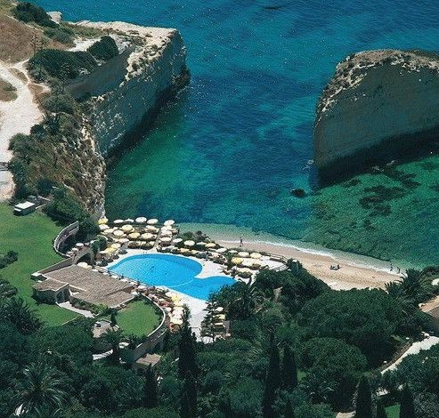
Thanks!!

