Slide 1
Automation

Slide 2
Motivations
No or small effort
“Replayable”
It’s documented, somehow…
Real motivations
People are lazy
but the “good lazy”
Notes:
Doesn’t require anyone to execute, or very small effort.
It’s not in “someone’s head” and it’s flawless, it will do what it’s coded to do
But in reality (majority of) people don’t like to do repetive tasks

Slide 3
Why Automating
People are expensive, machines aren’t
It’s hard to find skilled people
Efficiency and efficacy
Execute quickly (even if it’s the wrong result!)
Do more with less
Fights boredom
Free people to do other (and more challenging) tasks
Push boring (but important) jobs to the background
It’s getting cheaper and cheaper with the “cloud” and other tools
Notes:
A machine will do the precise task much faster, doesn’t get tired or bored
With monotonous tasks automated, people can actually do more challenging tasks

Slide 4
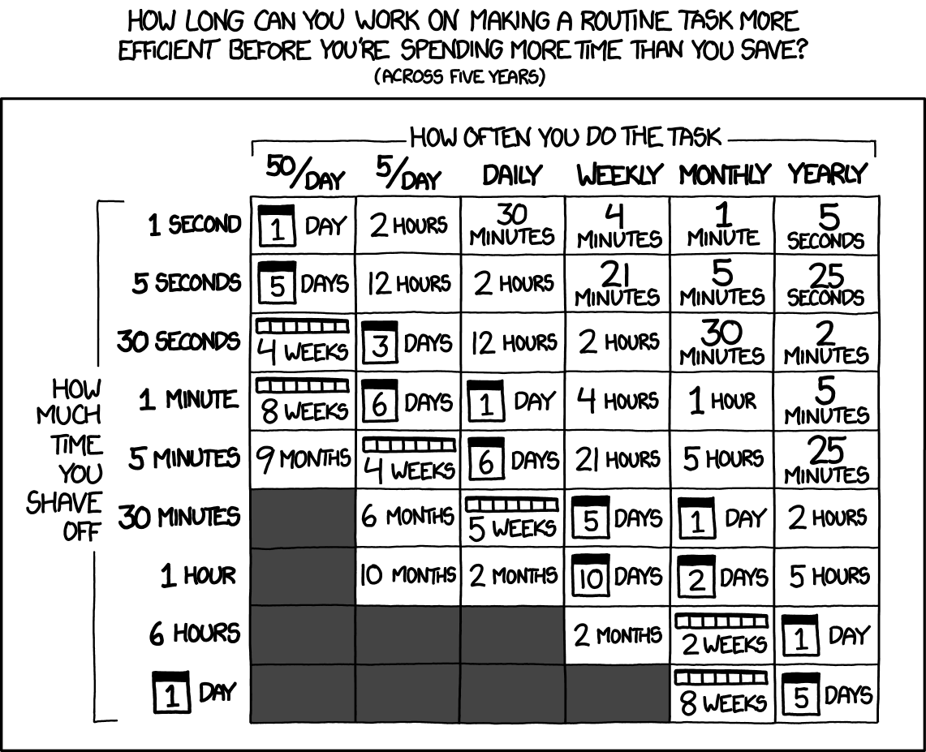
Why not Automating…
The time spent to automate will be much longer than the time to do the task (x times)
Task doesn’t require automation (programmers especially)
Process isn’t clear enough

Slide 5
Trigger Types
Time based
Every Monday at 9:30h
On first day of the month at 12h
On first December at 0h
Every minute
Event based
Every time I receive emails from x
When I get home/work
Just click on it
Hacker-script case
kumar-asshole.sh → scans the inbox for emails from "Kumar" (a DBA at our clients). Looks for keywords like "help", "trouble", "sorry" etc. If keywords are found - the script SSHes into the clients server and rolls back the staging database to the latest backup. Then sends a reply "no worries mate, be careful next time".
smack-my-bitch-up.sh → sends a text message "late at work" to his wife (apparently). Automatically picks reasons from an array of strings, randomly. Runs inside a cron-job. The job fires if there are active SSH-sessions on the server after 9pm with his login.
https://github.com/NARKOZ/hacker-scripts
http://bash.im/quote/436725
Notes:
Time based: a schedule is defined and it just follows it
Event based: it’s triggered only when an event is received
Crazy hacker script, from a Russian software engineer

Slide 6
Tools
From my life experience

Slide 7
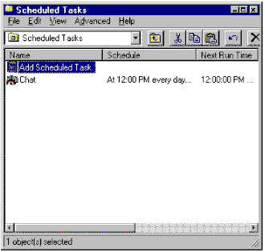
In the beginning of the times
Windows Task Scheduler
Introduced in the Windows 95
https://en.wikipedia.org/wiki/Windows_Task_Scheduler
Batch scripts (.bat)
Shell scripts
Notes:
The first automation tool I heard about

Slide 8
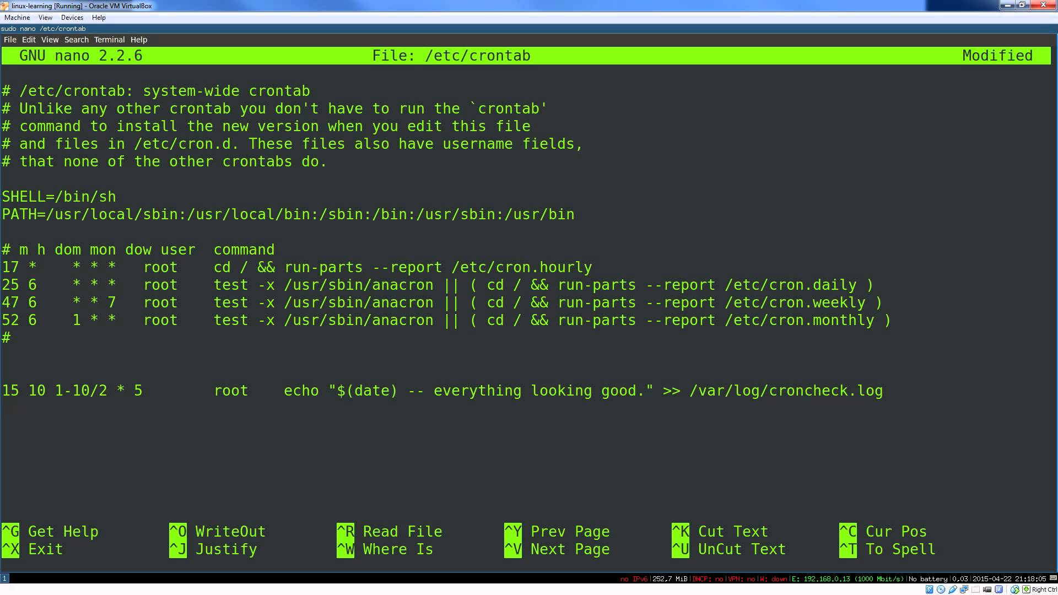
Before the beginning of the times
Unix running cron, since 1979
Still used until today, mainly for system administrators and programmers
All *nix systems have it nowadays
https://en.wikipedia.org/wiki/Cron
Notes:
Oldest scheduler I used
Still in use today, it’s possible to configure cron style for cloud lambdas/functions

Slide 9
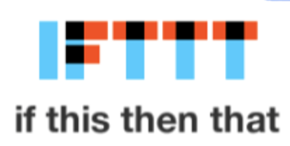
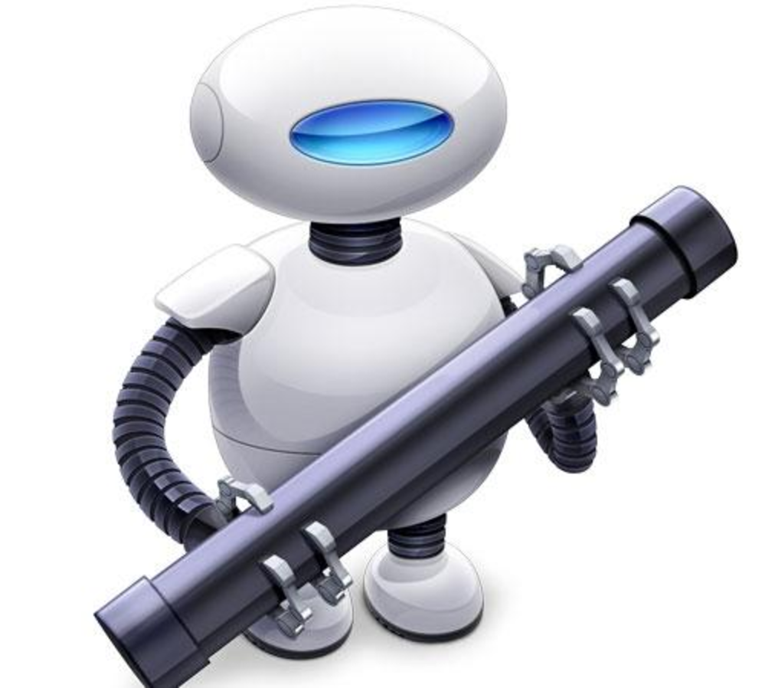
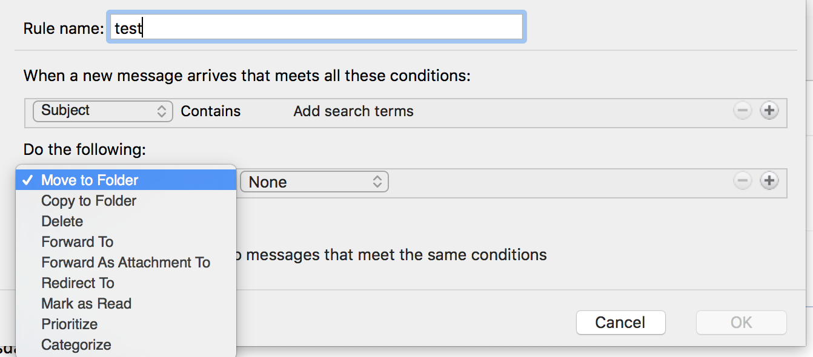
Generation Y tools
IFTTT and alternatives
Outlook rules
Automator (mac)
Chat tools (slack)
…
Your own!
Notes:
Much more user friendly, nice UI, better feedback, less code

Slide 10
Automating your stuff

Slide 11
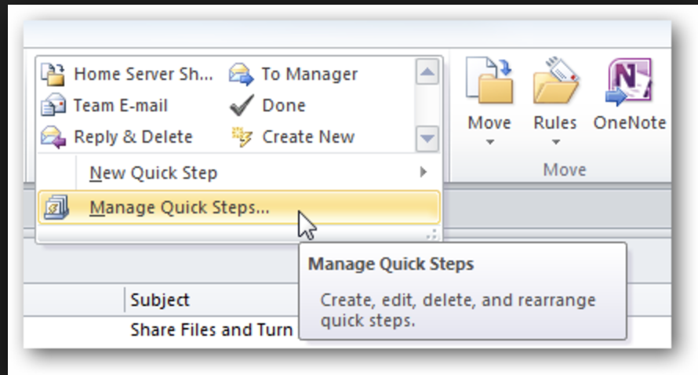
Outlook rules
Basic handling
Filter options
Actions
Integrations
Jira
Open issue → email template handlers
Sending emails → notifications
Webhooks → send to anything (e.g. slack)
Be careful with the noise generated
https://docs.microsoft.com/en-us/outlook/rest/webhooks
https://confluence.atlassian.com/adminjiraserver071/creating-issues-and-comments-from-email-802592933.html
https://confluence.atlassian.com/adminjiraserver073/configuring-email-notifications-861253776.html
Notes:
Example: A client sends a request the the client manager. If there is a pattern it can be automatically forwarded to JIRA, or you can have just a button to do it.
From JIRA, you can notify the whole team, or just the team leader for the issue.
When the status of the issue changes, it notifies slack (public or private channel)

Slide 12
Batch Script / Powershell
Batch script is known because it can do basic things on Windows, which is false
Batch scripts can do anything on Windows and interact with other programs:
MS SQL BCP (Bulk copy)
Downloading things (BITS, wget, curl, ftp)
Call programs, scripts and so on…
Powershell is “a newer version” of Batch, easier to use and with more features
Other terminals
Cygwin
Linux for Windows (Ubuntu)
Notes:
Sample for Ftp downloads with powershell

Slide 13
Node/Python script
Node/Python can do almost everything, from managing folder and files locally to ML
Free and “easy” to learn
Good community support
Cutting edge libraries
Notes:
Sample with the copy from github to jira and report generator from jira

Slide 14
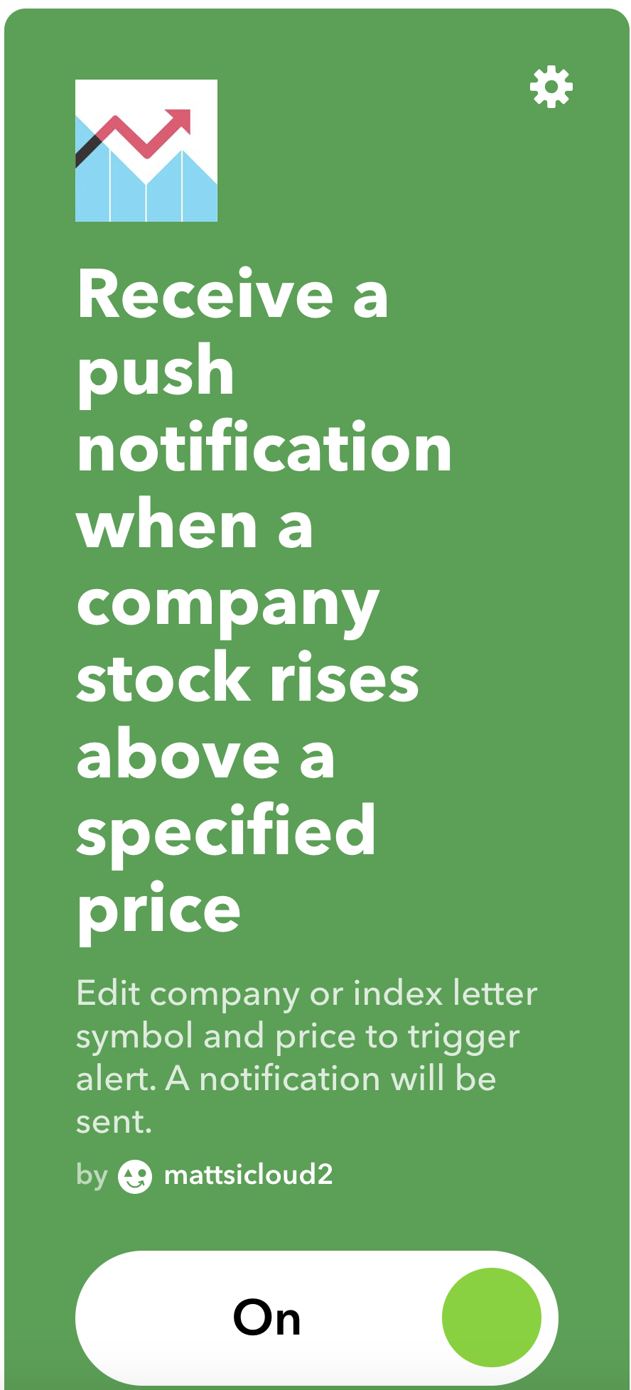
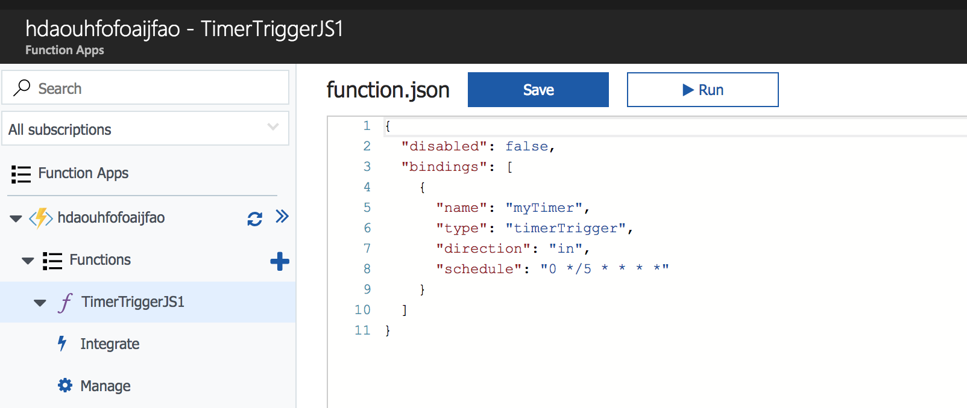
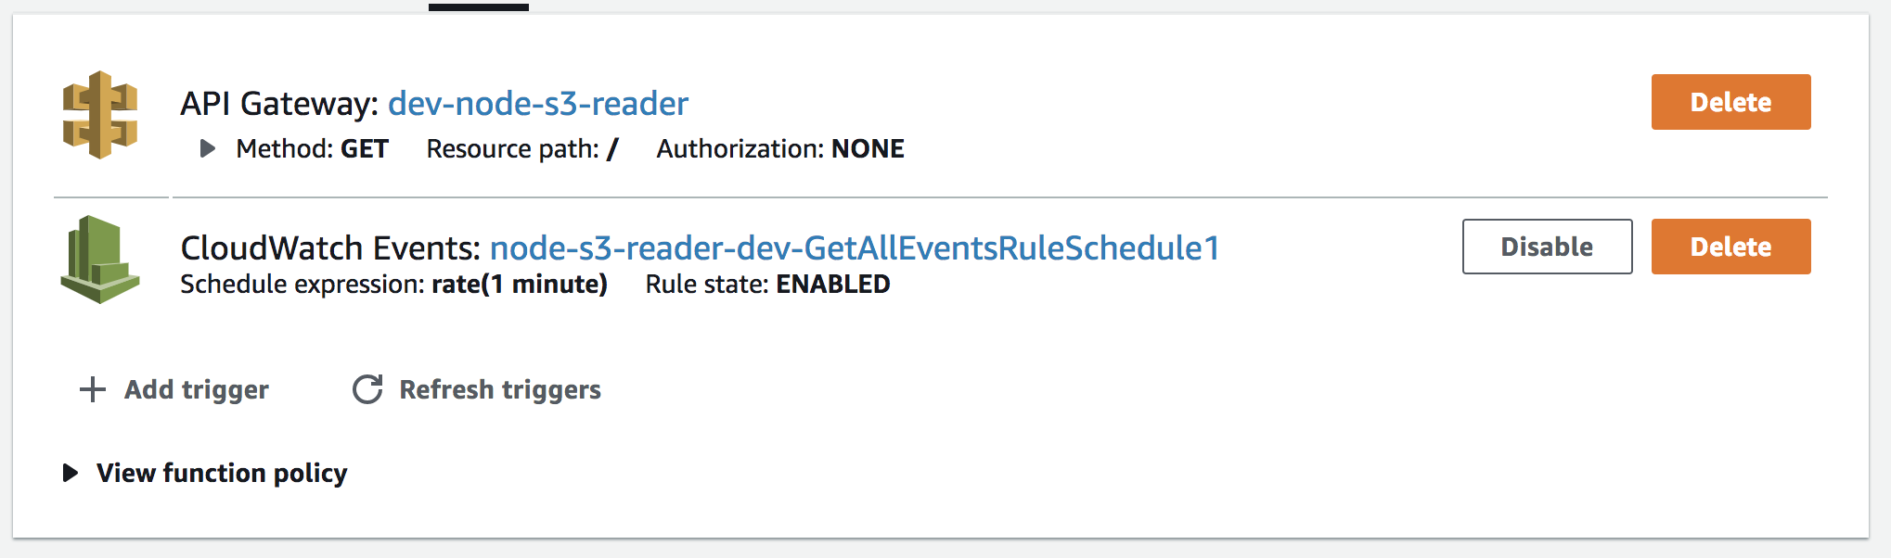
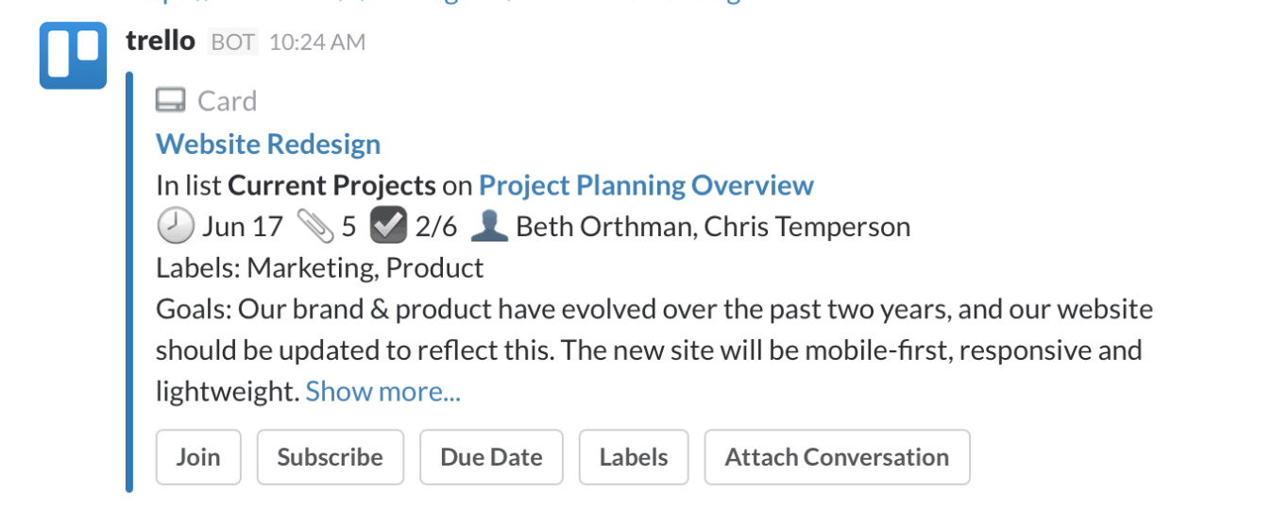
Using the cloud
AWS Lambdas
Azure Functions
IFTTT
“ChatOps”

Slide 15
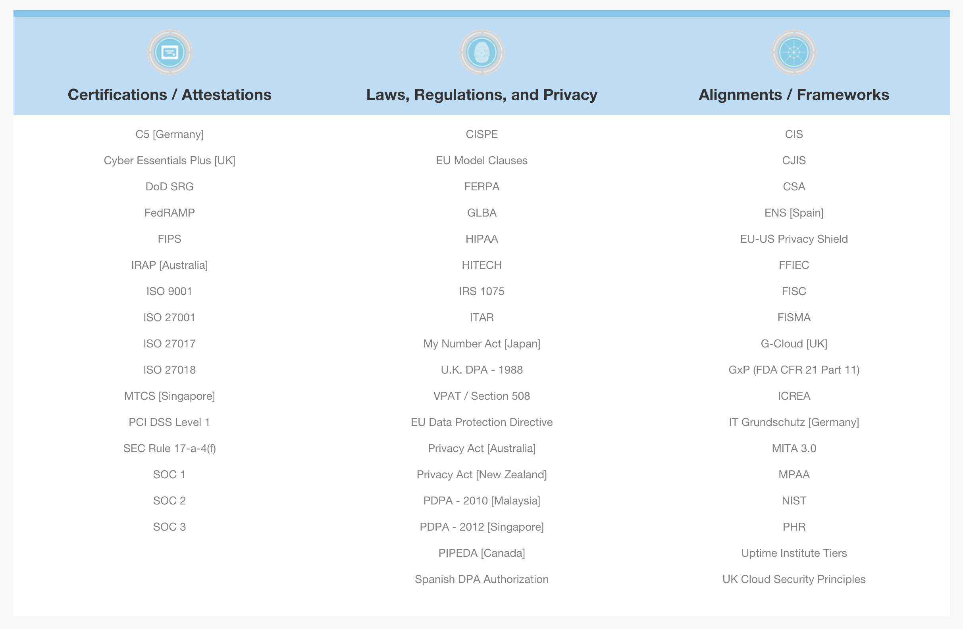
Security
Compliance certifications:
AWS → https://aws.amazon.com/compliance/
Google cloud → https://cloud.google.com/security/compliance
Azure → https://www.microsoft.com/en-us/trustcenter/compliance/complianceofferings
Regions:
UK, EU, USA, South America, …
Disposable machines:
Process and persist the data → wipe the machine

Slide 16
Future of Automation
Increase of event-base automation (software development is going to the same direction)
Script languages like nodejs and python will get more popular
More use of cloud providers
More and better integrations
Notes:
Alexa / Google Home → South Park trolling Alexa ; burger kind trolling google now
Autonomous car
Helping processes at work → build/deploy pipeline, time/tasks management

