Slide 1
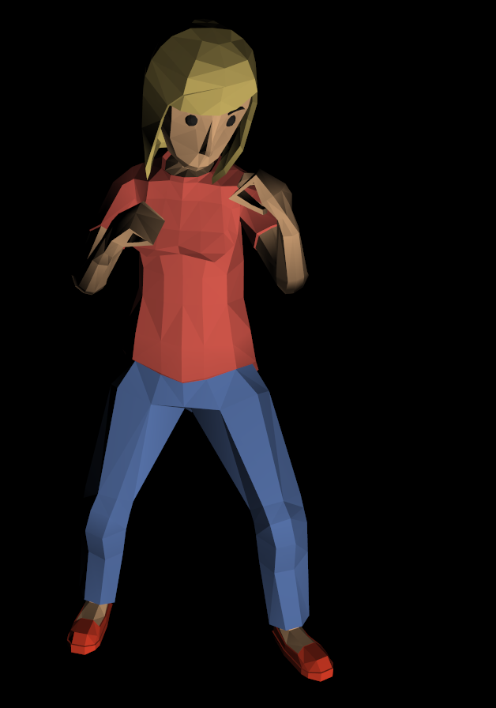
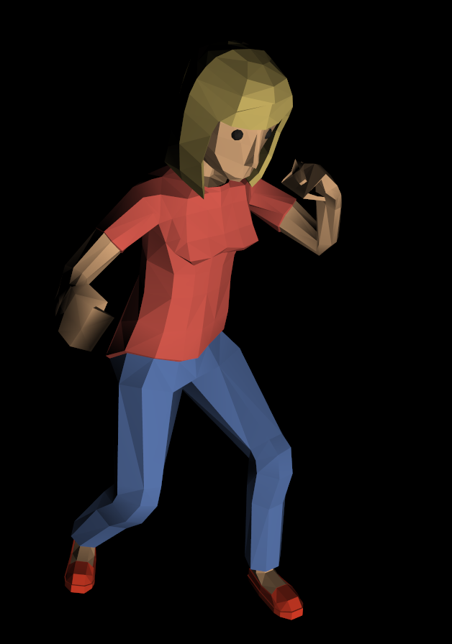
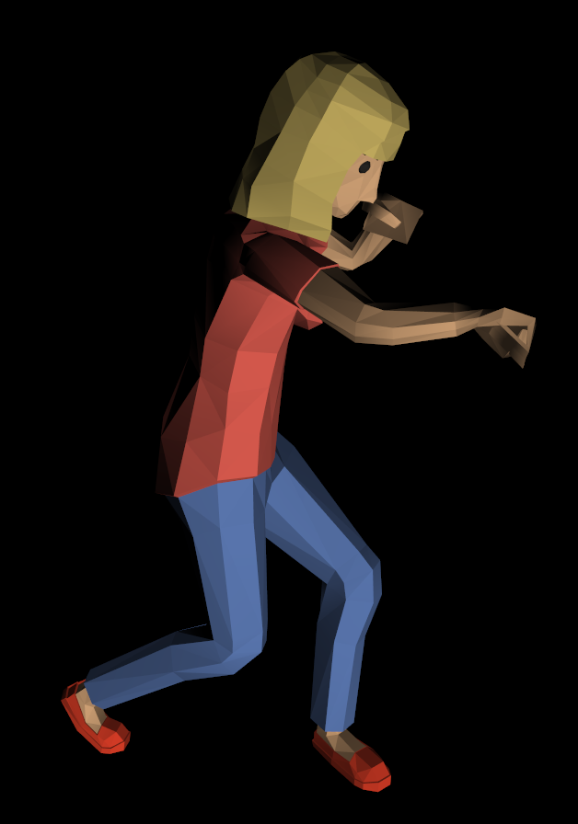
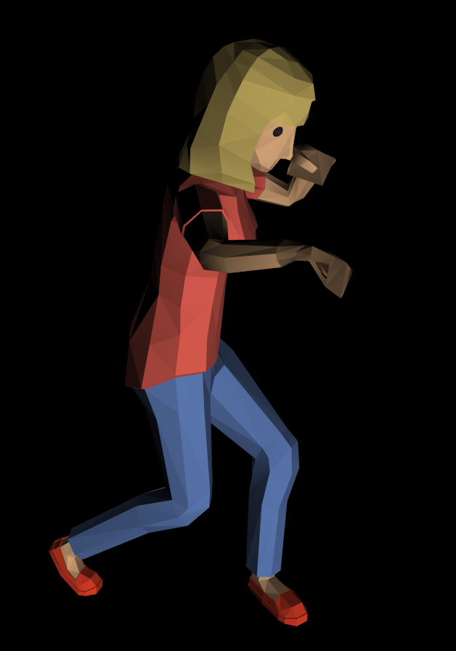
Animation – Changing geometry with time
0 seconds
0.2 seconds
0.4 seconds
0.6 seconds

Slide 2
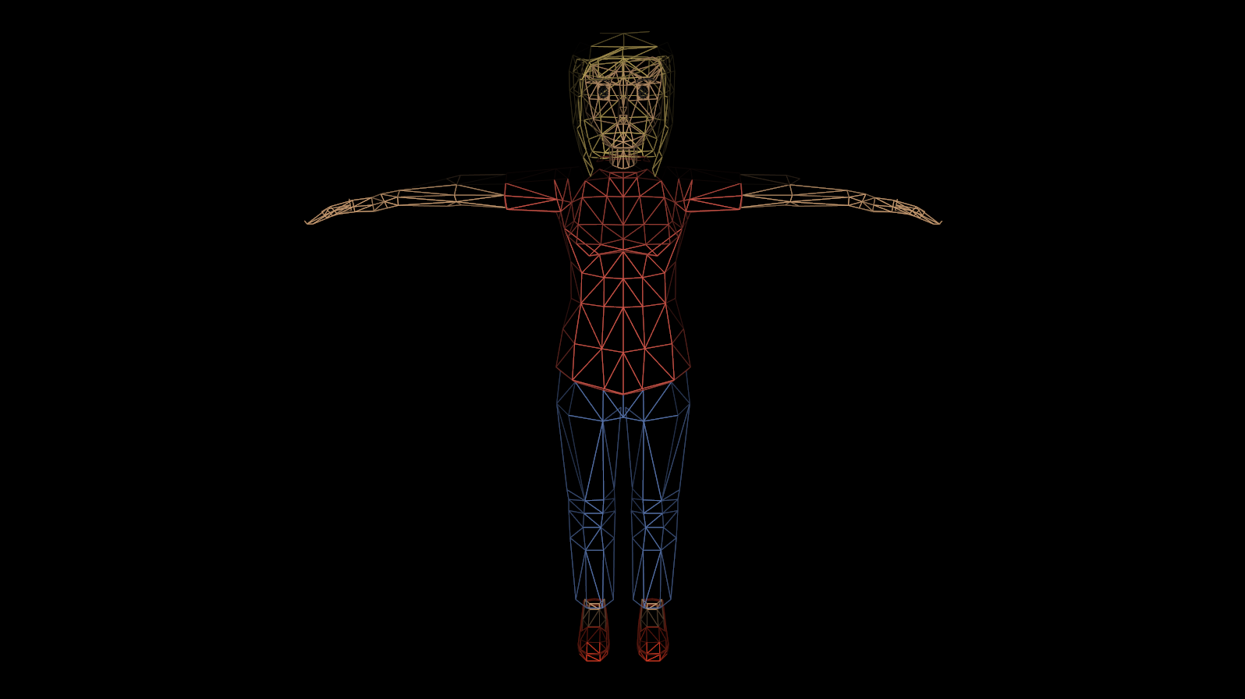
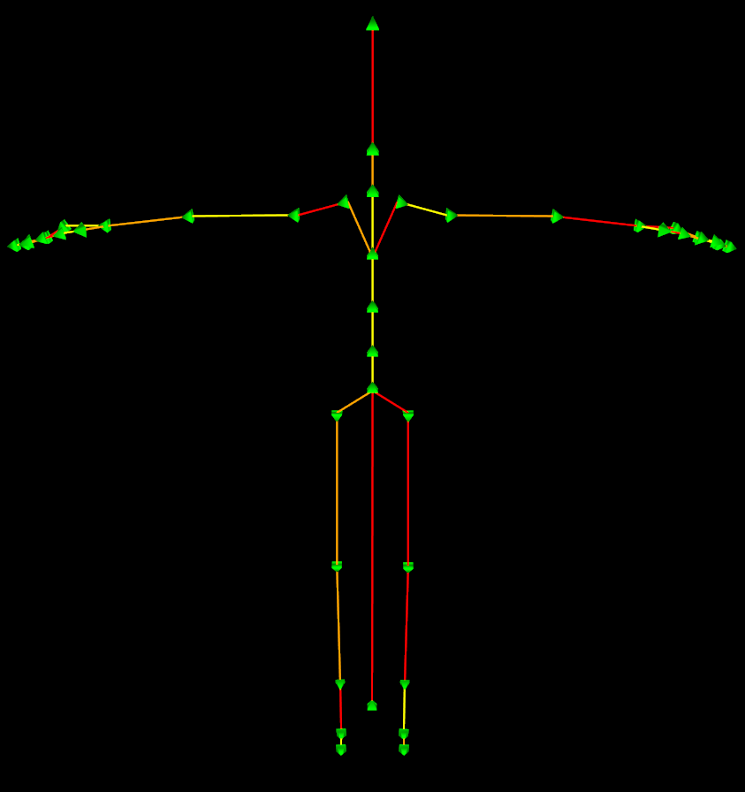

Slide 3
Mesh
- Position
- Normal
- Texture coordinates

Slide 4
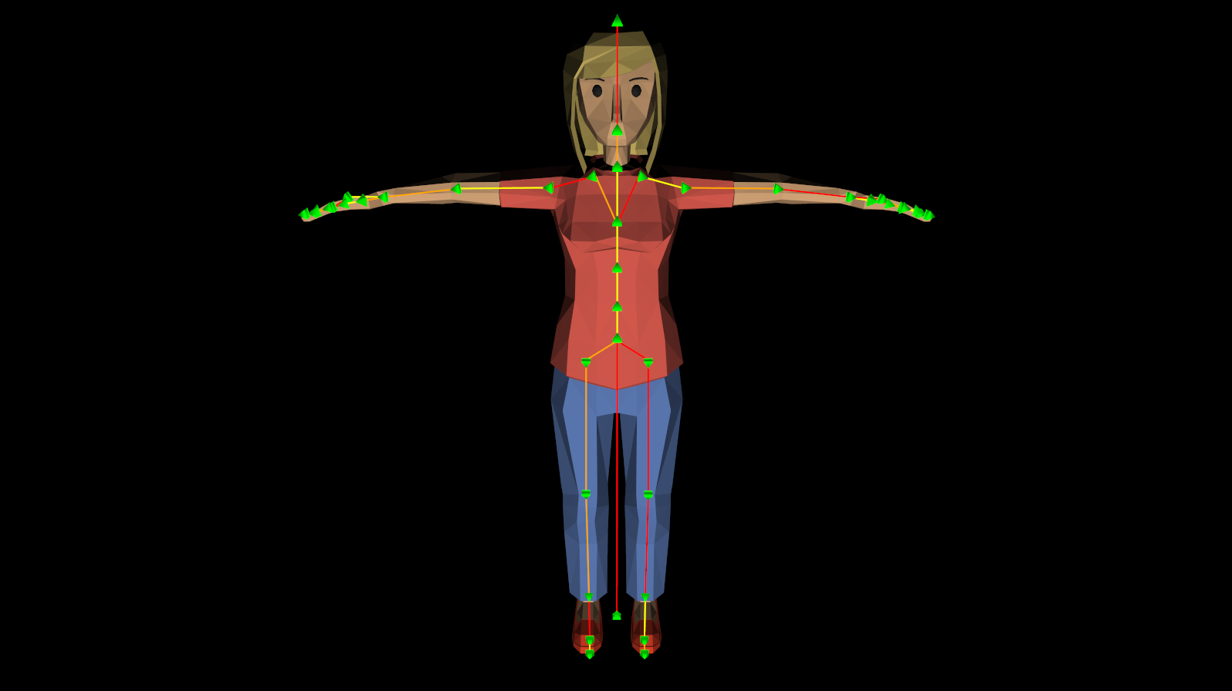
Joints
- Position
- Rotation
- Scale

Slide 5
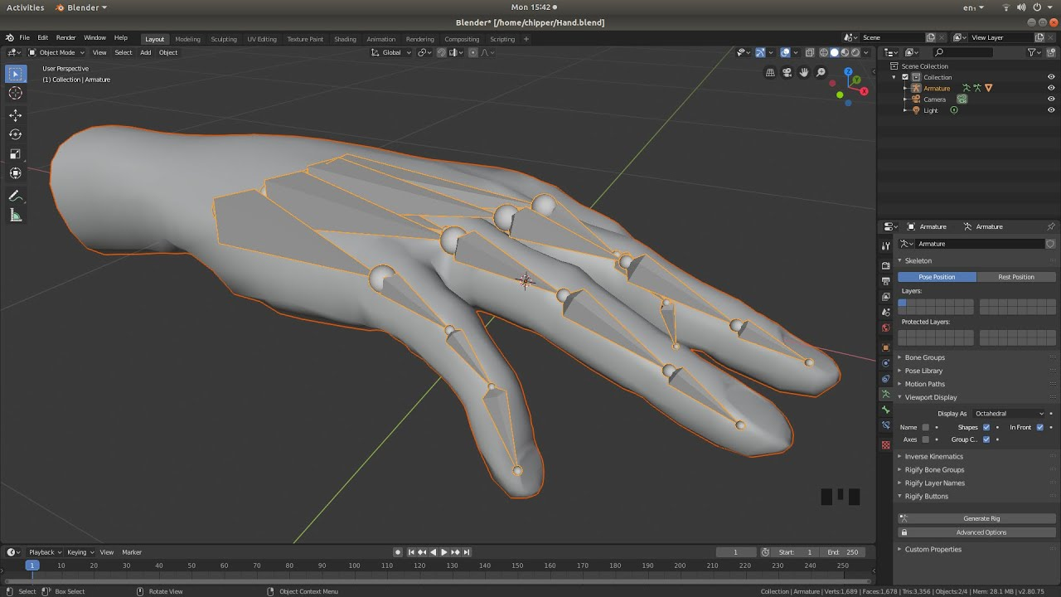
Huesos

Slide 6
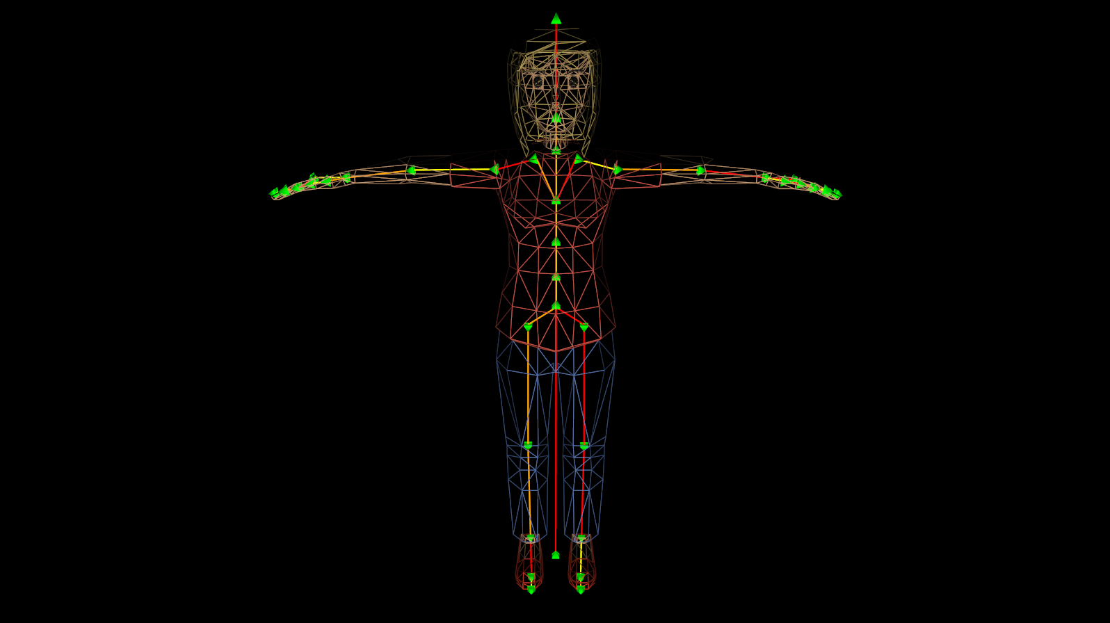
Rigging – Telling vertices what joints affect them
2
1
0
- I’m affected by joints 0, 1 y 2

Slide 7
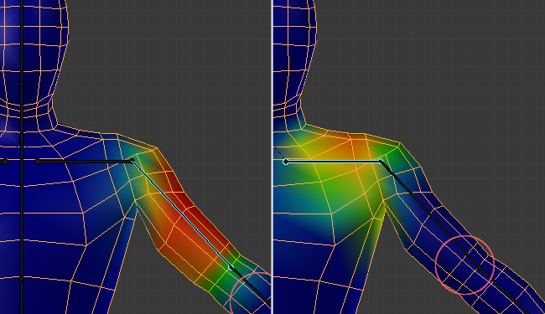

Slide 8
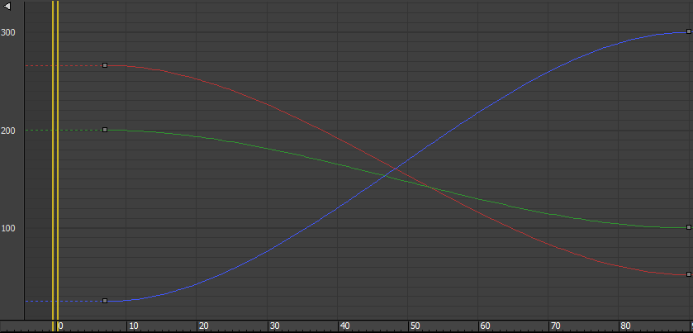
Animation curves
- Position (X, Y, Z)
- Rotation (X, Y, Z, W)
- Scale (X, Y, Z)

Slide 9
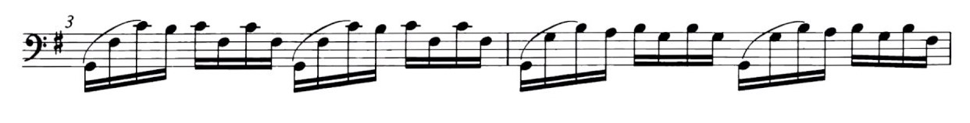




0 seconds
0.2 seconds
0.4 seconds
0.6 seconds
Sounds:

Slide 10
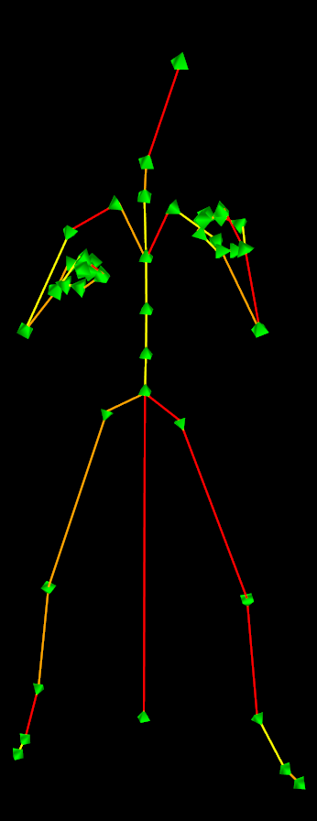
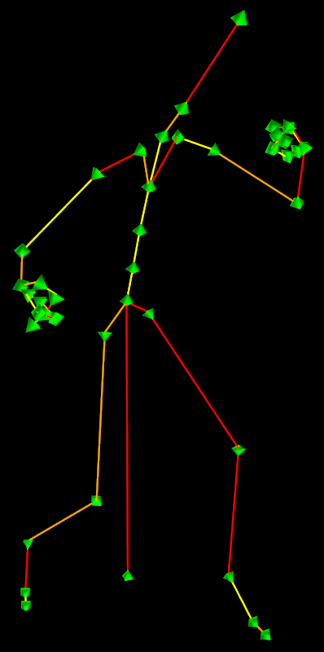
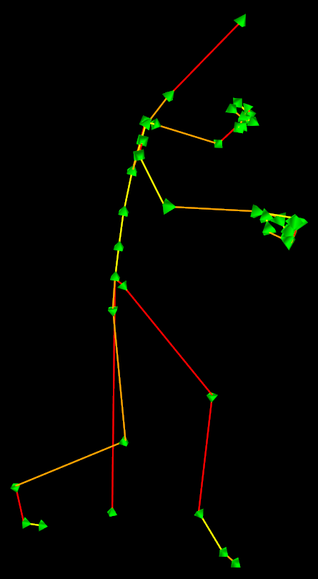
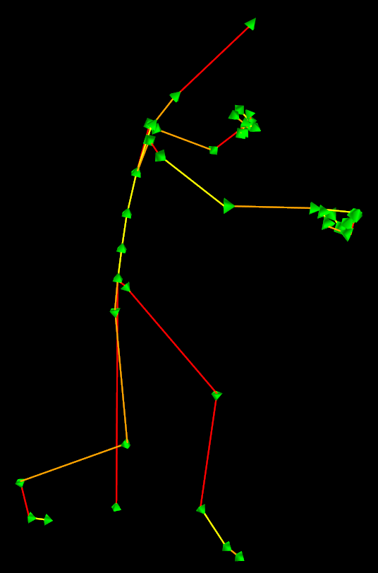
0 seconds
0.2 seconds
0.4 seconds
0.6 seconds
Skeletons:
Poses:

Slide 11
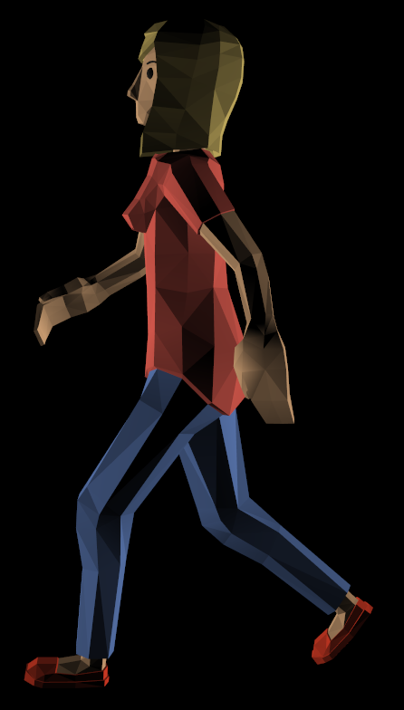
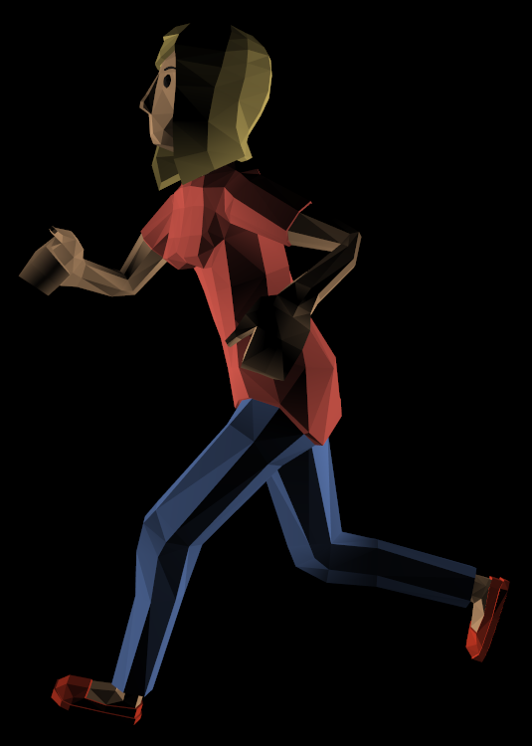
Fading between different clips

Slide 12
