Slide 1
Data-Driven Phenotypic Dissection of AML Reveals Progenitor-like Cells that Correlate with Prognosis
Jacob H. Levine, Erin F. Simonds, Sean C. Bendall, Kara L. Davis, El-ad D. Amir, Michelle D. Tadmor, Oren Litvin, Harris G. Fienberg, Astraea Jager, Eli R. Zunder, Rachel Finck, Amanda L. Gedman, Ina Radtke, James R. Downing, Dana Pe’er, Garry P. Nolan
Cell
Volume 162 Issue 1 Pages 184-197 (July 2015)
DOI: 10.1016/j.cell.2015.05.047
Copyright © 2015 Elsevier Inc. Terms and Conditions

Slide 2
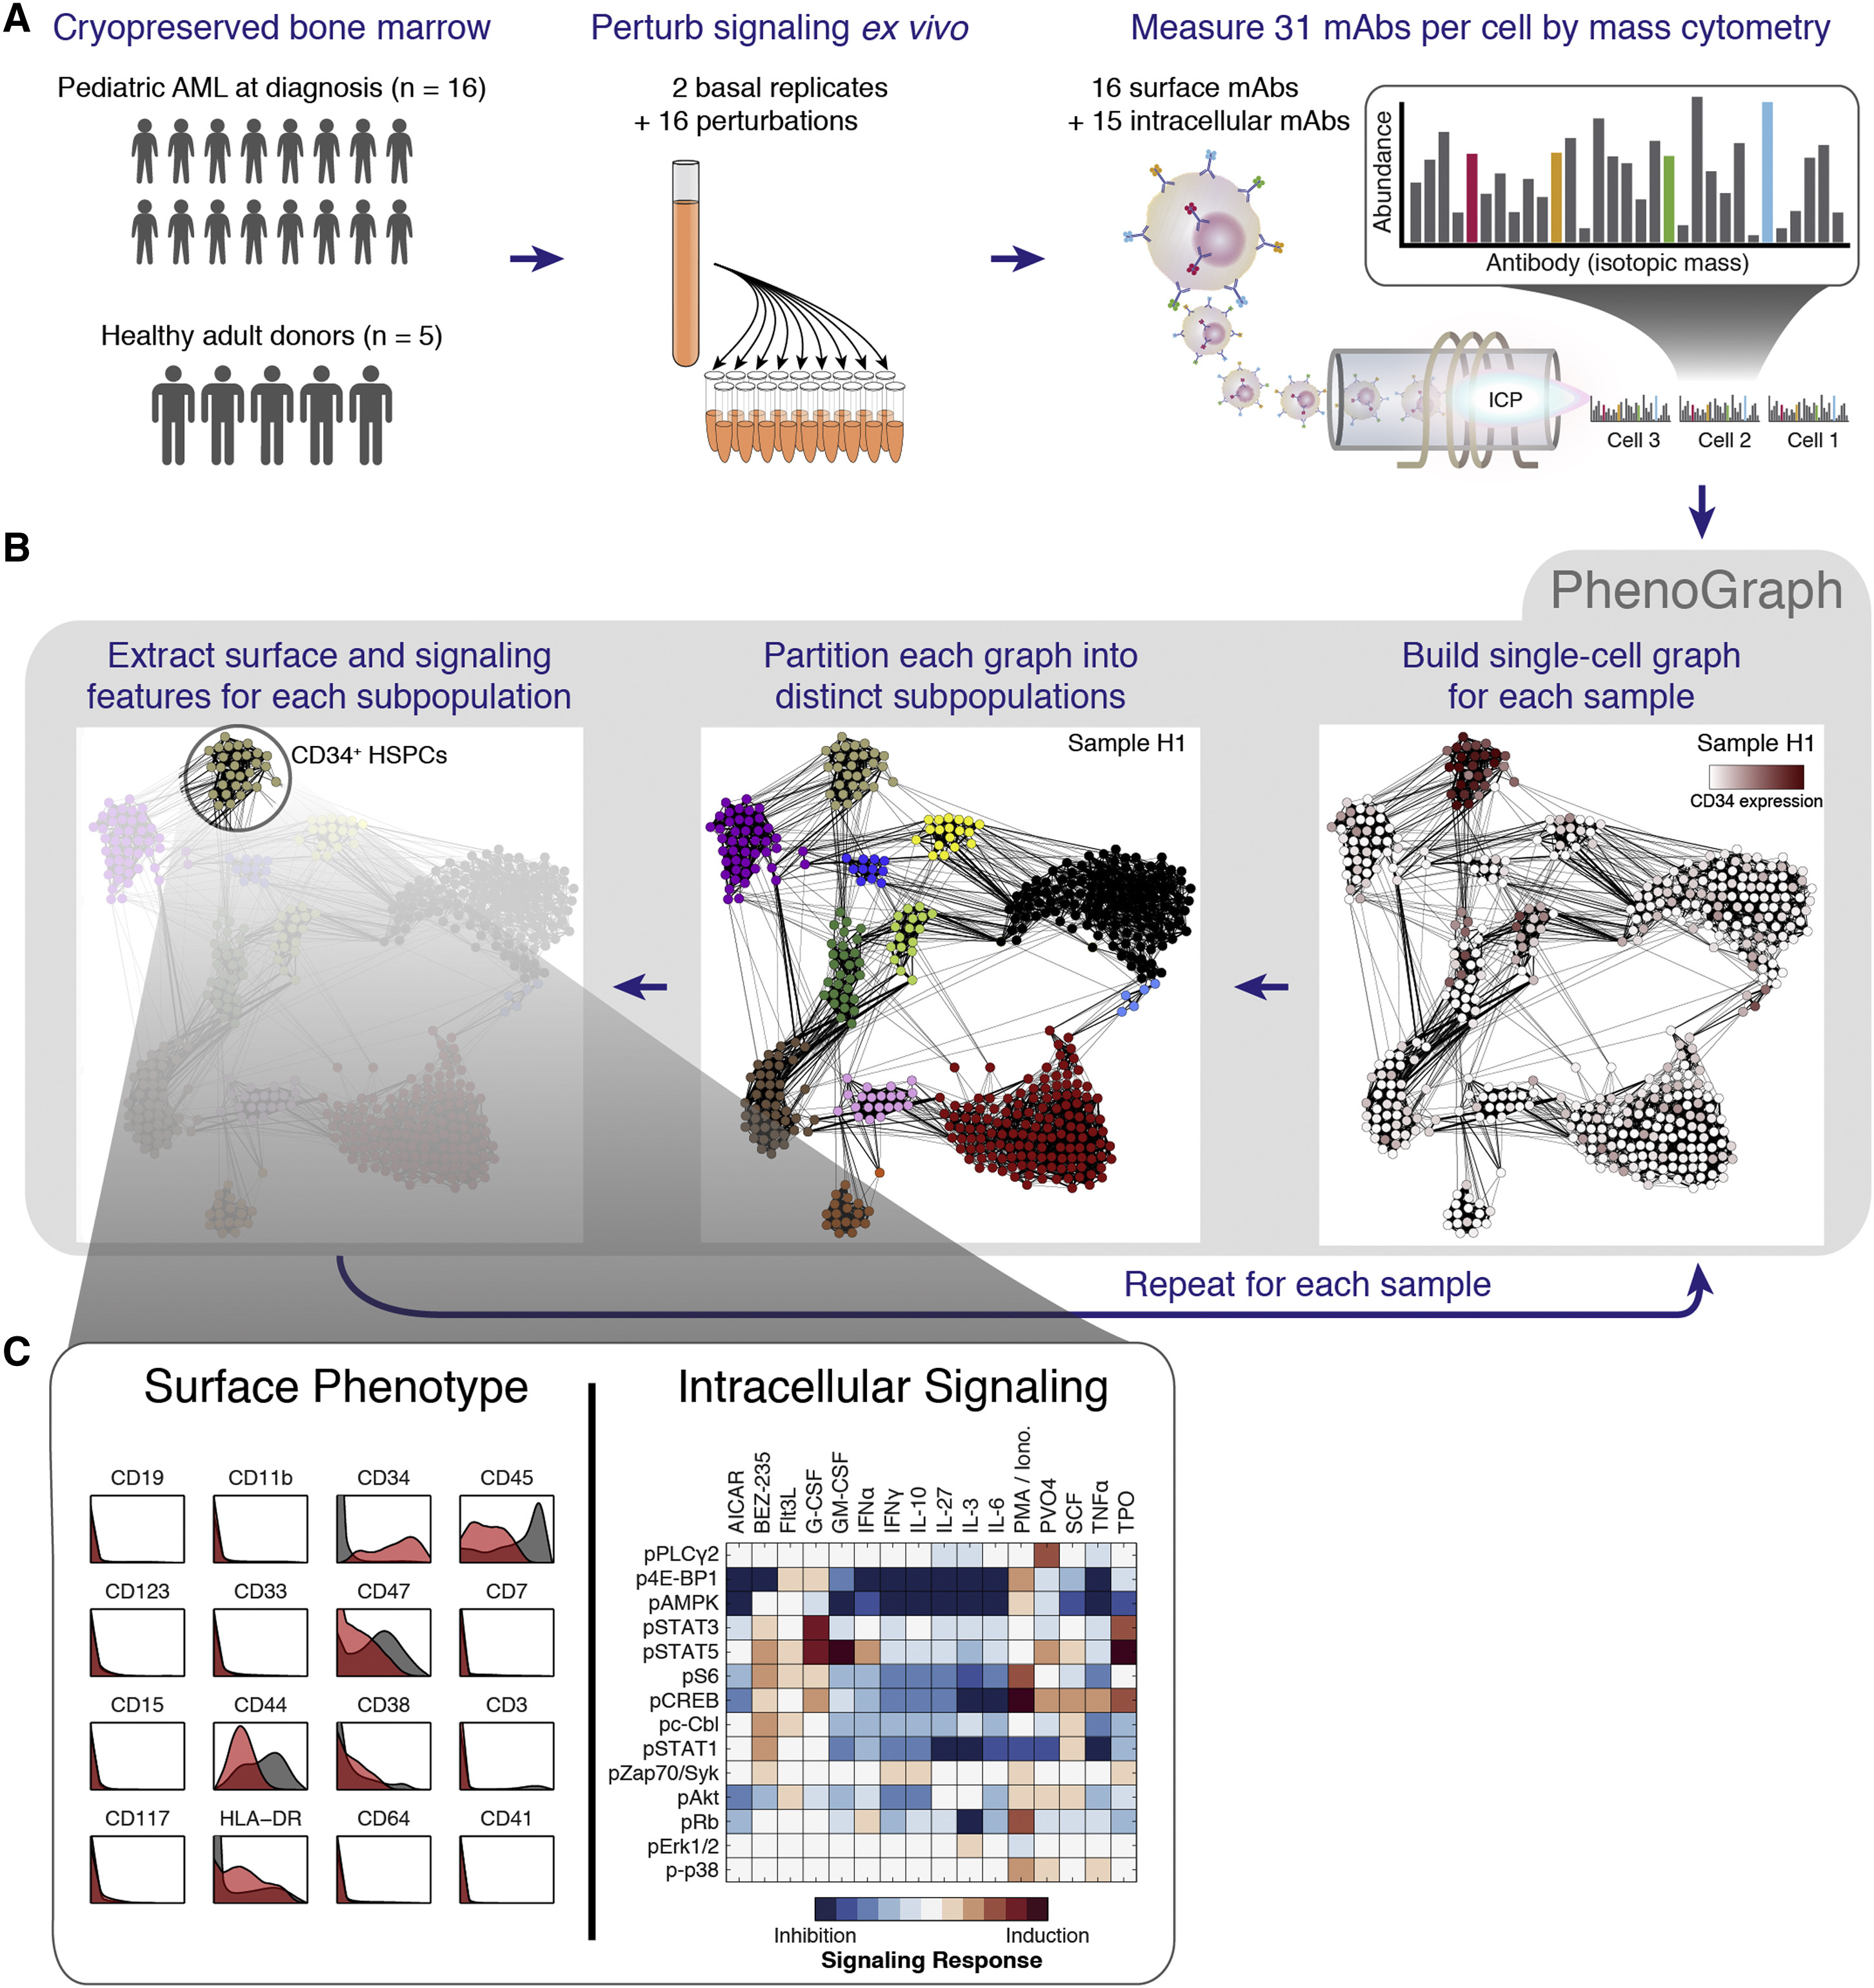
Figure 1
Cell 2015 162184-197DOI: (10.1016/j.cell.2015.05.047)
Copyright © 2015 Elsevier Inc. Terms and Conditions
Notes:
Mass Cytometry Analysis of Signaling Responses in Pediatric Acute Myeloid Leukemia
(A) Summary of experimental design.
(B) PhenoGraph method for clustering high-dimensional single-cell data. Each node in the neighbor graph represents one of 500 random cells from healthy donor H1 colored by CD34 expression. CD34⁺ HSPCs form a dense subgraph and are automatically assigned to a single subpopulation. See Figure S1 and Experimental Procedures for more details on the PhenoGraph algorithm.
(C) HSPCs identified by PhenoGraph from donor H1. This subpopulation (red histograms) had a CD34⁺/CD45^{low} phenotype relative to the other cells in the sample (gray histograms). Each PhenoGraph subpopulation contained cells from all perturbations, permitting analysis of 224 signaling responses.

