Slide 1
install.packages("glmnet")
library(glmnet)
load("hiv.rda")
dim(hiv.train$x) 704 208
head(hiv.train[[1]], 1)
p1 p2 p3 p4 p5 p6 p7 p8 p9 p10 p11 p12 p13 (...)
[1,] 1 1 1 1 1 1 1 1 1 1 1 1 1 1
(...)
p232 p233 p234 p235 p236 p237 p238 p239 p240
[1,] 0 0 0 0 0 0 0 0
head(hiv.train[[2]], 1)
2.30103

Slide 2
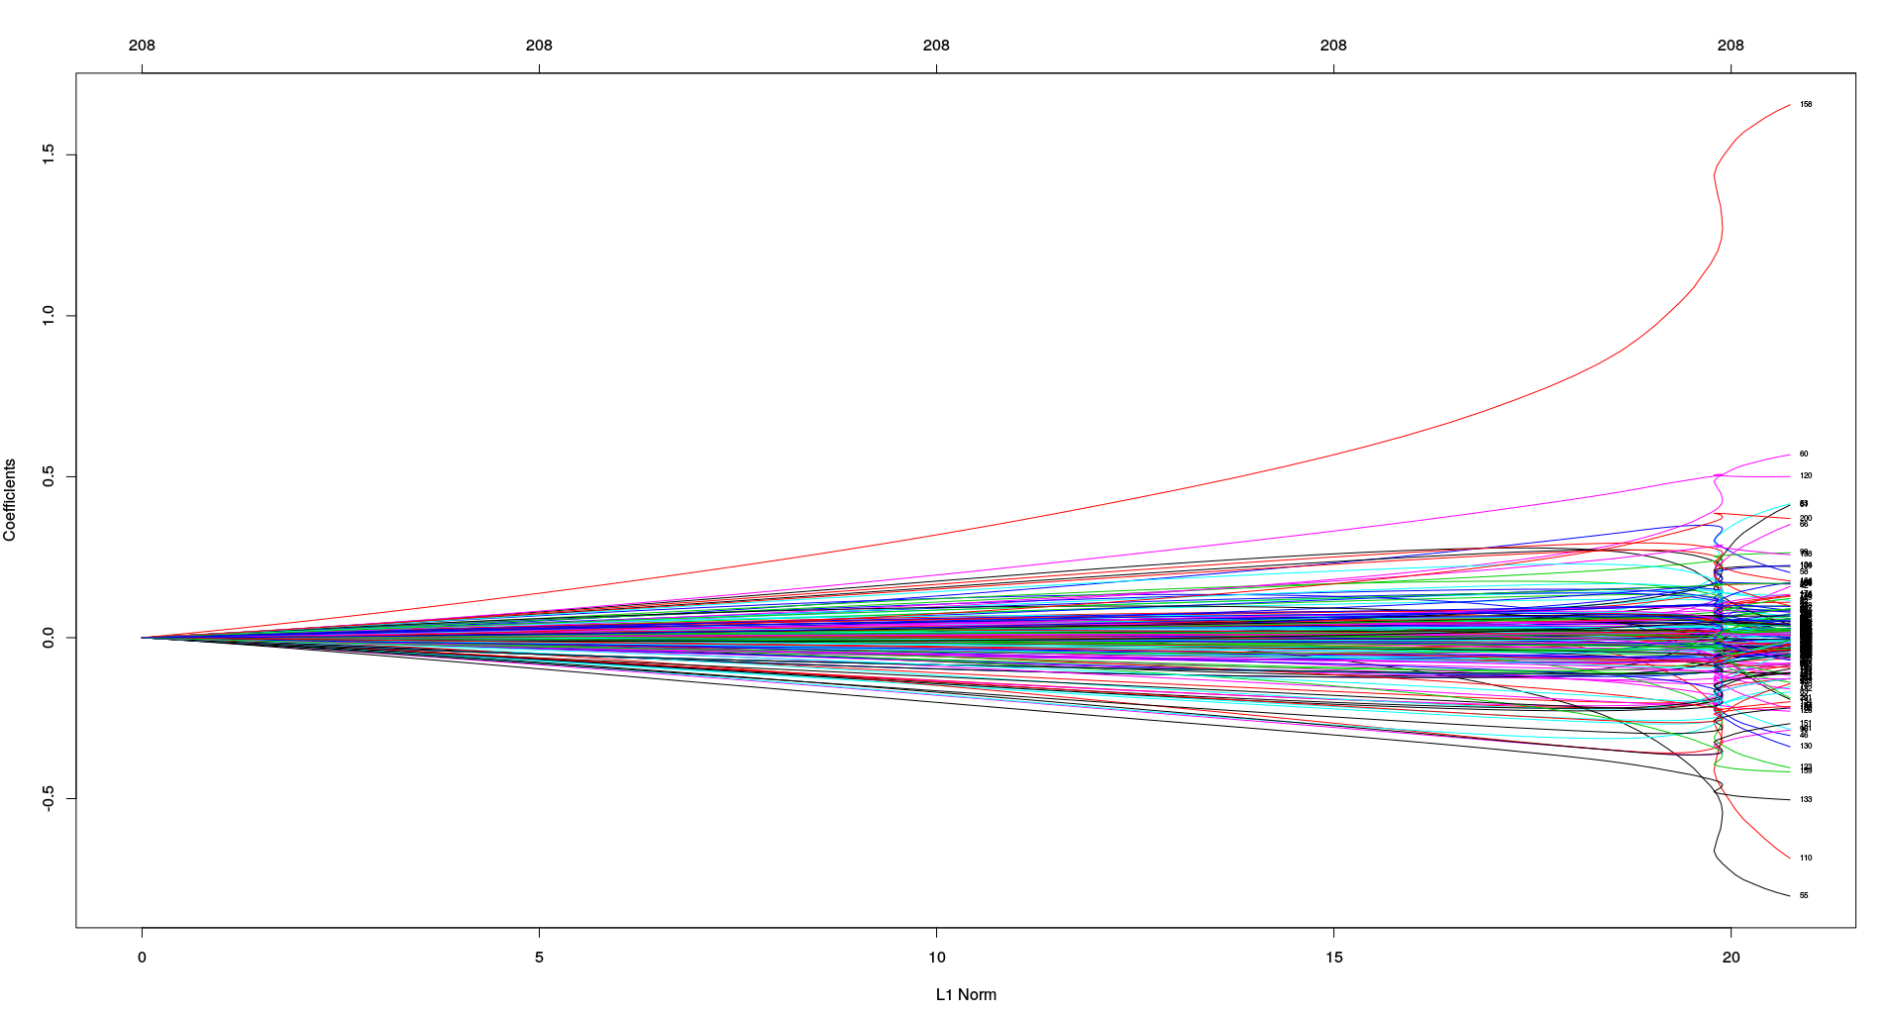
ridge <- glmnet(hiv.train$x, hiv.train$y, alpha = 0)
plot(ridge, label = TRUE)

Slide 3
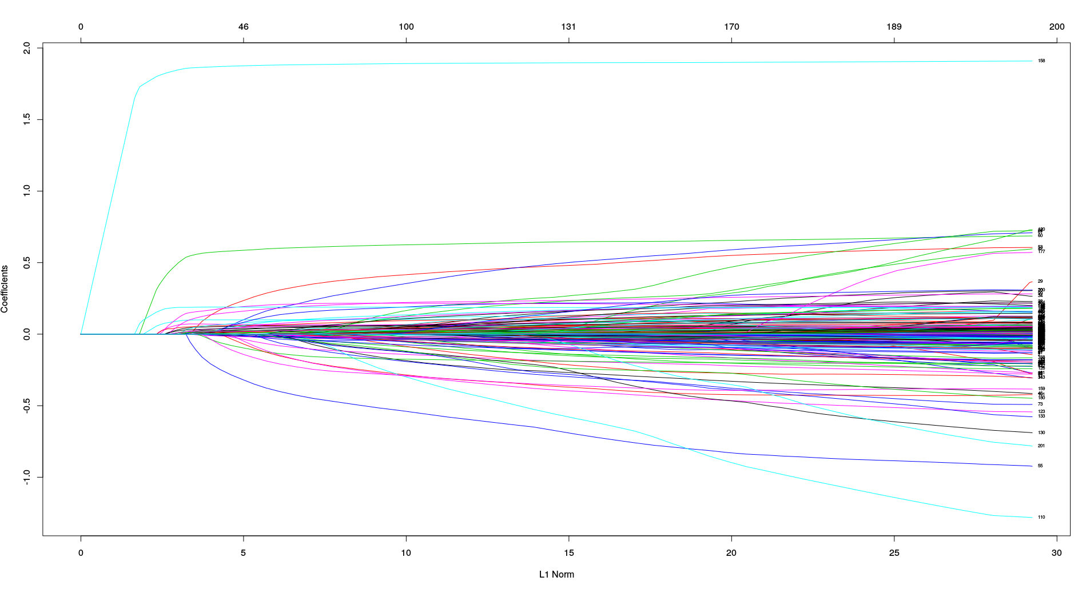
lasso <- glmnet(hiv.train$x, hiv.train$y, alpha = 1)
plot(lasso, label = TRUE)

Slide 4
modelo <- glmnet(hiv.train$x, hiv.train$y)
Call: glmnet(x = hiv.train$x, y = hiv.train$y)
Df %Dev Lambda
[1,] 0 0.0000 0.9885000
[2,] 1 0.1545 0.9007000
[3,] 1 0.2827 0.8207000
[4,] 1 0.3891 0.7478000
[5,] 1 0.4775 0.6813000
[6,] 1 0.5509 0.6208000
[7,] 1 0.6118 0.5656000
(...)
[94,] 196 0.9703 0.0001727
[95,] 197 0.9703 0.0001574
[96,] 200 0.9705 0.0001434
[97,] 200 0.9705 0.0001307

Slide 5
cv.modelo <- cv.glmnet(hiv.train$x, hiv.train$y)
cv.modelo$lambda.min
0.01136518
cv.modelo$lambda.1se
0.02392261
coef(cv.modelo, s = cv.modelo$lambda.min)
209 x 1 sparse Matrix of class "dgCMatrix"
(Intercept) 1.255203e-01
p 1 .
(…) .
p21 1.450258e-03
(…) .
p240 .

Slide 6
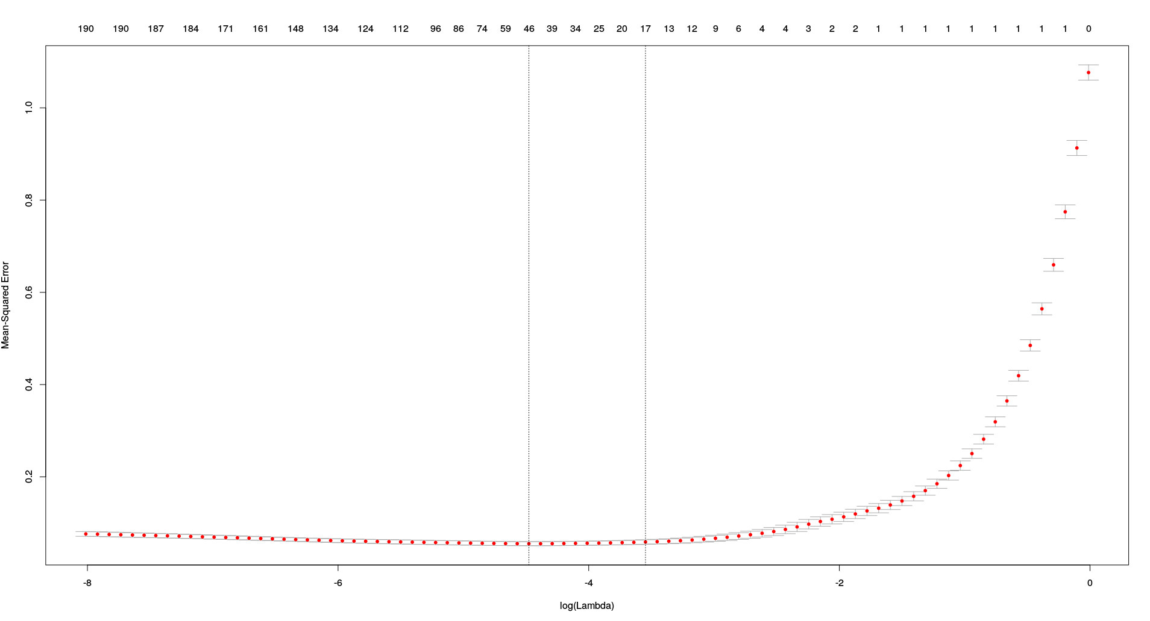

Slide 7
predicciones <- predict(modelo, hiv.test$x)
error <- apply((predicciones - hiv.test$y)^2, 2, mean)
points(log(modelo$lambda), error, col="blue", pch="*")

Slide 8
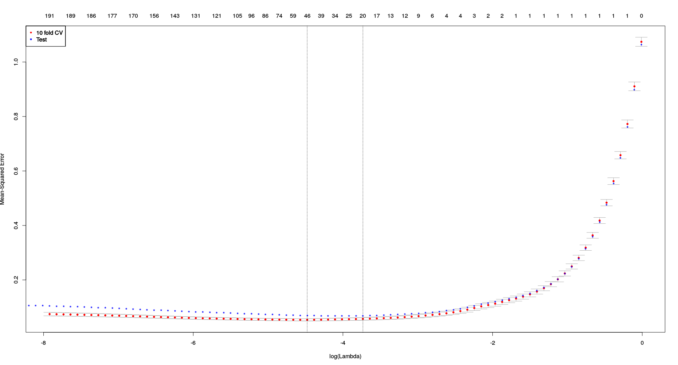

Slide 9
import matplotlib.pyplot as plt
import numpy as np
from sklearn import datasets, linear_model
from sklearn.metrics import r2_score
hiv_train_x = np.genfromtxt('train.x.csv', delimiter=",")
hiv_train_y = np.genfromtxt('train.y.csv', delimiter=",")
hiv_test_x = np.genfromtxt('test.x.csv', delimiter=",")
hiv_test_y = np.genfromtxt('test.y.csv', delimiter=",")

Slide 10
alpha = 0.1
l1_ratio = 0.7
en = ElasticNet(alpha = alpha, l1_ratio = l1_ratio)
en_model = en.fit(hiv_train_x, hiv_train_y)
predicciones = en_model.predict(hiv_test_x)

Slide 11
l = linear_model.LinearRegression()
l_model = l.fit(hiv_train_x, hiv_train_y)
y_pred_l_model = l_model.predict(hiv_test_x)
r2_score_l_model = r2_score(hiv_test_y, y_pred_l_model)

Slide 12
lassocv = linear_model.LassoCV()
lassocv_model = lassocv.fit(hiv_train_x, hiv_train_y)
y_pred_lassocv = lassocv_model.predict(hiv_test_x)
r2_score_lassocv = r2_score(hiv_test_y, y_pred_lassocv)

Slide 13
l1_ratios = [.5,.6,.7,.8,.9,1]
encv =linear_model.ElasticNetCV(l1_ratio=l1_ratios)
encv_model = encv.fit(hiv_train_x, hiv_train_y)
y_pred_enetcv = encv_model.predict(hiv_test_x)
r2_score_encv = r2_score(hiv_test_y, y_pred_enetcv)

Slide 14
r2_score_l_model
0.88868424783910593
r2_score_lassocv
0.93820094210822402
r2_score_enetcv
0.93825334982548758

