Slide 1

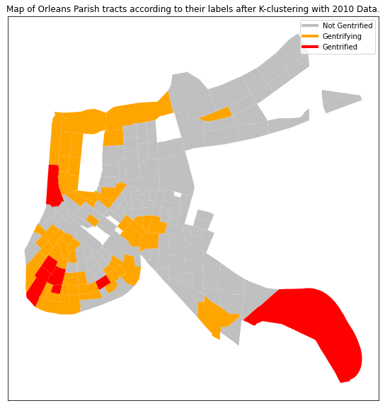
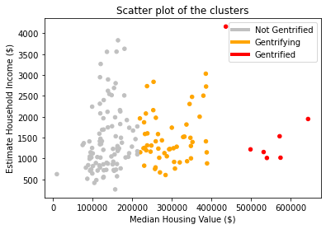
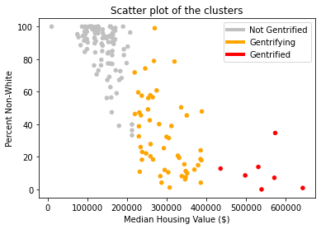
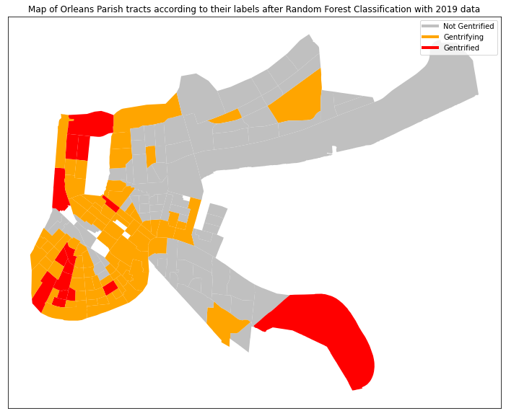
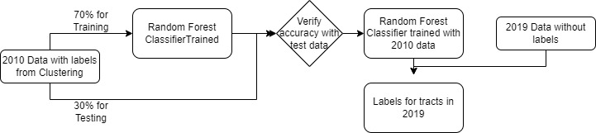
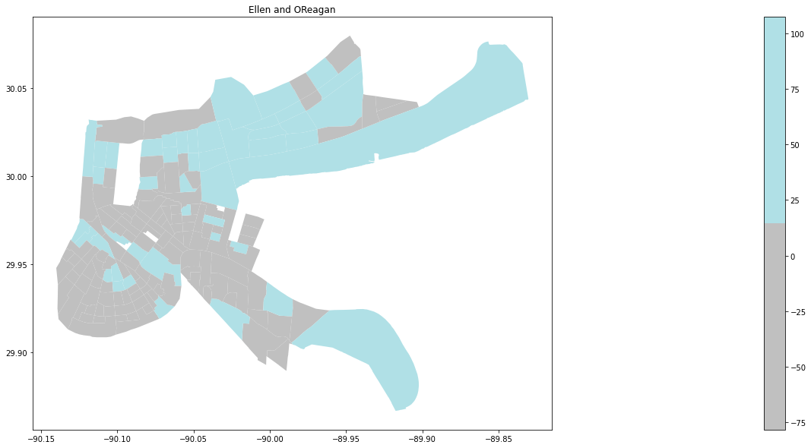
Diego Oldenburg: Economics and Computer Science Manuel Posada: Mathematics and Computer Science Advisor: Carola Wenk, Department of Computer Science
Machine Learning to Identify Gentrification
Introduction
Fig 3. Map of Orleans Parish with tracts labeled as non-gentrified (grey) and eligible for gentrification (light blue), and gentrified (dark blue), based on the labels created by a k-clustering algorithm on 2010 census data.
New Orleans is a city susceptible to demographic changes of displacement, often called gentrification. We set out to apply machine learning algorithms to census data of the Orleans Parish from 2010 and 2019 to generate a quantitative definition of gentrification in the Orleans Parish, which works alongside existing qualitative research on the issue in Orleans Parish.
Problem Statement
Our project seeks to apply techniques used by David Knorr in his paper Using Machine Learning to Identify and Predict Gentrification in Nashville, Tennessee in New Orleans. We found this approach used to define and analyze the definition of gentrification in cities throughout the world, and we wanted to apply it the city of New Orleans so that we can arrive at a better definition for gentrification than that previously seen in displacement studies which can be useful for further studies of the city and its inhabitants.
Methods/Approach
From the US census American Community Survey, we collect 5-year average data for 2010 and 2019. We looked at 160 tracts(census neighborhood divisions) in Orleans Parish, and for each we identified over 20 attributes which we thought relevant to identifying risk of displacement, such as percent non-white population and median rent value.
We can also see how our machine learning algorithm understands the data form the city to be changing as we compare the labels given by us for 2010 to the ones predicted by the algorithm for 2019. From these, residents of the area can begin to construct narratives for the change in the city. For example, the contrast between gentrifying neighborhoods of uptown and the neighborhood of Holly Grove, or the consolidation of white and wealthy residents near the magazine street shopping area.
Fig 3. Map of Orleans Parish with tracts labeled as non-gentrified (grey) and eligible for gentrification (light blue), and gentrified (dark blue), based on the predictions of the Random Forest Algorithm on 2019 census data.
Results
By considering a variety of indicators for each tract we were able to create a classifier for gentrification which for Orleans Parish is much more accurate than other definitions of gentrification such as that by Ellen and O’Reagan, who in studying low-income neighborhood change defined a tract or neighborhood as eligible (at risk of gentrification) if less than 70% of metropolitan income in start year. Gentrified if 10%+ increase in ratio of tract to metro average household income over 10 years. By this measure, exactly zero tracts in Orleans Parish are gentrified.
Conclusion/Future Work
We were interested in applying a known process to Orleans Parish as we feel it is a City particularly susceptible within the US to displacement, and which has been excluded from most studies in this area. In isolation this work is not contribute to solve the issue of displacement in New Orleans, but we hope to encourage discourse of the issue as a serious threat to the population and identity of the city.
While we only used data available through the US census American Community survey, the same machine learning approach can be extended to analyze other factors of gentrification in Orleans Parish. We found, for example, articles studying the correlation between tourism and displacement in New Orleans. If data from Airbnb and other services could be gathered for 2010 and 2019 and added as an attribute, the link between short term rentals and displacement in Orleans Parish could be studied and quantified through this approach.
Fig 1. Map of Orleans Parish with tracts labeled as inelegible (grey) and eligible (light blue) for gentrification, with no tract defined as gentrified based on the metric from the Ellen and O’Reagan paper applied to 2019 census data.
References
https://data.census.gov/cedsci/
Knorr, David Christopher. “Using Machine Learning to Identify and Predict Gentrification in Nashville, Tennessee.” N.p., 2019. Print
Royall, Emily. (2016). Towards an epidemiology of gentrification : modeling urban change as a probabilistic process using k-means clustering and Markov models.
Ellen, I., O’Regan, K., 2010. How Low Income Neighborhoods Change: Entry, Exit and Enhancement (Working Paper). NYU Wagner School and Furman Center for Real Estate & Urban Policy.

