Slide 1











Eje de simetría
$L_{xIC}=0.02$ [m]
$L_{xIC}=0.02$ [m]
$L_{xIC}=0.02$ [m]
$z$
$$t_{rec}$$
$$L_{zIC}$$
$L_{zPCB}$
$$L_{z}$$
$x$
$t_{rec}$
$L_{x}=0.14$ [m]

Slide 2
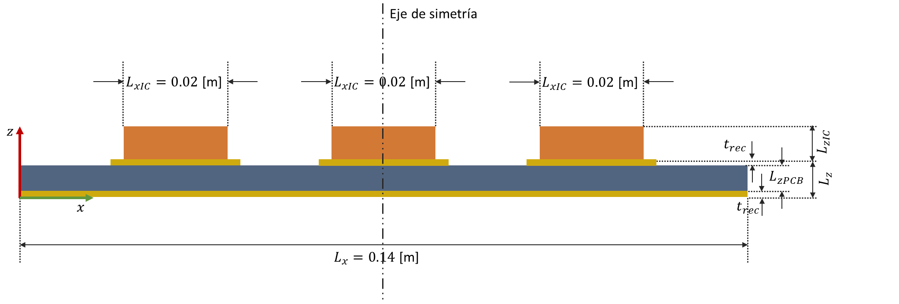

Slide 3






Eje de simetría
$L_{y}=0.10$ [m]
$$L_{yIC}$$
$L_{x}=0.14$ [m]
$0.03$ [m]
$y$
$x$
$L_{x}=0.14$ [m]

Slide 4
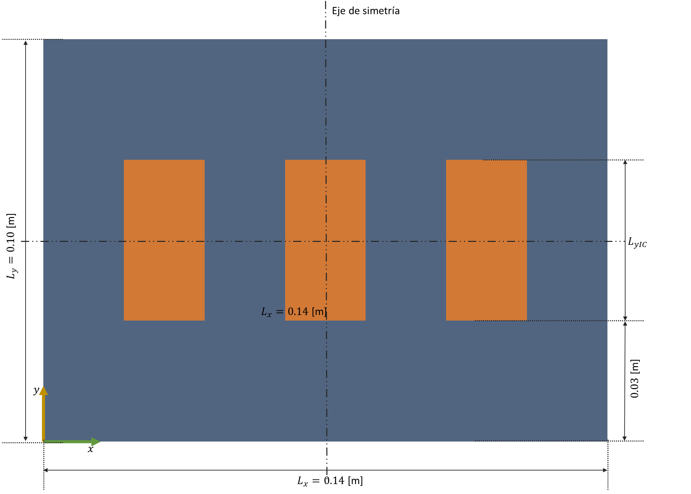

Slide 5

$L_{xIC}=0.02$ [m]
$L_{xIC}=0.02$ [m]
$L_{xIC}=0.02$ [m]
$z$
$x$
1
2
3
4
5
6
7
$L_{x}=0.14$ [m]

Slide 6
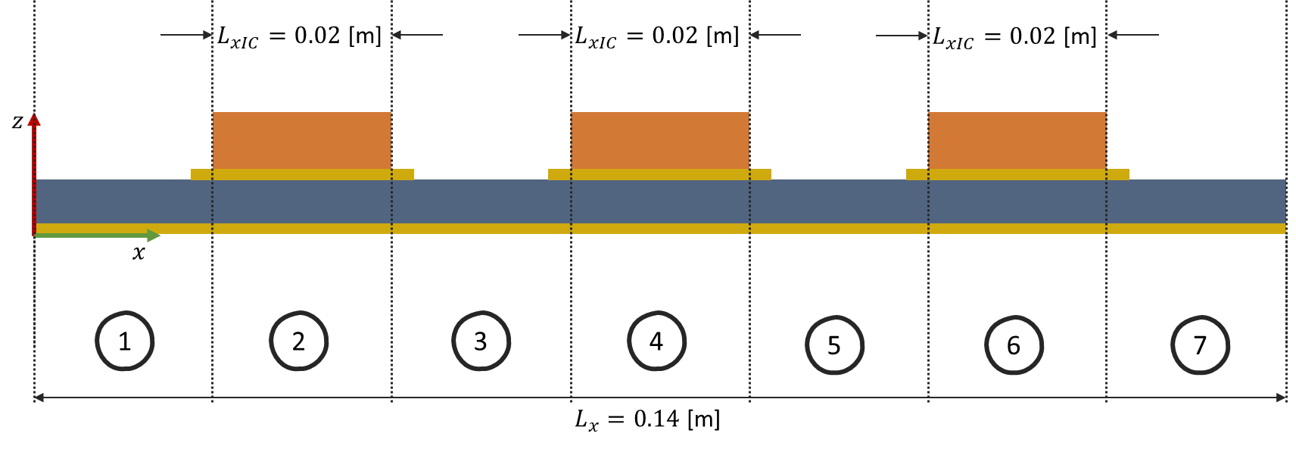

Slide 7









$$N_{y}+1$$
$$…$$
$y$
$$1$$
$x$
$$1$$
$$…$$
$$N_{x}+1$$

Slide 8
