Slide 1

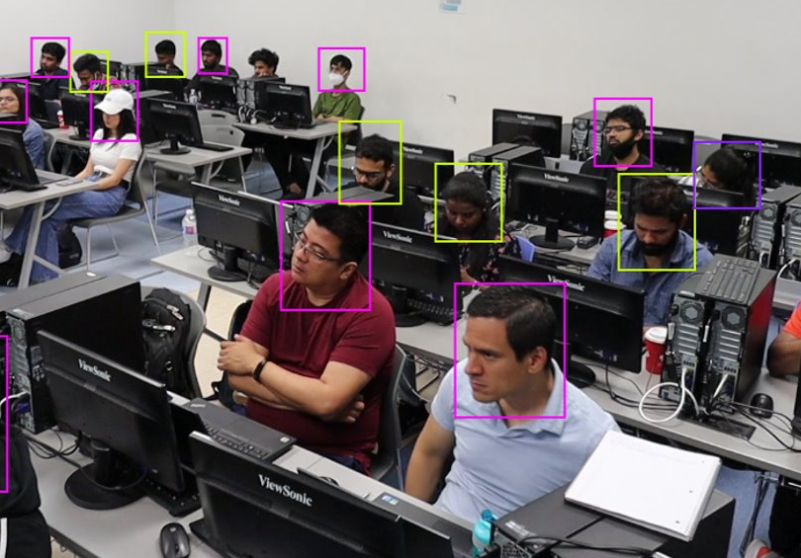
AML-3406
Capstone Project
Image detection of students’ attentiveness in the classroom

Slide 2



AML-3406
Capstone Project
Group Number 3
Diego Ortiz
Henry Ramos
Julio Sánchez
Parth Patel

