Slide 1
ETL
Weather Data
Ingeniero Mecatrónico Especialista en Inteligencia Artificial,
Diego Iván Perea Montealegre

Slide 2
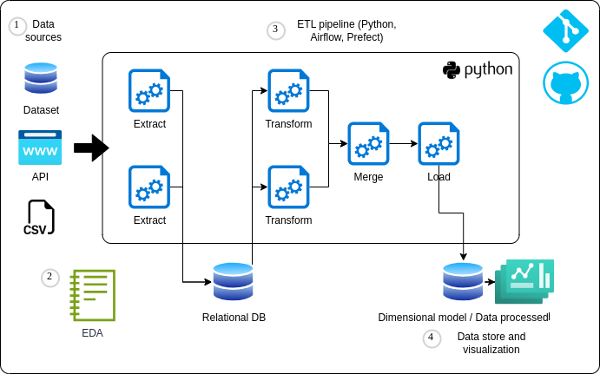


ETL Project

Slide 3

Weather Data
This dataset contains synthetic weather data generated for ten different locations, including New York, Los Angeles, Chicago, Houston, Phoenix, Philadelphia, San Antonio, San Diego, Dallas, and San Jose. The data includes information about temperature, humidity, precipitation, and wind speed, with 1 million data points generated for each parameter.

Slide 4






Weather Data
Features:
Location: The city where the weather data was simulated.
Date_Time: The date and time when the weather data was recorded.
Temperature_C: The temperature in Celsius at the given location and time.
Humidity_pct: The humidity in percentage at the given location and time.
Precipitation_mm: The precipitation in millimeters at the given location and time.
Wind_Speed_kmh: The wind speed in kilometers per hour at the given location and time.

Slide 5
01
Extract

Slide 6
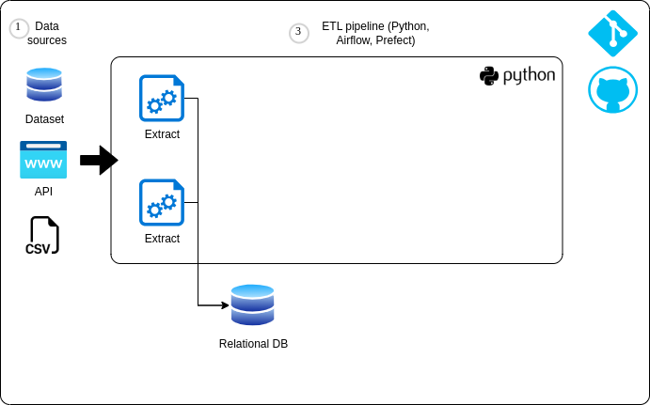
Phase 1

Slide 7



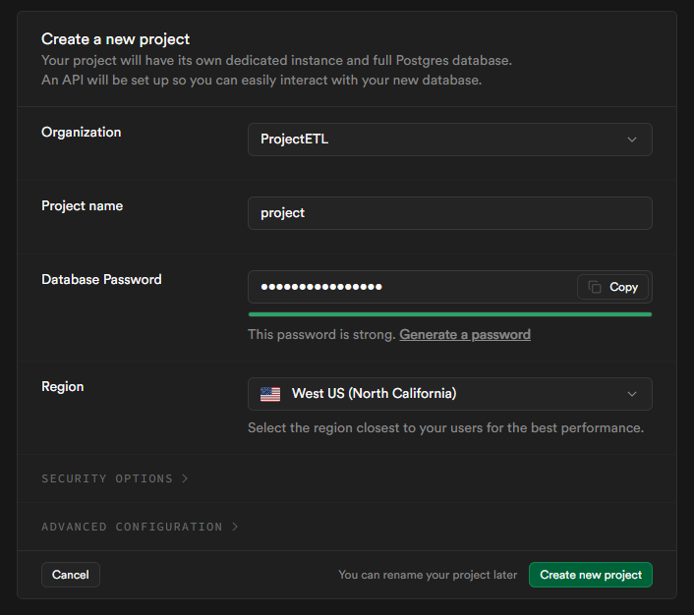
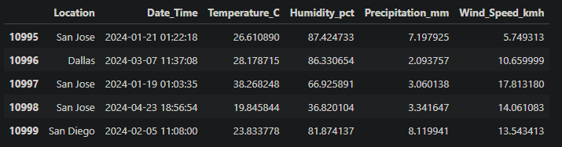
Phase 1
1 million rows
11000 rows

Slide 8
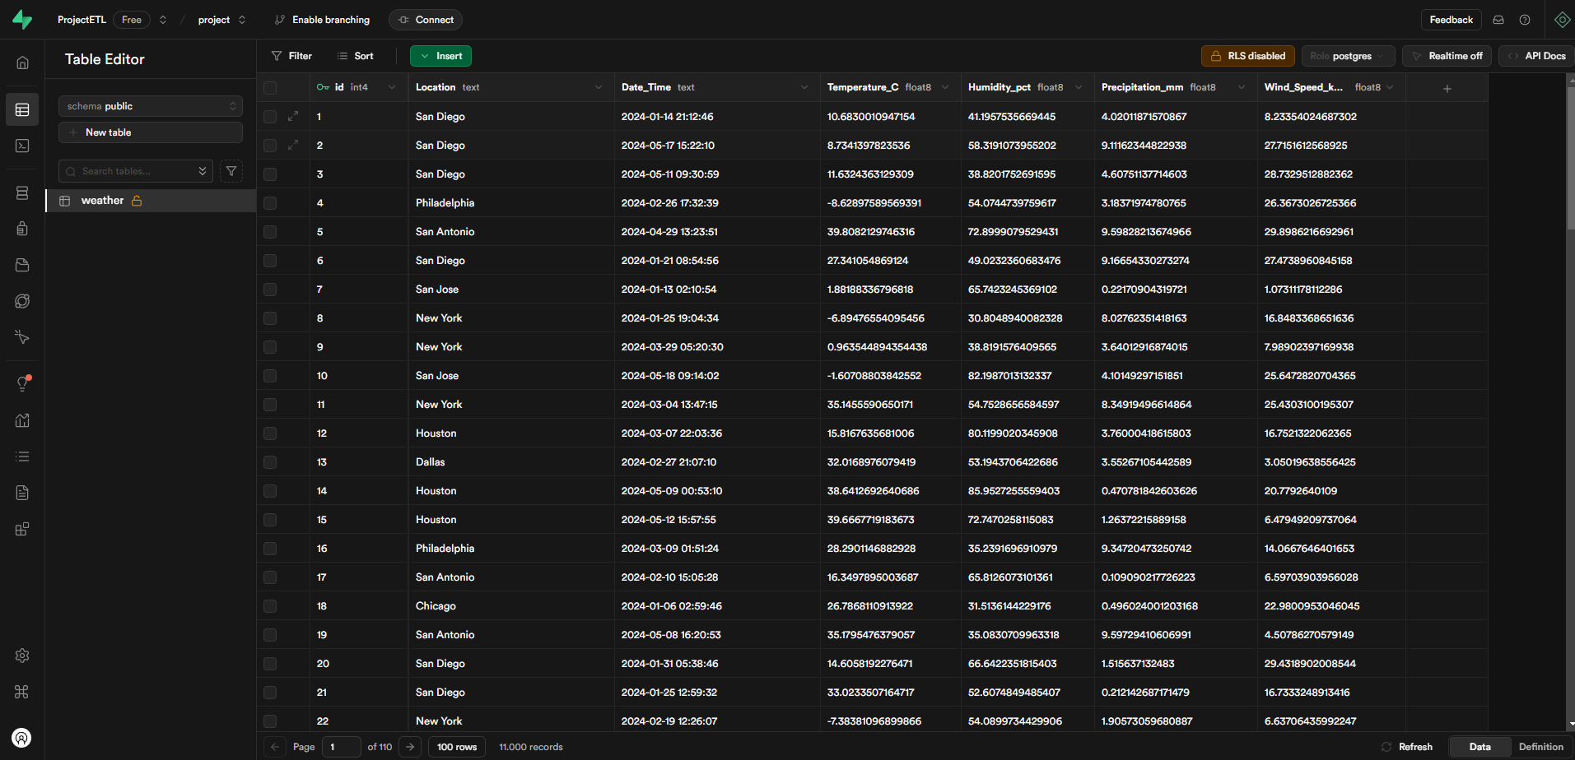
Phase 1

Slide 9
Phase 1

Slide 10
02
Transform

Slide 11
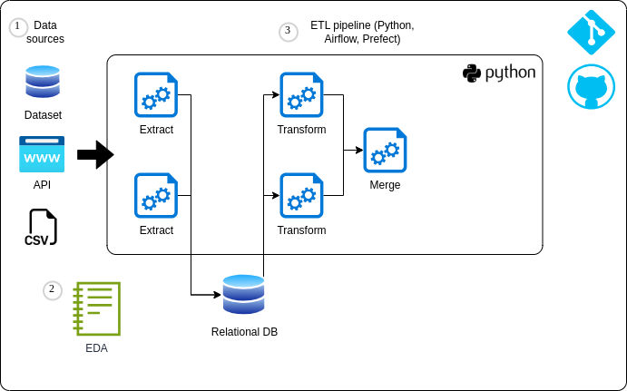
Phase 2

Slide 12
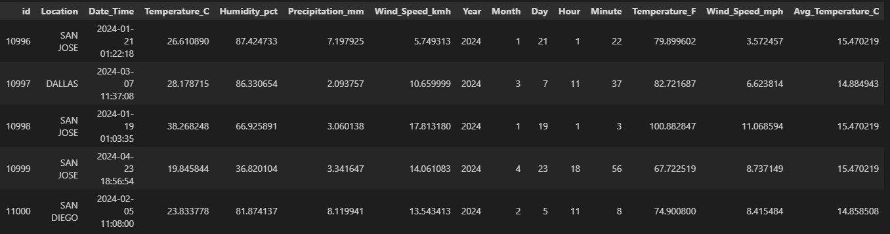
Phase 2
The following transformations are performed:
Extract year, month, day, hour, and minute from Date_Time
Convert Location to uppercase
Normalize Temperature_C to Fahrenheit
Normalize Wind_Speed_kmh to mph
Average temperature per location

Slide 13
03
Load

Slide 14
ETL Project

Slide 15
Phase 3

Slide 16
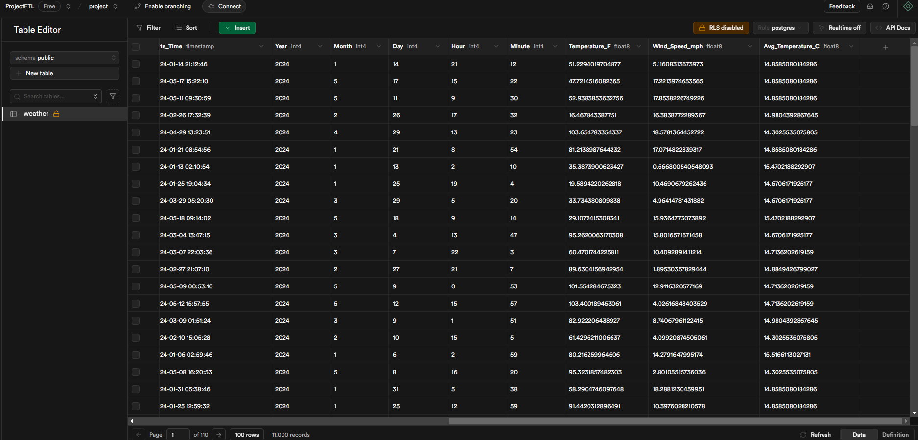
Phase 3

Slide 17
04
Visualization

Slide 18

ETL Automatization
ETL
python etl.py
All Phases

Slide 19


Dashboard

Slide 20
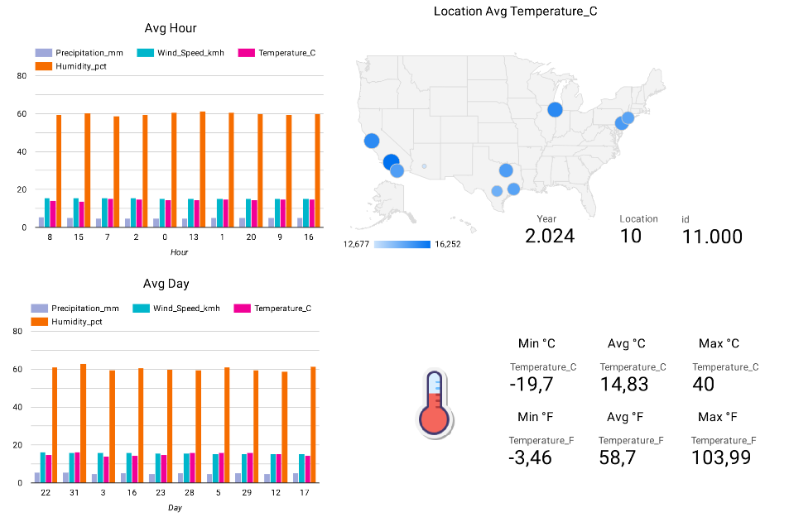
Dashboard

Slide 21
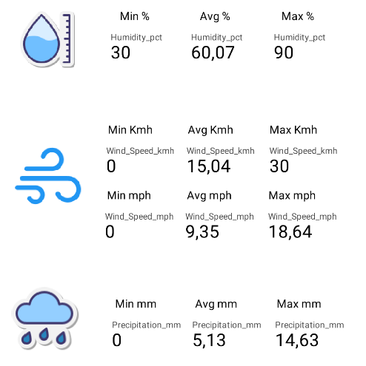
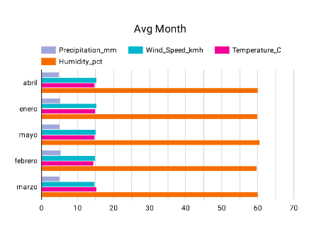
Dashboard

Slide 22
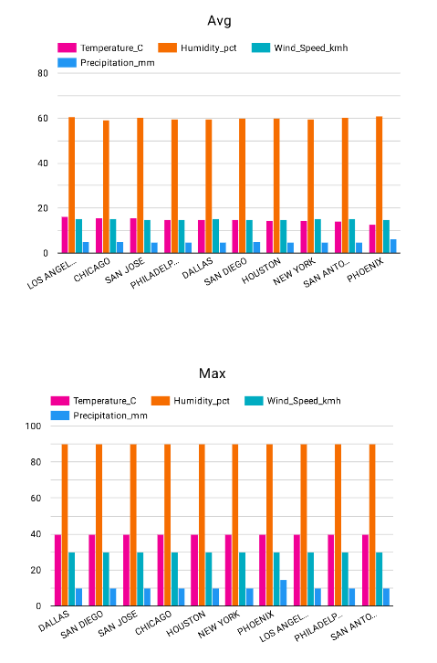
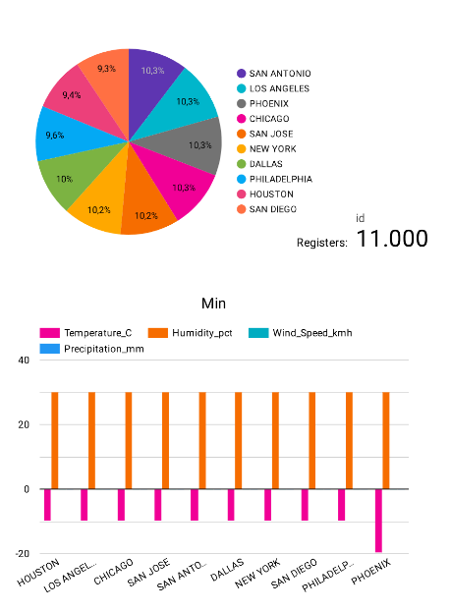
Dashboard

Slide 23


https://github.com/diegoperea20/Project-ETL

Slide 24
¡Gracias!

