Slide 1



Rolling Horizon Evolution versus Tree Search for Navigation in Single-Player Real-Time Games
Diego Perez, Spyridon Samothrakis,
Simon M. Lucas and Philipp Rohlfshagen
Games Intelligence Group
University of Essex, UK
DETA2, Evolution in Music and Games
Amsterdam, The Netherlands
July 06-10, 2013

Slide 2
Table of Contents
The Physical Travelling Salesman Problem.
Monte Carlo Tree Search.
Rolling Horizon Evolutionary Algorithms.
Experiments.
Conclusions.

Slide 3
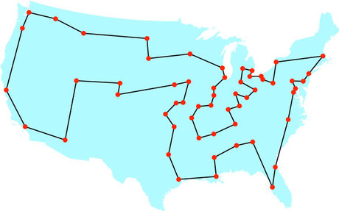
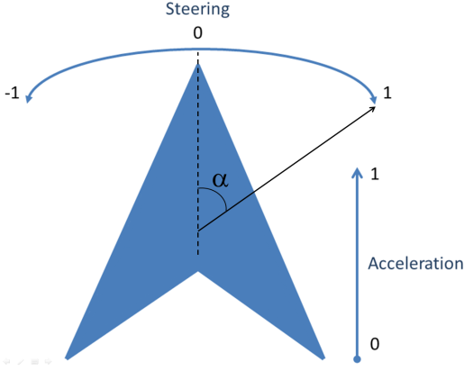
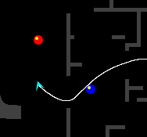


The Physical Travelling Salesman Problem
Travelling Salesman Problem:
Turn it into a real-time game!
Drive a ship.
In a maze.
With constraints:
10 waypoints to reach.
1000 steps to visit next waypoint.
40ms to decide an action.
1s initialization.

Slide 4
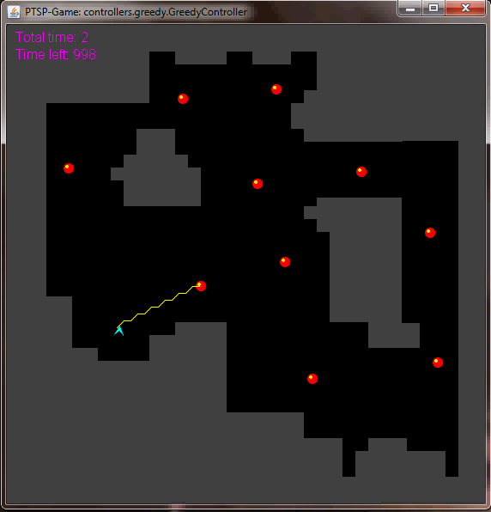
The Physical Travelling Salesman Problem
Features some aspects of modern video games.
Navigation.
Obstacle avoidance.
Pathfinding.
Real-time game.
Competitions.
www.ptsp-game.net
WCCI/CIG 2012
Winner: MCTS.
CIG 2013
Open till end of July.

Slide 5
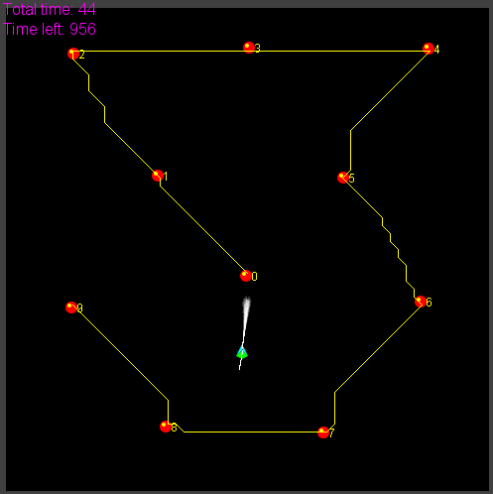
Solving the PTSP – TSP Solvers

Slide 6
Solving the PTSP – Macro-actions
Single action oriented solutions:
6 actions, 10 waypoints, 40ms to choose move.
1000-2000 actions per game.
Search space ~ 6¹⁰⁰⁰ - 6²⁰⁰⁰
Limiting look-ahead to 2 waypoints:
Assuming 100-200 actions per waypoint.
Search space ~ 6¹⁰⁰ - 6²⁰⁰
Introducing macro-actions:
Repetitions of single actions in L time steps.
Search space ~ 6¹⁰ – 6²⁰ (L=10).
Time to decide a move increased: L*40ms

Slide 7
Solving the PTSP – Score function
Heuristic to guide search algorithm when choosing next moves to make.
Reward/Fitness for mid-game situations.
Components:
Distance to next waypoints in route.
State (visited/unvisited) of next waypoints.
Time spent since beginning of the game.
Collision penalization.

Slide 8
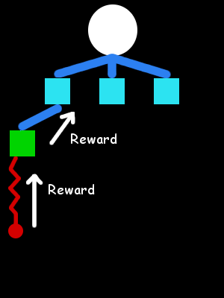
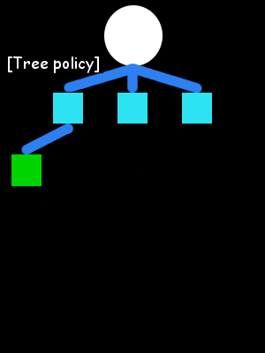
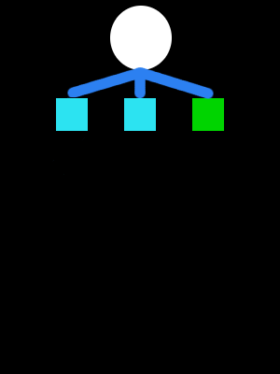

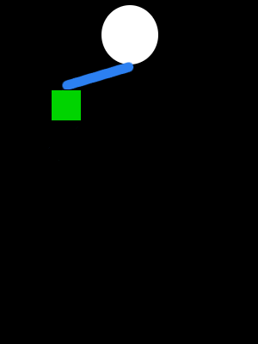
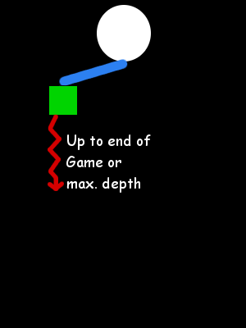
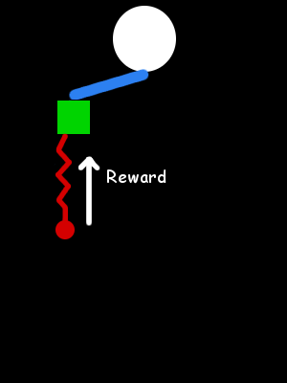
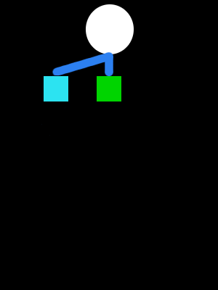
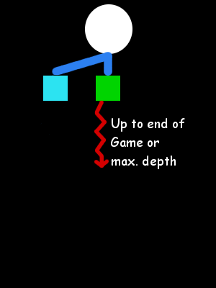

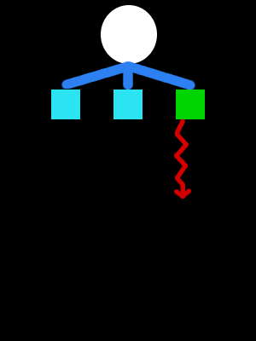
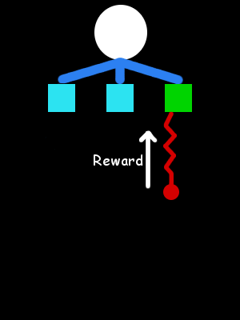
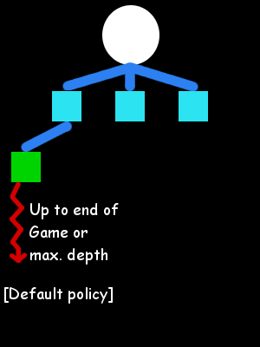
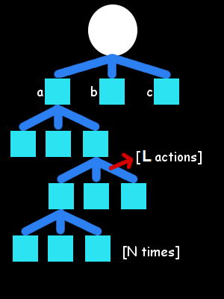
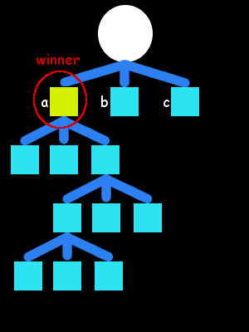
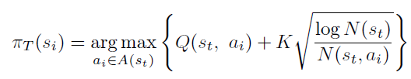
Monte Carlo Tree Search
Monte Carlo Tree Search (MCTS)
Monte Carlo Tree Search
Monte Carlo simulations.
Exploitation vs. Exploration.
Builds an asymmetric tree.
Anytime.

Slide 9

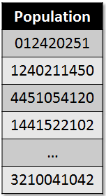
Rolling Horizon Evolutionary Algorithms
Individual as a sequence of N macro-actions.
Initialized at random
Evolve population during L (macro-action length) game steps.
Fitness: score function.
Tournament selection.
Uniform crossover.
Mutation (smooth).
Reset population after L game steps.

Slide 10
Experimentation
10 different maps (PTSP Competition).
20 matches per map.
Five configuration pairs:
{(N,L)} = {(50,1),(24,5),(12,10),(8,15),(6,20)}; N x L = 120
Four algorithms:
MCTS.
Random Search.
GA (Selection, Crossover and Mutation [0.2, 0.5, 0.8]).
GA (Mutation [0.2, 0.5, 0.8]).
Measurements:
Efficacy: number of waypoints visited.
Efficiency: t/w (t: time spent, w: waypoints visited).

Slide 11
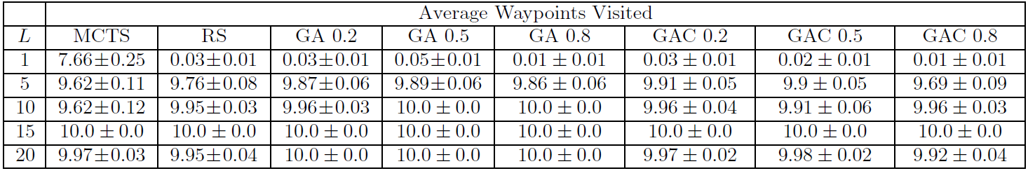
Analysis of results - Efficacy
L=15 obtains always optimum efficacy.
Matches previous results in PTSP Competition.
MCTS is the only algorithm that performs reasonably well without macro-actions.

Slide 12
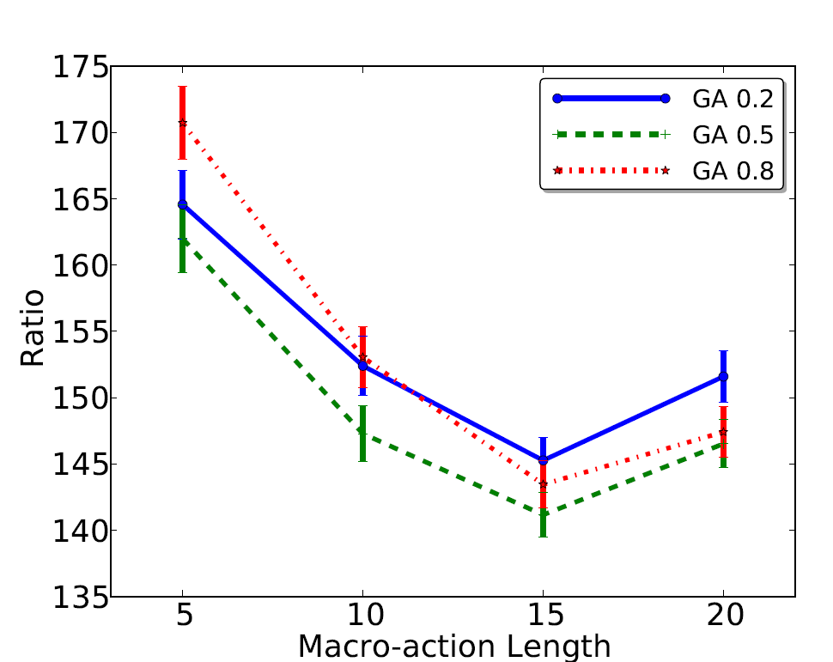
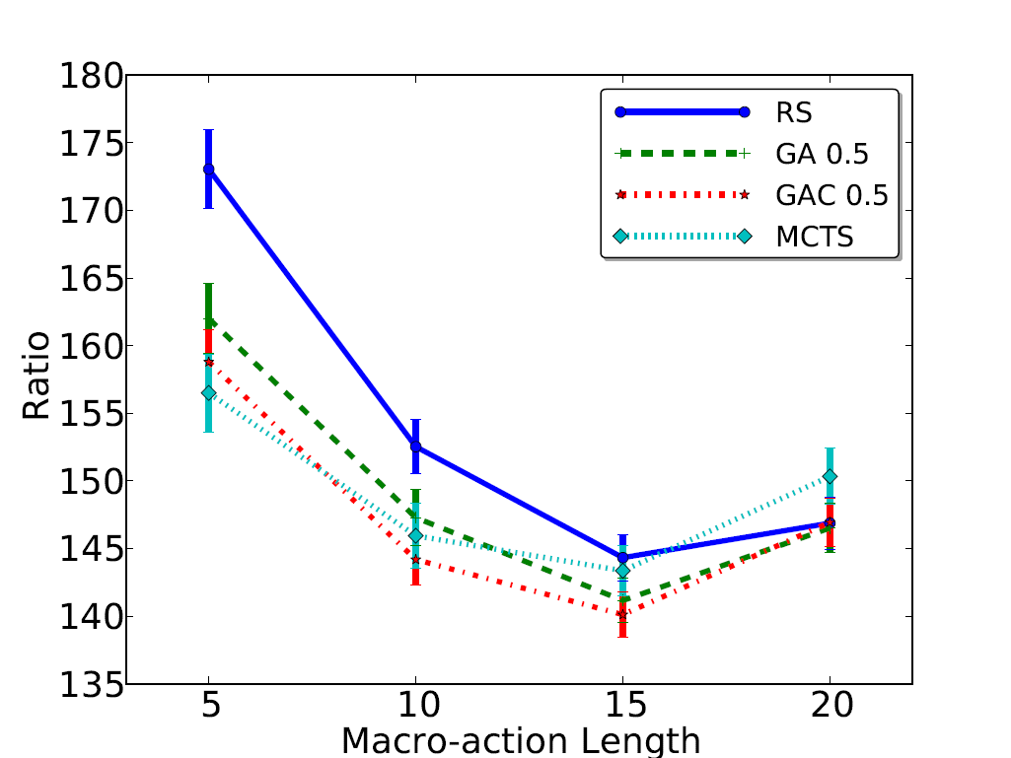
Analysis of results - Efficiency

Slide 13
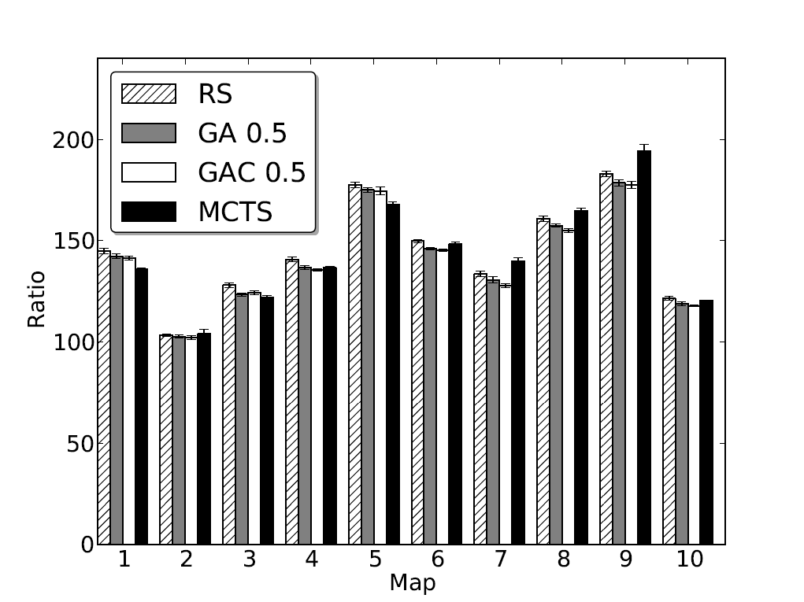
Analysis of results – Per Map

Slide 14
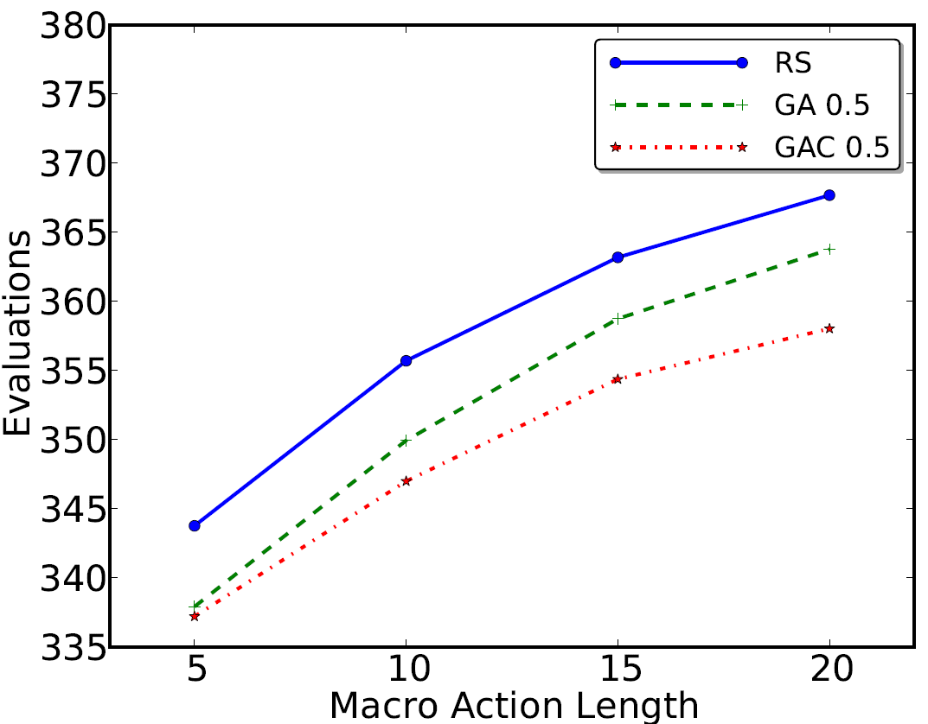
Analysis of results – Evaluations
Evaluations per game cycle (L=15):
RS: ~362
GA: ~358
GAC: ~353
MCTS?
~ 1200

Slide 15
Final notes to take away
Importance of macro-actions.
Fine-tuning of the macro-action length.
High level commands in more complex games.
MCTS deals with single action solutions.
MCTS performs more evaluations per cycle.
Re-use of game states.
Less sensible to high costs in forward model.
Rolling horizon evolution obtains similar, sometimes better, solutions than MCTS (winner of the PTSP Competition).
Viable alternative for general video-game agent control.

Slide 16
Q & A
Thanks for your attention!

