Slide 1


Traffic Accidents in Pennsylvania
Diego Salazar D’Antonio
CSE449

Slide 2

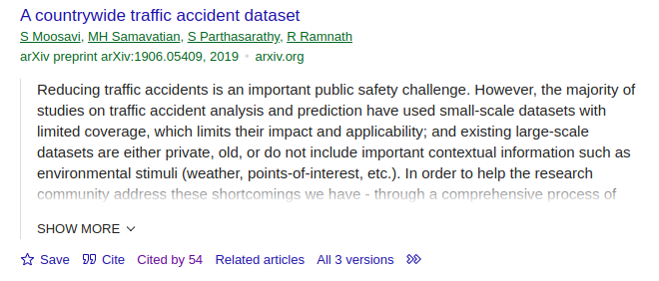
Dataset
This dataset was collected in real-time using multiple Traffic APIs. It contains 1.5 millions accidents data collected from February 2016 to March 2023 covering 49 states in US.
The US-Accidents dataset can be used for numerous applications, such as car accident prediction, studying car accident hotspot locations, casualty analysis, extracting cause and effect rules to predict car accidents, and studying the impact of precipitation, other environmental stimuli on accident occurrence.
54 citations from a wide variety of conferences and journals.
Source: Moosavi, S., Samavatian, M.H., Parthasarathy, S., Ramnath, R.: A countrywide traffic accident dataset. arXiv preprint arXiv:1906.05409 (2019) https://www.kaggle.com/datasets/sobhanmoosavi/us-accidents/data

Slide 3
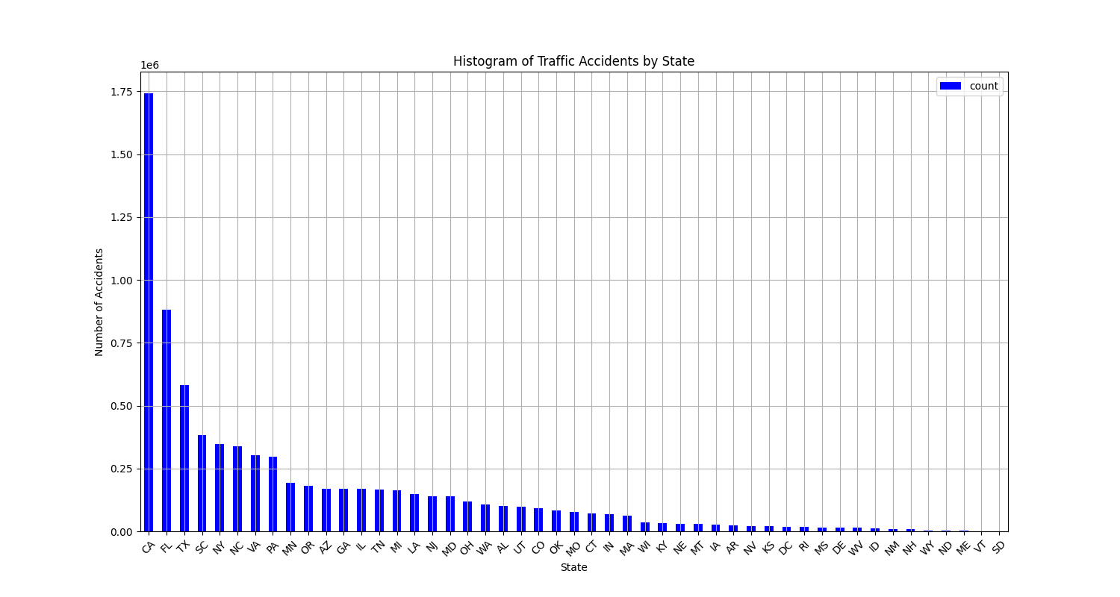
Dataset for PA
Manageable Dataset Size:
Easier data handling with 350,000 accidents.
Reduced computational resource requirements.
Local Relevance and Impact:
Direct applicability to PA road safety policies.
Immediate benefits for local authorities and communities.
Detailed Regional Analysis:
In-depth understanding of PA-specific road conditions and traffic patterns.
Tailored analysis to state-specific factors.
Model Precision:
Higher accuracy in predictions specific to PA.
Captures local nuances effectively.

Slide 4
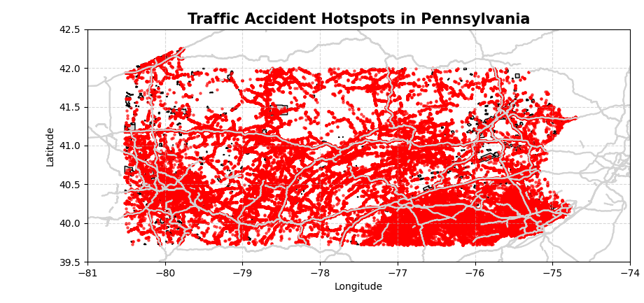
Challenges
Sparse temporal data along 67 counties
Pattern with time dependency

Slide 5
Features
ID,Source
Severity
Start_Time
End_Time
Start_Lat
Start_Lng
End_Lat
End_Lng
Distance(mi)
Description
Street
City
County
State
Zipcode
Country
Timezone,Airport_Code
Weather_Timestamp,
Temperature(F)
Wind_Chill(F)
Humidity(%)
Pressure(in)
Visibility(mi)
Wind_Direction
Wind_Speed(mph)
Precipitation(in)
Weather_Condition
Amenity
Bump
Crossing
Give_Way
Junction
No_Exit
Railway
Roundabout
Station
Stop
Traffic_Calming
Traffic_Signal
Turning_Loop
Sunrise_Sunset
Civil_Twilight
Nautical_Twilight
Astronomical_Twilight​
Road features

Slide 6
Spatial Insight through Heatmapping
Are there more accidents in warmer or colder areas?
Which city has the highest number of accidents? How about per capita?
What time of day are the accidents most frequent in?
Which days of the week have the most accidents?
Which months have the most accidents?

Slide 7
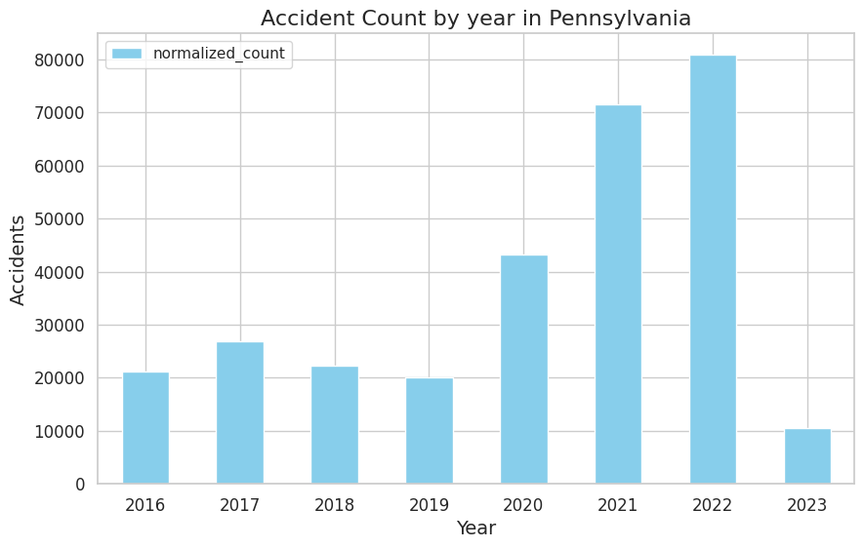
Covid 19 effects in the PA
If there were fewer cars on the streets during COVID, why did the number of accidents increase?
The trend appears to have increased from 2020 to 2022. Is there a discrepancy in this tendency?
The number of accidents from 2016 to 2019 was similar trend. How correlated are these with the years from 2020 to 2022?

Slide 8
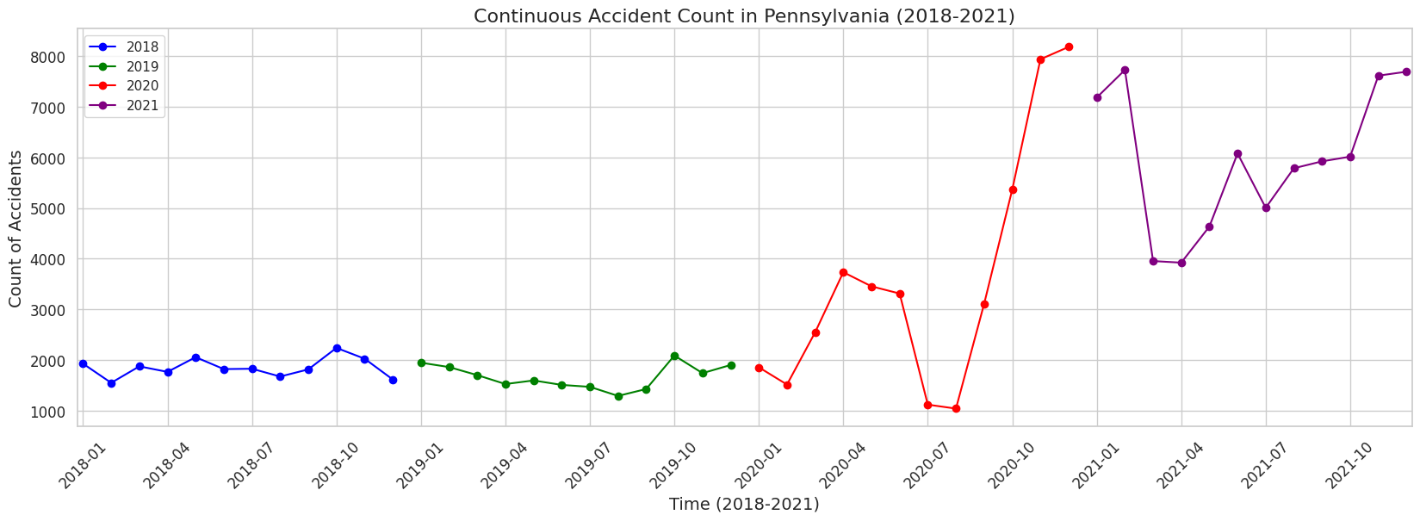
Covid-19's impact on the number of accidents in Pennsylvania
August, 2020
Schools remain activities
MARCH 23, 2020
Initial stay-at-home order
MARCH 6, 2020
First cases, disaster declaration
Source [https://www.abc27.com/timeline-of-a-year-of-covid-19-in-pennsylvania/,
https://en.wikipedia.org/wiki/COVID-19_pandemic_in_Pennsylvania]

Slide 9
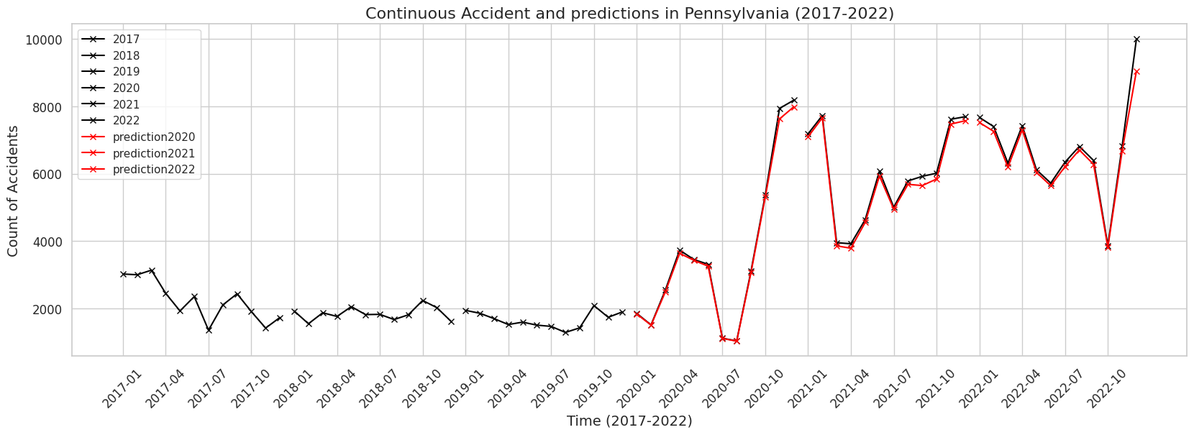
Random forest severity classification
Train data Prediction

Slide 10
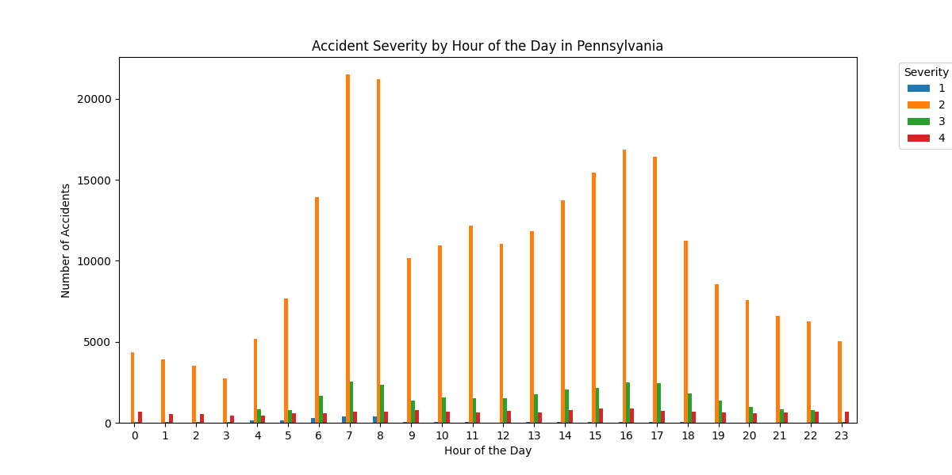
Predictions of Temporal Patterns and Severity Analysis
Time in Accident Analysis
Changes in Accident Frequency: 24-Hour Period and Monthly Variations
Predictions Over Time
Shift hour

Slide 11
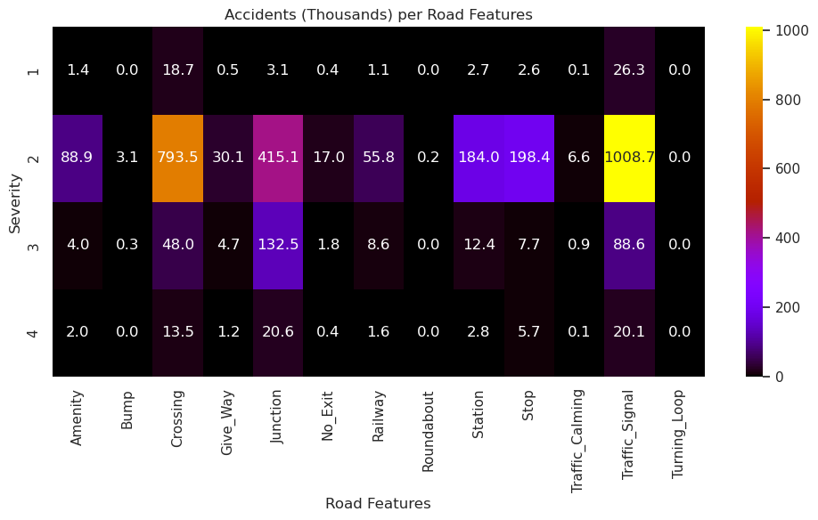
Correlation of Severity with Roadway

Slide 12
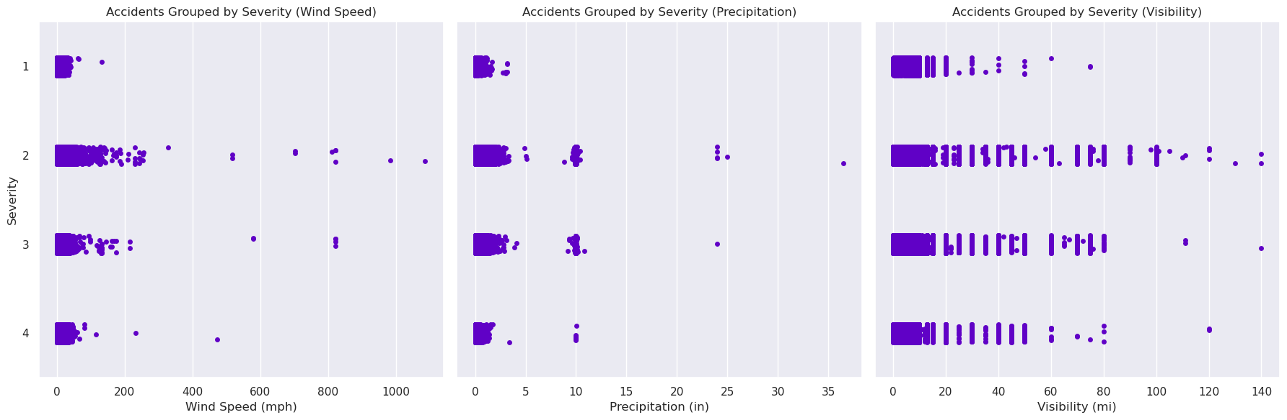
Correlation of Severity with Roadway Attributes
Examination of how various road features affect accident severity.
Utilization of a correlation chart to display the relationship between accidents and road characteristics.
Insights into variables that may increase or decrease accident severity.

Slide 13
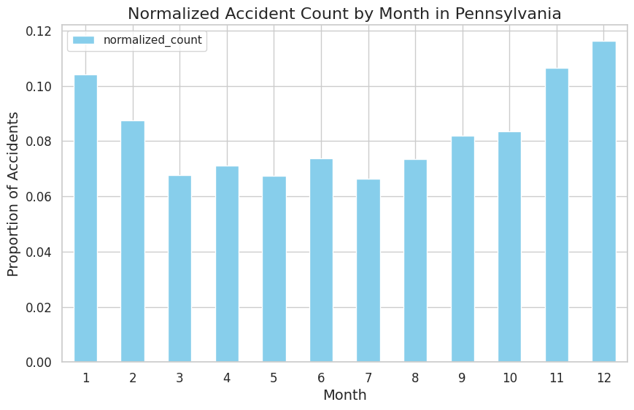
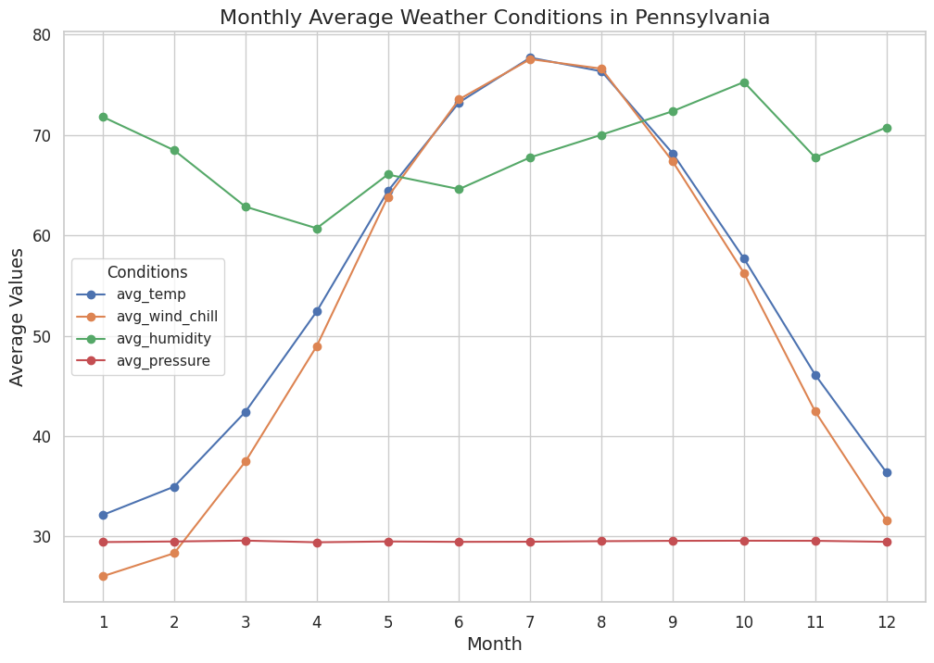
Weather conditions Attributes
Impact of Road Features on Accident Severity
Correlation Chart: Road Characteristics vs. Accident Severity
Identifying High-Risk Road Features
Variables Influencing Accident Severity

Slide 14
Thank you Diego S. D’Antonio diego.s.dantonio@lehigh.edu
Notes:
https://www.kaggle.com/code/leandrocassius/analyzing-and-predicting-car-accident-severity

