Slide 1
Postman
Diego Silva

Slide 2
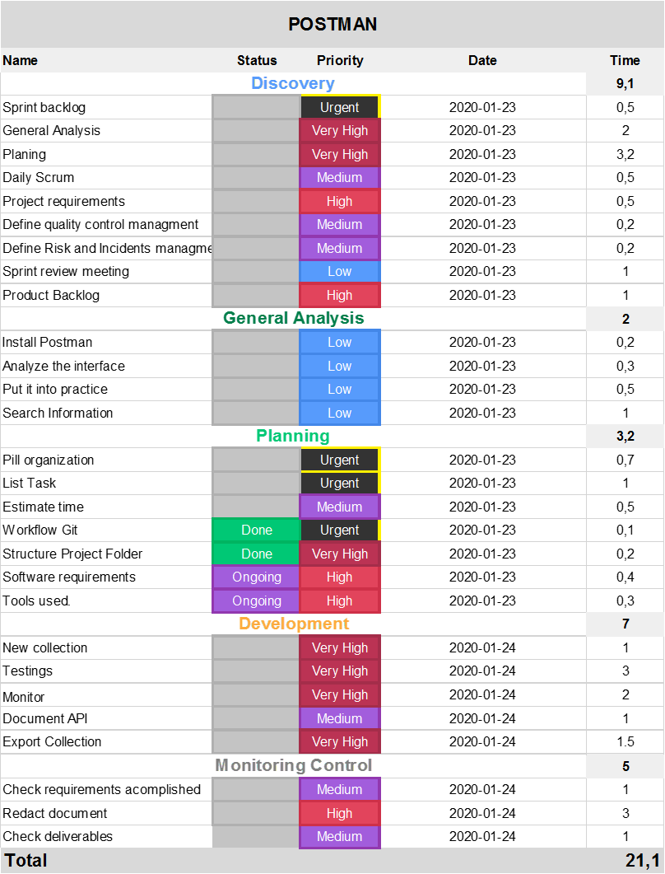
How the tasks of the pill have been organized?

Slide 4
How the tasks of the pill have been organized?
Using a tool for project management, called monday.com. Tasks are reflected within sprints or stages. Adding the hours each task for each sprint we have that the project will be executed in 21.1 hours in 4 days, it will be 5.5 hours average per day for the project deadline.
The first sprint called Discovery were divided in two main sub-sprints: Structure analysis and Project Planning.

Slide 5
Explain the knowledge learned
A quickly way to rest an API avoid the files downloads, with tools power puff and robust for read responses and set up the headers.
Generate environments with variables for the same URL for rest API.
Test the request made previously with the conditions for the requirements.
Monitors for checking and testing an API.

Slide 6
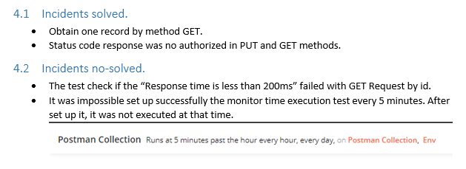
What difficulties have arisen during the pill

Slide 7
What are the environment variables
A variable in the Postman is same as in any programming language.
A variable is an entity whose value can be changed.
The key part in the key-value set in environment is called variable.
This variable can have any value and in place of the key we can use the variable name in every request.
This will be clear with an example shown below and steps shown thereafter.

Slide 8
What types of scopes exist within POSTMAN and what are they used for?
The following scopes are available for use:
Global
Environment
Collection
Local
Data
Scopes can be thought of as different "buckets" in which values reside. If a variable is in multiple "buckets", the scope with a higher priority wins and the variable gets its value from there. Postman resolves scopes using this hierarchy progressing from broad to narrow scope.

Slide 9
How to set the color option to be enabled by default?
Use colors for the exit. In Windows, we use ANSICON or ConEmu.
There are three possible values for this option:
never: never show colors at the exit. This is the default value when the option is used. --colors.
auto: displays the colors at the output unless the current terminal does not support colors or if the
output is channeled to a command or if it is redirected to a file.
always: always show colors at the output even when the terminal does not support colors or when the output is channeled to a command or redirected to a file.
When using --colors without any value, the auto option is taken

Slide 10
How to define the path in which the tests are stored (so that it is not necessary to write it by parameter when executing PHPUnit).
The PHPUnit XML configuration file (XML Configuration File) can also be used to compose a test suite.
A <testsuite> element must have a name attribute and may have one or more <directory> and/or <file> child elements that configure directories and/or files, respectively, that should be searched for tests.

Slide 11
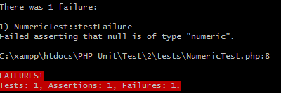
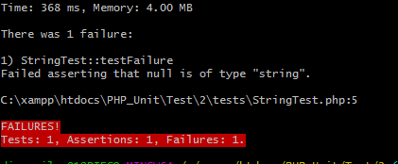
What verification methods and assertions are the most used for:
Verify numerical values
Reports an error identified by $message if $actual is not of type numeric.
Verify text strings
Reports an error identified by $message if $actual is not of type string.

Slide 12
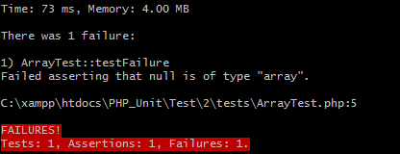
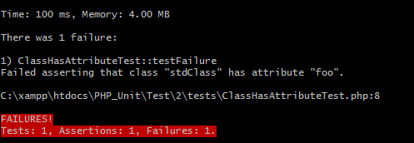
Work with arrays
For checking arrays the function assertIsArray was used. This functions reports an error identified by $message if $actual is not of type array.
For work with arrays the method @dataprovider was used. For compare the same data adding
Work with Classes
Reports an error identified by $message if $className::attributeName does not exist.

Slide 13
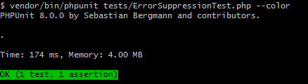
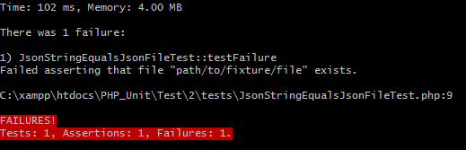
Work with directories and files
Work with JSON

