Slide 1
Postman
Diego Silva

Slide 2
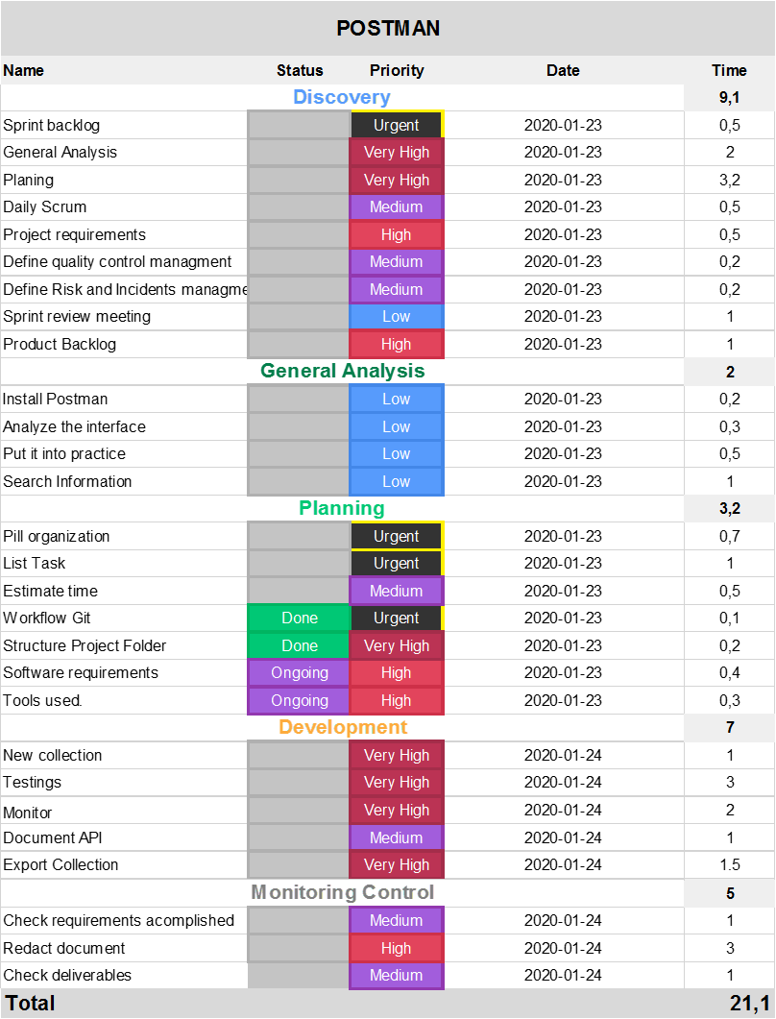
How the tasks of the pill have been organized?

Slide 4
How the tasks of the pill have been organized?
Using a tool for project management, called monday.com. Tasks are reflected within sprints or stages. Adding the hours each task for each sprint we have that the project will be executed in 21.1 hours in 4 days, it will be 5.5 hours average per day for the project deadline.
The first sprint called Discovery were divided in two main sub-sprints: Structure analysis and Project Planning.

Slide 5
Explain the knowledge learned
A quickly way to rest an API avoid the files downloads, with tools power puff and robust for read responses and set up the headers.
Generate environments with variables for the same URL for rest API.
Test the request made previously with the conditions for the requirements.
Monitors for checking and testing an API.

Slide 6
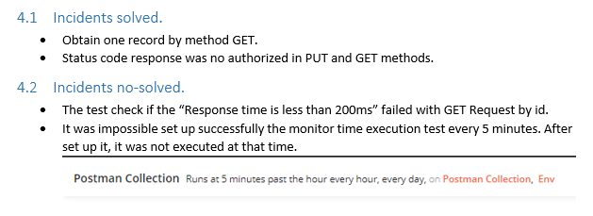
What difficulties have arisen during the pill

Slide 7
What are the environment variables
A variable in the Postman is same as in any programming language.
A variable is an entity whose value can be changed.
The key part in the key-value set in environment is called variable.
This variable can have any value and in place of the key we can use the variable name in every request.
This will be clear with an example shown below and steps shown thereafter.

Slide 8
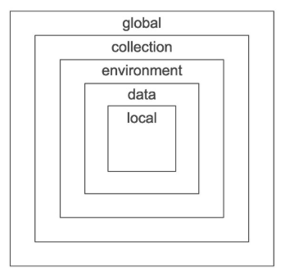
What types of scopes exist within POSTMAN and what are they used for?
The following scopes are available for use:
Global
Environment
Collection
Local
Data
Scopes can be thought of as different "buckets" in which values reside. If a variable is in multiple "buckets", the scope with a higher priority wins and the variable gets its value from there. Postman resolves scopes using this hierarchy progressing from broad to narrow scope.

Slide 9
How to set the color option to be enabled by default?
Use colors for the exit. In Windows, we use ANSICON or ConEmu.
There are three possible values for this option:
never: never show colors at the exit. This is the default value when the option is used. --colors.
auto: displays the colors at the output unless the current terminal does not support colors or if the
output is channeled to a command or if it is redirected to a file.
always: always show colors at the output even when the terminal does not support colors or when the output is channeled to a command or redirected to a file.
When using --colors without any value, the auto option is taken

Slide 10
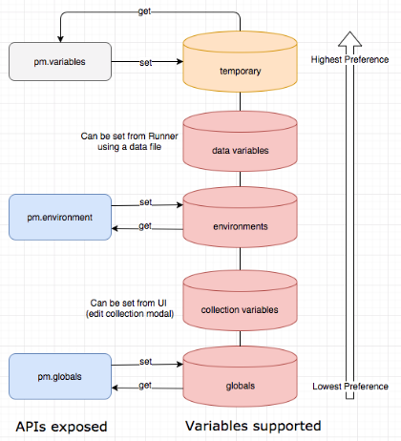
Variables
Global variables allow you to access data between collections, requests, test scripts, and environments.
Collection variables are available throughout the requests in a collection and are independent of environments, so do not change based on the selected environment.
Environment variables allow you to tailor your processing to different environments, for example local development vs testing or production. Only one environment can be active at a time.
Local variables are temporary, and only accessible in your request scripts. Local variable values are scoped to a single request or collection run, and are no longer available when the run is complete.
Data variables come from external CSV and JSON files to define data sets you can use when running collections via Newman or the Collection Runner.

Slide 11
Describe those POSTMAN functionalities that are most interesting to you
Monitors, Runs, API Documentations, testing.
Different forms to show o see the information from the URL.
Chain the requests.

Slide 12
Explain the purpose of the tests and in which cases you recommend using them
Everyone agrees that writing tests is important, but not everyone does it. As you introduce new code, tests ensure that your API is working as intended. You can write and run tests in Postman for each request.
Different forms to show o see the information from the URL.
Most people agree that writing tests is important, but writing the first test is sometimes the biggest hurdle to testing.
The first step is to use code snippets. These stubs demonstrate how a Postman test runs, how they’re structured, and show test results.

Slide 13
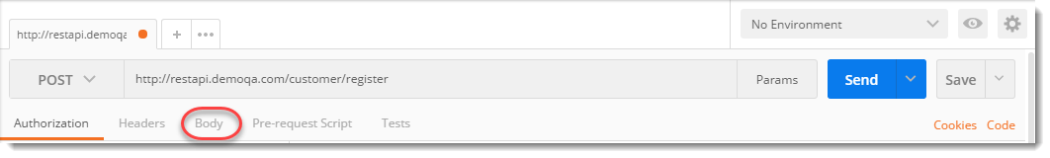
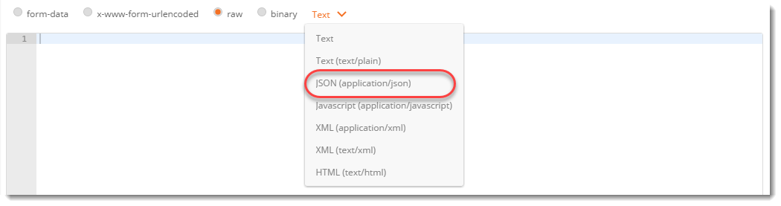
Explain how you can send JSON content to an endpoint
Now let us add a Request Body to our POST request. Every Endpoint will be document with what kind of Method type and the format of body that it expects. Let us see what body this request expects and how to add it. For that click on Body tab.
Click on raw and select format type as JSON, since we have to send in correct format which the server expects.

Slide 14
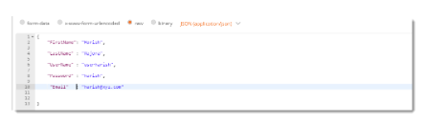
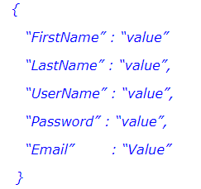
Explain how you can send JSON content to an endpoint
This endpoint expects a Json body which contains the details of the new user. Below is a sample Json body. Copy and Paste the following in the body tab of Postman.
Change the attribute value to any value you want (take reference from the below image).
Press Send and see the Response Body and Response Status.

Slide 15
Explain how you can send JSON content to an endpoint
Now let us add a Request Body to our POST request. Every Endpoint will be document with what kind of Method type and the format of body that it expects. Let us see what body this request expects and how to add it. For that click on Body tab.
Click on raw and select format type as JSON, since we have to send in correct format which the server expects.

