Slide 1
Postman
Diego Silva

Slide 2
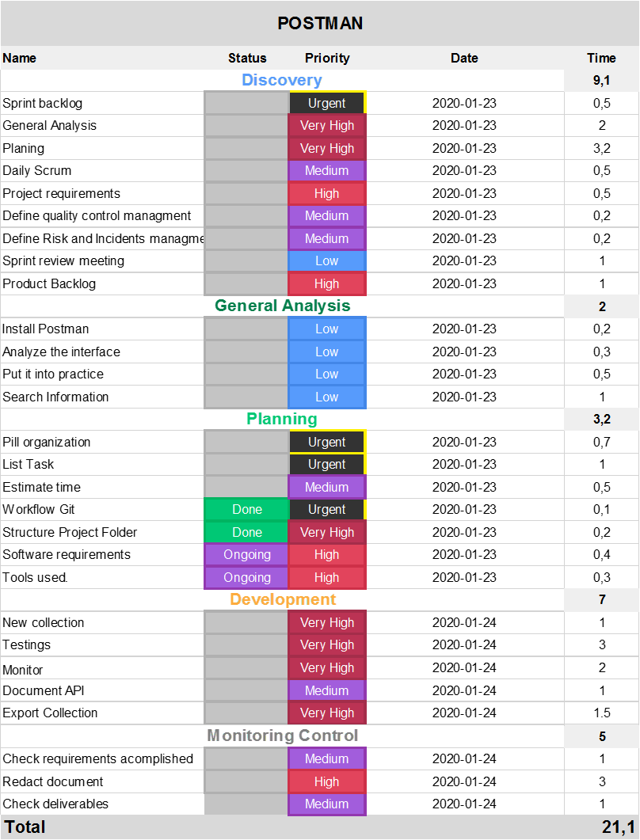
How the tasks of the pill have been organized?

Slide 4
How the tasks of the pill have been organized?
Using a tool for project management, called monday.com. Tasks are reflected within sprints or stages. Adding the hours each task for each sprint we have that the project will be executed in 21.1 hours in 4 days, it will be 5.5 hours average per day for the project deadline.
The first sprint called Discovery were divided in two main sub-sprints: Structure analysis and Project Planning.

Slide 5
Explain the knowledge learned
A quickly way to rest an API avoid the files downloads, with tools power puff and robust for read responses and set up the headers.
Generate environments with variables for the same URL for rest API.
Test the request made previously with the conditions for the requirements.
Monitors for checking and testing an API.

Slide 6
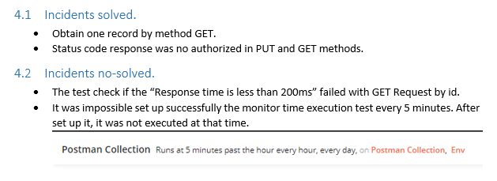
What difficulties have arisen during the pill

Slide 7
What is the phpunit.xml file used for?
The attributes of the <phpunit> element can be used to configure PHPUnit's core functionality.
Each application has its own PHPUnit configuration, stored in the app / phpunit.xml file.

Slide 8
What are its main parameters and what are they used for?
The parent node does the usual job of defining the schema for the XML file, but there are a few other components we’re namely concerned with:
backupGlobals. This is actually related to an annotation that we can make in our source code. Globals are something we should try to avoid in object-oriented programming, but if you opt to use one or need to use one, then this will tell PHPUnit to handle the values the global variables are maintaining (and will give you the option to restore them). I generally leave this as-is.
bootstrap. This is optional, but if you opt to include other files with your tests (like bringing in a mocking library, part of WordPress, or a third-party library), then this will all you to define the location of the script that needs to execute. Mocking and bringing in WordPress is outside the scope of this post but it’s something we’ll likely look at in the future as it’s useful when testing plugins. For now, I’ll be including a simple autoloader that basically adds all files in the root of the project directory. The full source for it will be shared later in this post.
colors. If you want the console to print out a report of your tests and do so using colors (to help more easily identify warnings, notices, errors, and so on), then set this to true.
The following are all boolean values. I recommend setting them to true for the most aggressive reports possible. This way, you won’t get away with simply having notices or warnings slip through while only worrying about errors. This is more of an exercise in code quality than anything else.
convertErrorsToExceptions
convertNoticesToExceptions
convertWarningsToExceptions

Slide 9
How to set the color option to be enabled by default?
Use colors for the exit. In Windows, we use ANSICON or ConEmu.
There are three possible values for this option:
never: never show colors at the exit. This is the default value when the option is used. --colors.
auto: displays the colors at the output unless the current terminal does not support colors or if the
output is channeled to a command or if it is redirected to a file.
always: always show colors at the output even when the terminal does not support colors or when the output is channeled to a command or redirected to a file.
When using --colors without any value, the auto option is taken

Slide 10
How to define the path in which the tests are stored (so that it is not necessary to write it by parameter when executing PHPUnit).
The PHPUnit XML configuration file (XML Configuration File) can also be used to compose a test suite.
A <testsuite> element must have a name attribute and may have one or more <directory> and/or <file> child elements that configure directories and/or files, respectively, that should be searched for tests.

Slide 11
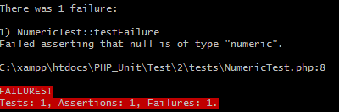
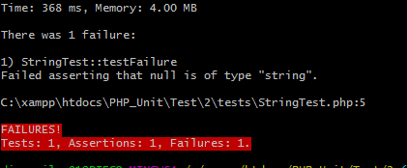
What verification methods and assertions are the most used for:
Verify numerical values
Reports an error identified by $message if $actual is not of type numeric.
Verify text strings
Reports an error identified by $message if $actual is not of type string.

Slide 12
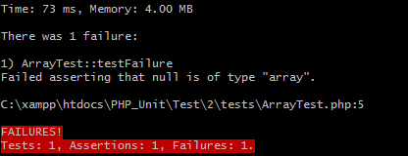
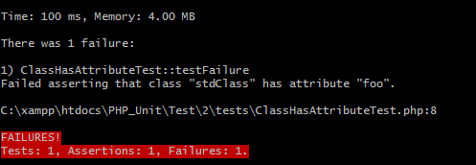
Work with arrays
For checking arrays the function assertIsArray was used. This functions reports an error identified by $message if $actual is not of type array.
For work with arrays the method @dataprovider was used. For compare the same data adding
Work with Classes
Reports an error identified by $message if $className::attributeName does not exist.

Slide 13
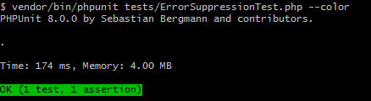
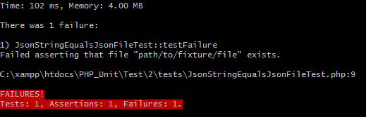
Work with directories and files
Work with JSON

