Slide 1
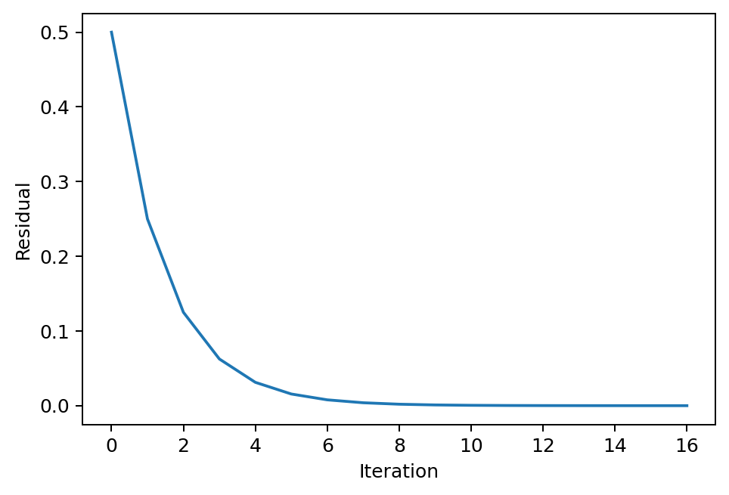
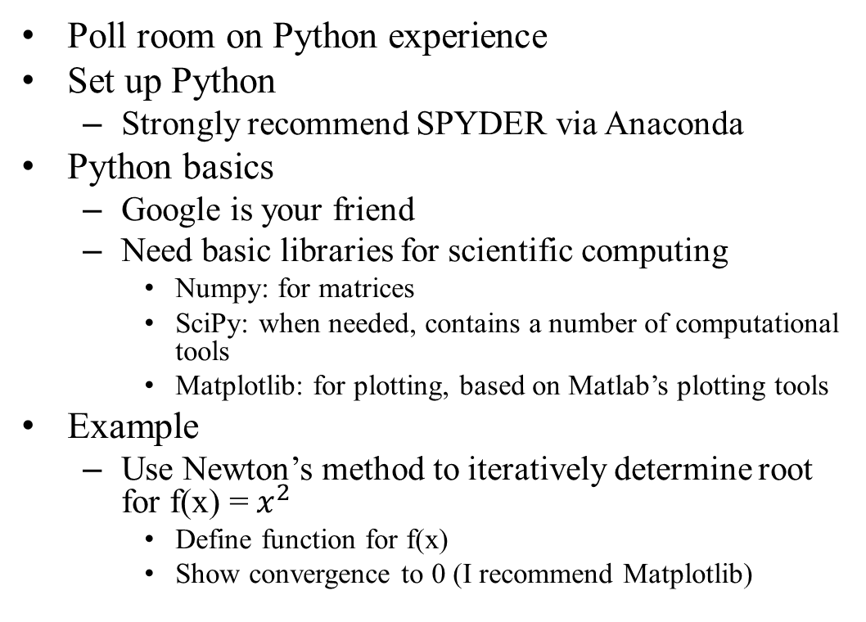
Day 1: 8/30/21
Poll room on Python experience
Set up Python
Strongly recommend SPYDER via Anaconda
Python basics
Google is your friend
Need basic libraries for scientific computing
Numpy: for matrices
SciPy: when needed, contains a number of computational tools
Matplotlib: for plotting, based on Matlab’s plotting tools
Example
Use Newton’s method to iteratively determine root for f(x) = $x^{2}$
Define function for f(x)
Show convergence to 0 (I recommend Matplotlib)

Slide 2
Example 2: the Taylor series
What? Estimate the function in a position different from where we know the value of the function and (at least one) derivative

Slide 3

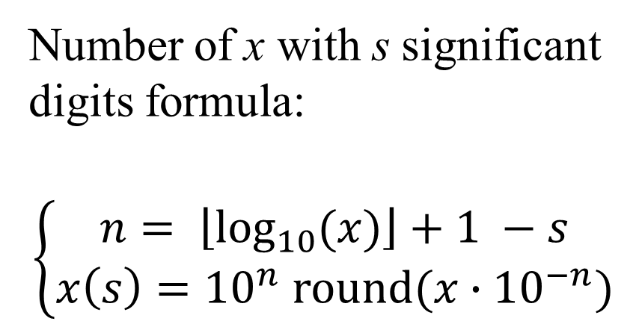
Rounding with specified significant digits
s | x(s)
2 | 3.1
3 | 3.14
4 | 3.142
5 | 3.1416
6 | 3.14159
7 | 3.141593
8 | 3.1415927
9 | 3.14159265
10 | 3.141592654
11 | 3.1415926536
12 | 3.14159265359
Number of x with s significant digits formula:
$$\left\{\begin{aligned}n= \left\lfloor \log_{10}{(x)}\right\rfloor +1 −s \\ x\left(s\right)={10}^{n} round(x∙{10}^{−n})\end{aligned}\right.$$
Example with $x=π$

Slide 4
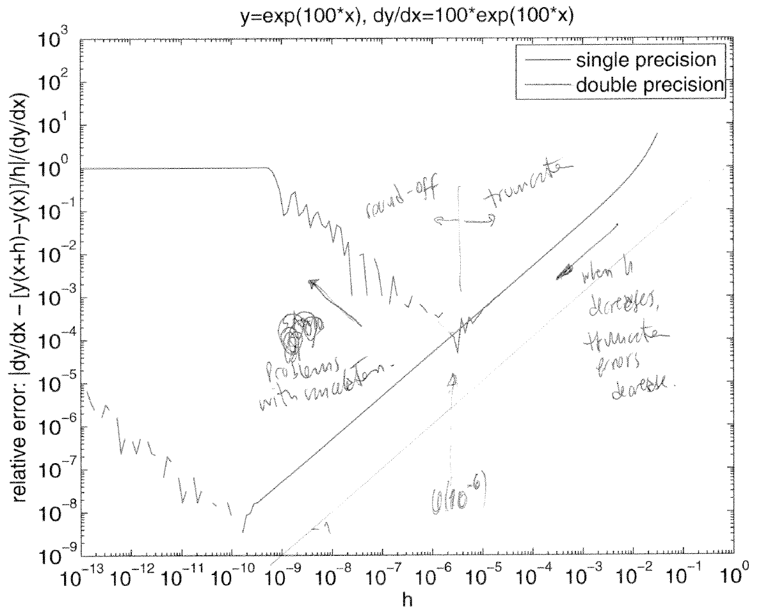
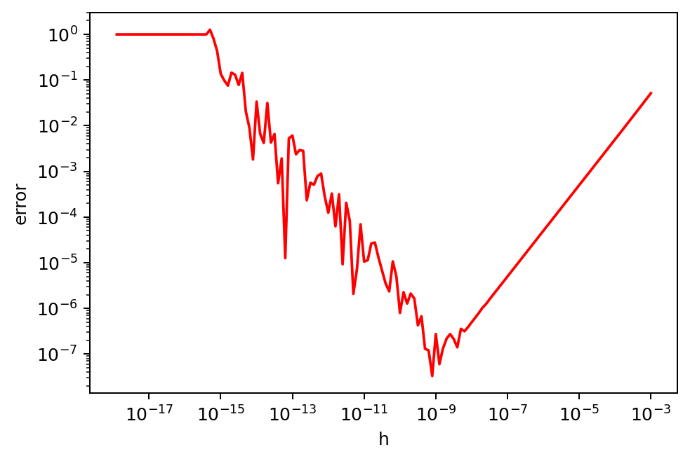
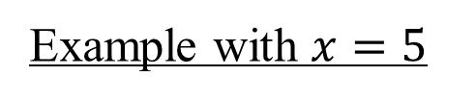
Recreate double precision chart
Python defaults to double precision
Recommend matplotlib.pyplot.loglog()
When h increases
round-off errors
decrease because
the significant digits
in the difference
decrease
When h decreases
truncation errors
decrease because
Taylor series provides
a more accurate
estimation
Example with $x=5$

Slide 5
Week 3 AERO 222 Lab
Relevant Notes for this week’s lab

Slide 6
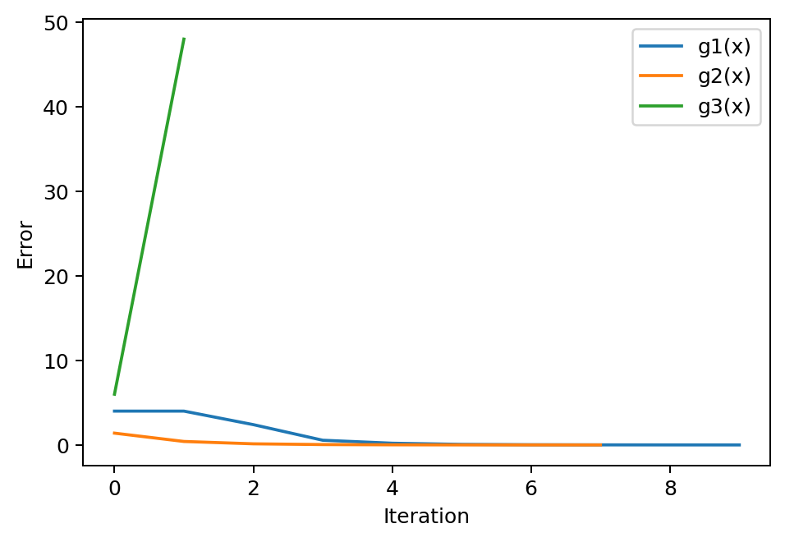
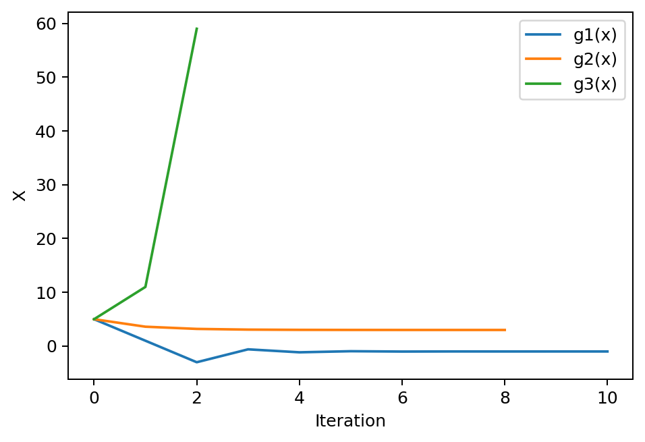
Problem Assignment
Given the equation x^2 – 3x – 5:
Find the roots using fixed point iteration starting at x = 5
Set ϵ = 0.001
There are 2 roots and 3 equations
2 functions converge to the 2 solutions
1 function diverges
Check to halt the process if the solution diverges
Plot

Slide 7
Fixed-point iteration: “x = g(x)” method

Slide 8
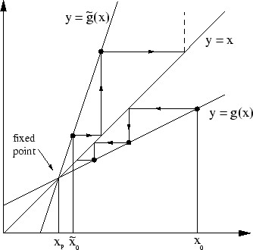
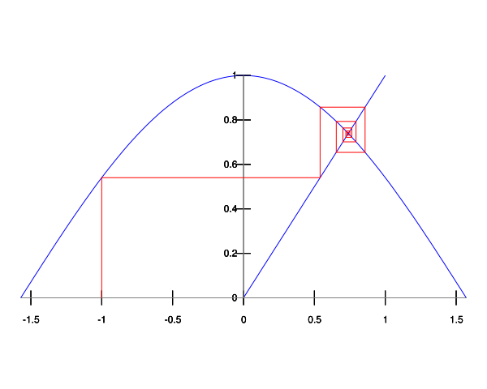
Go vertical to y = g(x)
Go horizontal to y = x

Slide 9
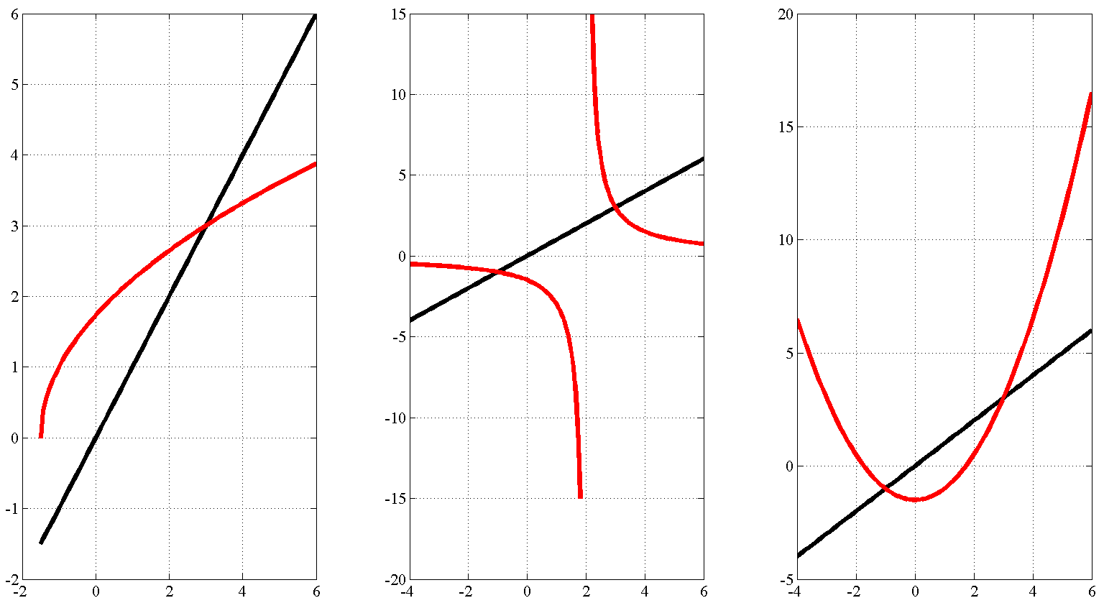
Fixed-point iteration: x = g(x) method
Convergence occurs where

Slide 10
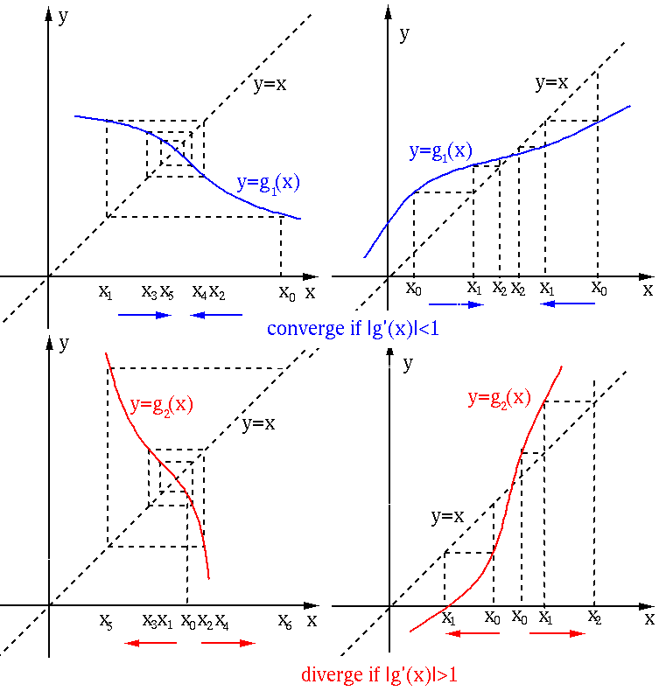
Keep doing convergence if
STOP doing convergence if

Slide 11
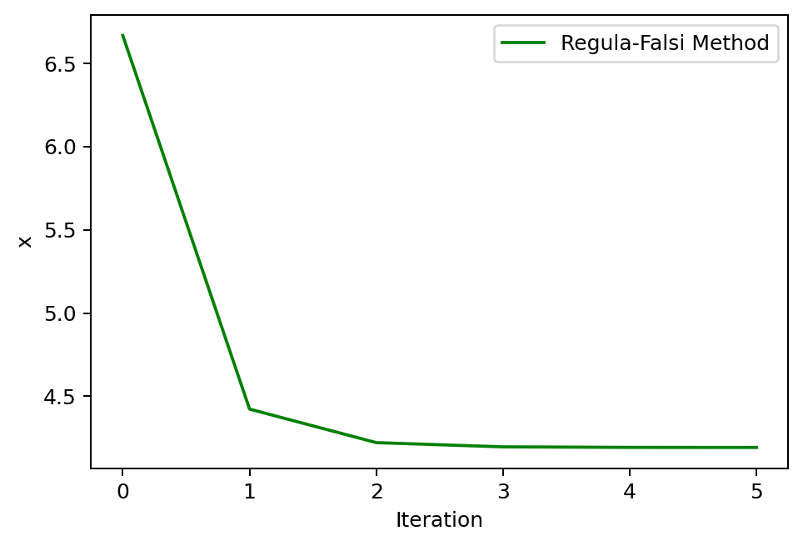
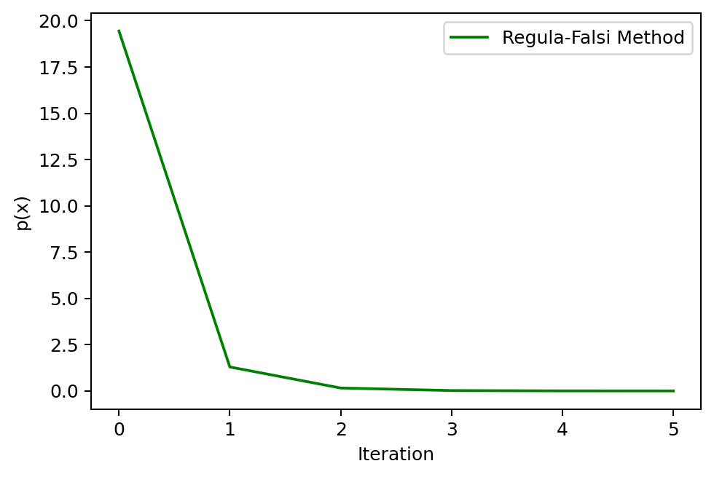
Problem 2
Given the equation x^2 – 3x – 5:
Find a roots using Regula-Falsi starting at x1 = -5, x2 = 5
Set ϵ = 0.001
Plot convergence of the residuals

Slide 12
Regula-Falsi
Regula-Falsi Method (False Position Method) is a linear interpolation method (fast) with convergence guaranteed (as bisection).
Algorithm Requirements
Bracketing required. Like bisection, it requires two points a and b for which f (a)⋅ f (b) < 0.
Convergence guaranteed. If the function f (x) is continuous on the interval [a,b] with f (a)⋅ f (b) < 0, the algorithm will converge to a solution.
Applicability limit. Secant and regula-falsi cannot be implemented to find a tangential root. That is for a function that is tangent to the x-axis (either positive or negative on both side of the root). For example f (x) = (x−3)², has a tangential root at x = 3.

Slide 13
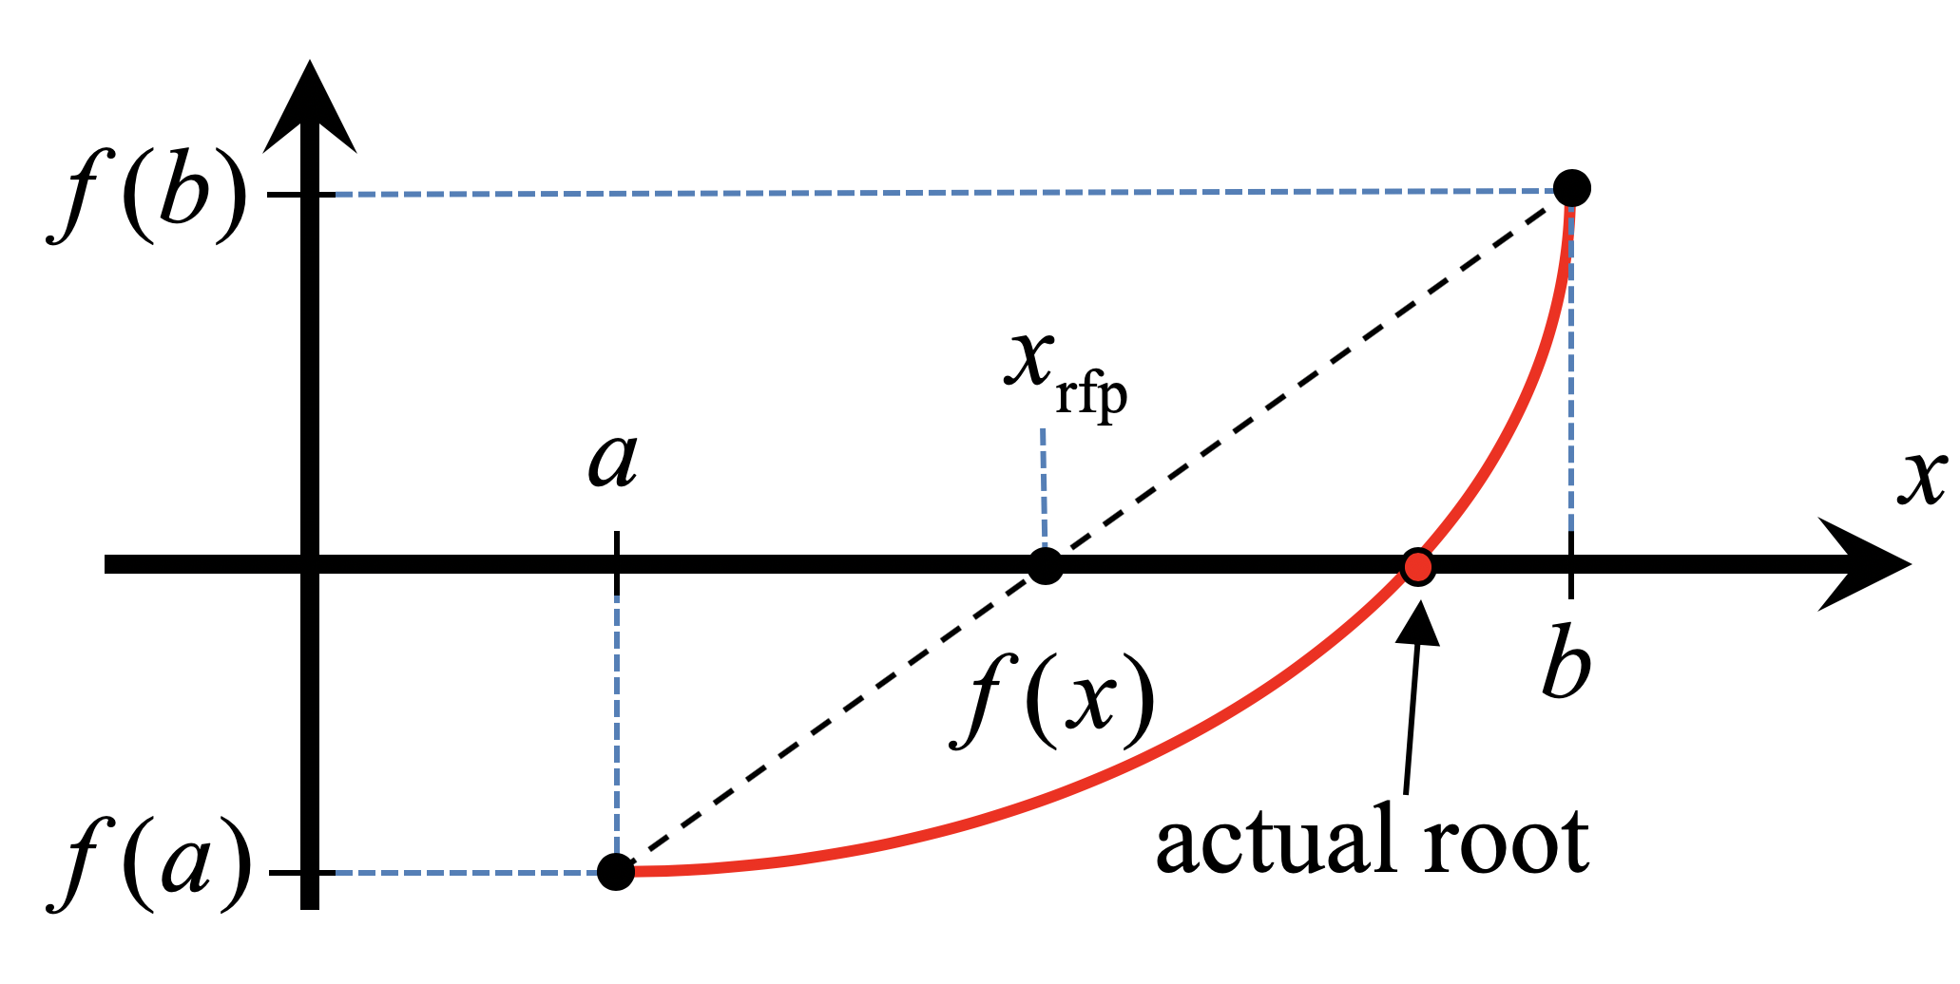

Regula-Falsi
1) Connect the points [a, f (a)] and [b, f (b)] with a straight line.
2) Find the Regula-Falsi Point (x_{rfp}) which is the solution to the linear equation connecting the endpoints.
Look at the sign of f (x_{rfp}):
while | f (x_{rfp}) | > ε then
if sign[ f (x_{rfp})] = sign [ f (a)] then set a = x_{rfp}
else set b = x_{rfp}
Equation of line:
$$\frac{y−f(b)}{f\left(b\right)−f(a)}=\frac{x−b}{b−a}$$
solving for $x_{rfp}$
$$\frac{0−f(b)}{f(b)−f(a)}=\frac{x_{rfp}−b}{b−a}$$
$$x_{rfp}=b−\frac{f(b)(b−a)}{f\left(b\right)−f(a)}$$

Slide 14
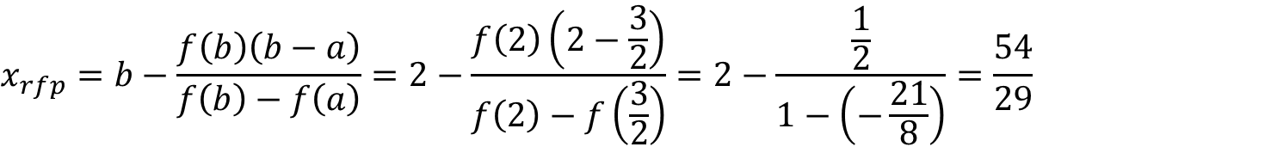
Regula-Falsi: Example
Let’s look for a solution to the equation f (x) = x³ − 2x − 3 = 0. On the interval [0, 2]. Consider a = 0 and b = 2. then f (0) f (2) = (−3)(1) = −3 < 0, → YES!
$$x_{rfp}=b−\frac{f\left(b\right)\left(b−a\right)}{f\left(b\right)−f\left(a\right)}=2−\frac{f\left(2\right)\left(2−0\right)}{f\left(2\right)−f\left(0\right)}=2−\frac{1\left(2\right)}{1−\left(−3\right)}=\frac{3}{2}$$
This is negative and we will make the a =3/2 and b is the same and apply the same thing to the interval [a=3/2, b=2].
$$f\left(x_{rfp}\right)=f\left(\frac{3}{2}\right)=−2.625$$
$$x_{rfp}=b−\frac{f\left(b\right)\left(b−a\right)}{f\left(b\right)−f\left(a\right)}=2−\frac{f\left(2\right)\left(2−\frac{3}{2}\right)}{f\left(2\right)−f\left(\frac{3}{2}\right)}=2−\frac{\frac{1}{2}}{1−\left(−\frac{21}{8}\right)}=\frac{54}{29}$$
Still negative and we will make the a =54/29 and b is the same and apply the same thing to the interval [54/29,2].
$$f\left(x_{rfp}\right)=f\left(\frac{54}{29}\right)=−0.26778$$

Slide 15
Stopping Conditions
Stopping condition is usually fixed to be a certain maximum number of iterations and
Standard Cauchy (residual or error). Consider a residuals tolerance, ε_{y}, and an error tolerance, ε_{x}.

Slide 16
Define your equations as functions
Test them out, make sure they return the correct values
Initialize your lists
Includes anything you need to track or plot
Determine your iterative
What error or an independent variable are you trying to converge?
Iterate to your solution
Keep track of which variables are inside your loop
What types of values are they?
Are you overwriting any values you need later?
Plot your solution
Matplotlib.pyploy.plt
plt.plot(xList, yList (optional)) is the simplest plot
For logarithmic axis:
plt.loglog() plots both axis as log scale
plt.semilogx() plots the x axis as log scale
plt.semilogy() plots the y axis as log scale
Other tips:
Defined functions only track their specified inputs and outputs
If you redefine a variable later in your main script, it will not remember the previous value
If you redefine a single value in a list or array, it will update the array and keep the other array values
If you append a list, it will add the value to the end of the list
Use brackets for indices, parenthesis for calling functions and (if necessary) grouping/order of operations
Parenthesis immediately after a word will likely be treated as a function call
Square brackets immediately after a word will likely be treated as the index of a list or matrix
Someone, somewhere has probably run into the same problem before
Googling your errors or problems is a legitimate way to find programming solutions

