Slide 1

How to retain more customers?
Big Bug Consulting

Slide 2
Problem Statement
Big Bug consulting has acceded to your data base in order to identify why our customers are leaving us.
We used different algorithms to create a model who predicts churn potential of risk.
We followed the OSEMN process.
Let’s double click on this.

Slide 3
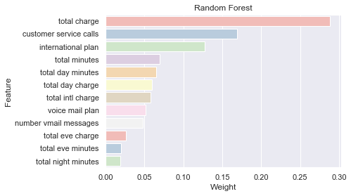
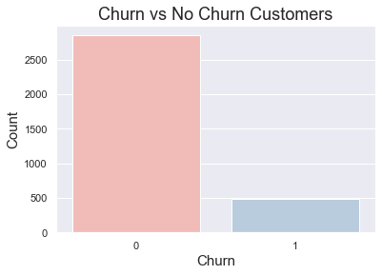
Insights
14.5% of your clients have churned.
International plans, Customer service calls and Total charge are strongly correlated with churn.

Slide 4
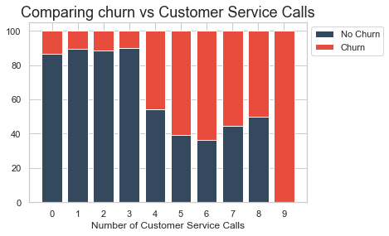
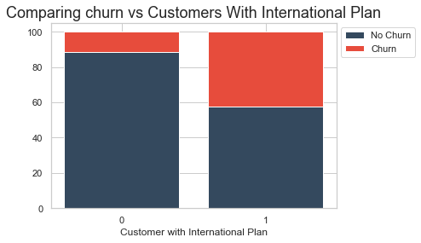
Insights

Slide 5
Algorithms Accuracy
Random Forest Score : 96%
Decision Trees Score : 95%
Adaboost Score : 92%
Logistic Regression Score : 85%

Slide 6
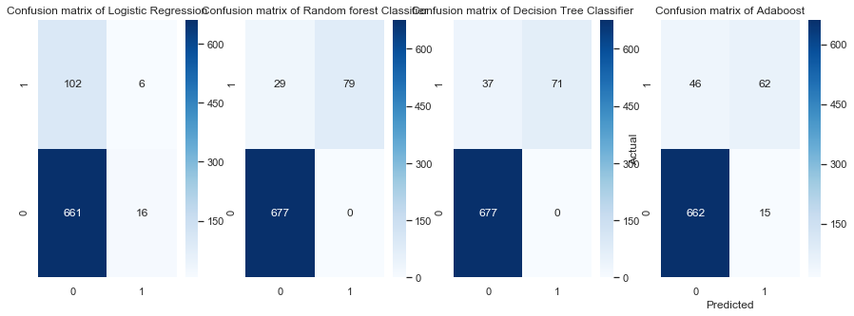
SO, which one is better?

Slide 7
Questions
Do we need to offer international service calls plans?
Are your customers paying more than they should?
Our competitors have better plans?
Are you able to solve customer problems quickly?
Is our customer service enough good?
Do you have issues with International plans?

Slide 8
Recommendations
We need a better system to track customer service calls
We need to look at our competitors international plans
We can offer different prices depending on the necessities of customers

Slide 9
Future Work
We got some insights, but it would be a great idea to get some more information about:
Surveys with information about why the customer churned.
We need to improve our logistic regression algorithm in order to improve accuracy.
Churn rate of our competitors.

Slide 10

Thank you for your time!

