Slide 1
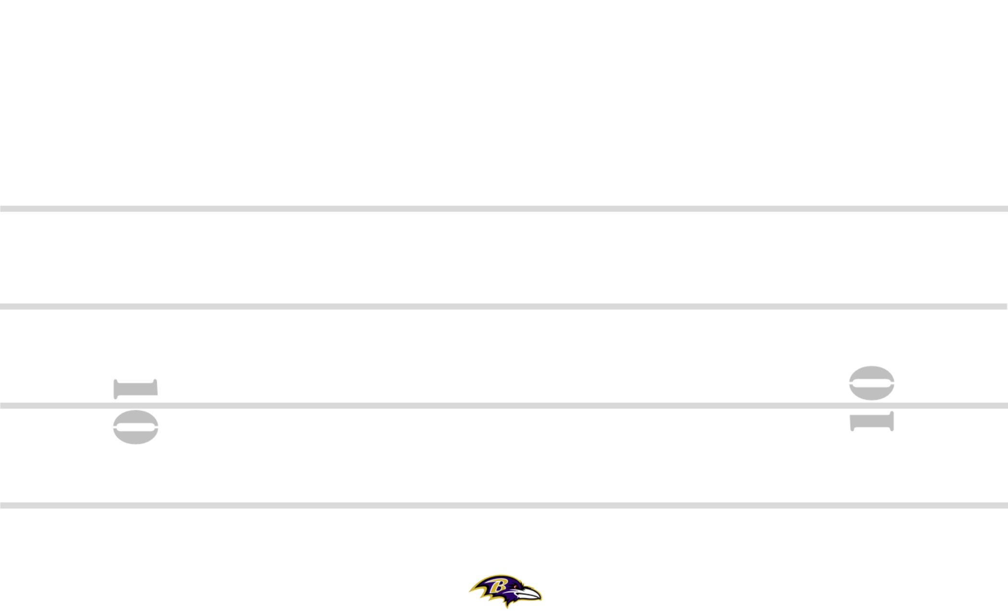
CIN-32 3-6 +30 ZEBRA YYO FRG TRPS STEELER BANG 8
12
8
8
84
11
#+2
19
M
89
M
30
7
2PT
SQ
PERIOD: PLAY#: HASH: L DEFENSE:

Slide 2
CIN-64 3-6 +30 ZEBRA YYO FRG TRPS STEELER BANG 8
12
8
8
84
#+2
7
30
89
M
19
11
PERIOD: PLAY#: HASH: L DEFENSE:

