Slide 1
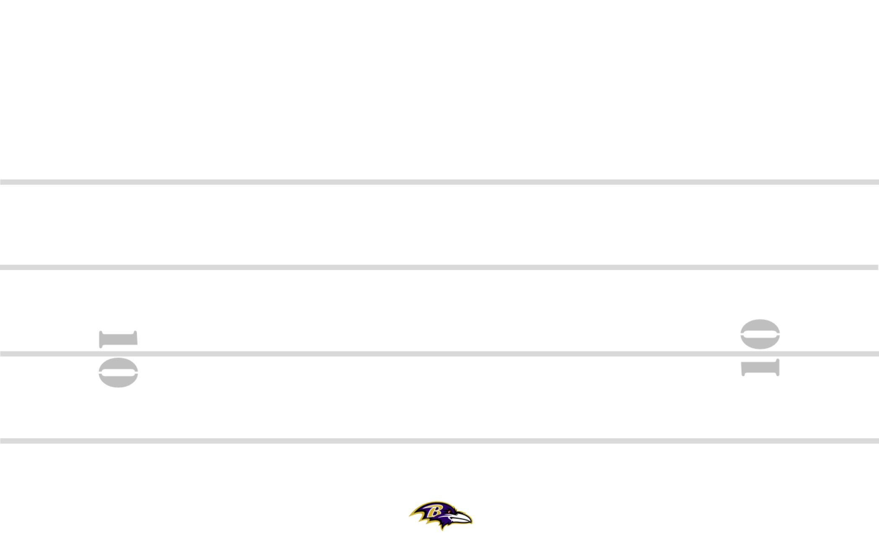
DOL-21 3-5 +5 ZEBRA YYO FRG TRPS STEELER BANG 8
8
19
11
84
M
30
M
#+2
89
7
2PT
SQ
PERIOD: PLAY#: HASH: L DEFENSE:

