Slide 1
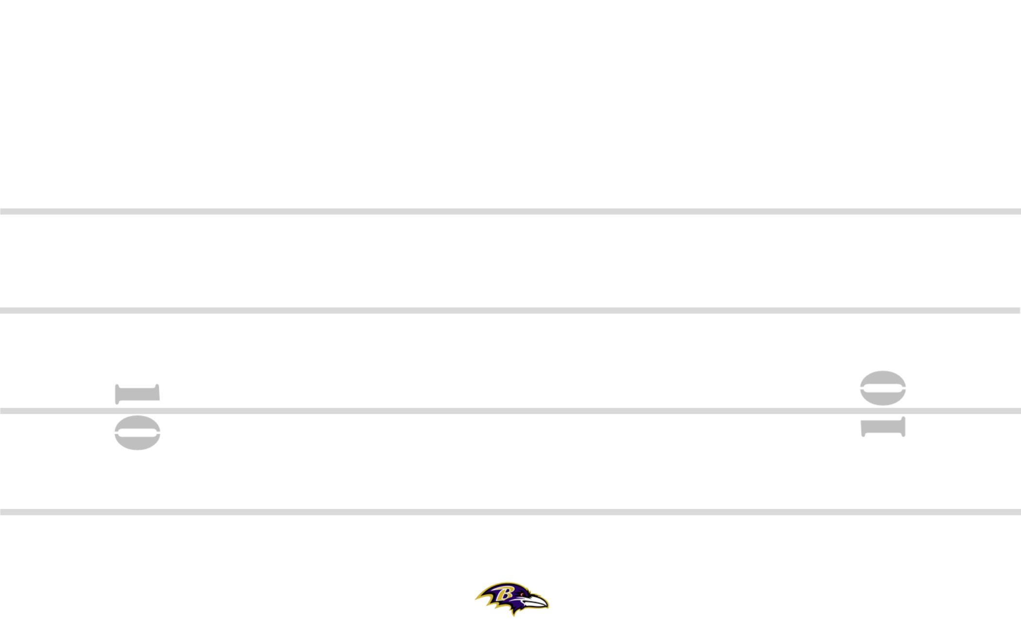
BLT-44 3-6 +25 ZEBRA YYO FRG TRPS STEELER BANG 8
8
89
11
19
M
84
7
M
#+2
30
2PT
SQ
PERIOD: PLAY#: HASH: L DEFENSE:

