Slide 1
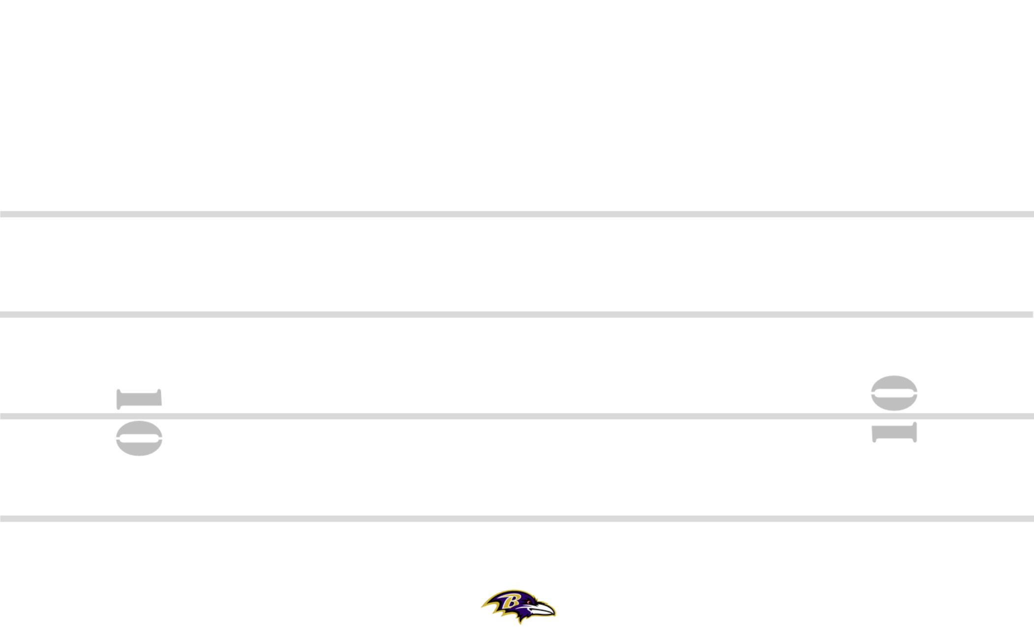
CIN-32 3-6 +30 ZEBRA YYO FRG TRPS STEELER BANG 8
12
8
8
84
11
#+2
19
M
89
M
2PT
SQ
30
7
PERIOD: PLAY#: HASH: L DEFENSE:

Slide 2
BLT-44 3-6 +25 ZEBRA YYO FRG TRPS STEELER BANG 8
8
89
11
19
M
84
7
M
#+2
30
2PT
SQ
PERIOD: PLAY#: HASH: L DEFENSE:

