Slide 1
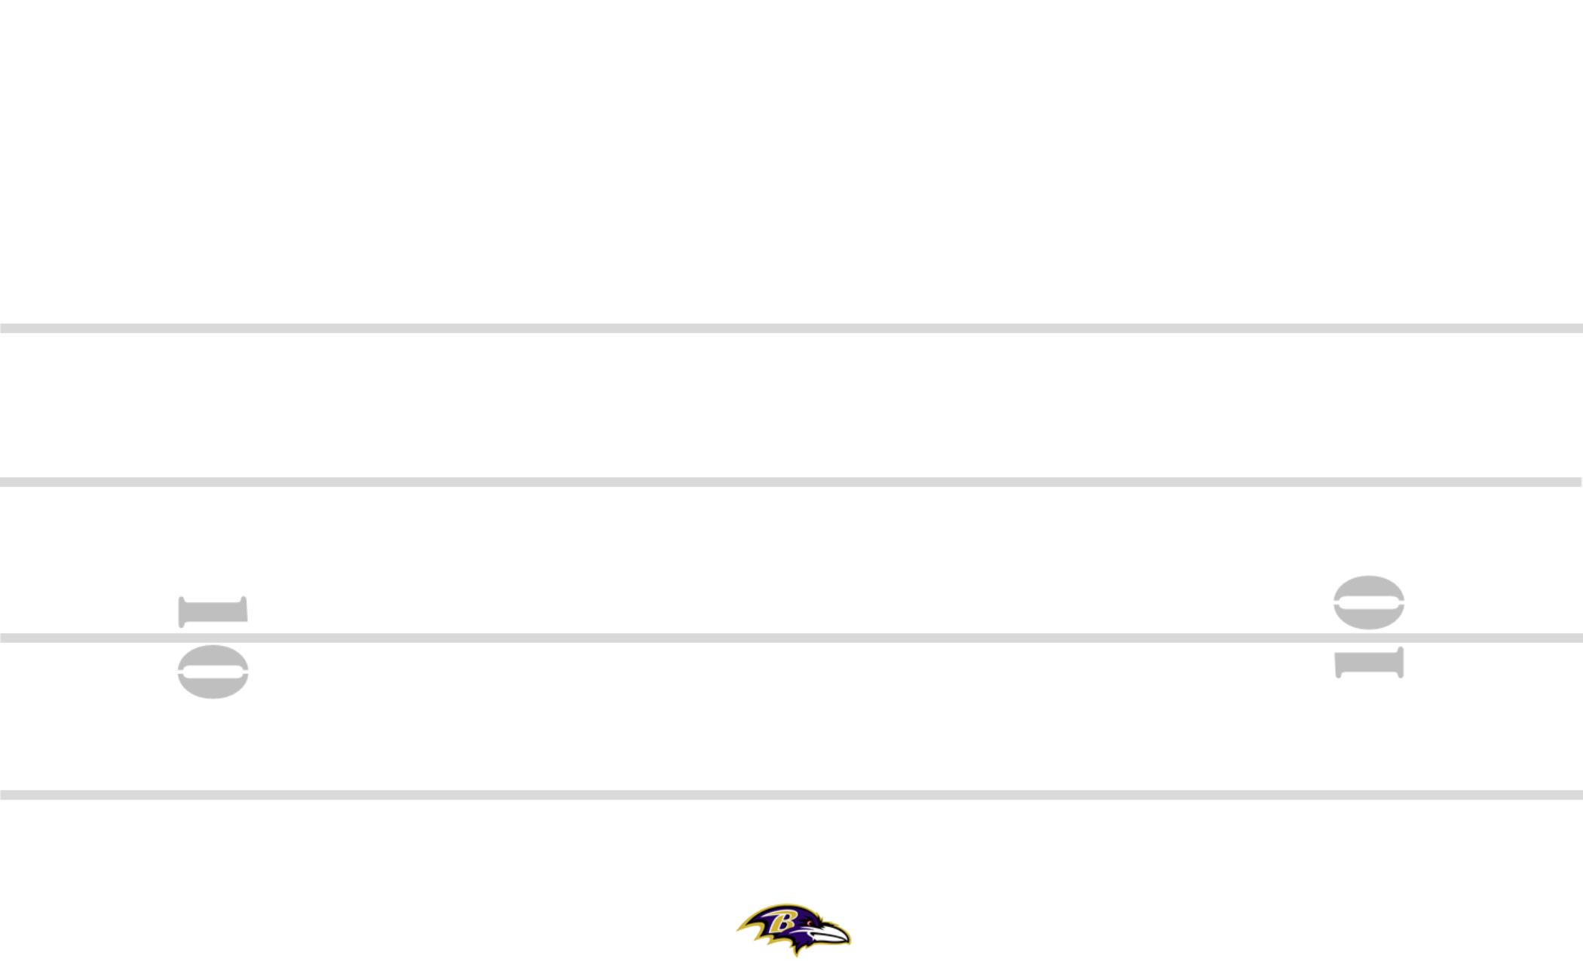
5
BUNCH
#-2
B#
M
H+1
H
1
T+2
P24U
2 PT
WR STANCE
WR STANCE
75
2
BUNCH
5
T#
H+3
2PT
T+2
M
5
10
2PT
FRWY
+3
*2PT PLAY
LATE DASH
85
B#
2
87
2
26
H+2
M
CIN-32 3-6 +30 ZEBRA YYO FRG TRPS STEELER BANG 8
89
#-2
84
T#
12
#+2
2ND
3
6
8
8
16
5
3
3
YOFF
FINISH
5
CHIP FLAT
30
84
11
START
#+2
19
M
M
M
89
CHECK RELEASE
BUNCH
2PT
SQ
30
7
PERIOD: PLAY#: HASH: L DEFENSE:
89
12
20
12

