Slide 1
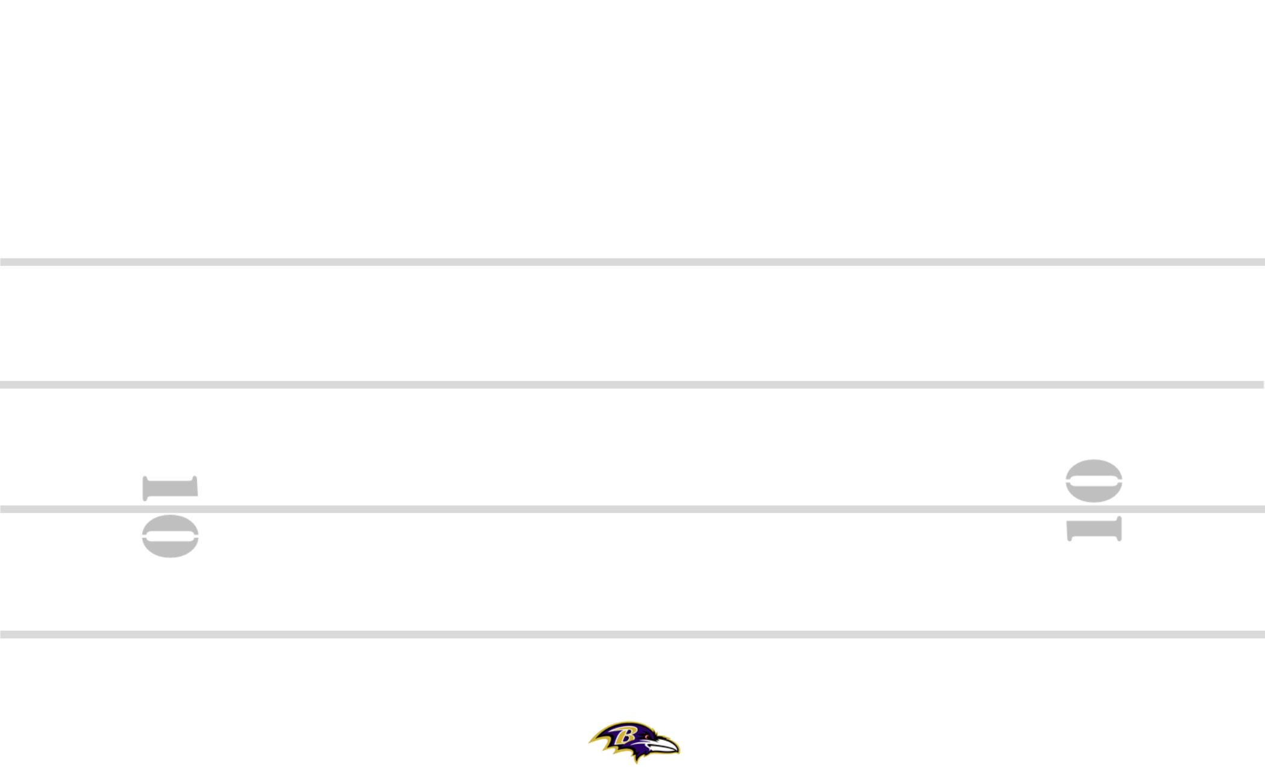
WAS-42 2-7 +15 ZEBRA YYO FRG TRPS STEELER BANG 8
8
#+2
11
84
19
M
7
89
M
2PT
SQ
30
PERIOD: PLAY#: HASH: L DEFENSE:

