Slide 1
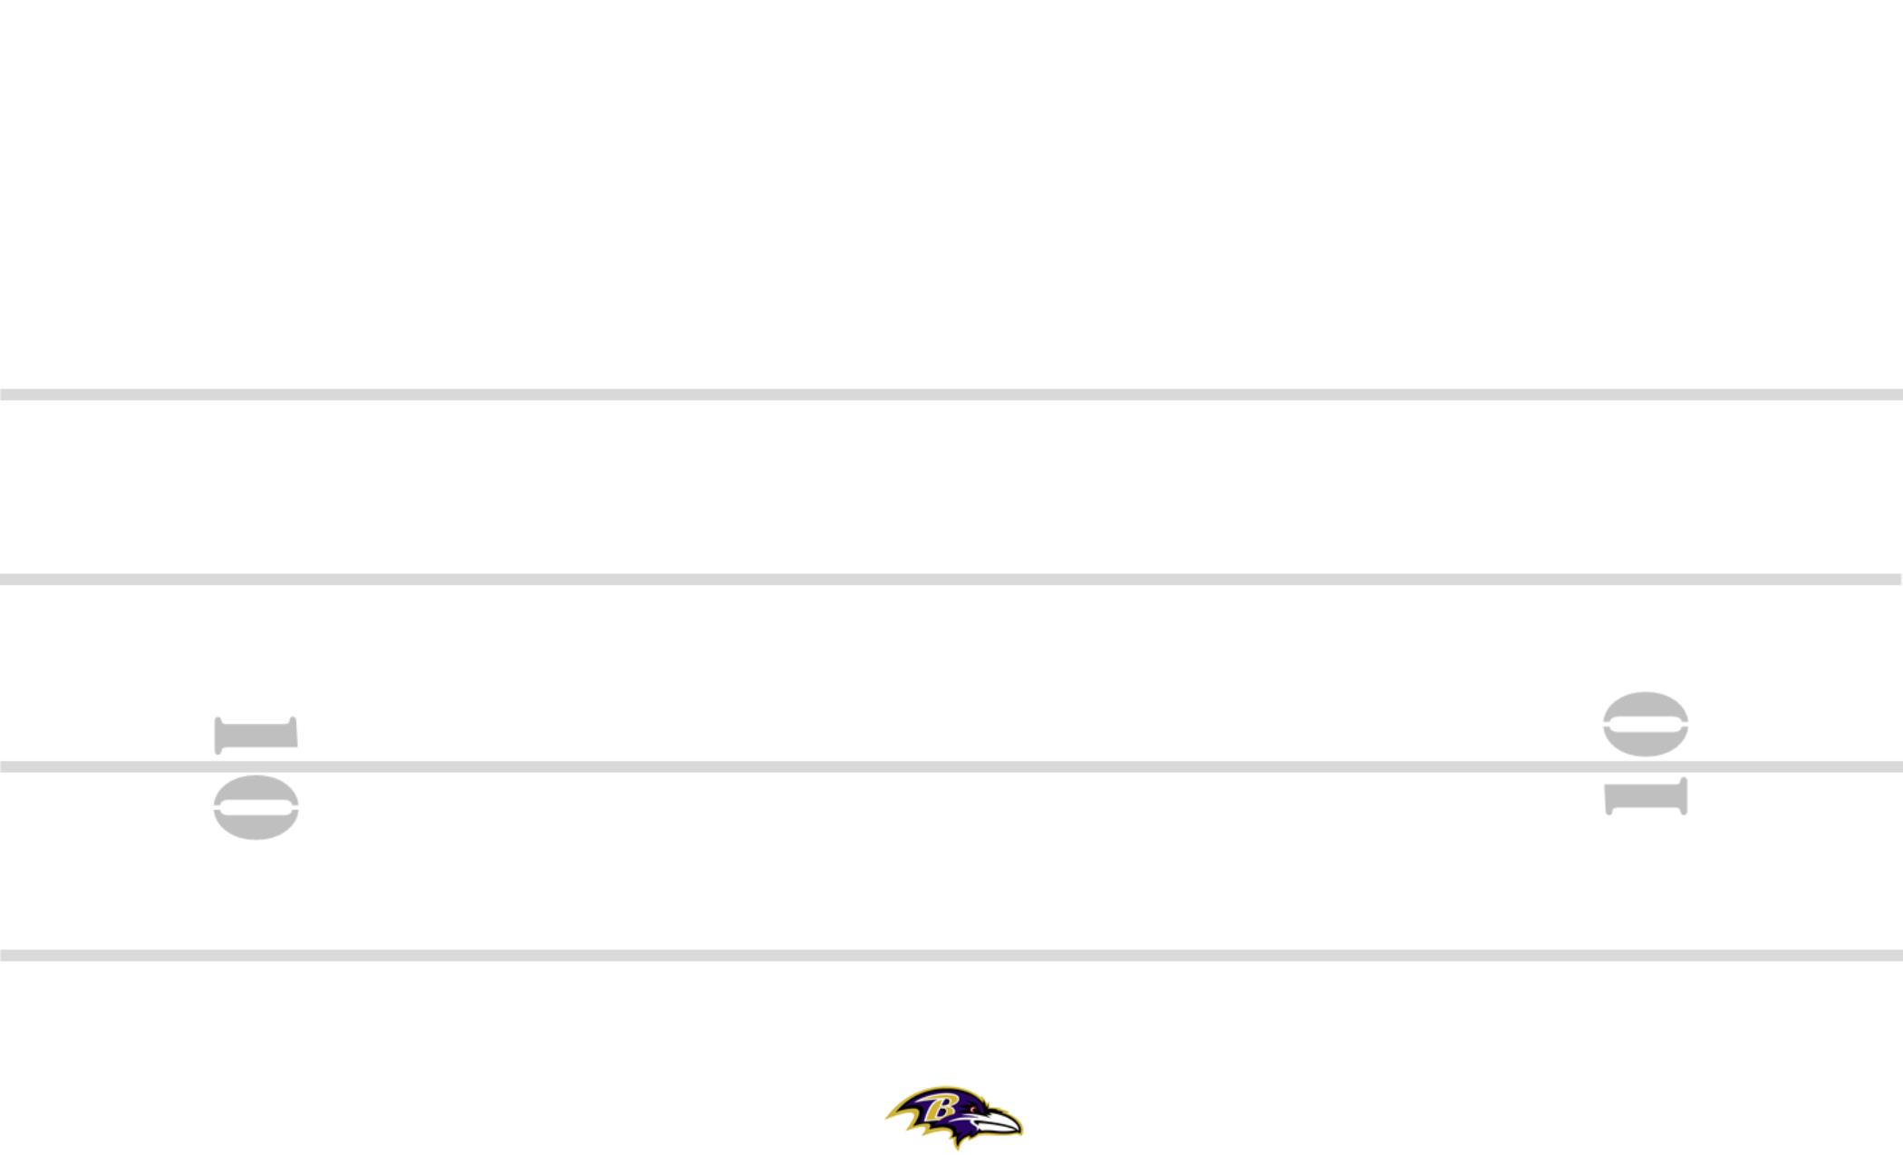
CIN-32 3-6 +30 ZEBRA YYO FRG TRPS STEELER BANG 8
89
PERIOD: PLAY#: HASH: L DEFENSE:

