Slide 1


Slide 2
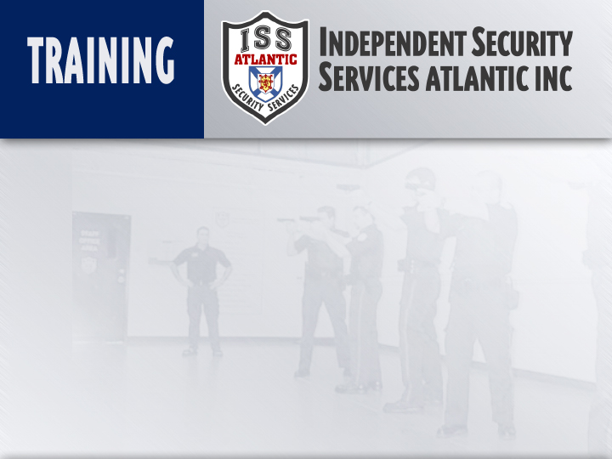
CONFLICT INTERVENTION
Instructor:
Date:

Slide 3
Objectives:
Examine how people communicate non- verbally
Look at how our Appearance/Attitude can affect the outcome of an enforcement encounter
Three elements of a good communicator
Discuss concept of “Verbal Judo”
Review various verbal skills to resolve confrontations
Method of Instruction: Lecture development
Training Aids: Presentation, Written Exam
Pen and Paper are Required

Slide 4
Introduction
As Security Officers, we are placed in situations where conflicts can and do arise.
It is our job to calm these situations down, rather than escalating them.
By using verbal, rather than physical techniques, we give ourselves more options to de-escalate the situation.
Conflict Intervention is the tool that we use to defuse potentially volatile situations and produce a more positive and useful outcome: compliance from the subject.

Slide 5
Introduction
Conflicts can have multiple causes. They can be at various stages of escalation or de-escalation. Interventions can be undertaken at any point in the peace-conflict-peace continuum and can be performed by third parties as well as by parties to the dispute themselves. We are most familiar with interventions that third parties take at the height of violent conflicts such as shuttle diplomacy, peacekeeping, or, in times of full-blown war, direct military intervention.

Slide 6
Yet efforts to intervene in conflicts can be and are taken by any party at all stages of the conflict—pre-violent, violent, or post-violent. Successful intervention depends on whether actions are appropriate to the conflict’s sources and stage.

Slide 7
Three Areas of Non-Verbal Communication
SPACE
EYE CONTACT
GESTURES

Slide 8
Space
Intimate
Personal
Social
Personal Space –
Divided into 3 zones
Intimate Zone - ( 0 – 4 feet )
Personal Zone - ( 4 – 12 feet )
Social - (12 feet + )

Slide 9
Space
Intimate
Personal
Social
Intimate zone is also “Attack zone”
Personal Zone is also “ Defense zone”
Social Zone is also “Alert zone”

Slide 10
Space
Intimate
Personal
Social
As security personnel, we ordinarily need to enter the first two zones while performing their duties.
This escalates the subject’s level of anxiety.

Slide 11
Space
Intimate
Personal
Social
As a general rule, maintain a minimum distance of 4 feet between the subject and yourself.
If distance closes, hands come up above the waist in preparation for defensive actions.

Slide 12
Tactical Considerations
Allow enough space to permit control tactics
Approach from the front or 45 degree angle (lower anxiety)
Approach from the weak side (harder for the subject to attack spontaneously)

Slide 13
Field Interview Stance
Always conduct conversations with individuals in a defensive / supportive stance
Allows for you to defend yourself properly and appear non aggressive to the subject.

Slide 14
EYE CONTACT
Observing the eyes of potentially resistive subjects provides various identifiers
Emotional state ( submissive, angry, etc )
Looking for a weapon / escape route
Planning an attack
Under the influence of drugs / alcohol

Slide 15
Physical Characteristics of the Eyes
Pupils dilate or contract as subjects attitude changes ( Positive / Negative )
When excited – pupils can dilate 4 X normal size
When angry – pupils contract

Slide 16
Other Characteristics
If their eyes,
Alternate between eyes, chest, hands - Sizing you up
Move around in various directions- Hallucinating
Dart side to side/up and down – Agitated
Appear to be looking around- Escape route
Are glazed, empty or “looking through you “
- Deranged / Shock / medical problems

Slide 17
Characteristics (cont’d)
Look at a target on your body ( chin, weapon etc )
Have 4/10 of a second before attack
Eyes widen with whites showing – surprise / fear
Glisten – anguish or distress
Observing the eyes gives you a more complete picture of what can be expected.

Slide 18
Gestures
People also communicate through gestures and posture.
If nonverbal signals do not match their eyes, believe the nonverbal , it’s harder to fake.

Slide 19
Basic Gestures and Posture Signals
There are various body signals that you can look for. Although they are not conclusive on their own, adding them with other signals helps determine possible intent.

Slide 20
HEAD
Angled:
Forward – Supportive/Compliant
Back – Possible Aggression
Straight – Assertive, not passive

Slide 21
FACE
Signs of anxiety or aggression can be:
Muscle tension
Twitching
Teeth clenched

Slide 22
BREATHING
Rate increases and then deepens
Usually indicates high level of nervous tension or anxiety.
Ordinarily precedes an attack

Slide 23
ARMS
Crossed – ( Thinker position ) – Supportive
Crossed with fists closed / holding upper arms
Indicates high levels of anxiety/tension.
Is trying to remain in control

Slide 24
PALMS
Above waist / palms out – non aggressive
Above waist palms in – possibly aggressive
Above waist / bladed position – aggressive
Below waist / palms in – non aggressive
Palms out / elbows close – possibly aggressive
Palms out / elbows away – non aggressive

Slide 25
HANDS
Opening/Closing – Anxiety or aggression
On hips – Assertiveness
Folded in front – Non aggressive
Closed – Aggressive
One open / behind back – Possible weapon
Fighting hand position - Aggressive

Slide 26
ELBOWS
Close to Body – Tense
Away from Body - Relaxed

Slide 27
LEGS / STANCE
Weight equally distributed – non aggressive
Front knee bent / rear leg locked – aggressive
Weight shifts forward – possible attack
Weight shifts backward – escape or creating distance for an attack

Slide 28
OVERALL BODY
Expanding body, chest out & shoulders back – Aggressive
Contracting Body, head down, arms hugging upper body – Non aggressive

Slide 29
Summary
Necessary to watch all signals to determine what the intent of the individual is.
Base your decision on all non verbal signals.

Slide 30
Need a Break?

Slide 31
RECOGNIZING THREATS
Generally aggressors are emotionally aroused to fight.
Begins by threats of violence / injury
This is known as Ritual Combat
With sufficient intimidation – someone gives up or backs off
Aggressor prefers to win without injury
Intense inner conflict results/physical action

Slide 32
When attack is Imminent
Some signals to watch for:
Mouth tightens
Head lowers to protect the neck
Eye contact goes from stare to target glances
Breathing goes from quick, to rapid, than deepens
Shoulders go from squared to bladed
Verbalization stops
Body lowers

Slide 33
Three Areas of Non Verbal Communication
Space
Distance has an impact on anxiety levels.
Golden Rule
Give subject space unless control is the main concern

Slide 34
Three Areas (cont’d)
Eye Contact
Watching for actions and physical characteristics of the eyes will give you an idea of what to expect from the subject.

Slide 35
Three Areas (cont’d)
Gestures
An awareness of what the subject is doing will offer valuable insight on their possible intent

Slide 36
Messages in Enforcement Encounters are communicated in Three ways.
How you are perceived by the subject will have a definite impact on the outcome
These messages that you send will be simultaneous and done in three ways

Slide 37
They Include
VERBAL
VOCAL
NON VERBAL

Slide 38
VERBAL / VOCAL
You must always speak:
Clearly
Confidently
With Authority

Slide 39
NON VERBAL FACTORS
-Professional self presentation very important
-Most often neglected due to complacency
-Has as much impact on outcome as tactics/skills used
-Uniform provides a “Natural Authority”
-Most people conditioned to respond to authority figures.

Slide 40
Choose to act Superior / Intimidate
Guaranteed Response from subject is:
Lack of understanding
Dislike
Mistrust
Resentment
Defensiveness
Hostility

Slide 41
Examples – What not to do
Not pay attention to them – disregard or ignore, not listen
Constant ongoing eye contact as they speak
Cross your arms and “Close them out”
Poor personal hygiene or deportment
Do not stand “over them”
Use derogatory language / tone

Slide 42
Project attitude of Equality/Understanding
Invites a positive response
Encourages mutual understanding
Easier to get an attitude adjustment
Easier to gain acceptance/compliance

Slide 43
What to do:
Portray yourself in a professional manner (dress and deportment)
Use proper eye contact, facial expressions to convey interest and concern.
Maintain a safe and proper distance so you don’t intimidate.
Use hand gestures to reinforce your words.
When using verbal commands – direct eye contact with proper body signals to reinforce intent.

Slide 44
THREE ELEMENTS OF A GOOD COMMUNICATOR
REPRESENTATION
TRANSLATION
MEDIATION

Slide 45
Representation
Ability to properly represent the policies / rules with objectivity
Keep the goal in mind
You are just the “Ambassador”
Stats show that a person who has a bad experience with an authority figure, will tell 28 people in 3 days

Slide 46
Translation
Ability to make the subject understand what you mean.
Use clear concise words.
Do not be evasive or uncertain
Your message will contain:
CONTENT, CODING, SENDING and DECODING

Slide 47
Mediation
This is the process where you help the subject see something “New”
Your role is to present options so that they will hopefully make the right decision.
Gaining compliance through reasoning is always the safest.

Slide 48
THREE MAXIMS OF VERBAL JUDO
Embrace frustration with Empathy
Overcome Hard with Soft
Be disinterested when you punish

Slide 49
Five Steps to Compliance ( LEAPS )
L – Listen
E – Empathize
A – Ask Questions
P – Paraphrase
S - Summarize

Slide 50
Listen
Four levels of listening
Appear open and unbiased
Actually listen to what is being said
Interpret the data
Act on what you understood

Slide 51
Empathize
Four Approaches to Empathy
Ethical Approach
Reasonable Approach
Personal Approach
Practical Approach

Slide 52
Ask
Five types of Questions
Fact Finding ( Who, What, Where, Why & How)
General Questions
Opinion Seeking
Direct Questions
Leading Questions ( Forecasting, etc. )

Slide 53
Paraphrasing
Shows you were paying attention
Benefits are:
Interrupt without generating resistance
Taken control since they are listening to you
Verifies the information received
Assist in report writing later on

Slide 54
Summarize
Condensing the situation and putting it all into one simple statement
Allows you to control the situation, avoid conflict and increases your abilities as a “Contact Professional”

Slide 55
OVERVIEW
In this session we have discussed various elements of communicating with others while in the performance of your security duties.
Additionally, the significance communication has on the outcome of any potential resistance

Slide 56
Overview ( cont’d )
Examined how our appearance and attitude plays a significant role in controlling subject behavior
Reviewed the necessary elements of an effective communicator.
Discussed Verbal Judo and other methods of Tactical Communication

Slide 57
Overview ( cont’d )
By understanding how communication works, you can reduce the number of incidents that will require physical control
Establishes your own credibility and enhances organizational professionalism.
Lowers your own personal risk by avoiding potentially violent confrontations.

