Slide 1


Slide 2
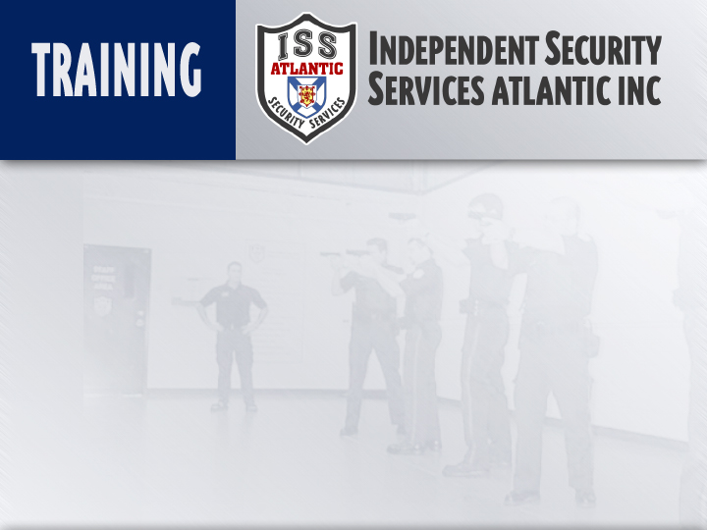
FIELD INTERVIEW
Instructor:
Date:

Slide 3
Topic: Field Interview
Objective: Gives Security Officers the ability to:
Use relative positioning when dealing with potentially resistive suspects
Use the concept of the Reactionary Gap as it relates to interviewing potentially resistive suspects.
Method of Instruction: Lecture-developmental and demonstrative performance
Training Aids: Presentation, practical performance, written exam
Pen and paper are required

Slide 4
Introduction
Field Interview is based upon a concept of relative body positioning; encompassing posture, hand position, body orientation and distance in dealing with subjects.
It will allow the Security officer to understand the role of a reactionary gap and how it applies to the concept of Field Interview, employing the stages of reaction, creating distance, and the use of proxemics.

Slide 5

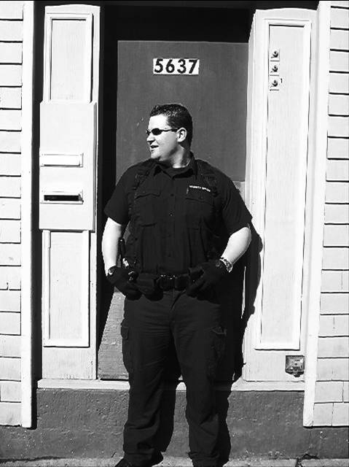
Body Posture – Do’s
Head up and aware (code yellow)
Hands above waist level
Body bladed slightly
Balanced stance

Slide 6
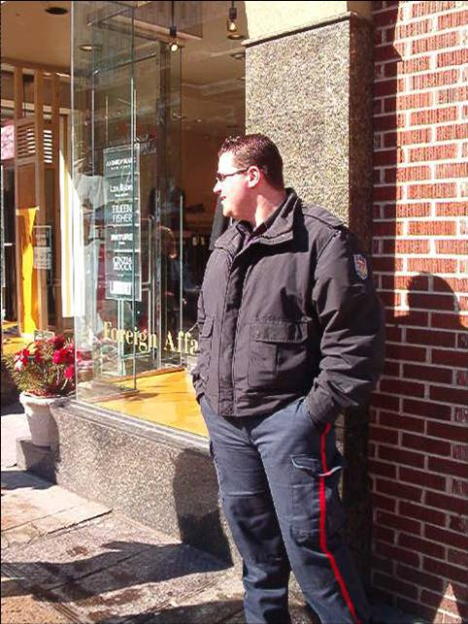
Body Posture – Don’ts
Head down and unaware (code white)
Hands in pockets, crossed, or behind back
Poor body alignment in relation to subject
Standing too close to a subject

Slide 7
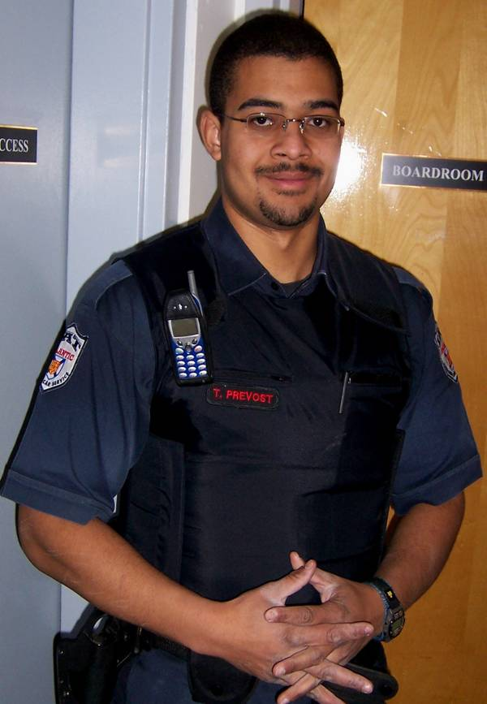
Dress and Deportment
Officer presence is the first level of force used in any encounter. With that in mind, it is important to realize that how you present yourself (dress and deportment) plays a role in how subjects will react to your presence.
Remember:
Uniform is to be clean, pressed and lint free
As uniform and non-uniform officers, we are a visible representation to public of who and what we are as a company
We are an authority figure in which our duties are to handle, with tact and diplomacy, any given situation

Slide 8
Levels of Relative Positioning
Attack
Intimate
Distance
0’-4’
3
Defense
Personal
4’-12’
2 1/2
2 1/2
Alert
Social
12’ plus
2
Subject
2
1
1
Officer
Position

Slide 9
Levels Of Relative Positioning
Interview – Position 1
45 degree angle (front) relative to subject
Used when interviewing a subject
3
2 1/2
2 1/2
2
Subject
2
1
1
Officer
Position

Slide 10
Levels Of Relative Positioning
Cover – Position 2
Abreast of the subject
Used when providing cover for the interviewing officer
3
2 1/2
2 1/2
2
Subject
2
1
1
Officer
Position

Slide 11
Levels Of Relative Positioning
Escort – Position 2 ^{1/2}
Behind the subject at a 45 degree angle
Used when taking a subject into custody, or escorting them from a location
3
2 1/2
2 1/2
2
Subject
2
1
1
Officer
Position

Slide 12
Levels Of Relative Positioning
Cover – Position 3
Directly behind the subject
Used for providing cover for the interviewing officer, or approaching a subject undetected.
3
2 1/2
2 1/2
2
Subject
2
1
1
Officer
Position

Slide 13
Body Position
Balanced Stance
Feet shoulder width apart, head up and centered
Gun/weapon side back
Takes a weapon out of reach
Bladed body position
Body bladed to your subject, providing less of a target as well as giving you the ability to avoid strikes

Slide 14
Hand Position
Above the waist
Modified high guard
Natural/subtle

Slide 15
Reactionary gap
Reactionary Gap
The distance it take for an individual to successfully implement Reaction Time concepts.
6 feet - is the normal/unarmed reactionary distance
10 feet plus the length of the weapon - is the reactionary distance for edged weapons
Increase the reactionary gap by placing stationary objects, as well as distance, between yourself and the attacker.
A greater distance between you and the attacker will allow you more time to react and formulate a plan of action.

Slide 16
Reactionary gap
Reaction Time
The time necessary to nullify or counter an attack. The process steps associated with reaction time are:
Assess
Plan
Act

Slide 17
Reactionary gap
The following conditions either impede or improve Reaction Time depending on the awareness of the officer.
Attention
Environment
Training
Distance

Slide 18
Proxemics
Proxemics deals with the study of spatial distances between individuals in different situations
In law enforcement, proxemics allows us to look at any given situation and use the appropriate distance to keep ourselves or others safe from potentially dangerous subjects
It also allows Security Officers the ability to identify when subjects are too close, thus making them a threat to our safety.

Slide 19
Summary
Field Interview is a series of concepts combined to allow Security Officers to safely deal with potentially resistive or violent subjects
We have covered the following concepts:
Levels of Relative Positioning
Body Position
Hand Position
Reactionary Gap
Remember, when dealing with a subject, distance or the ability to create distance is crucial.

