Slide 1
?
?
?
?
?
?
Ano pwede gawin sa boss na nampapawer trip?
?
Pwede ba mag-emergency leave?
?
?
Ambaho ng katrabaho ko pwede magreklamo?
Paano ko isusumbong boss ko?
?
?
?
?
Anlaki ng kaltas ko!
Bakit wala akong 13th month pay?
?
?
?
Magkano makukuha ko pag nagretire ako?
Pinahiya ako ng boss ko saan pwede magreklamo?
Yung HR nilabas private conversation ko at sinumbong sa boss ko, ano gagawin?
Are we allowed to be late?

Slide 2
Policy Assistant for Labor And Welfare
(PALAW)
Daryll Medina^{1,2}, Kam Deliña¹, Sean Marasigan¹, Carlo Barcelona³, Marie Montesa⁴, Jason Silverio⁵
¹OPENIT ASIA, INC., PHILIPPINES
²CHUNG YUAN CHRISTIAN UNIVERSITY, TAIWAN
³COLLEGIO DE MUNTINLUPA, PHILIPPINES
⁴MONTESSA MEDICAL GROUP, PHILIPPINES
⁵GOLDEN ARCHES DEVELOPMENT CORP., PHILIPPINES
Hong & Medina (2026) · Expert Systems with Applications 326 · Article 132719
01

Slide 3
Business Value
Key Question | Value Proposition
What insight is the customer needing? | Information regarding DOLE Policies General Law Information of Rights and Responsibilities as Employees
What Use Case is most relevant to your Agentic AI application? | Making Law accessible and Digestible to the general populace.
Why is this Use Case most appropriate for your team application? | We are a group of employees in a corporation.
Why is Agentic AI the right solution? | Agentic AI has tools to retrieve relevant information in line with the use case and explain such information.
What data input is required to achieve the desired insight? | DOLE Policies DOLE Advisories Company-based Policies
How would you address Responsible AI? | Adhere with GDPR, DPA, and PIA
How would you determine performance of your Agentic AI system? | Proper and Correct Interpretation of Policies and Laws

Slide 4
Agentic Use Case
Field | Content
Use Case Name | Policy Assistant for Labor And Welfare (PALAW)
Business Domain | Law and Order
Problem Statement | Lack of Law Awareness
Agentic AI Approach | Multi-Agent and RAG
Input Data | DOLE Policies for POC
Output / Action | TBD
Platform & Tools | Python
Key Prompting Strategy | TBD
Guardrails | TBD
MoP – Performance | Recall
MoE - Effectiveness | No. of Query Answered

Slide 5
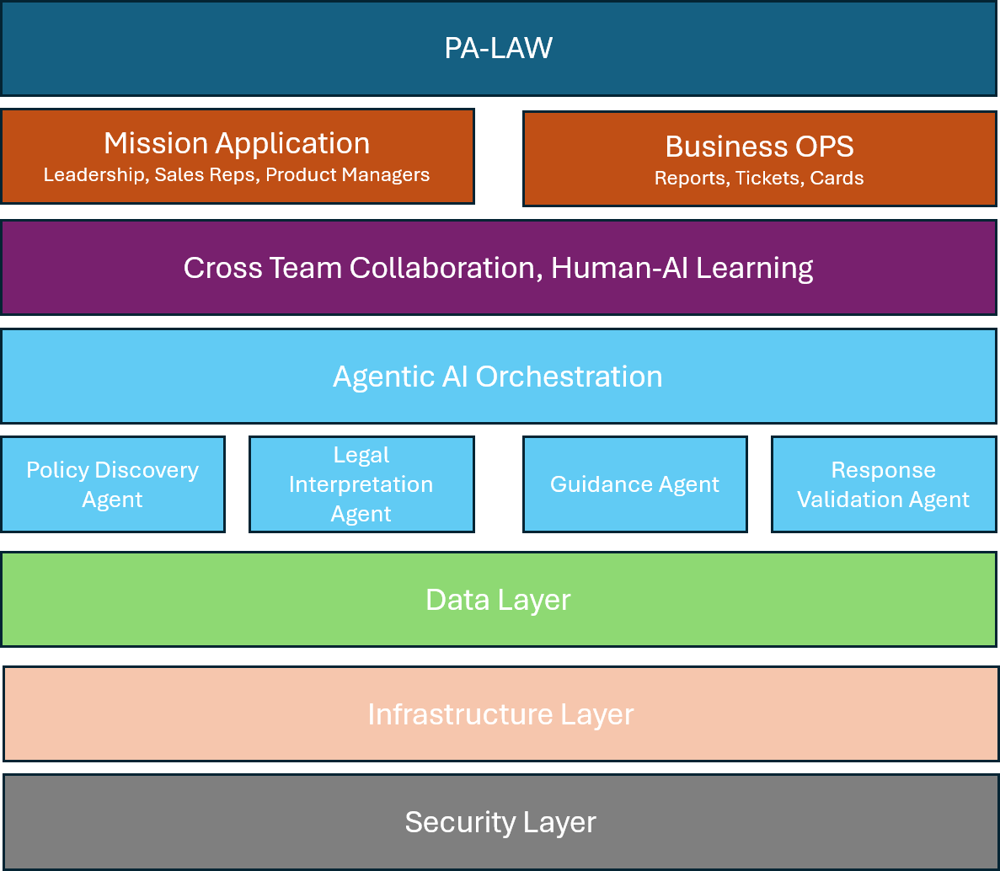
Agentic AI Architecture

Slide 6
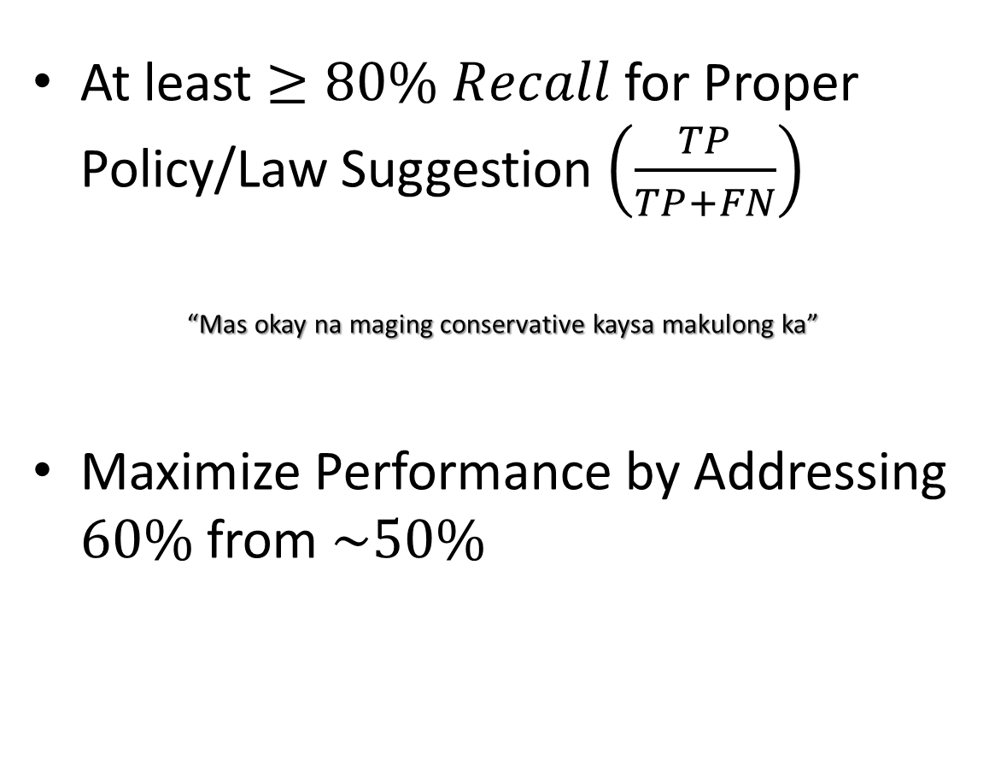
MoPs and MoEs
At least $≥80\% Recall$ for Proper Policy/Law Suggestion $\left(\frac{TP}{TP+FN}\right)$
“Mas okay na maging conservative kaysa makulong ka”
Maximize Performance by Addressing $60\%$ from $\sim 50\%$

Slide 7
Policy Assistant for Labor And Welfare
(PALAW)
Daryll Medina^{1,2}, Kam Deliña¹, Sean Marasigan¹, Carlo Barcelona³, Marie Montesa⁴, Jason Silverio⁵
1OPENIT ASIA, INC., PHILIPPINES
2CHUNG YUAN CHRISTIAN UNIVERSITY, TAIWAN
3COLLEGIO DE MUNTINLUPA, PHILIPPINES
4MONTESSA MEDICAL GROUP, PHILIPPINES
5GOLDEN ARCHES DEVELOPMENT CORP., PHILIPPINES
Hong & Medina (2026) · Expert Systems with Applications 326 · Article 132719
01

