Slide 1
Policy Assistant for Labor And Welfare
(PALAW)
Daryll Medina^{1,2}, Kam Deliña¹, Sean Marasigan¹, Carlo Barcelona³, Marie Montesa⁴, Jason Silverio⁵
¹OPENIT ASIA, INC., PHILIPPINES
²CHUNG YUAN CHRISTIAN UNIVERSITY, TAIWAN
³COLLEGIO DE MUNTINLUPA, PHILIPPINES
⁴MONTESSA MEDICAL GROUP, PHILIPPINES
⁵GOLDEN ARCHES DEVELOPMENT CORP., PHILIPPINES
Hong & Medina (2026) · Expert Systems with Applications 326 · Article 132719
01

Slide 2
Current End-to-End Process
User Message
How to apply for Emergency Leave?
Intent Classification
Inquiry
Department Classification
Human Resources

Slide 3
Proposed Schema
decision_schema = {
"type": "object",
"properties": {
"category": {
"type": "string",
"enum": ["INQUIRY", "COMPLAINT"],
},
"confidence": {
"type": "number",
"minimum": 0,
"maximum": 1,
},
"routed_team": {
"type": "string",
"enum": ["HR", "LEGAL", "ACCOUNTING", "IT_SUPPORT"],
},
"reason": {"type": "string"},
"next_action": {
"type": "string",
"enum": ["ROUTE_TO_LEGAL_AI_ASSISTANT", "ROUTE_TO_OTHER_TEAM"],
},
},
"required": ["category", "confidence", "routed_team", "reason", "next_action"],
"additionalProperties": False,
}

Slide 4
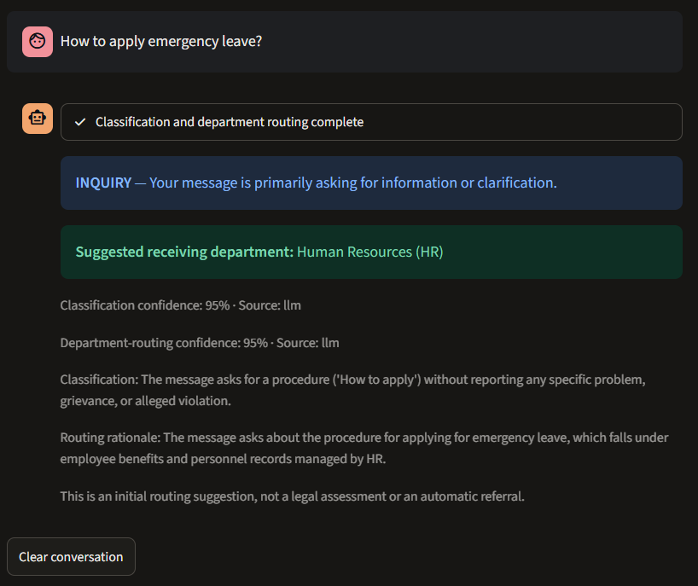
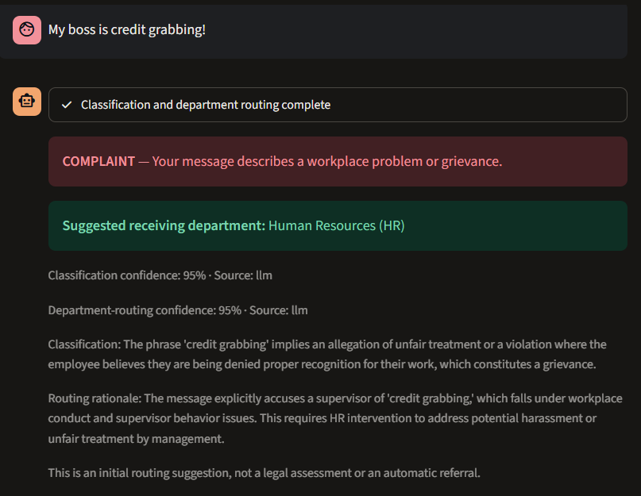
Demonstration Snippets

Slide 5
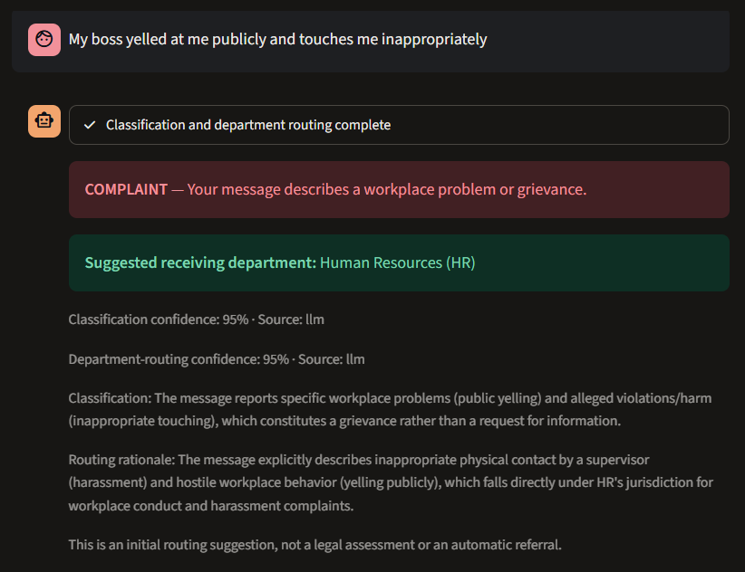
Demonstration Snippets

