Slide 1
Alert by Alerting
Notify with LIGHT & SOUND

Slide 2
LIGHT NOTIFICATIONS
We use Lights to signal
Colors for categorizing

Slide 3
LIGHT NOTIFICATIONS
We use Lights to warn
Fades for warring

Slide 4
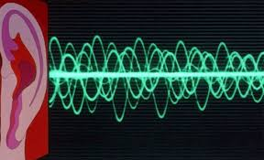
SOUND NOTIFICATIONS
We sound to signal
We use sound to notify

Slide 5
SOUND NOTIFICATIONS
We use speech to know
We use speech inform

Slide 6
Any questions?

Slide 7
Thank you for your attention!

