Slide 1
Alert by Alerting
Notify with LIGHT & SOUND

Slide 2

LIGHT NOTIFICATIONS
We use Lights to communicate status
Colors for categorizing

Slide 3
LIGHT NOTIFICATIONS
We use Lights to warn
Fades or flashes for warnings

Slide 4
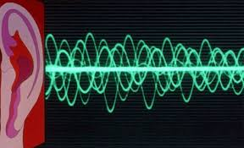
SOUND NOTIFICATIONS
We use sound to signal
We use speech to know
We use sound to notify
We use speech to inform

Slide 5
Any questions?

Slide 6
Thank you for your attention!

