Slide 1
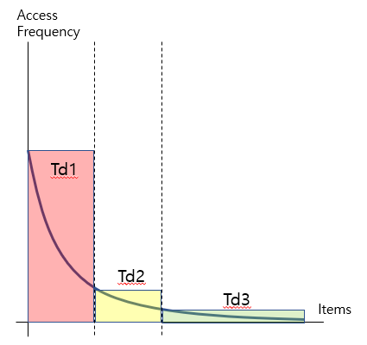
Figure 1: Access Frequencies per number of connections
Td1
Td1
Td1
Td mean
Td mean
Td2
Td2
Td2
Td3
Td3
Td3
Td1
Td mean
Td2
Td3

Slide 2
Figure 2. Experimental Design
Collect Raw Data
Pre-Processing
Data Cleaning
Split Train / Test Set
Train Set
Test Set
Sort Items
Td3
Simulate
Get Long-tail

Slide 3
Figure 3. Experimental Design
Request
Blocked IP?
yes
Block
no
Td3 Item?
Known IP?
yes
no
yes
Add to IP List
no
Increase Count
Exceed Limit?
yes
no
Add to Block List
Respond

Slide 4
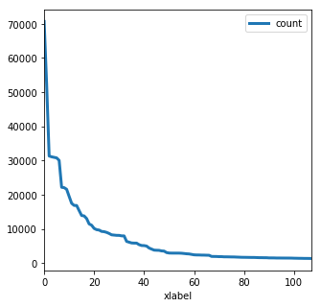
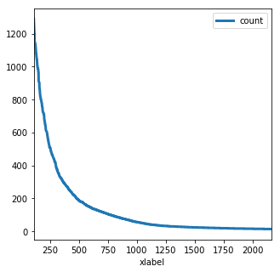
Figure 4 & 5
access count ranking
access count ranking

Slide 5
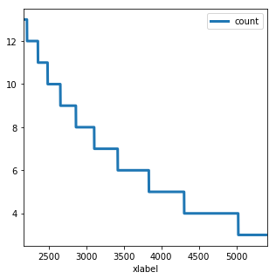
Figure 6. Access Count in Long-tail
access count ranking

Slide 6
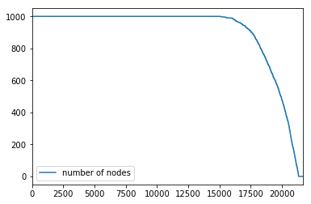
Figure 7. Number of IPs reduced by detection
collected items

Slide 7
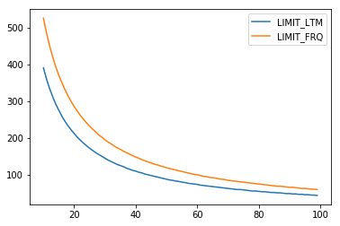
Figure 8. Number of Detectable Crawler Nodes
threshold

Slide 8
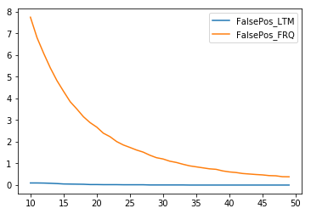
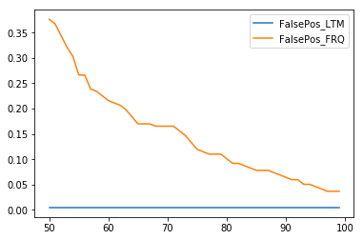
Figure 9 & 10
threshold
threshold

