Slide 1


Hanoi 7/2018
ICP TECHNOLOGY SHARING
NGUYỄN VIẾT ANH – DEVELOPER
TRẦN MINH DIỆN – DEVELOPER
Henry Ford

Slide 2
POC DEMOSTRATION
NỀN TẢNG DOCKER & K8S
CÔNG NGHỆ IBM CLOUD PRIVATE (ICP)
KIẾN TRÚC TRIỂN KHAI
QUY TRÌNH TRIỂN KHAI ỨNG DỤNG TỰ ĐỘNG
USE CASES

Slide 3
Logistics
Hi!
This will run from 1:30pm to 3:30pm
We'll have a coffee break around 2:30pm
Food will be served (to be confirmed)
Feel free (please do) interrupt me to ask questions
There is a Slack channel for questions: #kube
Chapters are separated by pictures of containers
The slides are targeting a wide audience
(i.e. people who might not have the Docker expertise that you have)

Slide 4
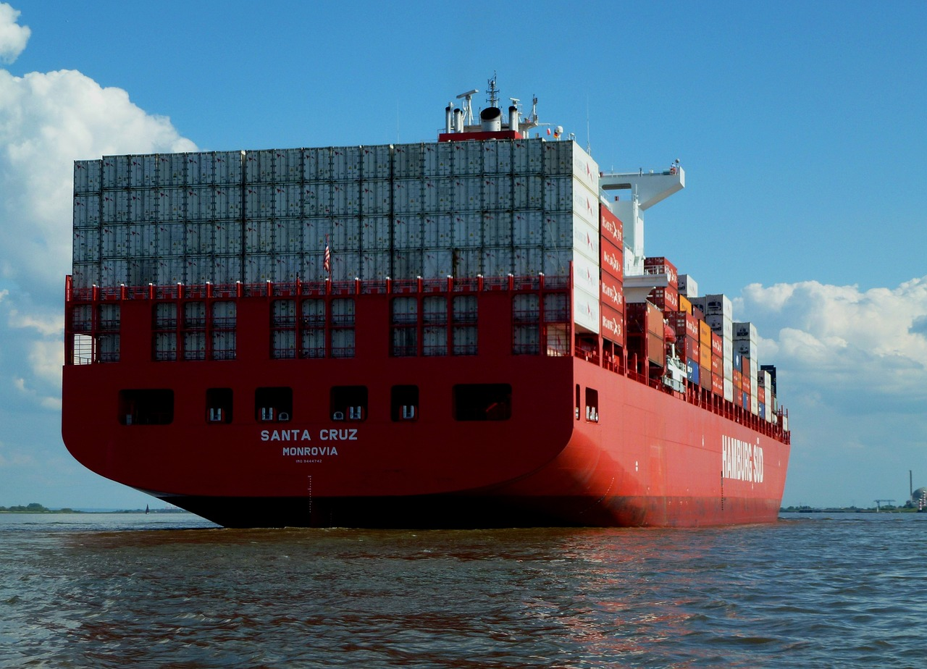
\
Notes:
Đây là hình ảnh của một container, giúp chúng ta dễ dàng liên hệ đến cách các ứng dụng được đóng gói lại với nhau thành một image (container), các ứng dụng này dễ dàng vận chuyện (deliver) từ nơi này tới nơi khác, dễ dàng lắp đặt triển khai như thế nào, ko phụ thuộc vào OS, môi trường

Slide 5
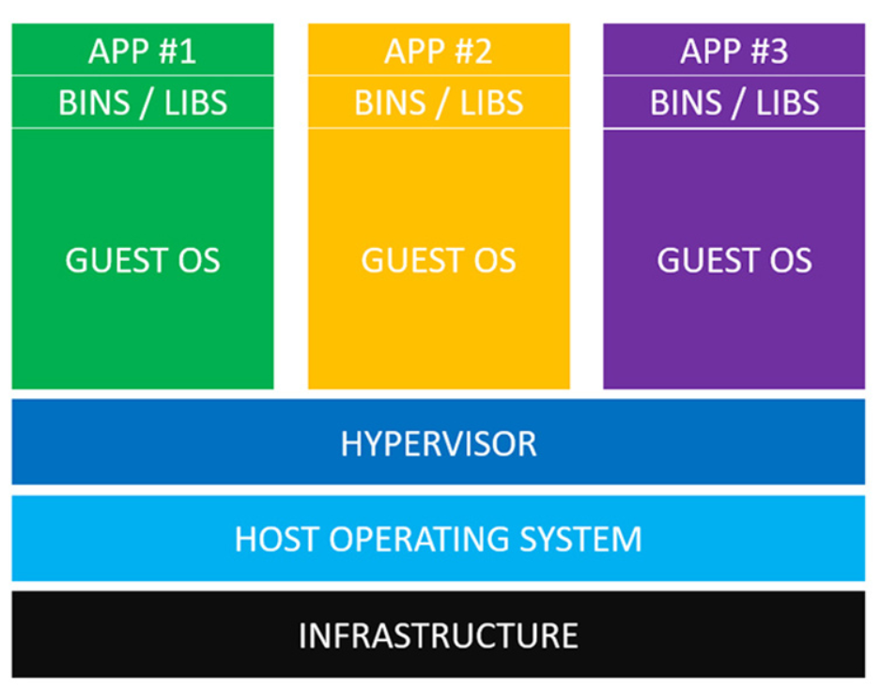
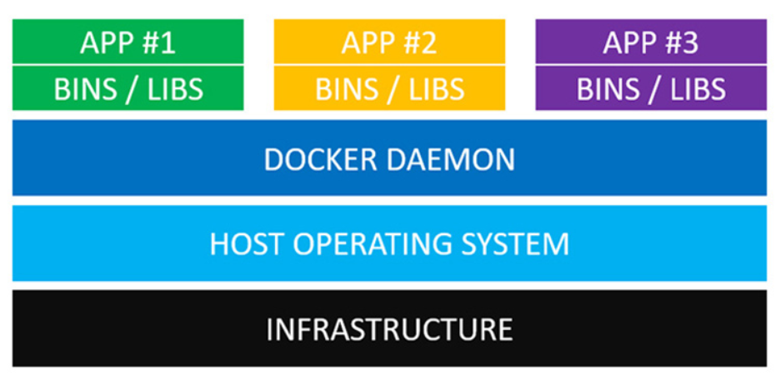
Virtual Machines vs Docker Containers

Slide 6
Virtual Machines vs Docker Containers
Virtual Machines
Now let’s define those layers from the bottom up of VMs:
It all begins with some type of infrastructure
On top of that host runs an operating system
Then we have a thing called a hypervisor: HyberKit for MacOS, Hyper-V for Windows and KVM for Linux
The next layer in this delicious server onion are your guest operating systems (Virtual machines come with a lot of baggage. Each guest OS in itself might be 700 MB)
Then on top of that, each guest OS needs its own copy of various binaries and libraries
Finally, we have our application

Slide 7
Virtual Machines vs Docker Containers
Docker Container
Now let’s define those layers from the bottom up of Docker Containers:
It all begins with some type of infrastructure
On top of that host runs an operating system
The Docker daemon replaces the hypervisor: Docker daemon is a service run in the background on host OS and manages everything required to run and interact with Docker containers
Next up we have our binaries and libraries
The last piece of the puzzle is our applications

Slide 8
Docker Overview
Docker is Open Source engine for containers
Build, ship, run applications with containers
Docker provides the ability to package and run application in a loosely isolated environment called a container
Docker provides tooling and a platform to manage the lifecycle of containers:
Develop your application and its supporting components using containers.
The container becomes the unit for distributing and testing your application.
When you’re ready, deploy your application into your production environment, as a container or an orchestrated service. This works the same whether your production environment is a local data center, a cloud provider, or a hybrid of the two.

Slide 9
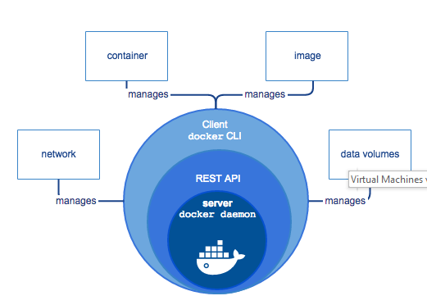
Docker engine

Slide 10
Docker engine
Docker engine is a client-server application with these major components:
A server which is type op long-running program called a daemon process (the dockerd)
A REST API whichs specifies interfaces that programs can use to talk to the daemon and instruct it what to do.
A command line interface (CLI) client
The CLI uses the Docker REST API to control or interact with the Docker daemon through scripting or direct CLI commands. Many other Docker applications use the underlying API and CLI.
The daemon creates and manages Docker objects, such as images, containers, networks, and volumes.

Slide 11
What can I use Docker for?
Fast, consistent delivery of your applications
Containers are great for continuous integration and continuous development (CI/CD) workflows.
Your developers write code locally and share their work with their colleagues using Docker containers.
They use Docker to push their applications into a test environment and execute automated and manual tests.
When developers find bugs, they can fix them in the development environment and redeploy them to the test environment for testing and validation.
When testing is complete, getting the fix to the customer is as simple as pushing the updated image to the production environment.
Responsive deployment and scaling
Running more workloads on the same hardware

Slide 12
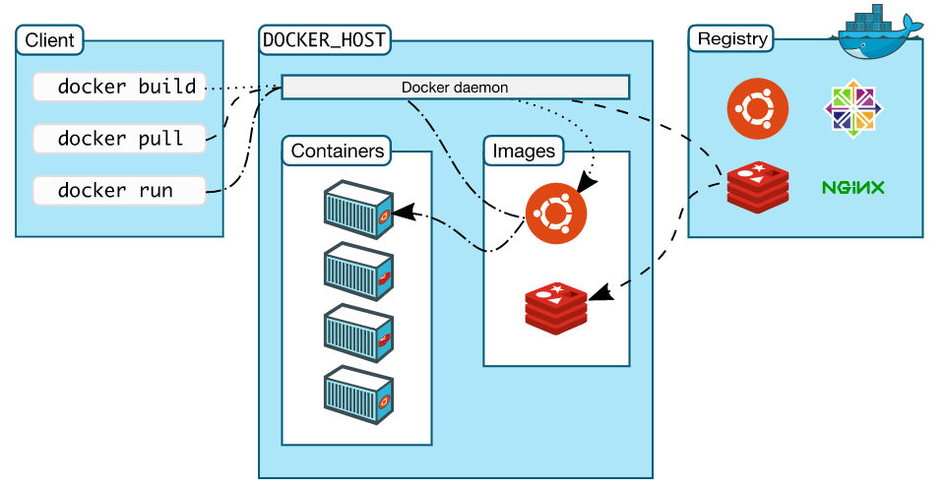
Docker architecture

Slide 13
Docker architecture
Docker uses a client-server architecture
The Docker client talks to the Docker daemon, which does the heavy lifting of building, running, and distributing your Docker containers
The Docker client and daemon communicate using a REST API, over UNIX sockets or a network interface

Slide 14
Docker daemon
The Docker daemon (dockerd) listens for Docker API requests and manages Docker objects such as images, containers, networks, and volumes
A daemon can also communicate with other daemons to manage Docker services.

Slide 15
The Docker client
The Docker client is the primary way that many Docker users interact with Docker
When you use commands such as docker run, the client sends these commands to dockerd
The Docker client can communicate with more than one daemon

Slide 16
Docker registries
A Docker registry stores Docker images
Docker Hub and Docker Cloud are public registries that anyone can use, and Docker is configured to look for images on Docker Hub by default
You can even run your own private registry

Slide 17
Docker Object - Images
An image is a read-only template with instructions for creating a Docker container
Often, an image is based on another image, with some additional customization
You might create your own images or you might only use those created by others and published in a registry
Each instruction in a Dockerfile creates a layer in the image. When you change the Dockerfile and rebuild the image, only those layers which have changed are rebuilt

Slide 18
Docker Object - Containers
A container is a runnable instance of an image
You can create, start, stop, move, or delete a container using the Docker API or CLI
You can connect a container to one or more networks, attach storage to it, or even create a new image based on its current state

Slide 19
Docker Components - Services
Services allow you to scale containers across multiple Docker daemons, which all work together as a swarm with multiple managers and workers
Each member of a swarm is a Docker daemon, and the daemons all communicate using the Docker API

Slide 20
Dockerfile
Docker can build images automatically by reading the instructions from a Dockerfile
A Dockerfile is a text document that contains all the commands a user could call on the command line to assemble an image
Using docker build users can create an automated build that executes several command-line instructions in succession

Slide 21
Dockerfile
Sample:
FROM tomcat:latest
MAINTAINER anhnv <anhnv@five9.vn>
# Update Apt and then install Nano editor (RUN can be removed)
RUN apt-get update && apt-get install -y \
nano \
&& mkdir -p /usr/local/tomcat/conf
# Copy configurations (Tomcat users, Manager app)
COPY tomcat-users.xml /usr/local/tomcat/conf/
COPY context.xml /usr/local/tomcat/webapps/manager/META-INF/
# Copy file deploy to Tomcat
COPY counterservice.war /usr/local/tomcat/webapps

Slide 22
Docker command
Find an image from Docker Hub: docker search <image>
By default, Docker will run a command in the foreground. To run in the background, the option -d needs to be specified: docker run -d <image_name>
Command lists all running containers, the image used to start the container and uptime: docker ps
Find out information about individual containers: docker inspect <friendly-name|container-id>
Display messages the container has written to standard error or standard out: docker logs <friendly-name|container-id>
Using -p <host-port>:<container-port> option to expose port, example: docker run -d --name redisHostPort -p 6379:6379 redis:latest
Expose Redis but on a randomly available port: docker run -d --name redisDynamic -p 6379 redis:latest

Slide 23
Docker command
Command line discovered expose port: docker port redisDynamic 6379
Persisting data, command line: docker run -d --name <container_name> -v <host-dir>:<container-dir> <image_name>
docker commit [OPTIONS] CONTAINER [REPOSITORY[:TAG]]: Create a new image from a container’s changes

Slide 24
Docker Compose
Notes:
Câu hỏi đặt ra là, chúng ta đã biết cách chạy từng ứng dụng trên nền docker, vậy, với các ứng dụng microservice trong đó bao gồm rất nhiều các service khác nhau thì chạy chúng trên nền docker như thế nào mà vẫn đảm bảo tính khả dụng của từng service? Chúng ta hãy đến với Docker Compose

Slide 25

Notes:
Hình ảnh docker compose, rất nhiều các ứng dụng khác nhau cũng chạy trên nền docker (containers) được phối hợp với nhau thành một ứng dụng duy nhaast
Compose is a tool for defining and running multi-containerDocker applications => Compose là một công cụ dung để định nghĩa và chạy đa ứng dụng nền docker với nhau

Slide 26
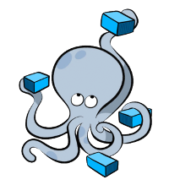
Docker Compose
Previously Fig
Initially, main purpose is to create fast, isolated development environments using Docker
But now, is to defining and running complex applications. One command to rule them all (just more beautiful words)
Great for dev, test, CI. Not ready for production.

Slide 27
Before compose
$ docker run -d -it --name redis redis
$ docker run -d -it --name postgres dientm/postgres
$ docker run -d -it --name web \ -v ~/Dev/gitlab.com/dientm/test-project:/var/www/html \ --link postgres:db --link redis:redis dientm/php-web
$ docker run -d -it -p 80:80 --name nginx \ --link web:web --volumes-from web dientm/php-nginx
docker run -d -it --name node --link web:web \ --volumes-from web dientm/gulp-bower

Slide 28
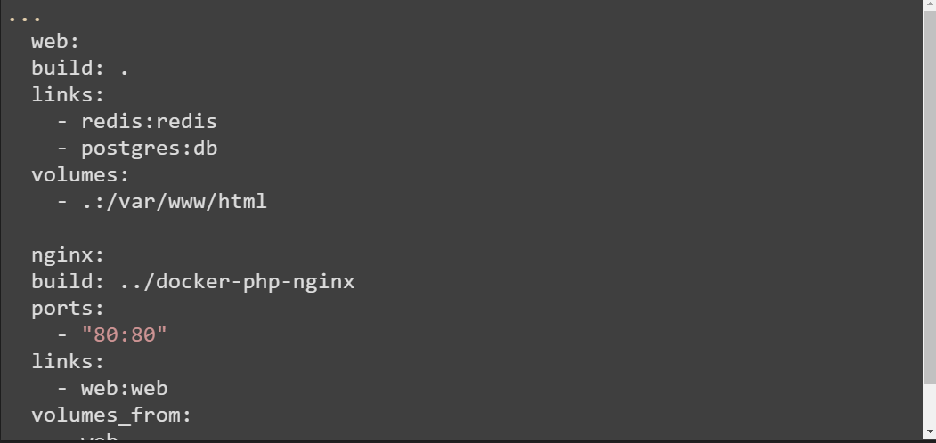
Compose YML File
With Compose, you define all your containers configuration in a yml file
Notes:
Một project có thể có nhiều file .yml, môt cho dev, một cho test, một cho production (không được khuyến khích). Mặc định , Compose sẽ sử dụng docker-compse.yml file.

Slide 29
Compose CLI
All of them
Some of interesting ones
Create and start containers
Scale containers
$docker-compose --help
$docker-compose up
$docker-compose scale web=3
Notes:
Docker CLI là tập lệnh để thao tác với docker compose thông qua giao diện dòng lệnh

Slide 30
Docker + Kubernetes = ❤️
Notes:
Chúng ta đã đi qua các hiểu biết về docker, cách đóng gói ứng dụng thành image docker và chạy ứng dụng docker trong container. Chúng ta cũng đi qua khái niệm Docker Compose, là một công cụ giúp chúng ta define và chạy nhiều ứng dụng dockers. Với compose, chúng ta sử dụng 1 file YAML để cấu hình tất cả các service, và với một dòng lệnh, compose up chúng ta có thể tạo và chạy các services trên cũng lúc với nhau, móc nối nhau thành một hệ thống hoàn chỉnh. Tuy nhiên, docker compose chỉ thích hợp để chạy các services trên môi trường dev và test, nó không hỗ trợ giải quyết nhiều vấn đề khi sản phẩm chạy trên môi trường production, như là optimize resource, update/rollback version without any downtime…
Để giải quyết các vấn đề đó, khai niệm “docker orchestration” xuất hiện

Slide 31
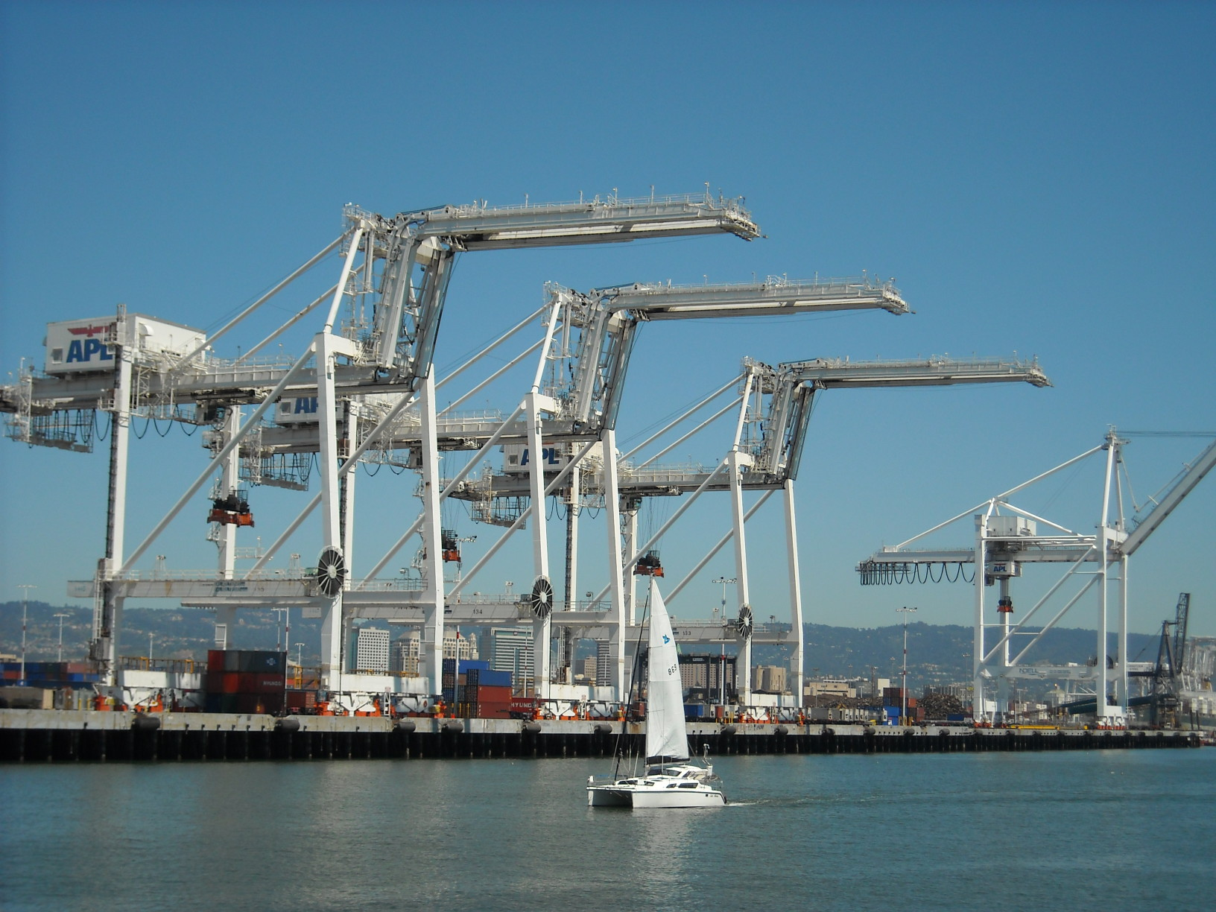
Notes:
Đây là hình ảnh “thưc tế” của một container orchestration: các container được sắp xếp ngăn nắp vào đúng vị trí một cách tối ưu nhất có thể.
Có rất nhiều Docker Orchestration. Docker Swarm là một native orchestration cho phép chạy và quản lí các services docker trên multi hosts. Nó cho phép làm những việc như scale, start một container khi nó bị crash,.
Bên cạnh đó còn nhiều các công cụ khác như Mesos Marathon, Amazon ECS…
K8S là một Docker Orchestration opensource, giúp tự động deploy, scale và quản lí các ứng dụng chạy trên nền docker.

Slide 32
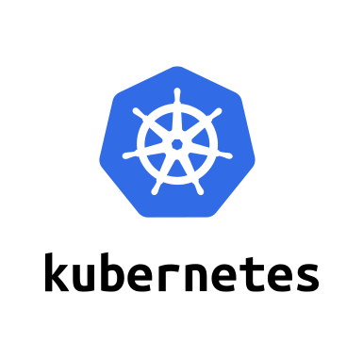
Introduction to Kubernetes

Slide 33
What is container orchestration?
Container orchestration
Manages the deployment, placement, and lifecycle of workload containers
Cluster management
Federates multiple hosts into one target
Scheduling
Distributes containers across nodes
Service discovery
Knows where the containers are located
Distributes client requests across the containers
Replication
Ensures the right number of nodes and containers
Health management
Replaces unhealthy containers and nodes
Container Orchestrator
Manager
Image Repository
Scheduler
Discovery DB
Replicator
Node
Node
Node
Daemon
Daemon
Daemon
Containers
Containers
Containers

Slide 34
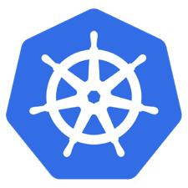
What is Kubernetes?
Container orchestrator
Runs and manages containers
Unified API for deploying web applications, batch jobs, and databases
Maintains and tracks the global view of the cluster
Supports multiple cloud and bare-metal environments
Manage applications, not machines
Rolling updates, canary deploys, and blue-green deployments
Designed for extensibility
Rich ecosystem of plug-ins for scheduling, storage, networking
Open source project managed by the Linux Foundation
Inspired and informed by Google's experiences and internal systems
100% open source, written in Go

Slide 35
Kubernetes Strengths
Kubernetes has a clear governance model managed by the Linux Foundation. Google is actively driving the product features and roadmap, while allowing the rest of the ecosystem to participate.
A growing and vibrant Kubernetes ecosystem provides confidence to enterprises about its long-term viability. IBM, Huawei, Intel, and Red Hat are some of the companies making prominent contributions to the project.
The commercial viability of Kubernetes makes it an interesting choice for vendors. We expect to see new offerings announced over the next several months.
Despite the expected growth in commercial distributions, Kubernetes avoids dependency and vendor lock-in through active community participation and ecosystem support.
Kubernetes supports a wide range of deployment options. Customers can choose between bare metal, virtualization, private, public, and hybrid cloud deployments. It enjoys a wide range of delivery models across on-premises and cloud-based services.
The design of Kubernetes is more operations-centric than developer-orientated, which makes it the first choice of DevOps teams.
35

Slide 36
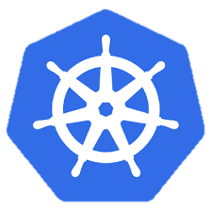
Kubernetes Cluster Architecture
internet
Master node
Node that manages the cluster
Scheduling, replication & control
Multiple nodes for HA
Worker nodes
Node where pods are run
Docker engine
kubelet agent accepts & executes commands from the master to manage pods
cAdvisor – Container Advisor provides resource usage and performance statistics
kube-proxy – routes inbound or ingress traffic
kubectl
firewall
Kubernetes cluster
Worker node
kube-proxy
kubelet
docker
pod
pod
pod
Master node
pod
pod
pod
cAdvisor
container
container
authentication authorization
container
container
APIs
container
scheduling
actuator
REST
Worker node
kube-proxy
controller manager
kubelet
Distributed watchable storage (etcd)
docker
pod
pod
pod
pod
pod
pod
cAdvisor
container
container
container
container
container

Slide 37
Master Node Components
Etcd
A highly-available key value store
All cluster data is stored here
API Server
Exposes API for managing Kubernetes
Used by kubectrl CLI
Controller manager
Daemon that runs controllers, which are the background threads that handle routine tasks in the cluster
Node Controller – Responsible for noticing and responding when nodes go down
Replication Controller – Replaced by ReplicaSet
Endpoints Controller – Populates the Endpoints object (that is, joins services and pods)
Service Account & Token Controllers – Create default accounts and API access tokens for new namespaces
Scheduler
Selects the worker node each pods runs in

Slide 38
Kubernetes Architecture: How apps are accessed
Kubernetes components
Master Node
Worker Node 1
Pod
Pod
Pod
Smallest deployment unit – runs containers
Each pod has its own IP
Shares a PID namespace, network, and hostname
Service
Collection of pods exposed as an endpoint
state and networking info propagated to all worker nodes
Types of service exposure
ClusterIP – Exposes cluster-internal IP
NodePort – Exposes the service on each Node’s IP at a static port
LoadBalancer – Exposes externally using a cloud provider’s load balancer
ExternalName – Maps to an external name (such as foo.bar.example.com)
App A
App B
App A Client
App A Service
Worker Node 2
Pod
Pod
App B
App A
App B Client
App B Service
Worker Node 3
Pod
Pod
App A
App B

Slide 39
Deployments & ReplicaSets
Deployment
A set of pods to be deployed together, such as an application
Declarative: Revising a Deployment creates a ReplicaSet describing the desired state
Rollout: Deployment controller changes the actual state to the desired state at a controlled rate
Rollback: Each Deployment revision can be rolled back
Scale and autoscale: A Deployment can be scaled
ReplicaSet
The next-generation ReplicationController
A set of pod templates that describe a set of pod replicas
Uses a template that describes specifically what each pod should contain
Ensures that a specified number of pod replicas are running at any given time
Deployment
create
ReplicaSet 1
Deployment
rollback
rollout
ReplicaSet 1
ReplicaSet 2
rolling update
pod
pod
pod
ReplicaSet 2
svcA
svcA
svcB
Notes:
https://kubernetes.io/docs/concepts/workloads/controllers/deployment/
https://kubernetes.io/docs/concepts/workloads/controllers/replicaset/
https://kubernetes.io/docs/user-guide/kubectl/v1.6/#rollout
https://kubernetes.io/docs/user-guide/kubectl/v1.6/#rolling-update
https://kubernetes.io/docs/concepts/cluster-administration/manage-deployment/#canary-deployments
Blue-green deployment isn’t built-in to Kubernetes (as of July 2017). Some examples others have built:
https://techbeacon.com/one-year-using-kubernetes-production-lessons-learned
http://www.devoperandi.com/kubernetes-deployment-resource-bluegreen-deploys-for-everyone/

Slide 40
Kubernetes Autoscaling
Horizontal Pod Autoscaling (HPA)
Automatically scales the number of pods in a replication controller, deployment, or replica set
Matches the observed average CPU utilization to the specified target
Fetches metrics in two different ways: direct Heapster access and REST client access
Kubernetes Heapster enables container cluster monitoring and performance analysis
Default config: query every 30 sec, maintain 10% tolerance, wait 3 min after scale-up, wait 5 min after scale-down
$ kubectl autoscale deployment <deployment-name> --cpu-percent=50 --min=1 --max=10 deployment ”<hpa-name>" autoscaled
Creates a horizontal pod autoscaler
An HPA instance
Maintains between 1 and 10 replicas of the pods controlled by the deployment
Maintains an average CPU utilization across all pods of 50%
Notes:
https://kubernetes.io/docs/tasks/run-application/horizontal-pod-autoscale/
https://kubernetes.io/docs/tasks/run-application/horizontal-pod-autoscale-walkthrough/
https://kubernetes.io/docs/user-guide/kubectl/v1.6/#autoscale
https://github.com/kubernetes/community/blob/master/contributors/design-proposals/horizontal-pod-autoscaler.md

Slide 41
Naming
Name
Each resource object by type has a unique name
Namespace
Resource isolation: Each namespace is a virtual cluster within the physical cluster
Resource objects are scoped within namespaces
Low-level resources are not in namespaces: nodes, persistent volumes, and namespaces themselves
Names of resources need to be unique within a namespace, but not across namespaces
Resource quotas: Namespaces can divide cluster resources
Initial namespaces
default – The default namespace for objects with no other namespace
kube-system – The namespace for objects created by the Kubernetes system
Resource Quota
Limits resource consumption per namespace
Limit can be number of resource objects by type (pods, services, etc.)
Limit can be total amount of compute resources (CPU, memory, etc.)
Overcommit is allowed; contention is handled on a first-come, first-served basis

Slide 42
Configuring Resources and Containers
Label
Metadata assigned to Kubernetes resources (pods, services, etc.)
Key-value pairs for identification
Critical to Kubernetes as it relies on querying the cluster for resources that have certain labels
Selector
An expression that matches labels to identify related resources
ConfigMap
Configuration values to be used by containers in a pod
Stores configuration outside of the container image, making containers more reusable
Secret
Sensitive info that containers need to read or consume
Encrypted in special volumes mounted automatically

Slide 43
Kubernetes Management Architecture
UI
Master Node
Worker Node 1
Worker Node 2
API
Worker Node 3
CLI
Worker Node n
Registry
Etcd
API Server
Controller Manager Server
Scheduler

Slide 44
Kubectl Commands
Get the state of your cluster
$ kubectl cluster-info
Get all the nodes of your cluster
$ kubectl get nodes -o wide
Get info about the pods of your cluster
$ kubectl get pods -o wide
Get info about the replication controllers of your cluster
$ kubectl get rc -o wide
Get info about the services of your cluster
$ kubectl get services
Get full config info about a Service
$ kubectl get service NAME_OF_SERVICE -o json
Get the IP of a Pod
$ kubectl get pod NAME_OF_POD -template={{.status.podIP}}
Delete a Pod
$ kubectl delete pod NAME
Delete a Service
$ kubectl delete service NAME_OF_SERVICE

Slide 45
DevOps

Slide 46
Recommendations
Consolidate Source code repositories into one e.g GitHub Enterprise
Currently there are SCM, Subversion, CVS, and GHE
Use GHE for Code review process
Use SonarQube for continuous inspection of code quality to perform automatic reviews
Develop DevOps Automation for Kubernetes clusters and App deployment
Infrastructure Automation, use IBM Schematics/Terraform templates
Deploy Micro services using toolchain through Jenkins and UCD
For DevOps governance Urban Code Deploy is strongly recommended for hybrid cloud environment (e.g.,on-prem and Cloud)

Slide 47
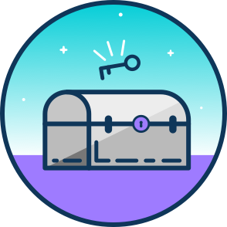




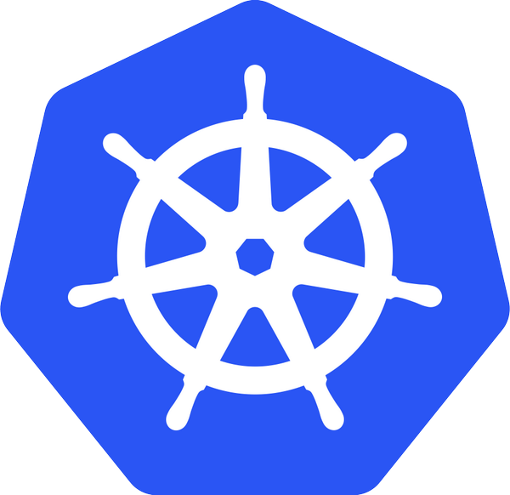



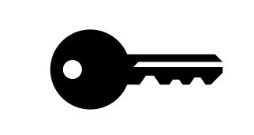

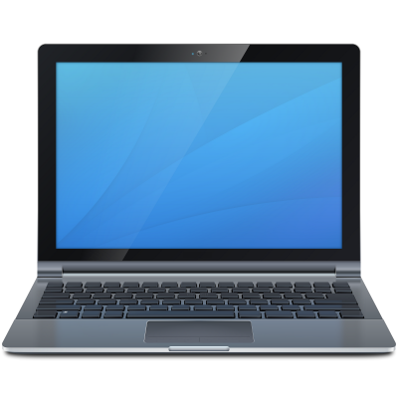
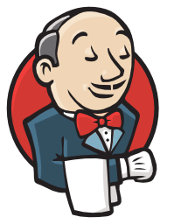
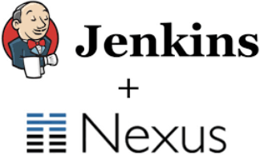

Proposed DevOps solution
Capabilities
Vulnerability Advisor
Examines running containers in various container environments for potential security issues and best practices
Notify
Single build process
Environment file to deploy to different environments
Scripts, etc. treated as code and stored in Git
Trusted repo with approved image
Dev
QA
Prod
Other Environment
Prod
Other Environment
Prod
Code/config change
Build
Test
Deploy Helm Chart
Staging/QA Deployment
Production Deployment
Production Deployment
Production Deployment
push
changes
Remote Desktop
Development
Triggers deployment
Production releases of other hybrid applications / services from other SCM systems
Production releases of hybrid applications and services across enterprise with UrbanCode Deploy
Pre-integrated Jenkins image out of the box with (multiple installed plugins including Kubernetes and Nexus Repository Manager OSS)
BUILD
Development Environments
SHIP
Secure Package Repo
Continuous Deployment
RUN
Deploy, Manage, Scale
Continuous Integration

Slide 48



Infrastructure and Microservices Toolchain
Infrastructure Toolchain
Remote Desktop
Auto
Push
Terraform
Chef
Notify
Push
Changes
Code/config change
Development
Pull
Microservices Toolchain
Remote Desktop
Push
Changes
Auto
Push
If Test OK
If Build & Push OK
Code/config change
Development
Code Analysis:
AppScan
Unit Tests
Pull
Run
Unit Tests
IBM Registry
Vulnerability Advisor
Prod
Manual
Deploy
Stage
Deploy
if Tests OK
QA
Deploy
if Tests OK
Test
Deploy
if Tests OK
Dev
Deploy
Pull Image
Tests
Tests
Tests
Tests
Run
Run
Run
Run

